Slide 1

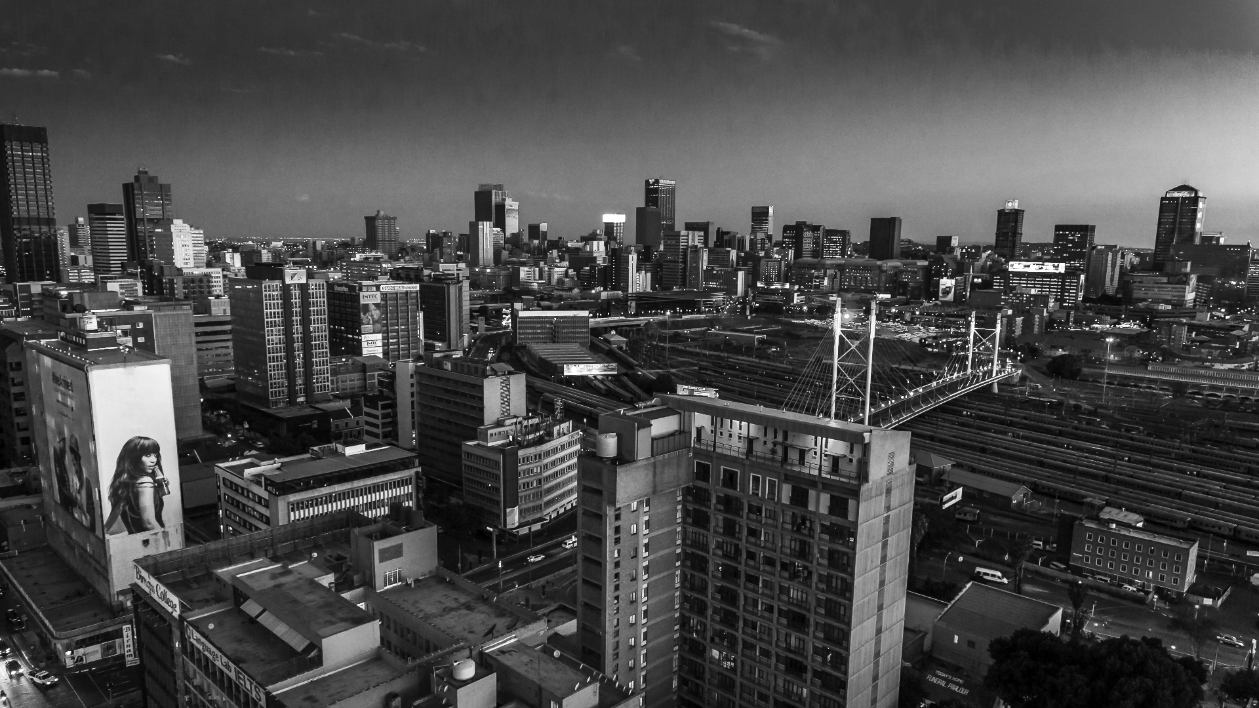

Title
Electricity Regulation Amendment Bill
Contentious Areas
12 October 2023
NATIONAL OFFICE
61 Katherine Street,
Sandton, 2196
P.O. Box 652807, Benmore, 2010

Slide 2
Contentious areas of the Electricity Regulation Amendment Act tabled in Parliament
s10(2)(g) has been reinstated
The deletion of S10(2)(g) was welcomed in the 2022 Amendment Bill, but the section has been reinstated in the 2023 Amendment Bill
S10(2)(g) provides for licence applicants to show compliance to the IRP, or provide a Ministerial consent to deviation to NERSA before launching a licence application
NERSA automatically deemed private sales of power to be non-compliant with the IRP, and Ministerial consents to deviation were almost impossible to obtain in practice
NERSA would not begin to consider a licence application without a Ministerial consent to deviation, hence this was a very effective roadblock to private generation and sales
The exemption schedule is relatively easily changed by the Minister, and private power sales could become licensable again
Solution :
Delete section 10(2)(g)
2

Slide 3
Contentious areas of the Electricity Regulation Amendment Act tabled in Parliament
Section 34 Ministerial determinations
”in’ consultation with NERSA vs “after” consultation with NERSA
Continued uninterrupted supply of electricity vs optimal supply
Tendering procedure which is fair, equitable, transparent, competent and cost-effective has been deleted
Insertion of new s34(2)(g) (“A determination referred to in subsection (1)(a) must include provisions dealing with the extent to which the new generation capacity contemplated in paragraph (a) may be established by independent power producers and the electricity so produced supplied to customers pursuant to multiple supply agreements”)
Determinations relating to electricity supply infrastructure – the infrastructure may be owned, operated or maintained by anyone designated by the Ministerendering procedure which is fair, equitable, transparent, competitive and cost-effective” and “for private sector participation”.
Solution :
Revert to “in” consultation with NERSA
Stay with optimal supply
Reinsert fair, equitable, transparent, competent and cost-effective tendering procedure
Deletion of s34(2)(g)
Electricity supply infrastructure must be transferred to the NTC
3

Slide 4
Contentious areas of the Electricity Regulation Amendment Act tabled in Parliament
Section 34 Ministerial determinations
Minister may deviate from the IRP or TDP in issuing a Ministerial determination without gazetting a notice for public comment “if it is reasonable and justifiable in the circumstances” (section 34(8))
procedure which is fair, equitable, transparent, competitive and cost-effective” and “for private sector participation”.
Solution :
Delete section 34(8)
4

Slide 5
Contentious areas of the Electricity Regulation Amendment Act tabled in Parliament
The Market
The market operator (Eskom) develops a transparent, non-discriminatory trading platform which allows market participants to trader, and develops the market code and rule.
NERSA must approve the trading platform and the market participants under the market code and rules, but not the market code and rules themselves
, competitive and cost-effective” and “for private sector participation”.
Solution :
Delete section 34(8)
NERSA must approve the trading platform, the market code and the rules, or better still, draft these documents with the input of, amongst others, Eskom
5

Slide 6
Contentious areas of the Electricity Regulation Amendment Act tabled in Parliament
The Role of IPPs
NERSA still regulates private licensees – pricing for everything except “direct sale agreement” which excludes sales by registered generators and sales to traders and generators, and the revenue of licensees. Private entities selling to private entities should not be regulated. This will hamper the proper functioning of an open, transparent and competitive market
“regulated transaction” should only apply to a State owned entity
, competitive and cost-effective” and “for private sector participation”.
Solution :
Amend the definition of “direct sale agreement” to include sales by registered generators and exclude sales to traders and generators
Delete the provision stating that NERSA may regulate the revenue of private licensees
Amend the definition of “regulated transaction” so that it only applies to State owned entities
6

Slide 7
Contentious areas of the Electricity Regulation Amendment Act tabled in Parliament
The CPA
The CPA only exists for the duration of a transition to a competitive market, but some of the agreements it will enter into are for the lifespan of Eskom generation assets
“vesting contracts” – sales to and from the CPA from Eskom generation and to distributors (including Eskom distribution and municipalities) do not have an explicit provision that their prices must be regulated by NERSA
The Amendment Bill provides that the CPA will sell energy from legacy independent power producer agreements, but leaves new independent power producer agreements silent
, competitive and cost-effective” and “for private sector participation”.
Solution :
Clarify how long the CPA is intended to exist and what will happen to sales from Eskom generation thereafter
Provide that the pricing under “vesting contracts” must be regulated by NERSA, and the format of the agreements too
Clarify what will happen with energy from new independent power producer agreements
7

Slide 8
Contentious areas of the Electricity Regulation Amendment Act tabled in Parliament
Ministerial Powers
The Minister’s powers are still too wide – eg the proposed amendment from “in consultation” with NERSA to ”after consultation” in section 34 and the provision that NERSA must consult with the Minister in determining the rules of the TDP
, competitive and cost-effective” and “for private sector participation”.
Solution :
Leave section 34 as “in” (not “after”) consultation
Delete references to consultation with the Minister in the formulation of the TDP. This should be left to NERSA, with input from Eskom
8

Slide 9
Contentious areas of the Electricity Regulation Amendment Act tabled in Parliament
The transitional nature of the NTC
WHAT HAPPENS IF THE TRANSMISSION SYSTEM OPERATOR SOC LTD IS NOT ESTABLISHED AND OPERATIONAL WITHIN 5 YEARS????mpetitive and cost-effective” and “for private sector participation”.
9
Notes:
the Transmission System Operator SOC Ltd is not established and operational within 5 years

