Slide 1

Localisation opportunities in the solar PV value chain
Manufacturing Circle Energy Round Table – 14 March 2023

Slide 2
Localisation in the solar PV value chain
Assumptions and considerations
Assessment based almost entirely on 2 key sources of data and information
  Draft SAREM document published in March 2022
  Study on localisation potential of solar PV industry published by SAPVIA in October 2022
Assumption that any local production needs to be competitive (quality and price) in the long term
  Potential to provide support to infant industry but should be limited in time (max 5 years)
  Long term sustainability requires ongoing and stable local demand which should be complemented by exports in order to achieve economies of scale and price competitiveness
Consideration that the solar PV value chain is still a relatively young industry with fast paced development in both scale and technology
  Potential window of opportunity to secure strong positioning in the global value chain
  Need ongoing investment and upgrades to keep up with progress in technology
Consideration that expectations must be realistic
  Local content % in solar PV projects in BW4 (58%) has already achieved a level higher than the average for the automotive sector, which is considered the best example of successful localisation in SA

Slide 3
SAREM document
Key data and findings
ITEM | % of CAPEX | LC% in BW4 | LC% of CAPEX
BoP | 41% | 88% | 36%
PV modules | 35% | 10% | 4%
Tracker | 11% | 85% | 9%
Inverters | 7% | 60% | 4%
Mounting | 4% | 75% | 3%
Sundry | 2% | 100% | 2%
TOTAL | 100% |  | 58%
Technology for PV modules is constantly evolving and requires ability to rapidly upgrade facilities;
There are currently two local factories for PV modules (ArtSolar and Seraphim) but not competitive against imports so not typically used by private sector;
There is some local capacity to produce some components of PV modules (e.g. aluminium frames) but not competitive and it would require some time to ensure proper supply chain integration;
Potential for Inverters is mainly in local assembly with limited opportunities for full local production;
There is strong potential for Trackers and Mounting structures but some time might be required to ramp up local capacity.
Based on the SAREM data and findings, the most realistic opportunities for localisation in the next 3-5 years seem to be in achieving higher % of local content in BoP, Trackers and Mounting structures

Slide 4
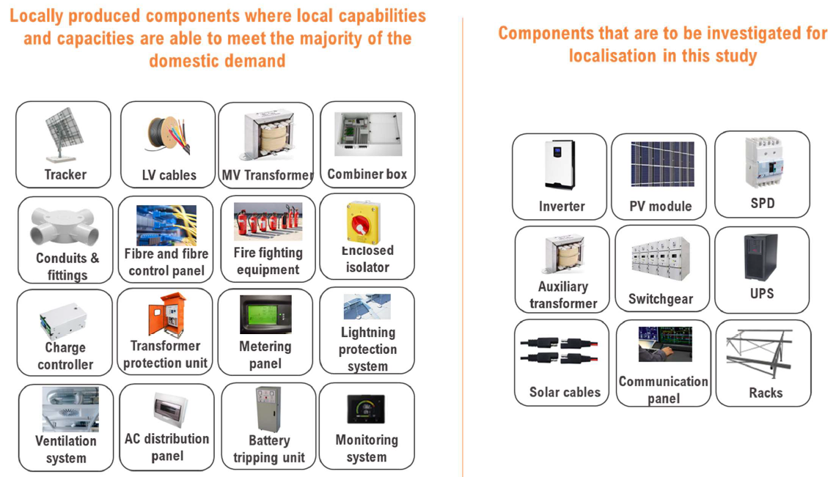
SAPVIA study
Focus of the study on 9 key components

Slide 5
SAPVIA study
Local industry status by key component
PV modules
PV module assembling capacity of about 600 MW pa. with old technology and significantly underutilised thus far
The two current local module assembling firms have plans to increase their annual assembling capacity to around 2.1 GW, and African Quartz Photovoltaics is also planning to add a further 500 MW
Seraphim is also working on establishing a local PV cell production plant with an annual manufacturing capacity of 500 MW
Inverters
The two local manufacturers currently specialising in microgrid inverter solutions have the capability to produce grid-tied inverters
RWW Engineering has been developing grid-tied inverters on a contractual basis for a Spanish OEM, GP Tech
Locally produced inverters are much more expensive than Chinese products but on par or cheaper than premium inverters
Market is transitioning from centralised inverter solutions to string inverters, which are not locally produced
Trackers and mounting structures
The local mounting structure and tracker manufacturing industry is relatively developed, with at least 7 manufacturers providing diverse mounting structure solutions with high levels of local content (>90%)
Capacity issues need to be addressed for the industry to realise its full potential, including ramping up of manufacturing capacities of local aluminium extruders and meeting warranty and product specification requirements for subcomponents
Solar cables
Copper and/or aluminium can be used for the PV cables but there are currently no local manufacturers of aluminium PV cables
Local PV cables have a local content of around 30% since the polymers and the copper are imported
Most of the PV cables are imported because of limited local production capacities and the local industry’s poor competitiveness in terms of price and quality, particularly with respect to the small flexible PV cables
Charge controllers, solar breakers, combiner boxes and switchgear
The 3 local manufacturers of combiner boxes pay around 20% customs duty to import subcomponents such as PC boards and fuses
Allbro is already producing combiner boxes beyond what the local industry can absorb, thus it is also relying on export markets
Local manufacturers such as RWW Engineering and Switchgear Unlimited can locally manufacture the switchgear components
The local manufacturing industry for controllers is still in a growth phase and can be further developed with the necessary support
Transformers
There are at least 10 local manufacturers of transformers which can ramp up production with a three-month lead time
Local transformer manufacturers have relatively small percentages of their transformers targeted at the PV industry
The local supply chain for transformers is well established, with copper available locally and the bushings manufactured locally

Slide 6
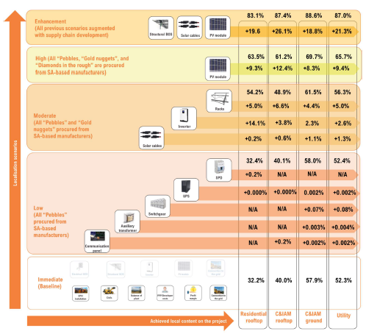
SAPVIA study
Localisation scenarios and key findings
Major gaps exist in the local industry’s ability to meet the existing and future demand for many components, including solar PV modules, inverters, solar cables, specialised solar transformers, communication panels, uninterruptible power supply (UPS) units, mounting racks (not trackers), switchgear, and circuit breakers and SPDs
South Africa’s solar PV industry needs sustainable demand of at least 2 GW from the utility segment and fully unlocked residential and C&IAM market segments that in combination with the utility market could deliver at least 3 GW of annual demand
Supply chain opportunities exist in ramping up production of aluminium extrusion products and local copper, solar cell manufacturing, solar glass production, and junction box manufacturing

Slide 7
Localisation in the solar PV value chain
Key take outs
Local PV modules are currently not competitive and require big effort and strong sustained demand (including from export) in order to achieve economies of scale – feasible?
  Developments at Seraphim solar cells manufacturing plant should provide further insights on overall feasibility for PV modules and other potential supply chain opportunities
  Decisions on potential large effort (similar to Chinese approach) to develop PV modules value chain and create African manufacturing hub need to be taken soon to enjoy current window of opportunity for the technology
SAPVIA localisation scenarios clearly indicate the best opportunities for “moving the needle”
  All “pebbles” together can only add a very minor increase in local content (0.1%)
  Mounting racks provide the most apparent opportunity due to local market development and impact (5%)
  Solar cables also provide opportunities – even greater if copper can be sourced locally or local companies start manufacturing aluminum cables
Lack of local product certification capabilities adds costs in the value chain – same as per other sectors
  Solar PV industry could join forces with other sector associations to investigate common solutions

