Slide 1
Nature Resilience & the Recommendations of the TNFD
South Africa Launch Event
22nd November 2023

Slide 2
TNFD and Africa
Consultation Groups – South Africa and Kenya
Pilot Testing and market engagement – FSD Africa
Indigenous community leader engagement
Engagement with policy makers and regulators
Notes:
Get rid of enterprise value – just use Business

Slide 3
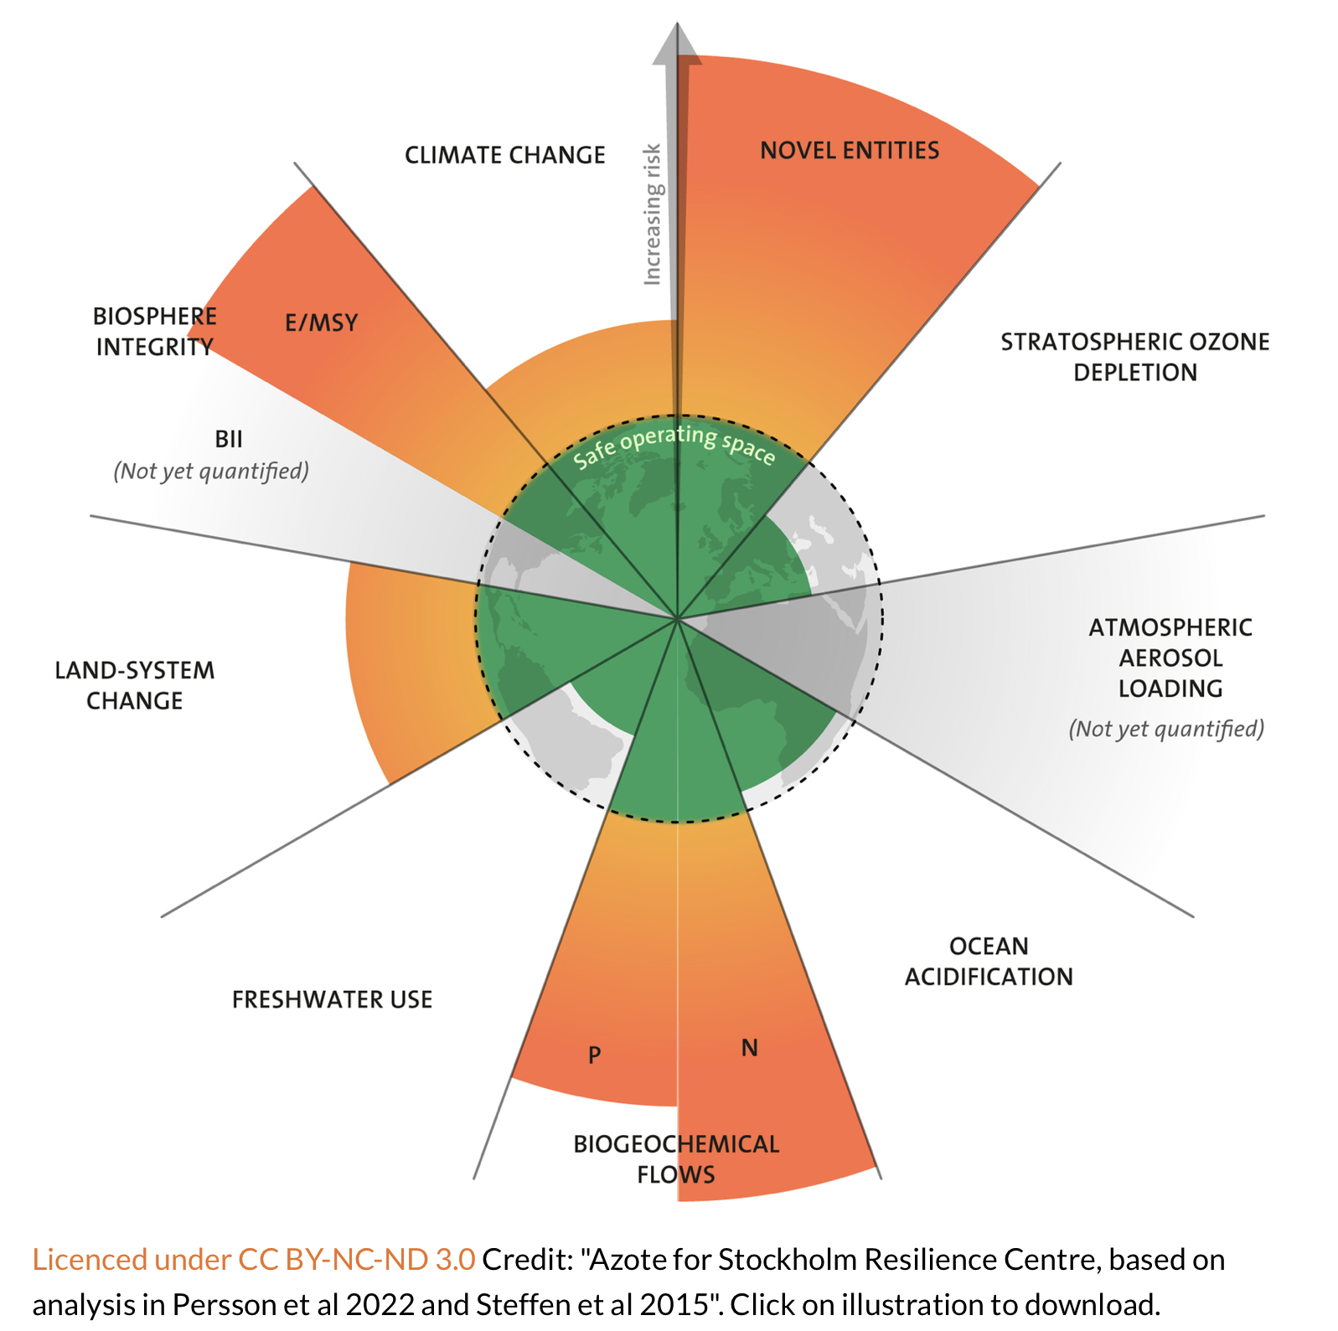
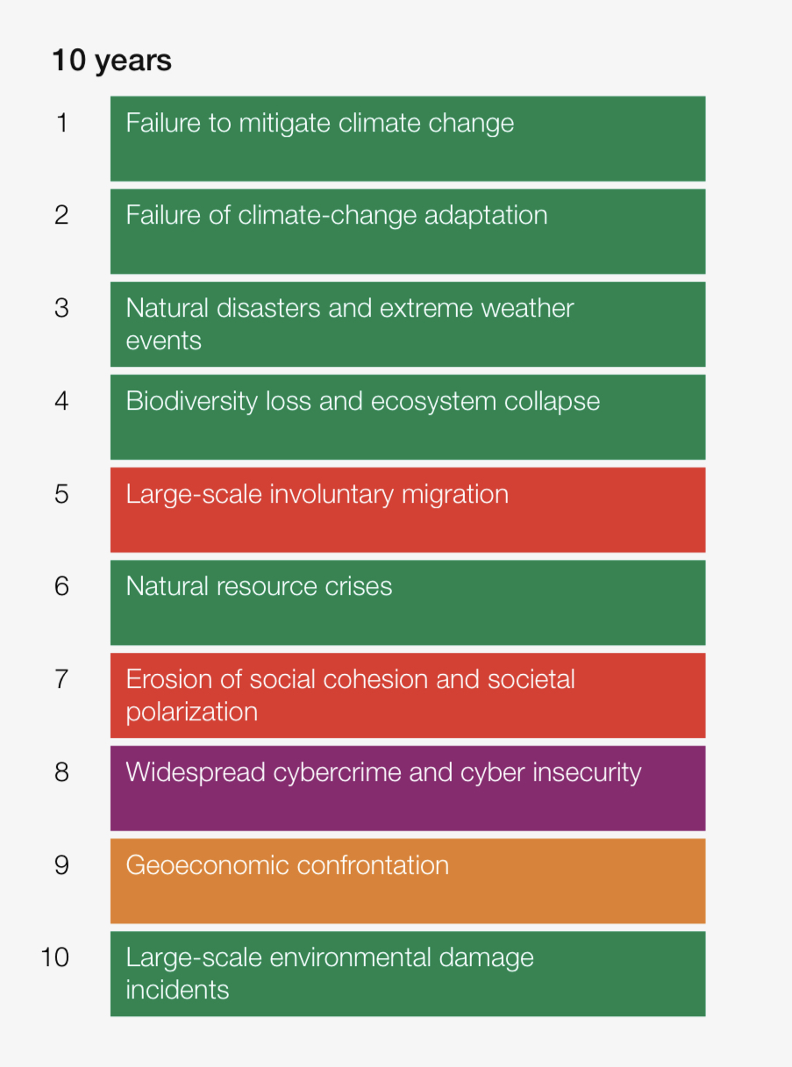
Nature is not just a CSR issue
The declining health and resilience of
the earth’s systems…
… is clearly reflected in the risk perceptions of global executives…
Source: Stockholm Resilience Centre
Source: WEF Risk Report 2023
Notes:
Get rid of enterprise value – just use Business

Slide 4
Cash flows and nature flows
The resilience of markets and the prosperity of societies
Investor expectations
Cash flows
Time
Flows of ecosystem services from nature to business
Accelerating nature loss
The resilience and health
of nature
“As central banks and supervisors, we have every reason to be concerned because it’s an illusion to think we can preserve financial stability if this (nature) degradation continues”.
Klass Knot, DNB and FSB Chair, 7th September 2023
Notes:
Get rid of enterprise value – just use Business

Slide 5
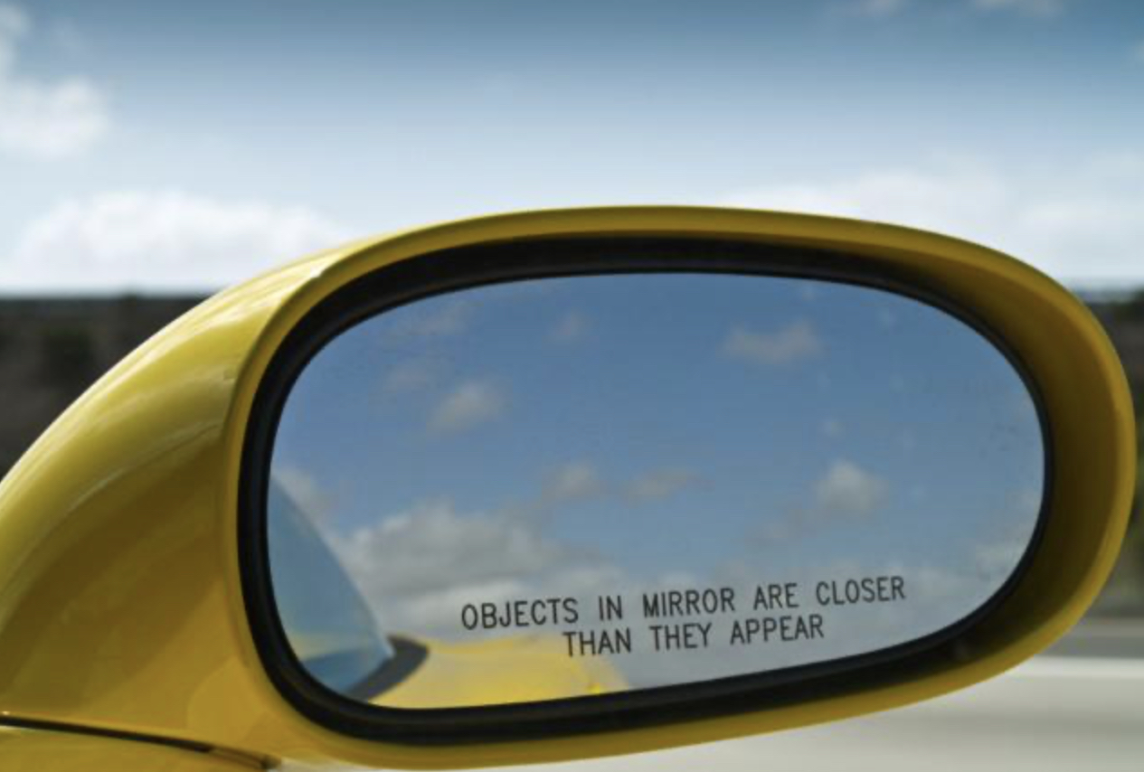
Why Nature ? Why Now ?
Regulation
(Governments)
Stewardship
(Investors)
Fiduciary Duty
(Company Directors)
Notes:
Get rid of enterprise value – just use Business

Slide 6
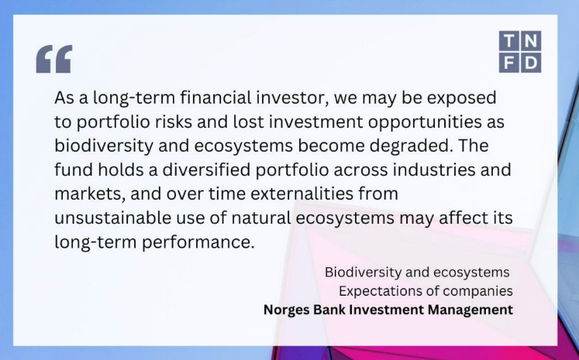
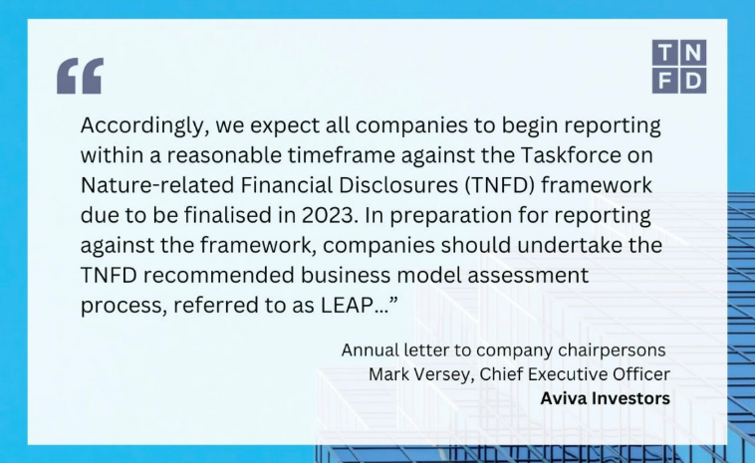
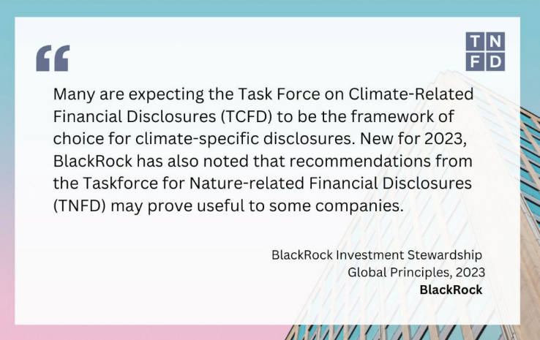



Investors are seeking more information
Notes:
Get rid of enterprise value – just use Business

Slide 7
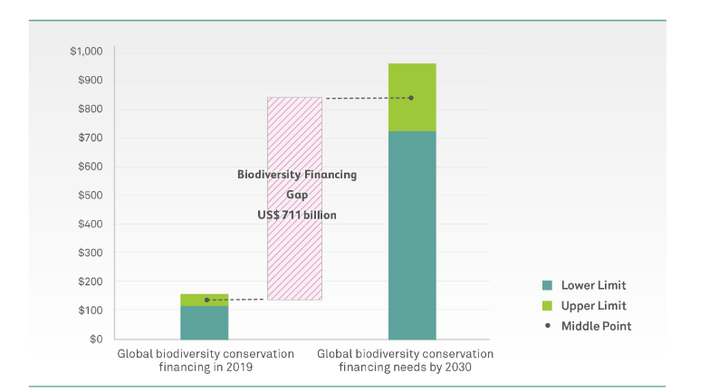
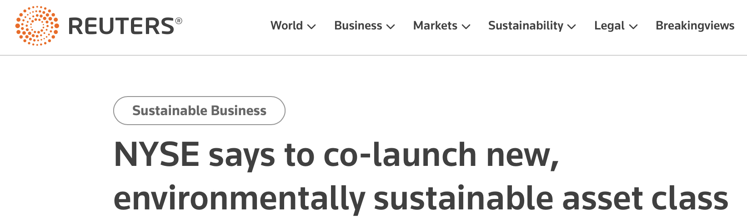

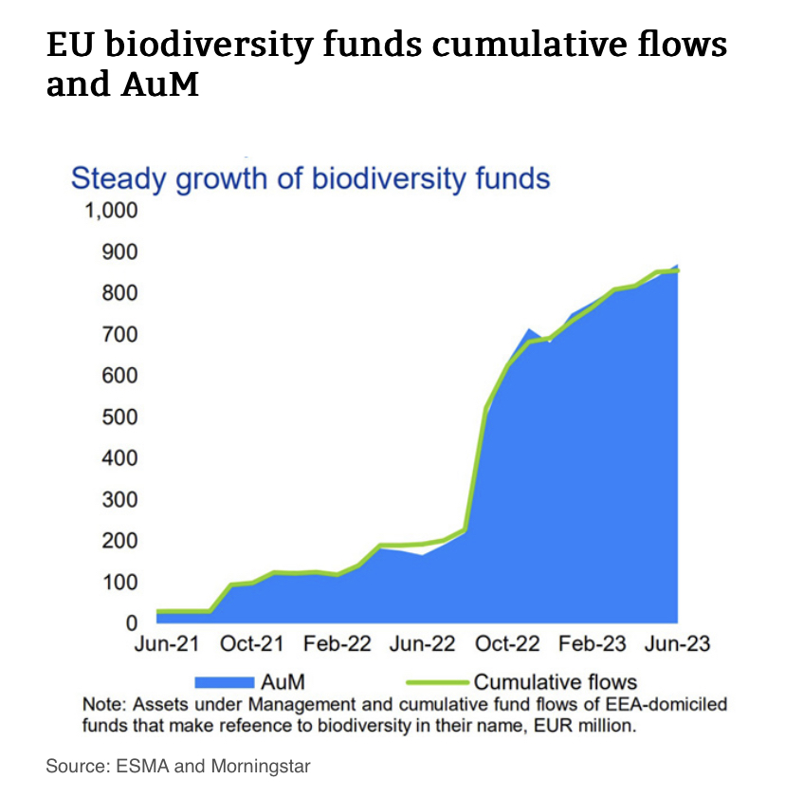
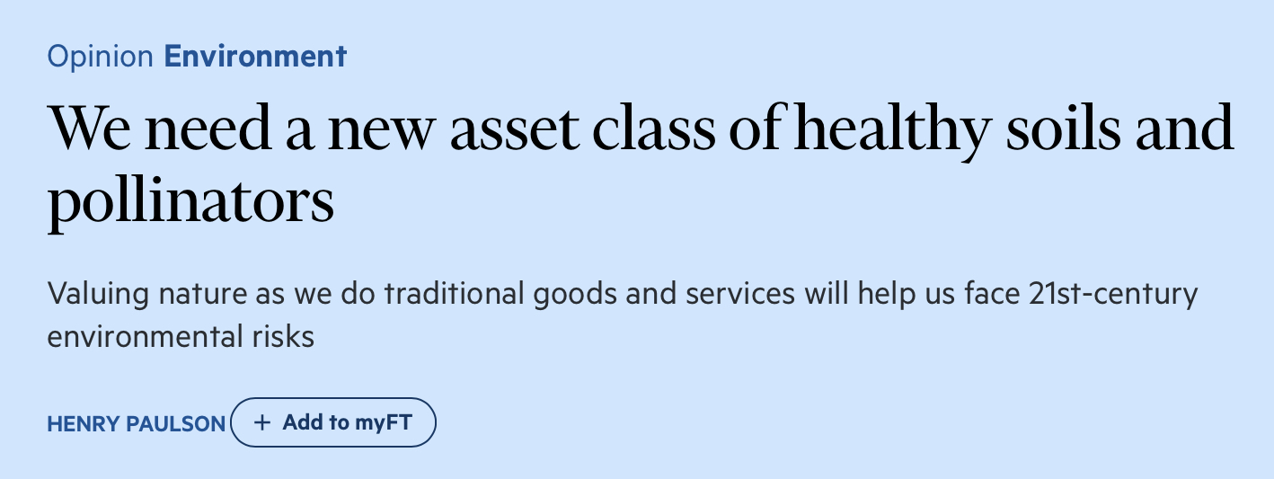
The opportunity side of the ledger
Notes:
Get rid of enterprise value – just use Business

Slide 8
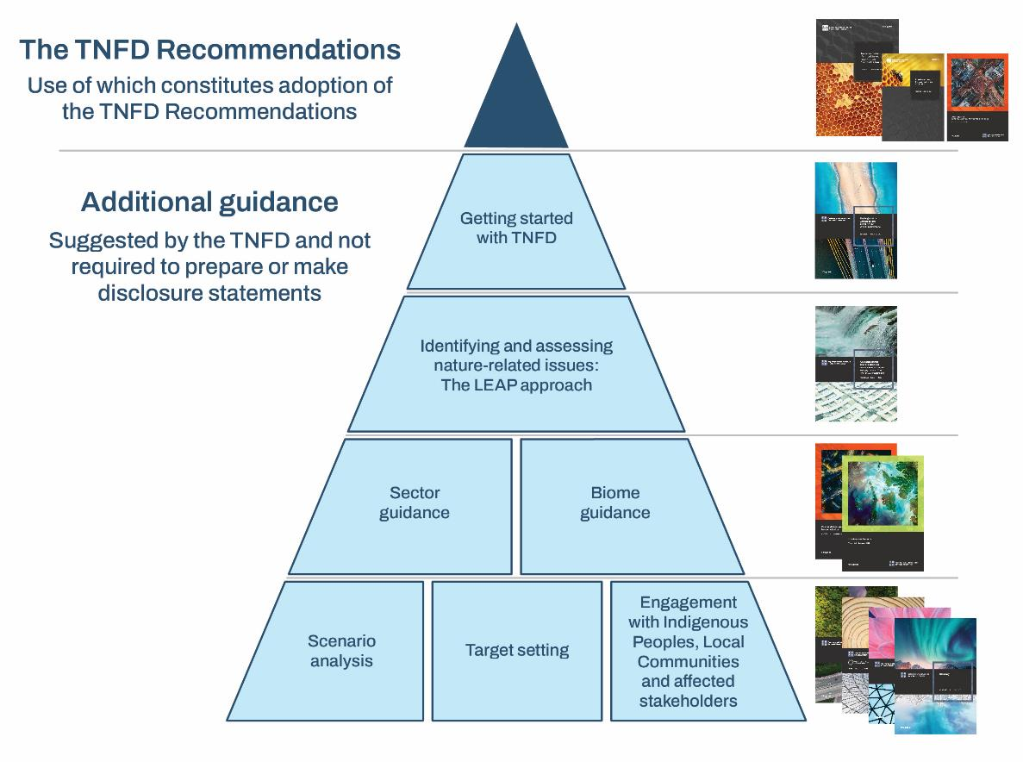

What we have published
Discussion
paper on sector
disclosure metrics
First sector guidance to be published in early December
Notes:
Get rid of enterprise value – just use Business

Slide 9
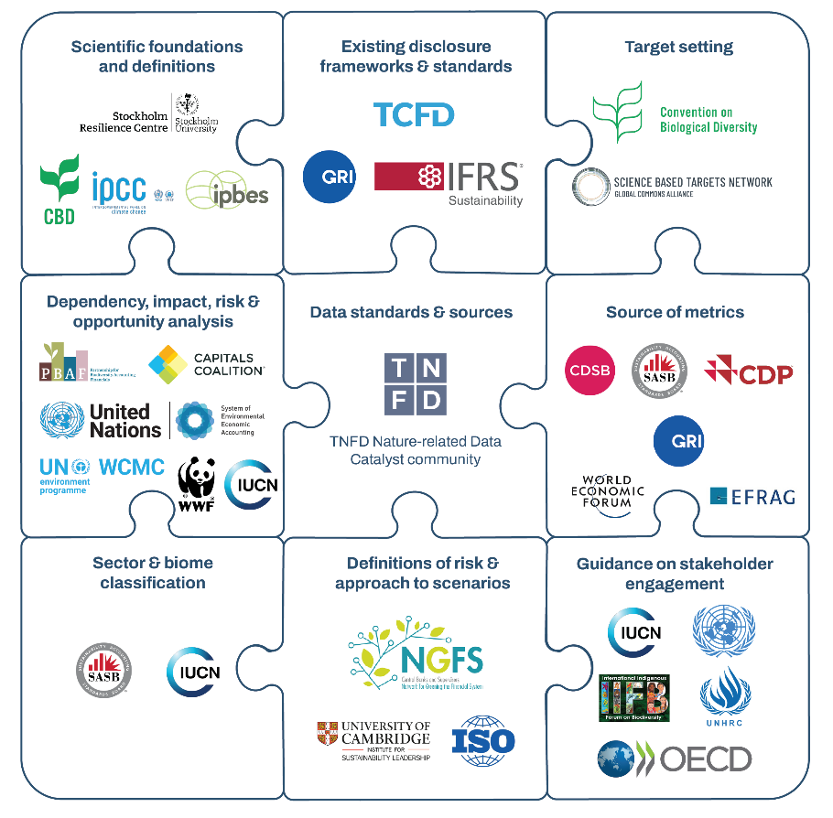
Our Approach: Building on existing frameworks, tools and metrics
Active support of 20 knowledge partners from leading science organisations to international standards bodies
Notes:
Our knowledge partners, including the world’s leading science and conservation organisations, multilateral institutions and standards-setting organisations, have provided a wealth of technical advice.
The Taskforce would like to thank them and the many other individual experts and organisations that have contributed their expertise to support the development of the TNFD’s recommendations and guidance.

Slide 10
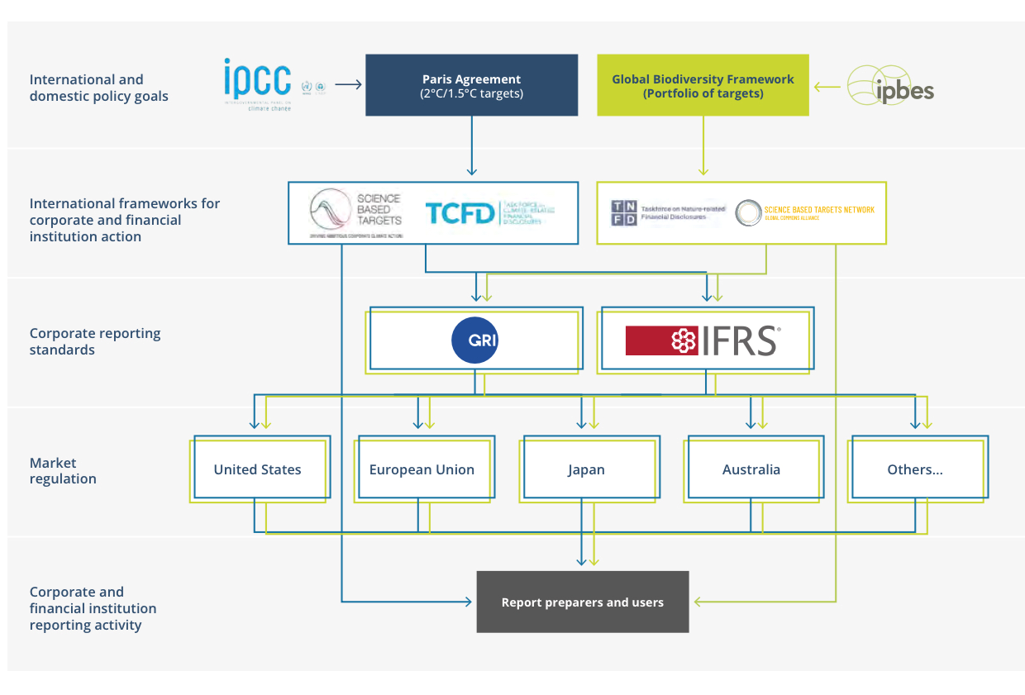
Our Approach: Align to global policy goals & emerging regulation
Pathways to adoption
Companies start adopting on a voluntary basis while nature-disclosure standards develop further
TNFD recommendations inform further standards development
TNFD recommendations inform regulatory developments
1
2
1
2
3
3
Notes:
This figure shows the emerging global architecture for nature-related corporate reporting, in parallel with what has emerged for climate-related reporting.
Based on the experience of the TCFD, the TNFD anticipates its recommendations being used along three related pathways to shift the corporate reporting landscape:
First, companies will now start adopting on a voluntary basis while nature-disclosure standards develop further
Second, the TNFD recommendations can inform further standards development, such as the global sustainability standards developed the ISSB and GRI
Finally, the TNFD recommendations can start informing regulatory developments, led by regulators in different jurisdictions.

Slide 11
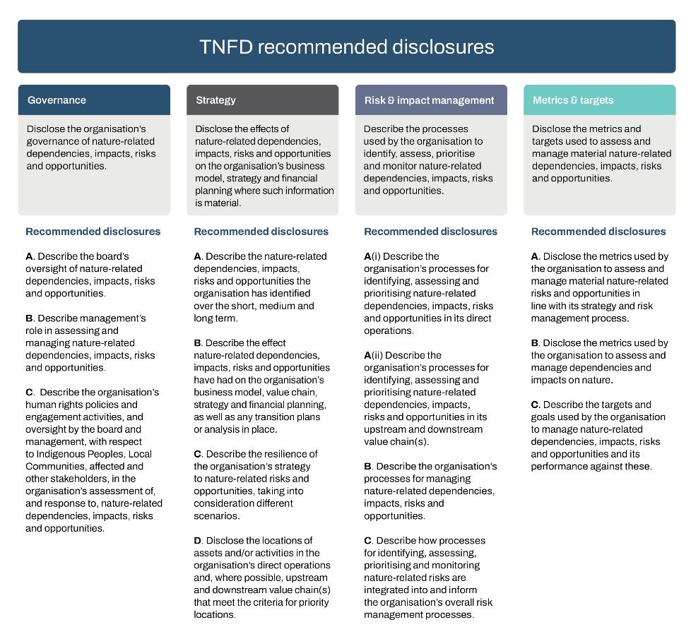
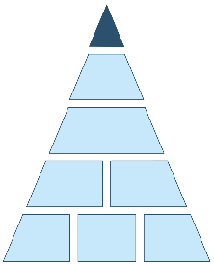

The recommended disclosures: Alignment with TCFD
Highlights
All 11 TCFD recommended disclosures carried-over to:
  Build on existing market practice
  Encourage integrated (climate+nature) reporting
Notes:
All 11 of the TCFD recommended disclosures have been carried over to TNFD, with a focus on nature.
The Taskforce has done this by design to:
encourage and support integrated climate and nature reporting;
make it easier for those already reporting against TCFD by building on existing market practice.

Slide 12
The recommended disclosures: New recommended disclosures
Highlights
All 11 TCFD recommended disclosures carried over
Three further disclosures added, covering three important areas for nature:
  Engagement
  Sensitive locations
  Value chains
Notes:
The Taskforce has added three additional recommendations to the 11 from TCFD.
The TNFD replicates all 11 TCFD recommended disclosures for nature-related issues
The TNFD only added additional recommended disclosures where there is a clear rationale to do so for nature.
With this rationale, the TNFD has added 3 additional disclosures covering:
engagement with IPLCs and affected stakeholders;
specific locations, including the interface with ecologically sensitive locations; and
value chains.

Slide 13
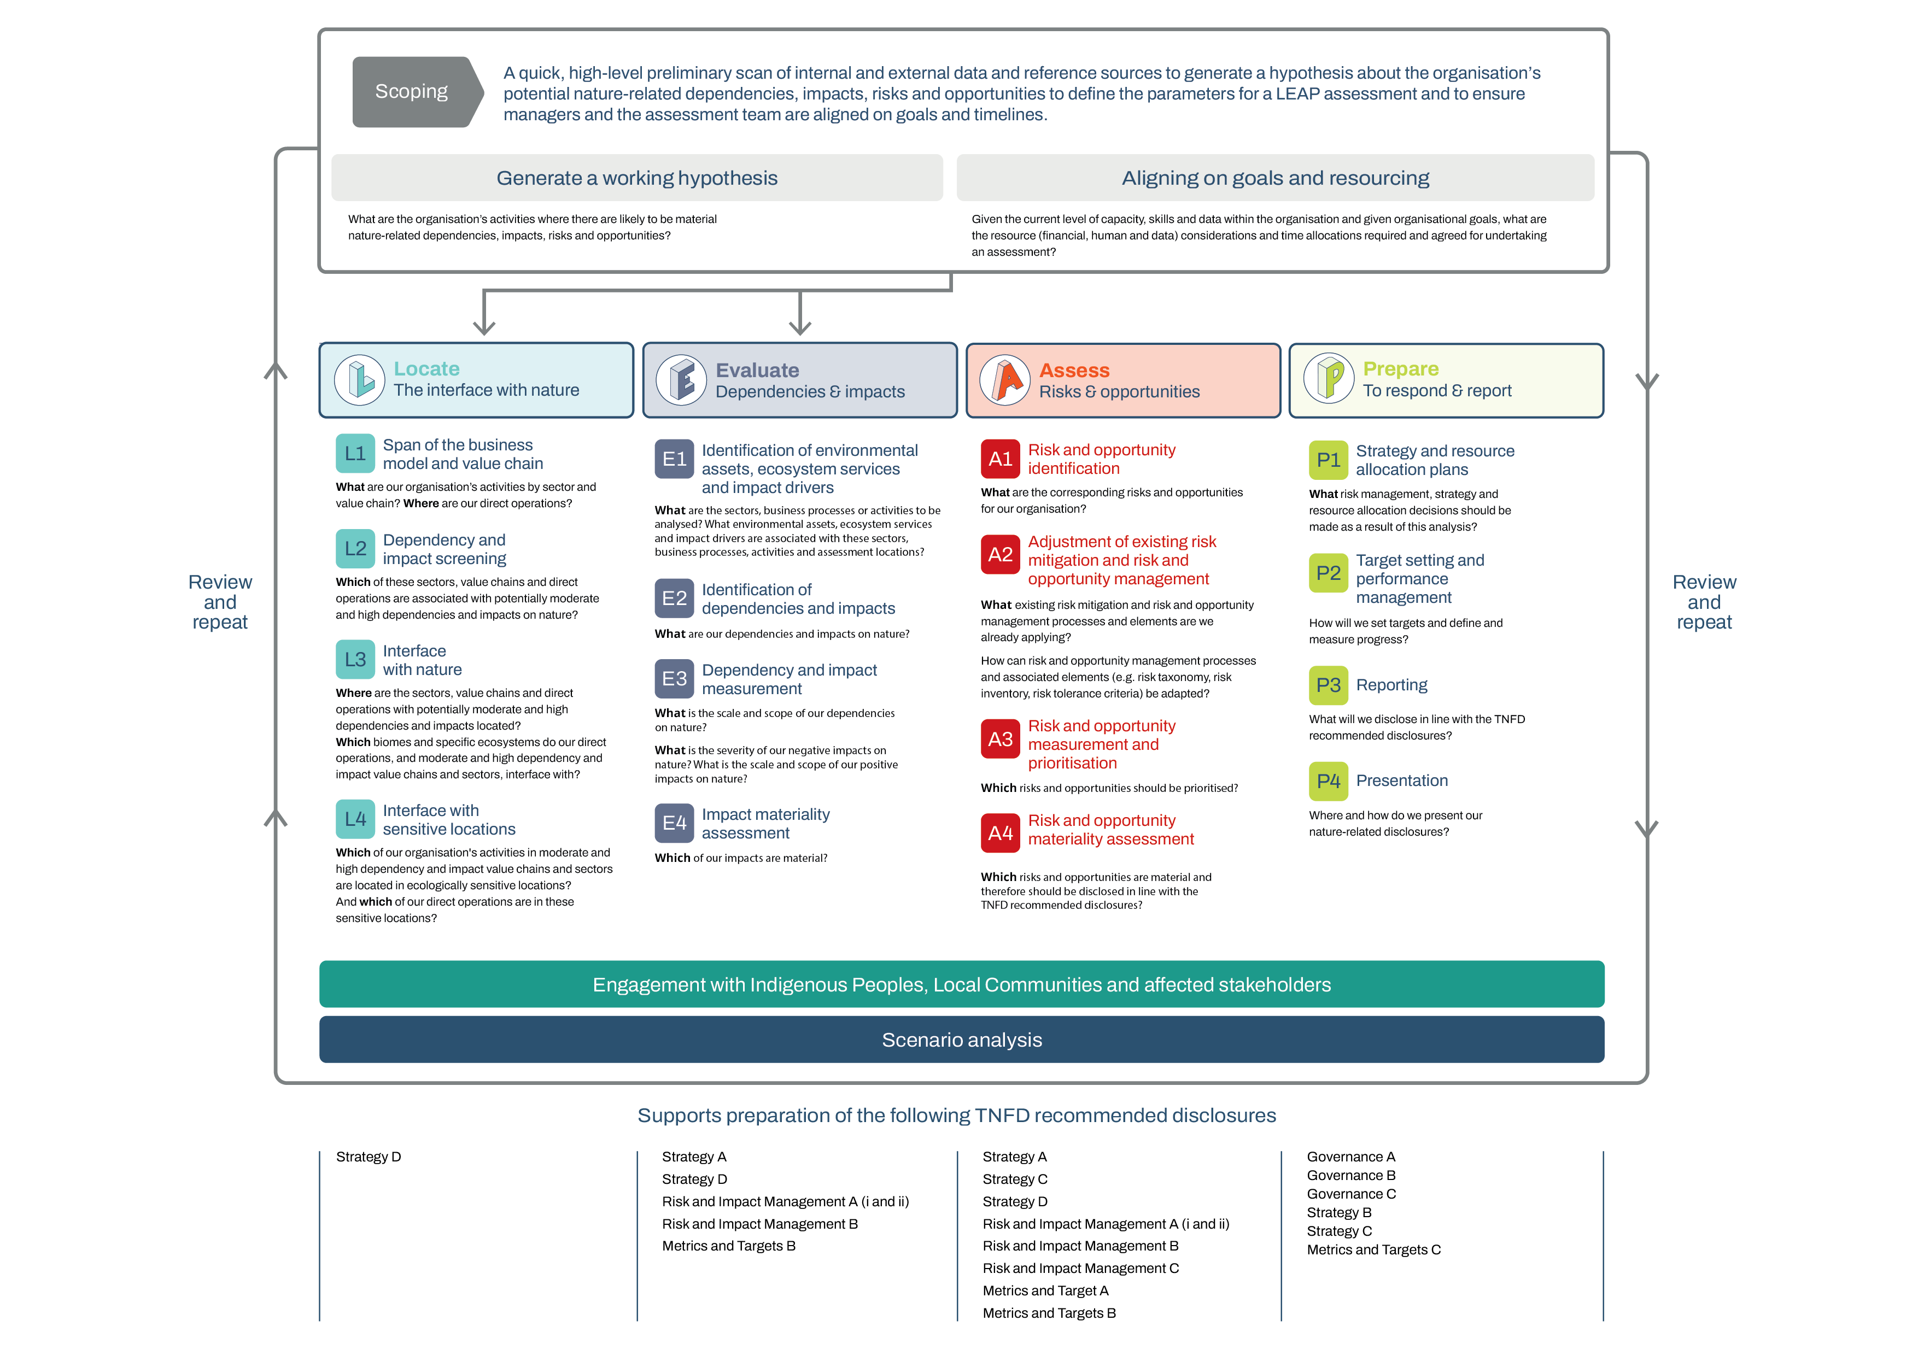

Assessment metrics & disclosure metrics​
Metrics for internal assessment
Metrics for external disclosure

Slide 14
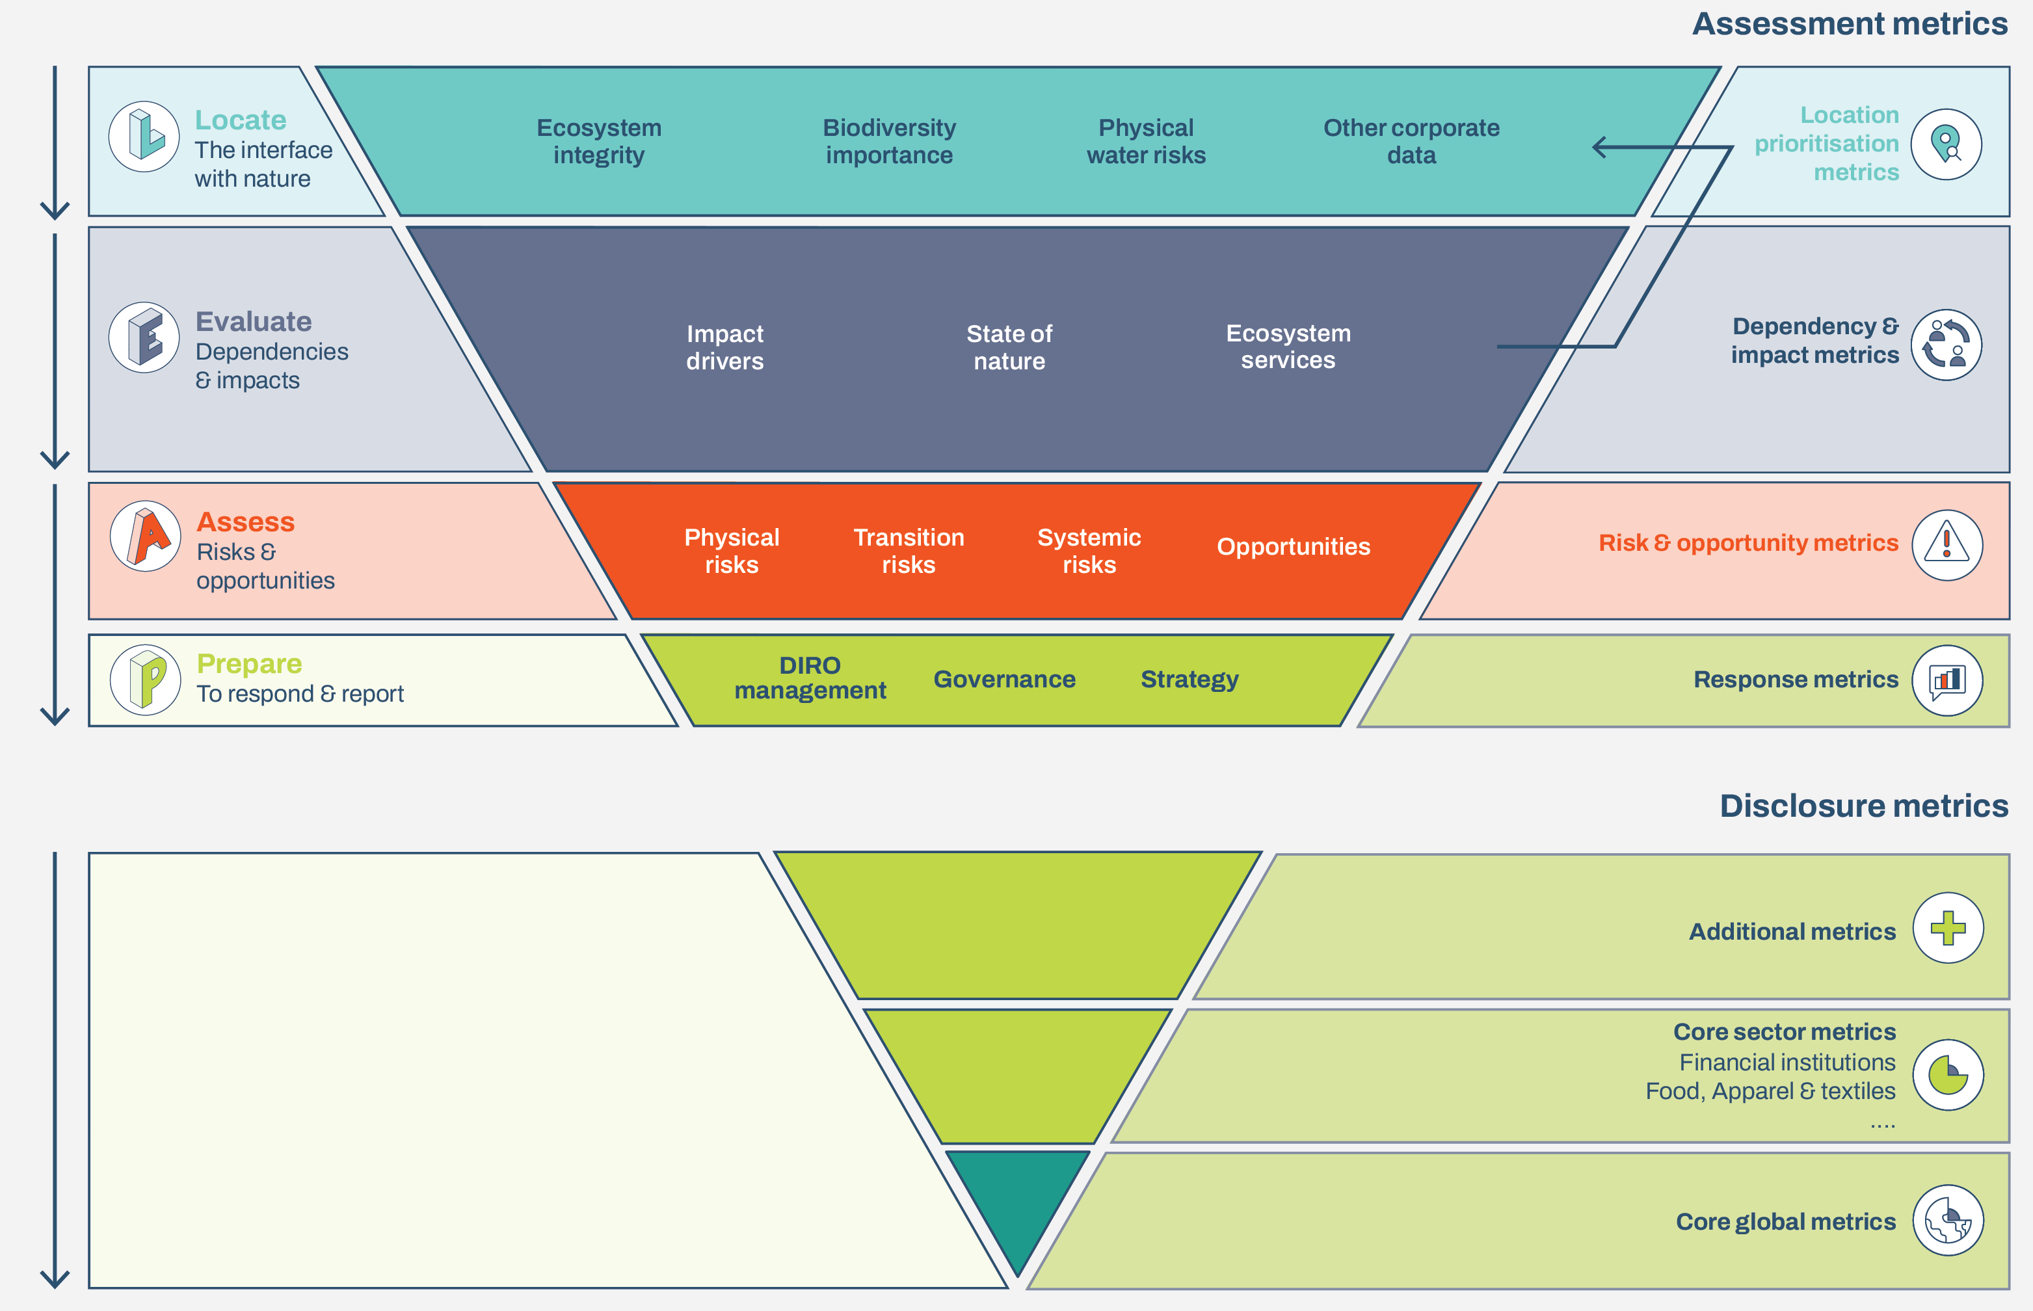
Providing a focused & flexible set of ‘leading indicators’​
Highlights​
Market user concerns about metrics in use today – time lags, consistency and comparability ​
‘Leading indicators’ approach necessary for disclosure – as with company financial accounts and national economic accounts​
Extensive input from knowledge partners

Slide 15
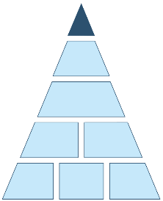
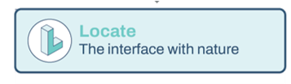
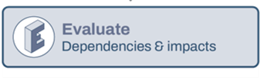

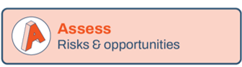
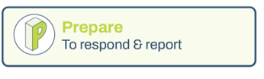
Additional guidance – the LEAP approach
Highlights​
Suggested guidance – not required to make TNFD disclosures​
Extensive market feedback and pilot tested by over 240 institutions across sectors, geographies and biomes​
Designed as a reference manual for an internal assessment team​
A flexible approach with components

Slide 16
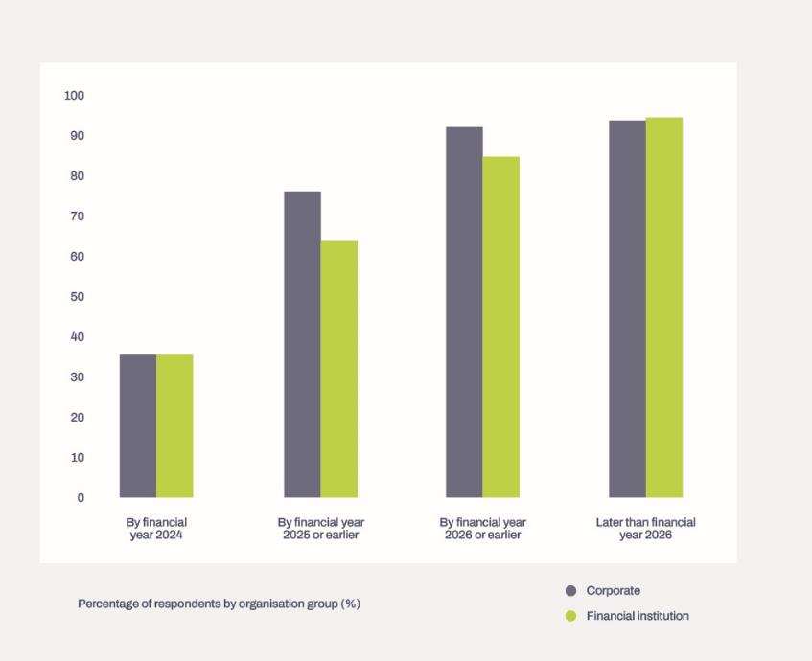
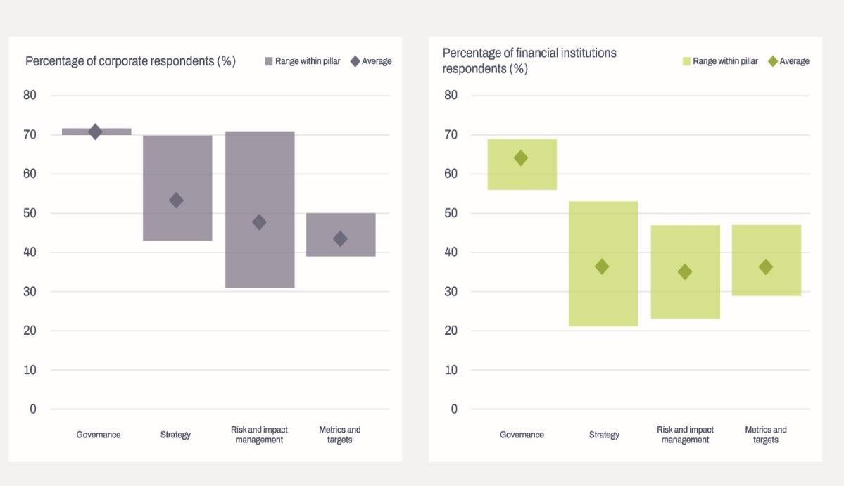
It’s time to get started – TNFD survey July/August 2023
239 responses from companies and financial institutions across 11 sectors, with organisations headquartered in over 35 countries.
Likely to get started in financial year:
Which disclosures likely to start with:

Slide 17
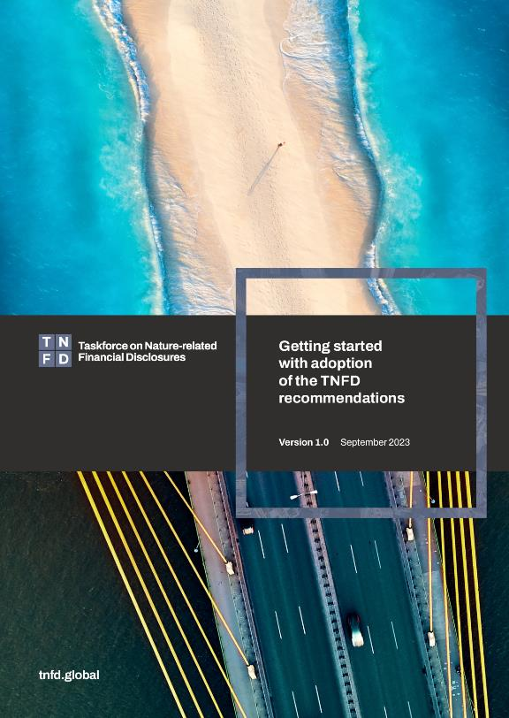
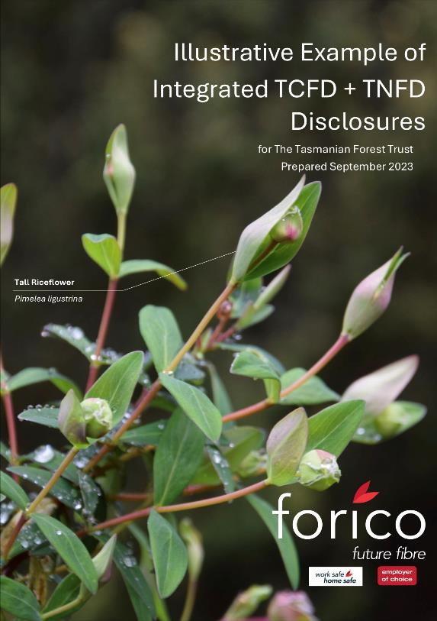
Time to get started

Slide 18
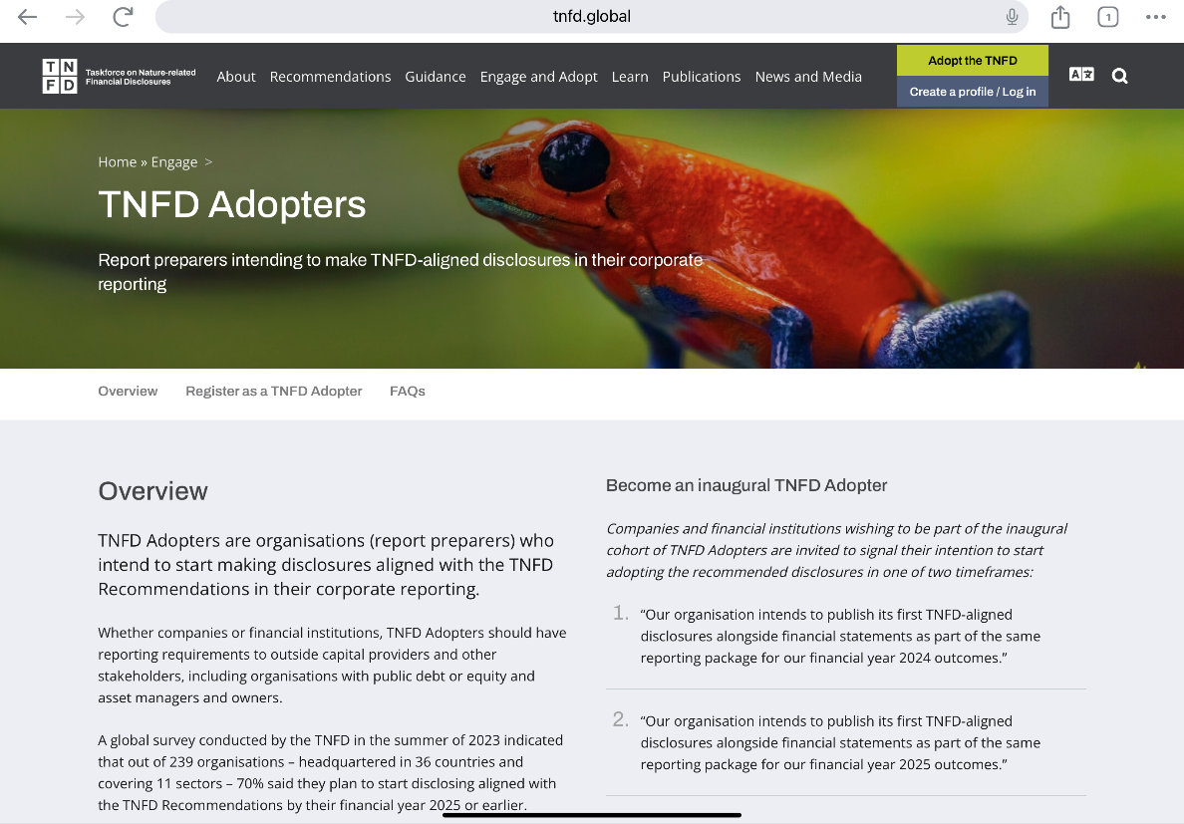
Time to get started – TNFD Adopters campaign​
Based on the survey results about intentions to start adopting, the TNFD is rallying early TNFD Adopters​
Ready to start adopting the TNFD recommendations and reporting in your financial reporting package for either FY2024 or FY2025 outcomes​
To be announced in January at the World Economic Forum in Davos as a group of inaugural early adopters

Slide 19
Thank you

