Slide 1
LNG & RMIPPP
National Ports Act
Process considerations
Meeting DMRE & TNPA
23rd March 2021

Slide 2
THE BUSA GAS WORKING GROUP
Increased focus on gas energy supply risks and shortages lead to establishment of The BUSA Gas Working Group (GWG) in 2019 within BUSA Energy structures.
Working closely with DMRE on LNG Bridging and Gas Master Plan
Gas can play an elevated role in the future lower carbon energy mix of a post-COVID-19 economic recovery.
GWG is made up of BUSA members and other relevant parties i.e.:
                Large industrial users
                Leading gas producers & suppliers
                DFI’s, leading banks (local & international)
                Regulatory specialists
                Technical expertise
Objective to ensure sufficient and efficient availability of gas to stimulate economic growth and ensure gas energy security
RMIPPPP VIEWED AS CATALYST FOR LNG ENTRY TO SA MARKETS
Business remains concerned about gas energy availability and general energy risk

Slide 3
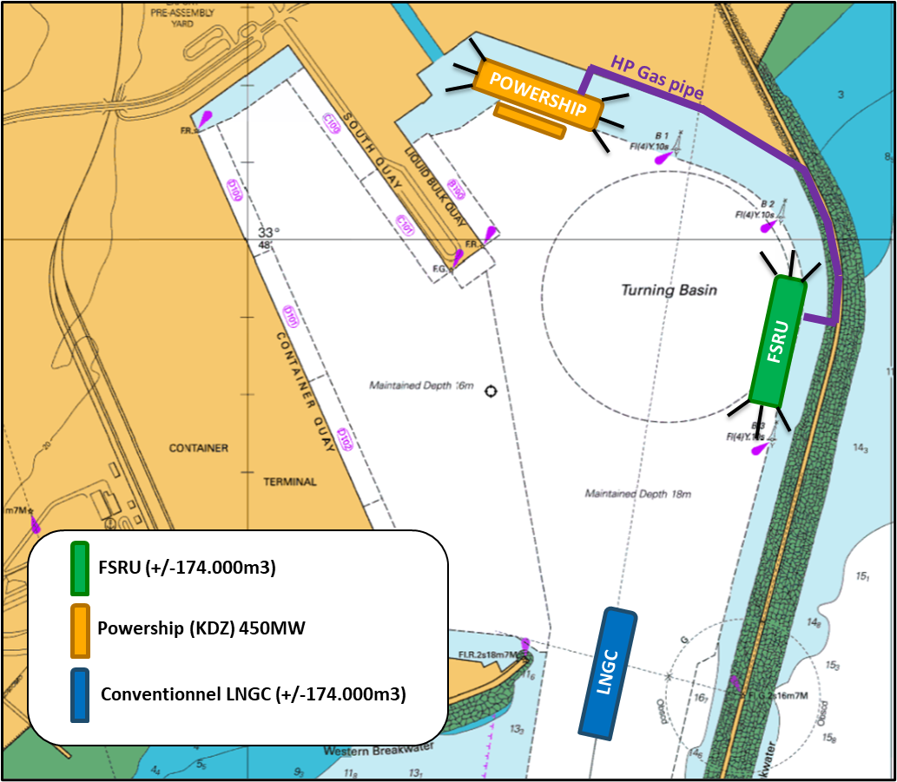
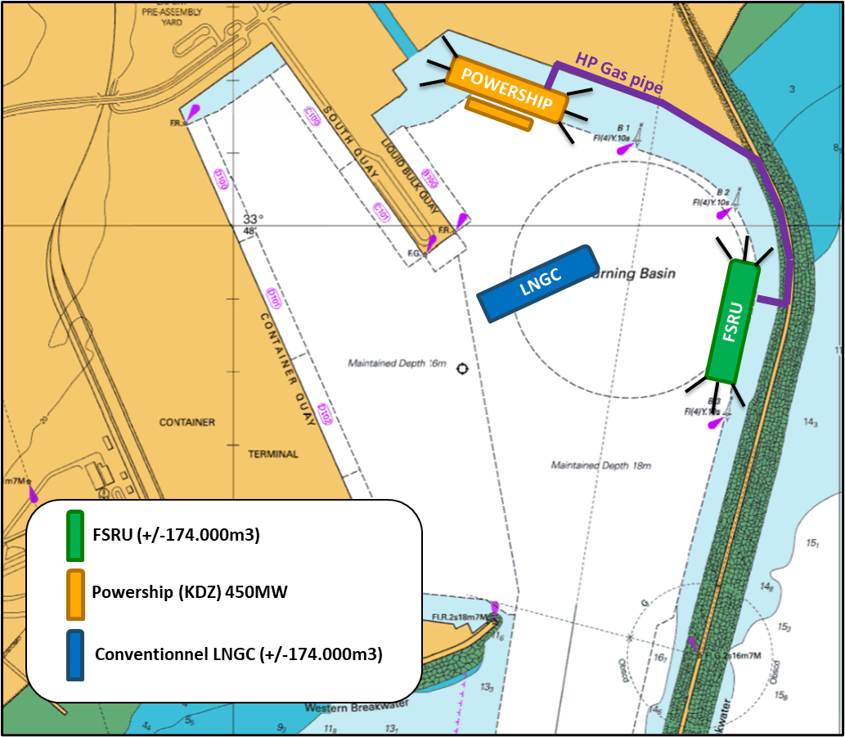
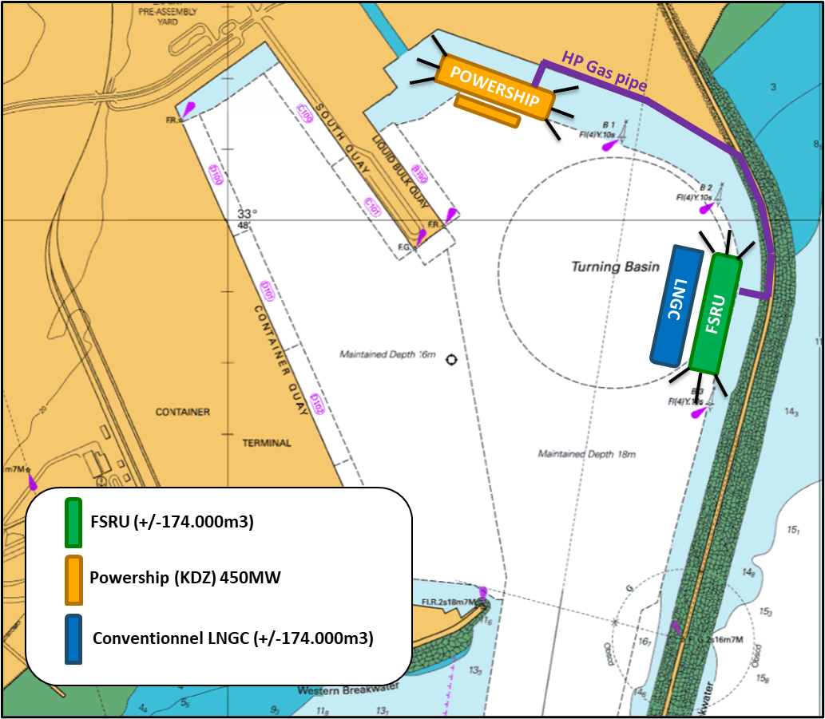
LNG INFRASTRUCTURE
LNG INFRASTRUCTURE – Operation Scheme
1
2
3
Large Ship-to-Ship between
an FSU (150km3)
and an LNGC (170km3)
Small Ship-to-Ship between
an FSU (150km3)
and a small LNGC (20km3)
Ship-to-Truck between
a small LNGC (20km3) and
4 LNG trucks (22-25tons)

Slide 4
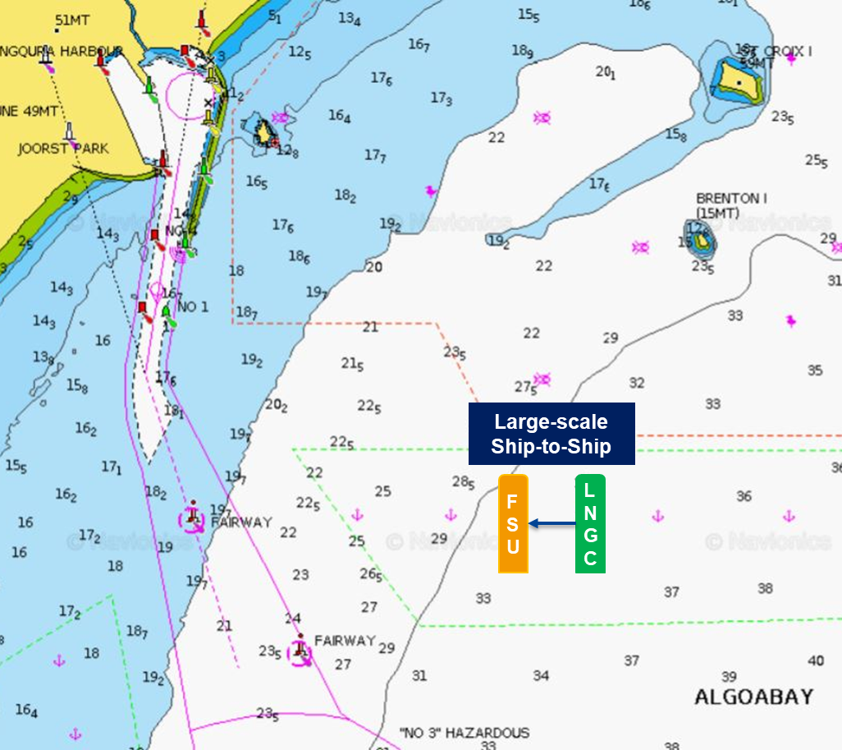
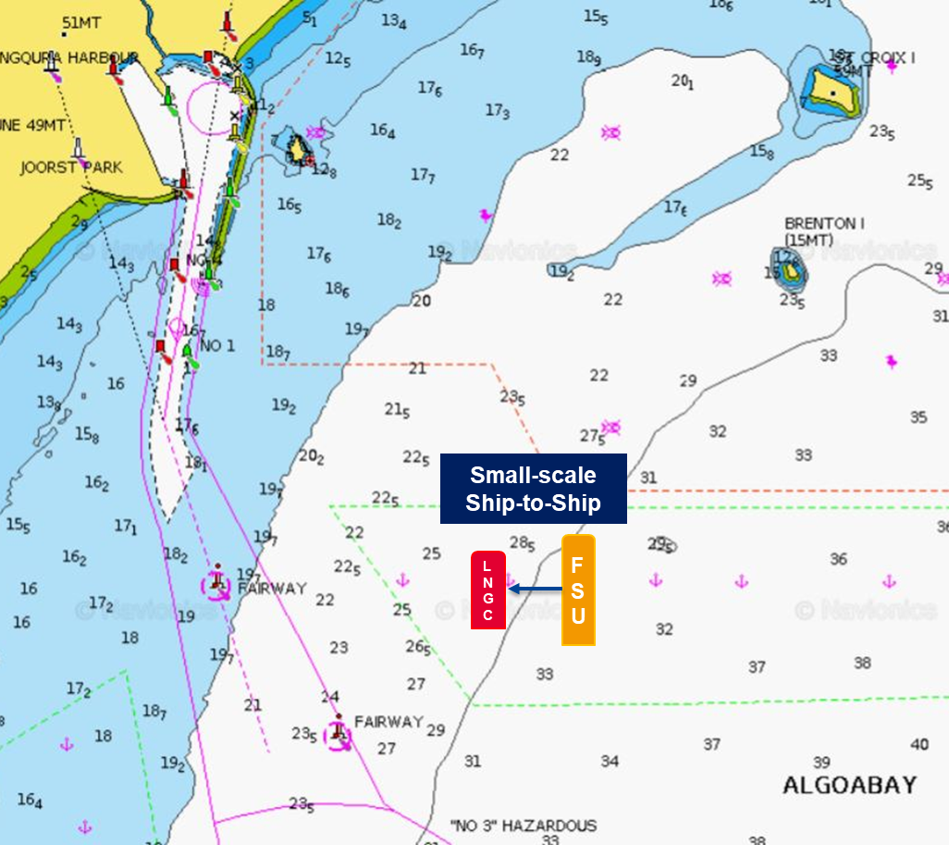
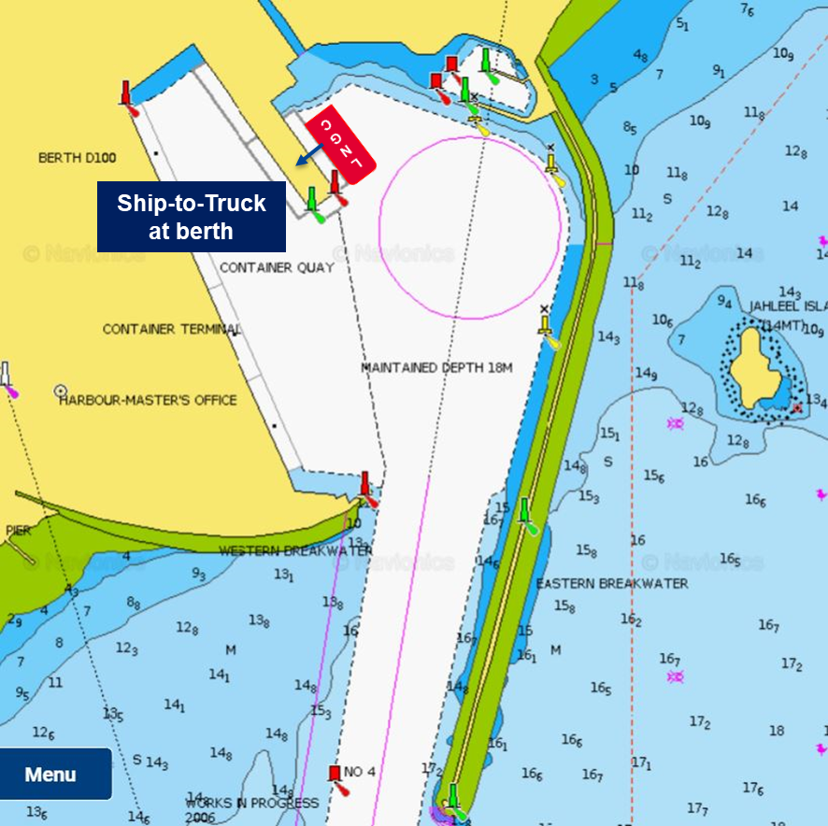
LNG SERVICES
LNG SERVICES – Operation Scheme
1
2
3
Large Ship-to-Ship between
an FSU (150km3)
and an LNGC (170km3)
Small Ship-to-Ship between
an FSU (150km3)
and a small LNGC (20km3)
Ship-to-Truck between
a small LNGC (20km3) and
4 LNG trucks (22-25tons)

Slide 5
PORT REGULATORY PATHWAY
Ministerial Consultation
DMRE-DoT;
DoT-DPE;
DPE-Treasury
Ministerial Determination (DoT)
Section 79 Directive to Authority
LNG Delivery
LNG Infrastructure Model
LNG Services Model
LNG land based permanent infrastructure
Dedicated terminal
Restricted berthing
Movable infrastructure no land based or terminal infrastructure
Multipurpose terminal
Open access to berthing
Section 11(1) – Legislative competence of Authority
Section 56 - Agreement
Section 56 (1) – Port Terminal or Port Facility
Section 56 (4) – Service contracting
Section 56 (5) – Procurement requirements: fair, transparent, competitive, cost effective
Section 66 – Licence for off-shore cargo handling facility (FSRU/FSU) , Sections 65-65 apply
Section 58 – Conditions of licence
Section 11(1) – Legislative competence of Authority
Section 57 (1) – Licence
Section 57 (3) – Authority issues invitation in Gazette
Section 57 (6) – issue/refuse licence within 6 weeks of receipt of application
Section 57 (7) – read with Section 11 (3) – “exemption, harmonisation, organ of State”
Section 66 – Licence for off-shore cargo handling facility (FSRU/FSU), Sections 65-65 apply

Slide 6
QUESTIONS FOR CLARIFICATION
What are TNPA’s views on LNG Infrastructure and LNG Services distinctions as referred to above?
Which regulatory pathway/s do TNPA consider for LNG schemes with reference to Sections 56/57?
What steps are the preferred bidders to follow regarding the regulatory pathway/s?
What are the agreed timelines between TNPA/IPPP/preferred bidders to achieve regulatory compliance for allowing LNG in ports?
What are the key process and other risks in achieving regulatory compliance to allow LNG in ports?
Achieving timeous regulatory compliance for LNG handling in ports is key to mitigate further energy risks for South Africa

Slide 7
THANK YOU

