Slide 1


Relevant decision under Biodiversity Related Multilateral Agreements

Slide 2
OVER VIEW BIODIVERSITY RELATED MEAs

Slide 3
BIODIVERSITY RELATED MEAs CONT…

Slide 4
BIODIVERSITY RELATED MEAs CONT…

Slide 5
BIODIVERSITY RELATED MEAs CONT…

Slide 6
Relevant decision

Slide 7
Background
Biodiversity is an important cross-cutting issue in the 2030 Agenda for Sustainable Development;
The SDGs and the Kunming- Montreal Biodiversity Framework explicitly recognize the importance of halting biodiversity loss;
It is critical that we make progress in mainstreaming biodiversity and transforming how societies value and manage it;
Economic activities depend on biodiversity for resources such as water, food, fiber, minerals and metals and so much more.
Despite numerous commitments, biodiversity loss continues to accelerate across the globe.
In addition, the anticipated expansion of sectors that depend on and affect biodiversity
    — including agriculture, forestry, fisheries and aquaculture
    — will pose a significant challenge to halting biodiversity loss in the coming decades.
Reversing these trends will require action by all sectors and stakeholders, policy makers, financial institutions, civil society, academia and business.
Mainstreaming biodiversity will ensure that addressing development needs and protecting the environment are mutually supportive.

Slide 8

Decision 6/COP.15 Participation and involvement of the private sector in meetings and processes of the United Nations Convention to Combat Desertification
Stressed the importance of the involvement of the private sector in the implementation of the Convention and the 2018−2030 Strategic Framework of the United Nations Convention to Combat Desertification,
Noted the outcomes of the Sustainable Land Management Business Forum, and the information provided in document ICCD/CRIC(20)/5 related to the initiatives undertaken by the Global Mechanism,
Takes note of the initiatives undertaken by the Global Mechanism and requests the secretariat and the Global Mechanism to continue implementing the United Nations Convention to Combat Desertification business engagement strategy and the private sector engagement strategy 2021–2030 when engaging in partnerships with the private sector;
Requests the secretariat and the Global Mechanism within their mandate and subject to the availability of resources to:
  Engage with companies that are working in the food-feed-fibre sector that have potential to make positive contributions to addressing desertification/land degradation and drought;
  Continue promoting, together with other partners, decent land-based jobs for youth and land-based youth entrepreneurship;

Slide 9
Decision 6/COP.15 Participation and involvement of the private sector in meetings and processes of the United Nations Convention to Combat Desertification
c) Facilitate, in collaboration with the relevant partners and representatives of the private sector, the organization of the seventh Sustainable Land Management Business Forum on the sidelines of the sixteenth session of the Conference of the Parties;
d) Continue engaging with the private sector on the introduction of sustainable land use and value chain development, including for the promotion of sustainable sourcing practices;
Facilitate, in collaboration with partners, the development of the Business for Land initiative, bringing visibility to the commitments made by participating companies towards the objectives of the Convention and ensuring that the initiative is self-sustained in the future;
3. Invites Parties, business and industry entities to support the Business for Land initiative and present specific commitments to ensure the achievement of land degradation neutrality, on a voluntary basis;
4. Requests the secretariat to report at the sixteenth session of the Conference of the Parties on the measures taken to facilitate and encourage the participation and involvement of the private sector in meetings and processes of the United Nations Convention to Combat Desertification

Slide 10
UNCCD 2018–2030 Strategic Framework
Strategic objective 5: To mobilize substantial and additional financial and non-financial resources to support the implementation of the Convention by building effective partnerships at global and national level Expected impact 5.1: Adequate and timely public and private financial resources are further mobilized and made available to affected country Parties, including through domestic resource mobilization

Slide 11

The Fourth Ramsar Strategic Plan 2016–2024
Target 3: The public and private sectors have increased their efforts to apply guidelines and good practices for the wise use of water and wetlands.

Slide 12

Scoping report for a methodological assessment of the impact and dependence of business on biodiversity and nature’s contributions to people
The Plenary, at its ninth session approved the undertaking of the business and biodiversity assessment;
Also request the secretariat to establish the institutional arrangements necessary to mobilize the technical support required for the assessment.
The assessment will categorize the dependencies and impacts of business and financial institutions on biodiversity and nature’s contributions to people, which incorporates ecosystem services and other analogous concepts, including in relation to indigenous peoples and local communities.
It will assess methods for measuring direct dependencies and impacts and, where appropriate, indirect dependencies and impacts, and will assess options for actions by businesses and by others, including Governments, the financial sector, indigenous peoples and local communities, and civil society, that interact with business.

Slide 13
Assessment approach and Timeline
Timeline and geographical coverage
The assessment will be global in scope and
Address issues related to all sectors and business types.
Regional adaptations and applications, including past and present examples, will also be considered across terrestrial, freshwater and marine ecosystems.
Taking into account, where relevant, existing international obligations.
The assessment will be carried out following the fast-track approach for thematic and methodological assessments.
Methodological approach
The assessment will also identify key gaps in knowledge, data, methodologies, and reporting standards
Chapter outline
Chapter 1. Setting the scene;
Chapter 2. How does business depend on biodiversity?
Chapter 3. How does business impact biodiversity?
Chapter 4. Approaches for measurement of business dependencies and impacts on biodiversity;
Chapter 5. Businesses as key actors of change: options for action by business;
Chapter 6. Creating an enabling environment for business: options for actions by Governments, the financial sector and civil society

Slide 14

Business Collaboration Convention of Biological Diversity
The need to engage businesses in achieving the objectives of the Convention was recognized by the Conference of the Parties at its eighth meeting, in Curitiba, Brazil, in 2006;
Decision VIII/17 foresaw the participation of businesses in various biodiversity meetings and their involvement in the development and implementation of national and international biodiversity strategies and action plans.
Subsequent decisions were taken to establish the conditions that facilitate private sector engagement. The decisions encouraged businesses to “adopt practices and strategies that contribute to achieving the goals and objectives of the Convention and the Aichi Biodiversity Targets."
This includes decisions to:
  Strengthen biodiversity consideration in business operations and promote behavioral change through “mainstreaming''
  Encourage enterprises to align investments, management, and procurement policies with the conservation and sustainable use of biodiversity and ecosystem services.
  Encourage businesses & support the establishment of the Global Partnership for Business and Biodiversity and other public/private partnerships to provide a platform to facilitate tool sharing, dialogue, and capacity building.
  Support the measurement and reporting of business impacts and dependencies to biodiversity by formalizing biodiversity impact reporting in their annual reports.
  Further encourage businesses to take into account individual supply chain activity, national priorities, and conditions when conducting biodiversity assessment.
  Promote business involvement in the development, revision, and implementation of national and international biodiversity strategies and action plans.

Slide 15
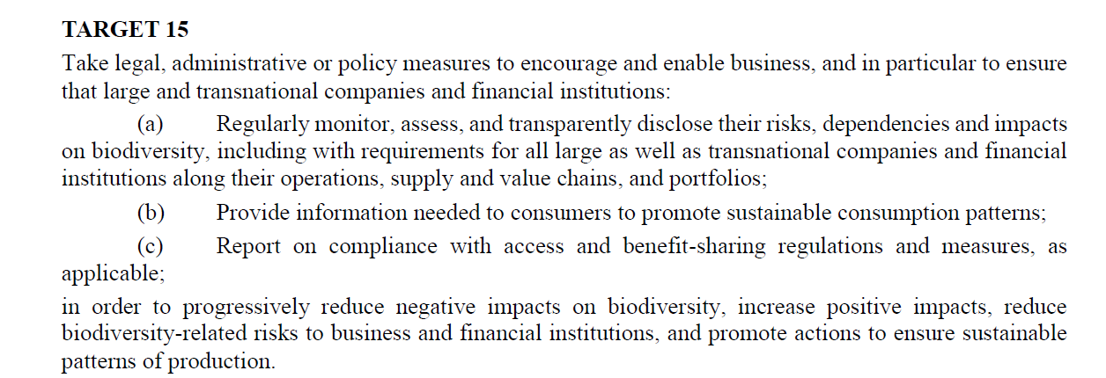
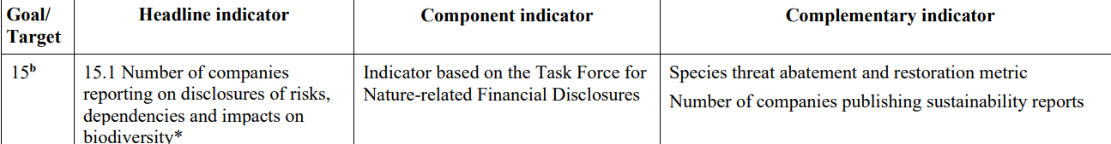
GBF TARGET 15

Slide 16
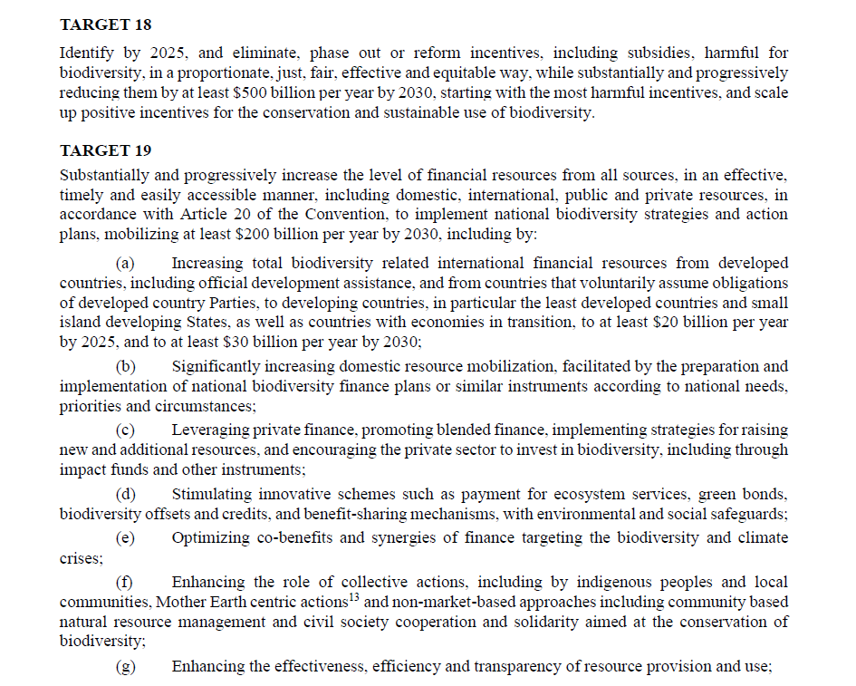

Slide 17

WCC-2016-Rec-102-EN Protected areas and other areas important for biodiversity in relation to environmentally damaging industrial activities and infrastructure development
CALLS ON the business community to respect all categories of protected areas as 'no-go' areas for environmentally damaging industrial activities and infrastructure development, to withdraw from those activities in these areas, and not to conduct future activities in protected areas; and
URGES companies, public sector bodies, financial institutions (including development banks), relevant certification bodies and relevant industry groups not to conduct, invest in or fund environmentally damaging industrial activities and infrastructure development within, or that negatively impact protected areas or any areas of particular importance for biodiversity and ecosystem services that are identified by governments as essential to achieving the Aichi Biodiversity Targets, and to make public commitments to this effect

Slide 18
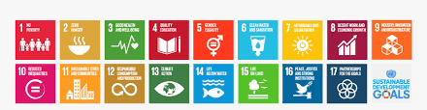
Linkages between Biodiversity and Sustainable Development Goal
Notes:
Biodiversity underpins sustainable development, and stress the need for coordinated policy responses that address global challenges as a whole beyond the scope of SDG 14 and 15 that respectively address life below water and life in land, biodiversity and healthy ecosystems provides essential resources and ecosystem services that directly support a range of societal sectors and economic activities, such as agriculture, forestry, fisheries, and tourism. Thus Biodiversity relevant to the achievement of SDG 1 on ending poverty; key for food security and nutrition, and contributes to the achievement of SDG 2 on zero hunger, and SDG 8 on decent work and economic growth. The CBD 3rd objective on fair and equitable benefit-sharing has the potential to improve socioeconomic and political inequality among countries and social groups (SDG 10). links between biodiversity and health (SDG 3) are increasingly recognized. Healthy ecosystems help to mitigate air, water, and soil pollution, and are the source of both modern and traditional medicines. They underpin the delivery of water supplies, water quality, and protect against water-related disasters (SDG 6); they are the source of energy (SDG 7); they can provide reliable and cost-effective natural infrastructure (SDG 9); and in general provide basic services to cities, and nature-based solutions to challenges related to urban well-being (SDG 11) and to climate change (SDG 13). All these are however undermined by current unsustainable production and consumption patterns (SDG 12), as well as illegal wildlife trade, fishing, and timber trade (SDG 16).

Slide 19
SA WHITE PAPER AND ITS ALIGNMENT TO THE GBF
Vision: An inclusive, transformed society living in harmony with nature, where biodiversity conservation and sustainable use ensure healthy ecosystems, with improved benefits that are fairly and equitably shared for present and future generations.
Enabler 1 ~ Integrated, Mainstreamed and Effective Biodiversity Conservation and Sustainable Use: Integrate policy and practice across government and effectively implement multilateral agreements; aligned to T14;T15;T16 of the GBF
Enabler 2 ~ Enhanced Means of Implementation: Expand and develop ability to effectively conserve biodiversity, to manage its use, and to address factors threatening it. Aligned to Goal D; T5, T18; T19-T23 of the GBF
GOAL1~ Biodiversity Conservation Promoted: Conserve all biological diversity and its components
GOAL2 ~ Sustainable Use: Ensure that sustainable use enhances thriving living land- and seascapes and ecosystems, livelihoods, and human well-being, while avoiding, minimising, or remedying adverse impacts on biodiversity
GOAL 3 ~ Equitable Access and Benefit Sharing: Ensure that benefits are derived and shared from the use and development of South Africa's genetic and biological resources, without compromising national interests
GOAL 4 ~ Biodiversity Conservation and Sustainable Use is Transformative: gives effect the environmental right and other human rights, facilitates redress, and promotes transformation
Aligned to Goal A; T1-T6, T8; T11 of the GBF
Aligned to Goal B; T2; T5; T9; T10; T12
Aligned to Goal C; T9,T10; T12
Aligned to T3; T22; T23 and section C

Slide 20
White Paper implications
GOAL 1: ENHANCED BIODIVERSITY CONSERVATION: All biological diversity and its components conserved
Policy objective:
1.1. Expand a representative system of protected and conservation areas that are effectively and efficiently managed..
Expected output:
5. Effective participation of landowners, business, traditional leaders, local communities and other interested and affected parties in expansion, management and custodianship of protected and conservation areas.
Expected outcome::
1. Expanded, connected, thriving, representative, inclusive, and effectively managed protected and conservation areas, including coordinated partnerships.
2. Species of special concern, including their genetic diversity, conserved, and viable populations maintained.
3. Contributions to global biodiversity conservation targets.

Slide 21
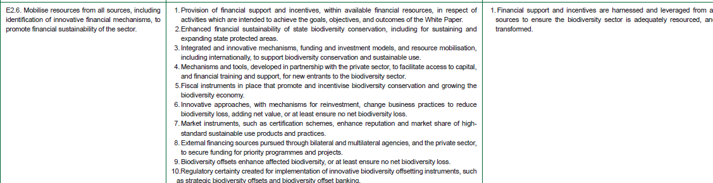
ENABLER 2: ENHANCED MEANS OF IMPLEMENTATION: EXPANDED AND DEVELOPED ABILITY TO EFFECTIVELY CONSERVE BIODIVERSITY, TO MANAGE ITS USE AND BENEFITS, WHILST ADDRESSING FACTORS THREATENING BIODIVERSITY.

Slide 22
PROCESS MAP FOR IMPLEMENTATION OF THE GLOBAL BIODIVERSITY FRAMEWORK UP TO 2030
CONVENTION ON BIOLOGICAL DIVERSITY – COP 15
MINISTERIAL BRIEFING → CABINET BRIEFING AND APPROVAL → COMMUNICATION OF POLICY BRIEF
IMPLEMENTATION EVALUATION OF THE NBSAP
NATIONAL STAKEHOLDER ROADSHOWS
TOOLS AND SOLUTIONS
National Reports
NBSAP
NBF
MTSF
NBSAP Forum resuscitated
FOCUS GROUPS: THEMATIC AREAS
REVISION OF NATIONAL BIODIVERSITY STRATEGY & ACTION PLAN (NBSAP)
GBF Implementation plan
Setting of National Targets
NBSAP review
IMPLEMENTATION EVALUATION OF NBSAP
Where do we come from → Where are we (baseline and existing tools + programmes) → Challenges and constraints → Opportunities
NATIONAL TARGET SETTING APPROACH
Conservation focus (SANBI):
  reducing threats;
  conservation area expansion
Sustainable Use (DFFE/SANParks)
Access & Benefit Sharing (DFFE/DSI)
Engagements to be have specific thematic focus
Identification of facilitators
APPROVAL PROCESS
Intergovernmental structure approval
Cabinet Approval end of 2023/24
Communication to secretariat
APRIL 2024
Tools and solutions for implementation
REVISION OF THE NATIONAL BIODIVERSITY STRATEGY AND ACTION PLAN (NBSAP)
Stakeholder consultations
NATIONAL BIODIVERSITY ASSESSMENT (2024)
Sector Monitoring and Evaluation Framework (under development -2024)
Cabinet approval
Communication to secretariat (2025/2026 FY)
NBSAP REVISED- 2025
NBF REVISED-2025
7TH NATIONAL REPORT - COP 17 (2026)
Consultation → Cabinet Approval → Communication to Secretariat
8TH NATIONAL REPORT - COP 18 (2028)
2030 - GLOBAL IMPACT REVIEW

Slide 23
Way forward
Develop a joint implementation plan taking into account varies decision taken in different Biodiversity Multilateral Fora;
Co-develop a national target and monitoring indicators on business and biodiversity for SA;
Support the process of revising and updating NBSAPs.

Slide 24


THANK YOU!

