Slide 1
Eskom – Business Roundtable
Business presentation for discussion purposes
19 April 2023

Slide 2
Business representation
Business is committed to contributing to the resolution of the electricity crisis. We are committed to the decarbonisation of our energy sector, while ensuring energy security and an optimal and just transition pathway for our economy and society.
Business supports the Presidential Energy Action Plan as well as the Necom workstream objectives
Business organisations present at the Eskom-business Roundtable:
BUSA
Energy Council
Manufacturing Council
Minerals Council
SIEFSA
EUIG
FAPA
BLSA
There are also a number of corporates supporting the Roundtable discussions.
2

Slide 3
Business Priorities
Business seeks to collaborate with, and support Eskom in addressing the following objectives
There is both significant risk and opportunity in the energy transition. We believe a transformed and sustainable, yet capable and financially strong Eskom is critical to a successful energy transition.
Key business imperatives
Load-Shedding is an immediate crisis that is causing significant damage to our economy and society, and must be resolved with urgency
In keeping with the recent meeting between the President (including key ministers) and Business, the recognition is clear that decisive action is required and all parties need to act in unison and in partnership.
Over and above addressing load shedding, the energy transition will require a significant national effort.
In addition to sector reform and critical enablers such as Grid expansion and Market establishment, supply ambitions by 2030 include:
                56,000MW of Wind and Solar
                8,000MW of storage
                5,000MW of Gas-to-Power and
                Decommission 12,000MW of coal

Slide 4


The Energy Council has been adopted as the business vehicle to enable unity in efforts towards an optimal Energy Transition for South Africa
Business collaboration has progressed by Energy Council becoming a member of BUSA and collaborating on consolidating and aligning efforts (including B4SA)
This approach is being expanded to include collaboration with all sector stakeholders
Addressing the Energy Trilemma
Ensure a unified voice of business, that meaningfully contributes to a national energy vision and pathway to Net-Zero
Play a leading role in a stakeholder-aligned national Energy Transition strategy and implementation pathways
Enabling investment across the energy sector with visibly increased localisation, industrialisation, & job creation
Collaborate with stakeholders to advance energy policy and regulatory certainty as well as business confidence

Slide 5
Government’s energy delivery structure is supported by business
How can we improve the interface and engagement with Eskom
Strategic oversight & support for the Energy Action Plan
BUSA CEO
B4SA CEO
Other business Execs
Presidential 5 point Energy Action Plan
Key Business CEO’s
JSOC
Minister & DG
Other Government
Tactical planning & support
NECOM
PMO + workstreams
EAF performance
Policy / Regulatory
New Pvt Generation
Emergency actions
Demand / Efficiency
Law enforcement
Data / Research
Public comms
Munics / Wheeling
Transmission
BUSA
B4SA
Other business Organisations
Energy Council
Coordination/ PMO
NECOM
Resource Mobilisation Fund
Operational delivery support
Industry Experts put forward by business
WORKSTREAMS
NECOM & Eskom leads nominated

Slide 6
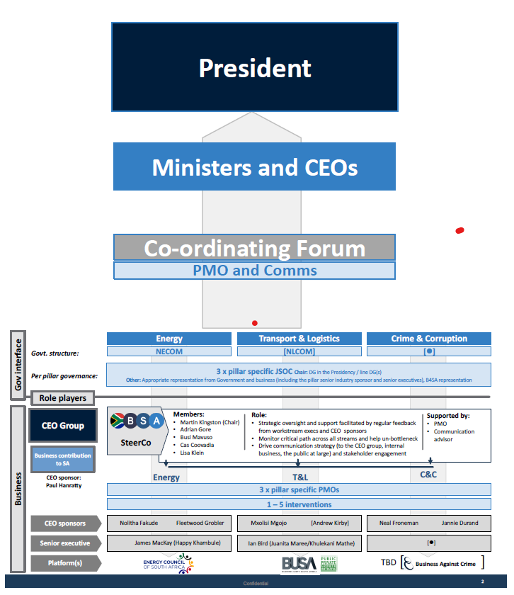
Leveraging the NECOM engagement process
What is the optimal platform and approach for business to engage with Eskom
Business has committed to partner with government to support focused delivery in the following areas
EAF performance Wks 1
Policy planning Wks 2
New Generation Wks 3
Demand & Efficiency Wks 5
Market & Wheeling Wks 9
One-stop-shop Wks 9
Grid enablement Wks 10
NECOM
PMO + workstreams
EAF performance
Policy / Regulatory
New Pvt Generation
Emergency actions
Demand / Efficiency
Law enforcement
Data / Research
Public comms
Munics / Wheeling
Transmission
Efforts in Energy are being duplicated across Logistics as well as Crime & Corruption
Eskom

Slide 7
Understanding the Eskom engagement process
Work with Eskom and NECOM to provide practical experience and support at the Power Station level
EAF performance Wks 1
Policy planning Wks 2
New Generation Wks 3
Demand & Efficiency Wks 5
Market & Wheeling Wks 9
One-stop-shop Wks 9
Grid enablement Wks 10
Energy Transition Policy scenario planning, jointly between government, business and civil society. Supported by the World Energy Council
Gas to Power; Private sector Gx support; FiT and Std offer;
DSR should include integrated planning with users to; develop options; optimise scheme rates; curtailment and load reduction planning and data; digital solutions; coordinated campaigns; efficiency and data analysis
Integrated Wheeling project to include: Seamless wheeling (VWM); Municipal wheeling and security deposits; trading and seamless wholesale market; enabling green tariff (RECs); Ancillary services market/ tariff.
Support and expediting establishment
Integrated Grid project to include: Queuing and allocation; permitting (CEL & BQ); TDP execution model; Institutional reform and independent Grid Co
Other Eskom related issues to be considered
Communication
  Need for transparent, accurate and quick communication on system constraints or risks. Enables planning and can potentially increase demand reduction during high-risk periods.
Finalise NRS 048-9 revision
  Reasonable notice for high stages of load curtailment. Mining may need more than 2 hours to safely taper down to essential loads
  Incentives to unlock and encourage investments that reduce pressure on the grid e.g. exemptions for generation in load curtailment.

Slide 8
Conclusions
  Significant progress is being made in building collaborative models to deliver the energy transition
  Proposal to agree and partner on key interventions and priorities :
  Business can add value (resources and expertise) to help planning and implementation
  It can be done in a short-space of time
  The impact is significant
  This will allow for
  Better communication channels for collaboration and partnership building
      Enhancement of early warning signals is important in promoting responsiveness and risk mitigation
      Continued platform building and discussion to enable trust and confidence

Slide 9
THANK YOU

Slide 10
Specific and additional considerations:
Supply-side options
Demand Side Management

Slide 11
Supply side

Slide 12
Industry Electricity Self Generation Plant
The DMRE published the amended Schedule 2 of the Electricity Regulation Act which removed the licensing requirement for generation projects of any size, these projects will only be required to register with NERSA
The removal of the licensing threshold has unlocked massive investment by the private sector. More than 100 projects amounting to over R150 billion, representing about 9 300 MW of new generation capacity, are now at various stages of development. Of these projects 7 500MW will be built by the mining industry.
Goldfields commissioned their 50 MW solar PV plant in 2022 and,
Pan African Resources also commissioned their 10 MW solar in 2022.
Information collected by the Presidency shows that in 2023 about 1 300 MW of industry projects will come online, in 2024 and 2025 the projects being commissioned will reach 2 000 MW.
NERSA Registration is taking a minimum of 19 days as red tape has been removed to allow an efficient system. By mid 2022 NERSA had approved Projects amounting to 575MW (315MW mining).
12

Slide 13
Opportunities
Reduction of the Eskom CEL(90 Days) an BQ(120 days) Process.
Ensuring Adequate Staffing at Distribution to deal with the increased number of applications
Finalisation of Queueing Rules and Implementation of a Transparent and Fair System for Grid Allocation
TDP Implementation: Geographic limitations and project sterilisation due to Transmission Network Capacity constraints, prioritise critical corridors (EC/NC/WC). Concern from members in the NC over the high cost for the augmentation of the NC Transmission Corridor(Hydra/Kronos 400kV line,180km@R3.5bn, 1500MW).
The transmission execution plan needs to be finalised as a matter of urgency and made public.
Equally important is the contracting method that Eskom will follow in the development of the grid to enable supply side contractors and manufacturers to plan accordingly for the anticipated demand. Local industry should also be afforded the opportunity to make inputs into design and specification of products used in the development of the tx system.
The requirement for municipality to pay Eskom Security Guarantee for the area of supply when the ESA is reopened during wheeling discussions is a challenge for the IPPs. Investigate a way of only reopening for the project instead of the whole ESA.
The identification of Renewable Energy Development Zones should continue to enable the development of large-scale wind and solar facilities(e.g., in MP Eskom land to be used by IPPs).
Security of Equipment and Infrastructure
The creation of the One-Stop-Shop will assist in streamlining generation authorisations and in the meantime continuation of the OV Electricity Task Team.
13

Slide 14
Demand Side Management

Slide 15
LPU Demand Side Management Focus
DSM for Large Power Users
Improve the incentive rates of Energy Efficiency rebates such as Section 12L.
Resources and Skills
Rebuild an Integrated DSM program with centralised support structures and a knowledge sharing platform.
Improve and expand Demand Response options – DR is cheaper than diesel and the cost of unserved energy. Consider increasing incentives for Demand Response to increase participation subject to system needs.
Voluntary electricity demand reduction scheme – voluntary reduction of NMD for specified periods with incentives. This could include options to trade capacity among customers to encourage productivity.
Establish a load-curtailment coordination framework with market opportunities for trading among participants. This can allow participating to avoid interruptions for longer periods.
Closing the gap between the electricity tariff and scheme rates.
Increasing exemptions to higher stages of load curtailment.
Investment in energy management technical skills development (Eskom, ESCOs, Industry) to match expected increase in skills demand.
Invest in research and development to speed up energy efficient technology development and adoption.
Consolidate and align different government agencies' programmes for maximum impact.
Encourage the development of micro-grids where suitable (e.g. remote sites, pumping)
Identify, develop and package common industry DSM focus areas (e.g. Peak Shifting, HVAC) and build execution models for rapid adoption.
Expand the focus of Energy efficiency in building beyond the Eskom and government buildings in NECOM WS 5
Collaborate/ partner with business. Large companies can potentially play a role in amplifying the reach of DSM campaigns and the roll out of technology to employees
Residential and Commercial sector load profiles drive the peak demand. Reducing the peaks is a significant opportunity.
Identify, develop technology focusing on mature smart/digital solutions. Design incentives to enable adoption.

Slide 16
Alignment and Communication
Policy Alignment
Communication
And
Expediting revision of NRS 048-9
Improved Communication
Need to drive national ESI and EDI vision and long-term strategic plans in collaboration with industry & other stakeholders
Develop a list of enablers and requirements from the banking sector, government (Treasury), private sector and Eskom to accelerate Commercial & Residential PV installation.
Re-design ‘green tariff’ to include carbon credits/renewable energy certificates(RECs). The RECs from the Commercial & Residential PV installations can be a valuable commodity for companies that require them to offset carbon emissions.
Introduce feed-in tariffs to private generators in metros/municipalities.
Enable market for electricity trading to reduce single-offtake PPA risk and financing costs.
Encourage private sector energy storage systems (ESS) by developing ESS regulations and ancillary services product/tariff.
Expedite the development of standardised, simple and cost-reflective wheeling framework
Need for transparent, accurate and quick communication on system constraints or risks.
Enables planning and can potentially increase demand reduction during high-risk periods.
Finalise NRS 048-9 revision
Reasonable notice for high stages of load curtailment– deep level mining may need far more than 2 hours to taper down to essential loads and evacuate workers in a safe and orderly manner.
Build in incentives to unlock and encourage investments that reduce pressure on the grid e.g. exemptions for private power generation in load curtailment.

Slide 17
THANK YOU

