Slide 1



Business inputs
Nedlac TIC Strategic Session with Minister Patel
25 January 2024
NATIONAL OFFICE
61 Katherine Street,
Sandton, 2196
P.O. Box 652807, Benmore, 2010

Slide 2
LOCALISATION
Case studies good; but
Must deal with root causes stifling industrialisation;
Concrete proposals in Freight Logistics Roadmap, energy etc.
NB – commercial consumers; but
Also need to understand & influence consumer trends – driven by price considerations;
Need cross-cutting efforts from all gov agencies to support local industry.
Examples;
      Need certainty & accessibility from Competition Commission to drive investment;
          Must help industries to collaborate on areas of national interest:
Dispensation needed to allow exporters to ‘hunt in packs’;
  Staggering exports and co-ordinating to relieve pressure on logistics;
  Price discussions (foreign trade mission and importers want to know how much SA can supply and at what price but we cannot have these discussions);
2

Slide 3
Imports of goods which improve productivity are falling, while imports of finished goods are rising
Intermediate goods
This is a pattern of de-industrialisation
Source: South African Revenue Services, trade statistics

Slide 4
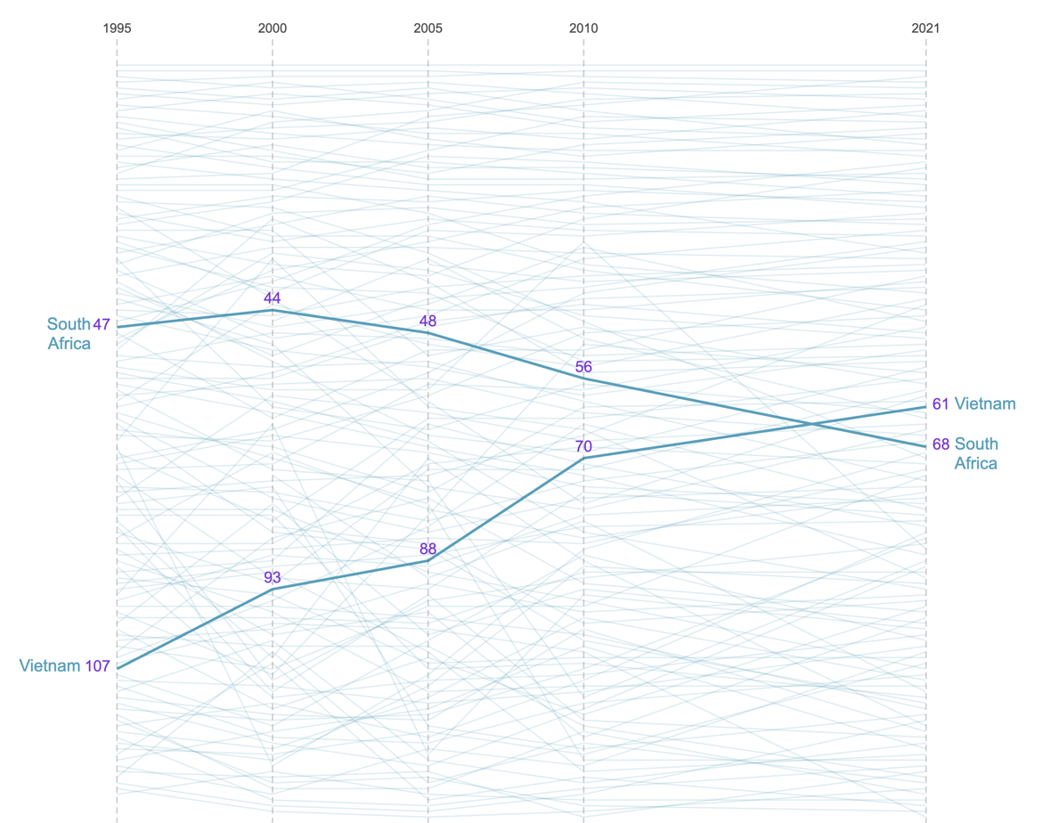
We are de-industrialising
Source: Harvard University’s Growth Lab

Slide 5
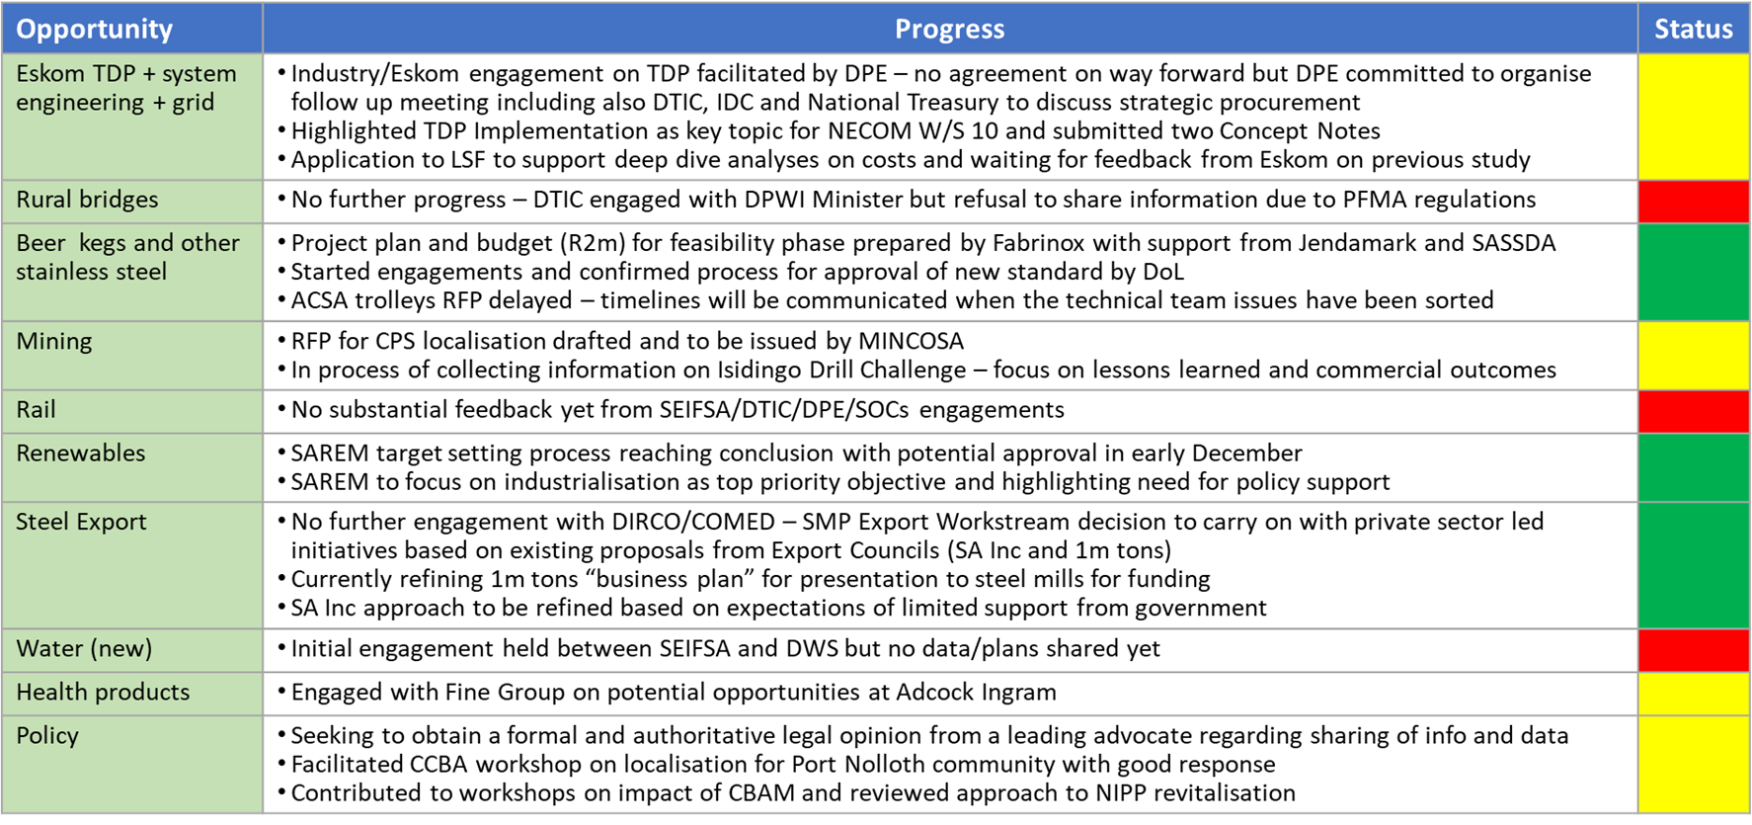
LOCALISATION – BUSA work done to date
5

Slide 6
RECAP OF 2023 AND PRIORITY AREAS FOR 2024
Very limited progress on all opportunities linked to public procurement despite intense effort, especially on the Eskom TDP
  Engagements with Eskom still not leading to fruitful discussions on how to jointly develop the local value chain
  DPWI is non-responsive to escalations from DTIC and BUSA
  Transnet still AWOL despite SEIFSA effort
Good progress on opportunities relying mainly/entirely on private sector efforts
  Ready to start the feasibility phase of the beer kegs project
  Good traction in Export Workstream in the absence of DTIC leadership/participation
Priority areas for 2024 are driven by the motto “By industry for industry”
  Exports – focus on sub-Saharan Africa
  Renewables
  Beer kegs and other stainless steel
  Mining – beyond CPS
  Health – depending on AICC lead and potential Master Plan activities
  Policy – CBAM responses and NIPP revitalisation
6

Slide 7
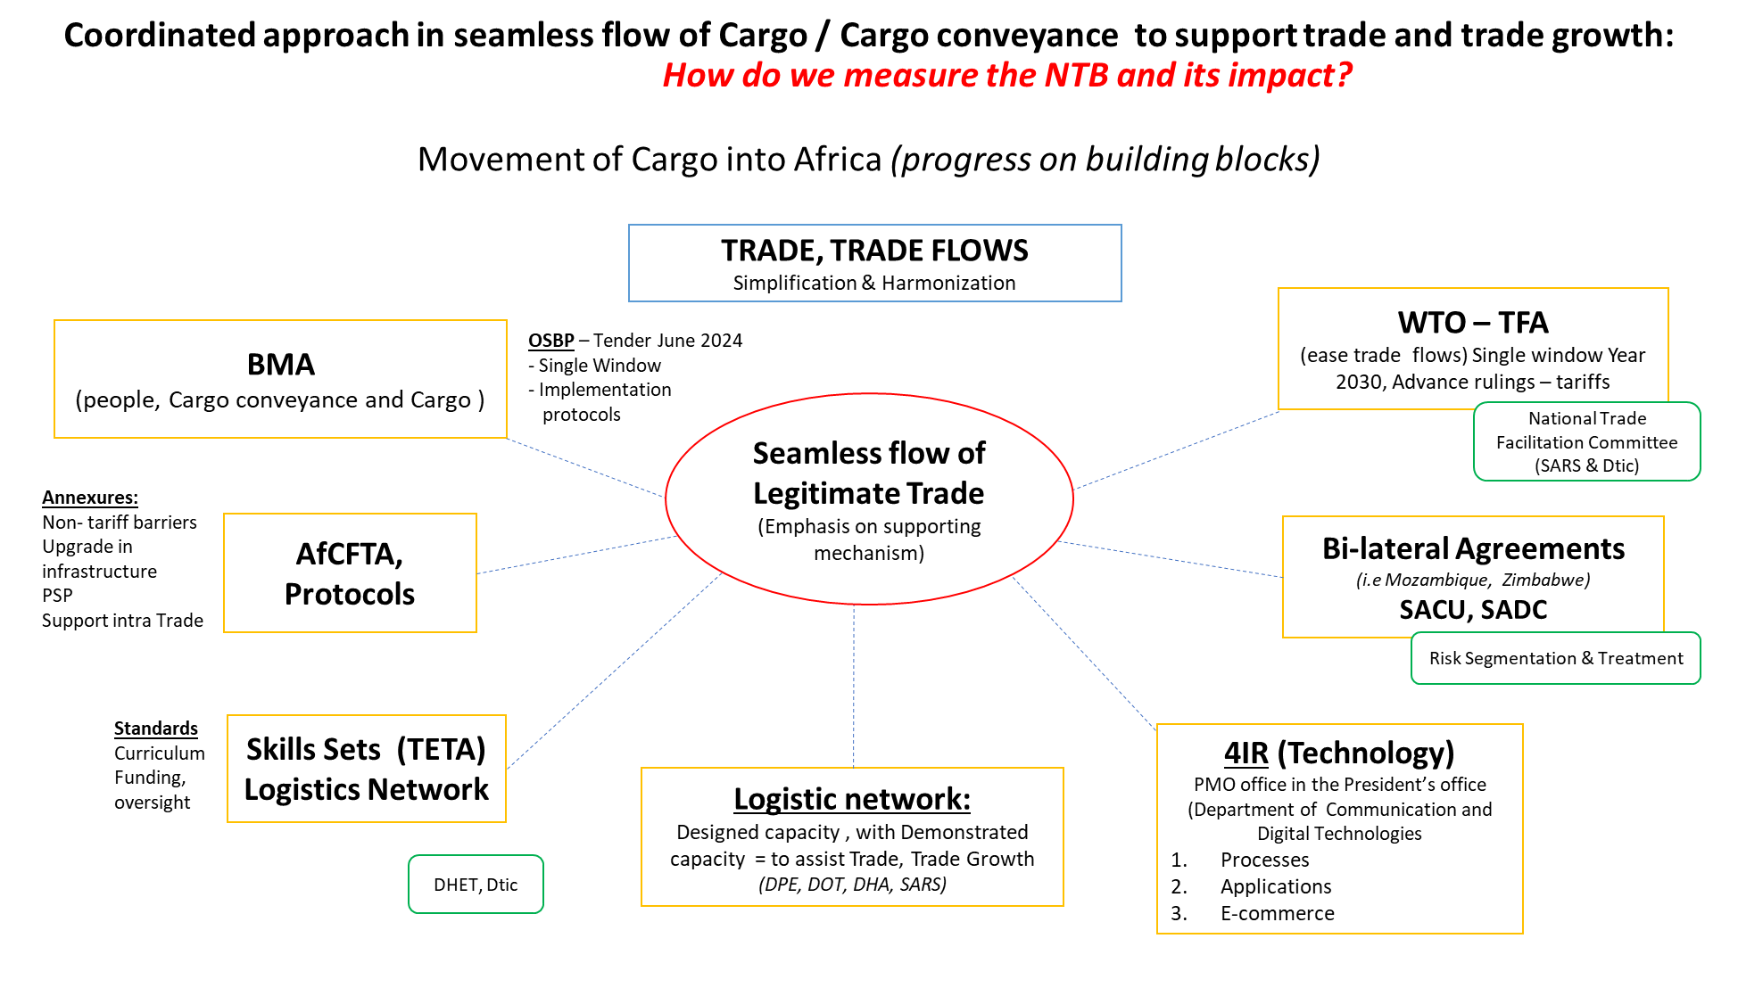
7

Slide 8
In November 2023…
Beitbridge
We exported R8.5bn through Beitbridge (R283m per day / R11.8m per hour)
This cargo took a median time of 23.4 hours to cross from South Africa to Zimbabwe. It should take 2 hours.
We should be exporting R141m of cargo per hour.
What takes a day to clear, can be moved through in 2 hours.
8

Slide 9
In November 2023…
Groblersbrug
We exported R4.3bn though Groblersbrug (R144m per day / R6m per hour)
This cargo took a median time of 19.1 hours to cross from South Africa to Botswana. It should take 2 hours.
We should be moving R54m per hour. What takes a day to clear, can be moved through in 3 hours.
9

Slide 10
TRADE MATTERS
WTO:
MC 13 Agenda and RSA Inc Focus?
Annual Policy Forums?
Workstreams – eCommerce etc?
AfCFTA:
GTI: Is Gap in Market any indicator of Market in Gap
What RSA Inc priorities – Trade Leadership?
AfCFTA vs TFTA
Priority/ies?
Modality of implementation
NEW TRADE?
East beyond India/China
Other?
SACU Quo Vadis: :
  Distribution Model?
  Regulatory Harmonisation?
AGOA
How to do better, if necessary?
Expanded BRICS
Need to realise trade benefits from membership
(e.g. 2.75% duties on wool make us un-competitive vis-a-cis Australia – compulsory standards for Wool needed for China)
Way forward on Summit commitments;
Dashboard? Workplan to resolve NTBs?
Institutional pathway to implements trade ambitions.
10

Slide 11
Tariff investigations should be completed in six months
Source: ITAC board reports

Slide 12
Most of South Africa's imports are sourced from countries we have no trade agreement with
July 2022 to June 2023
Source: South African Revenue Services, trade statistics

Slide 13
Need to address NTBs realise trade potential
Examples
Phytosanitary protocols under AGOA (Avos, red meat & Citrus):
Mandarins and navels to Japan;
India in-transit cold treatment protocol for citrus;
Time/temperature transit to Thailand;
Cherries to China (full protocol needed).
Dried Abalone Compulsory Specification VC 9108 for EU.
Potato exports to EU:
15% growth in industry by unlocking exports = 4 800ha / 20 000 new jobs.
Cherry exports to China (BRICS)
Chile supplies 88% of China’s demand (Starting mid-November);
SA only produce with a season of September – late October;
Significant market gap but SPS agreements required;
13

