Slide 1


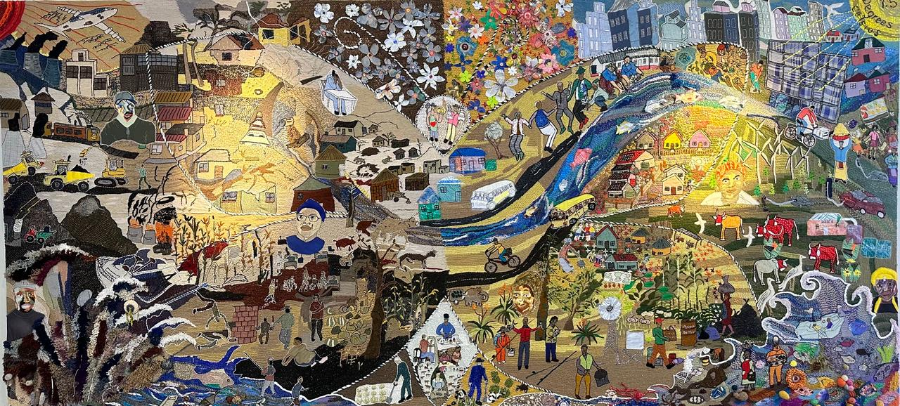


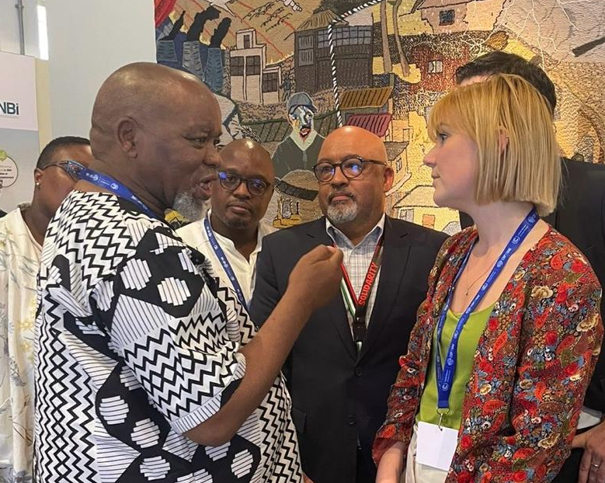
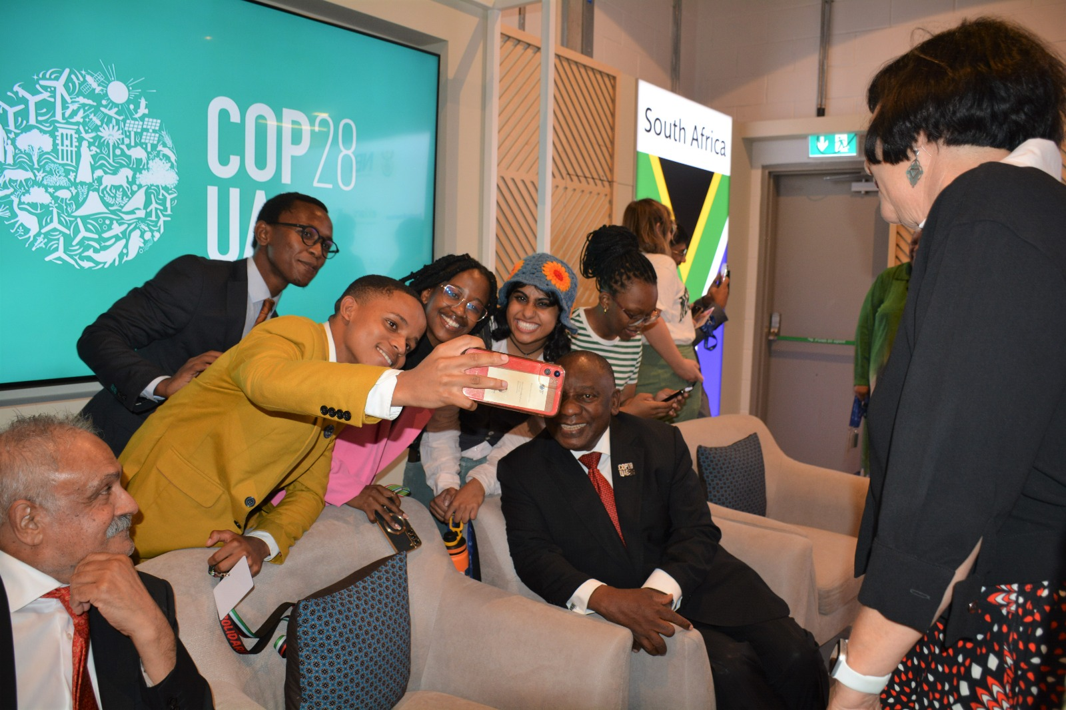

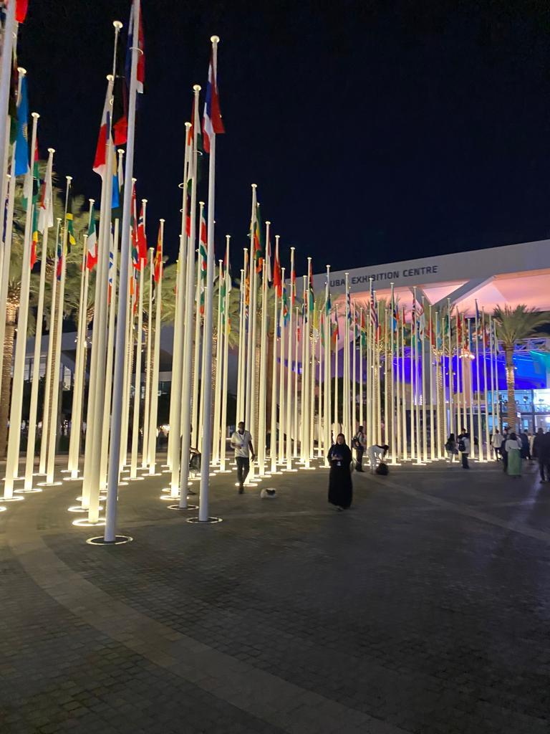
COP28 and the South Africa Pavilion

Slide 2
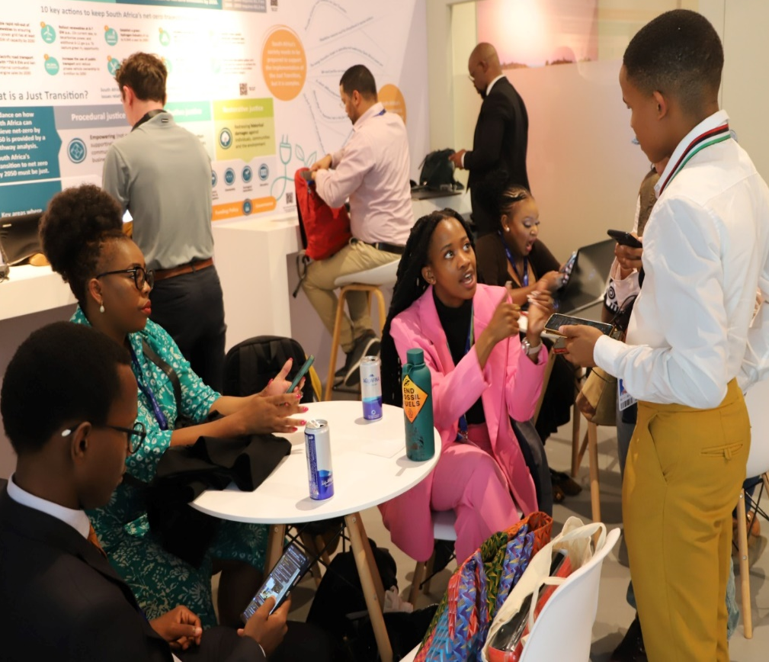

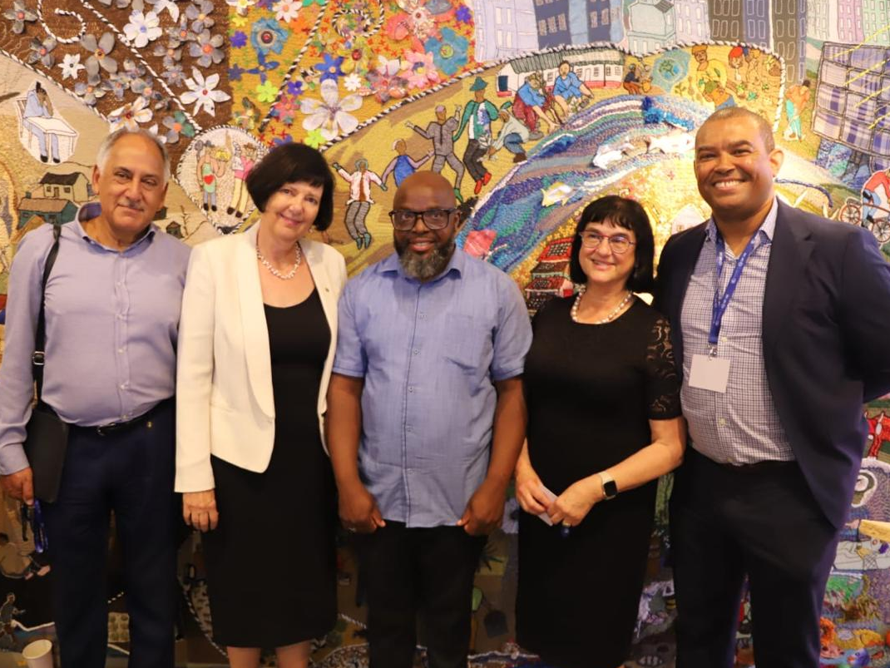

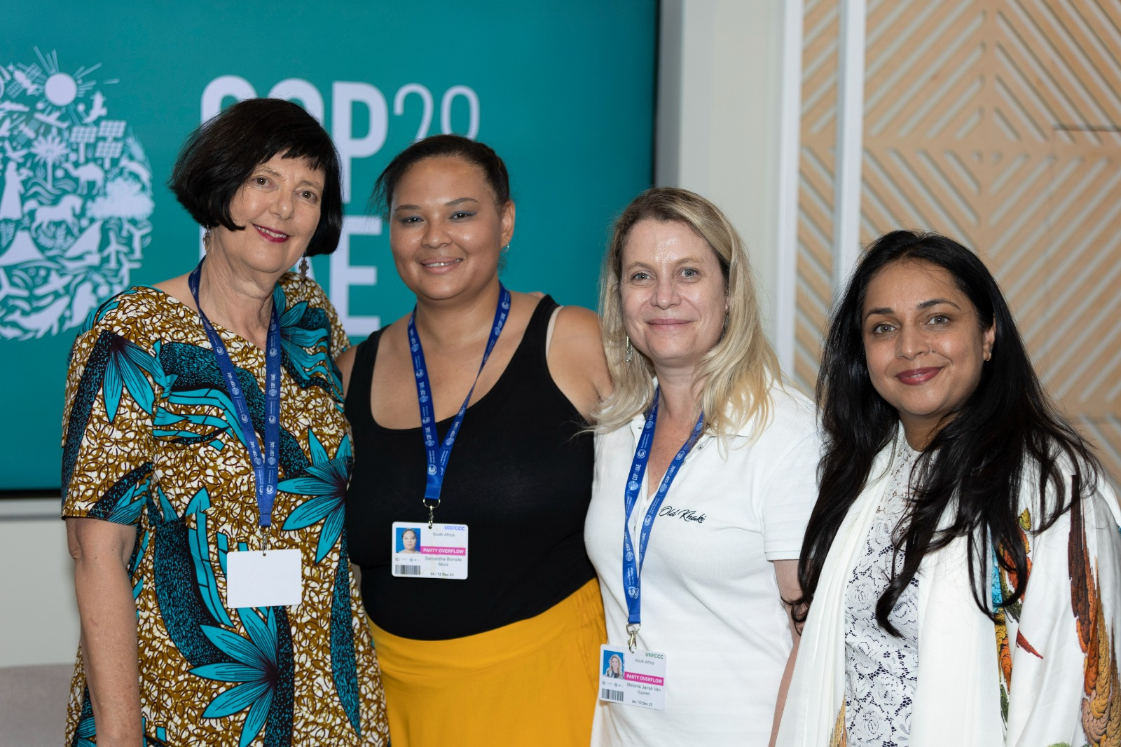

The COP28 South Africa pavilion was jointly hosted by business and government and follows several years of collaboration at COP
Text

Slide 3




















The South Africa COP28 pavilion was sponsored by the following organisations
Text

Slide 4


Slide 5
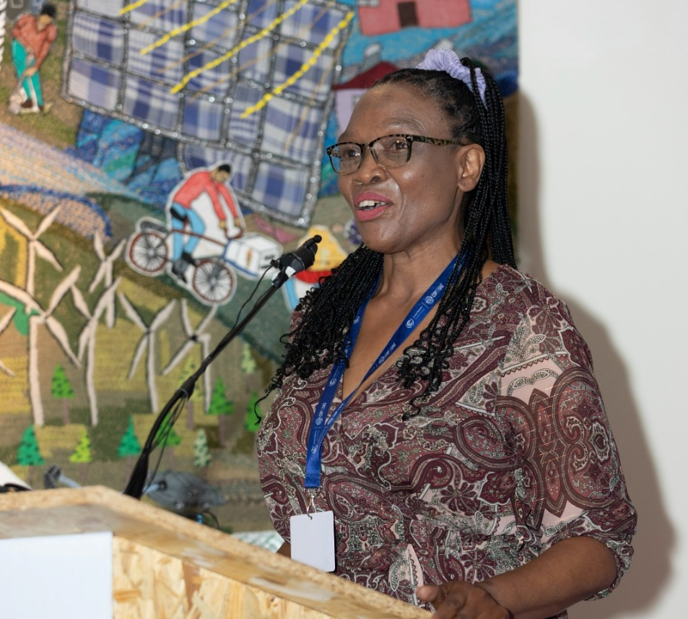
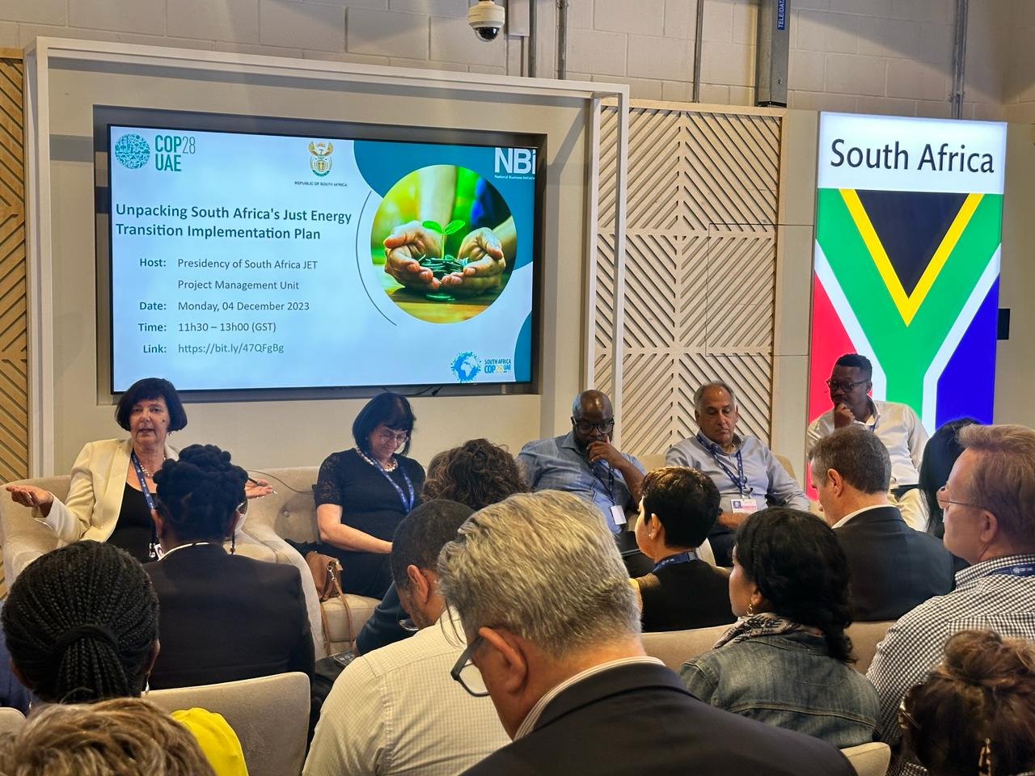
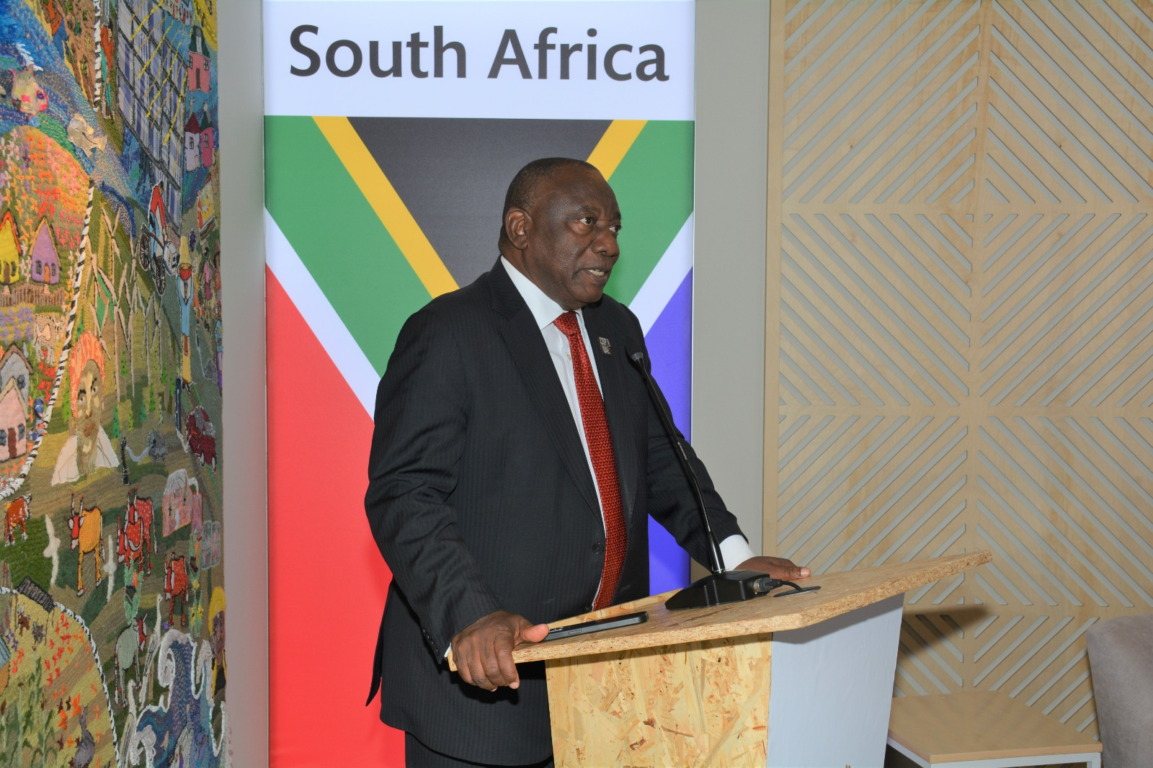
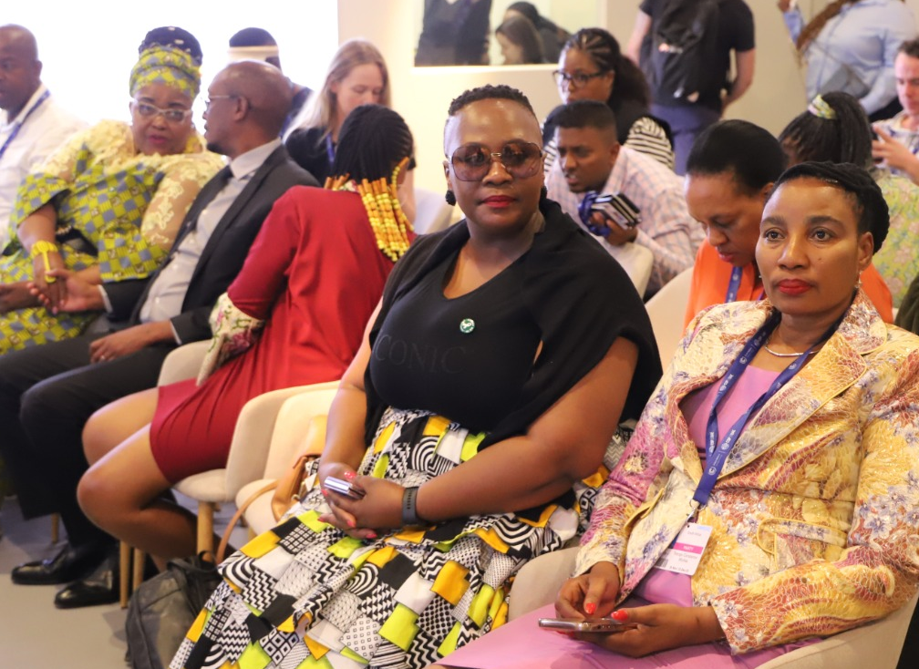
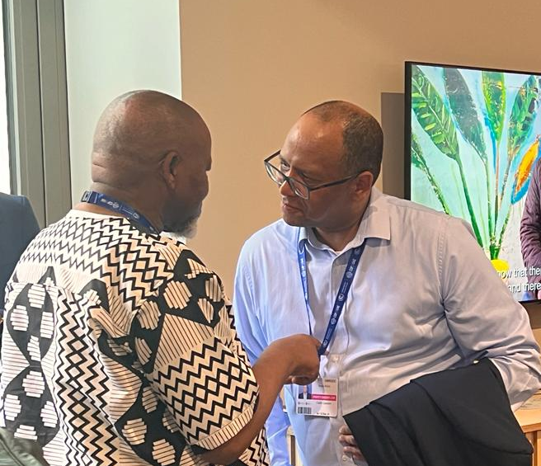
The South Africa COP28 pavilion story
The South Africa Pavilion was a space for business, civil society, government, communities and the international community to engage.
The Pavilion provided a platform place for South Africans to tell their stories, showcase action & opportunity, and demonstrate partnerships for implementation that align with these topics through their events hosted at the pavilion

Slide 6

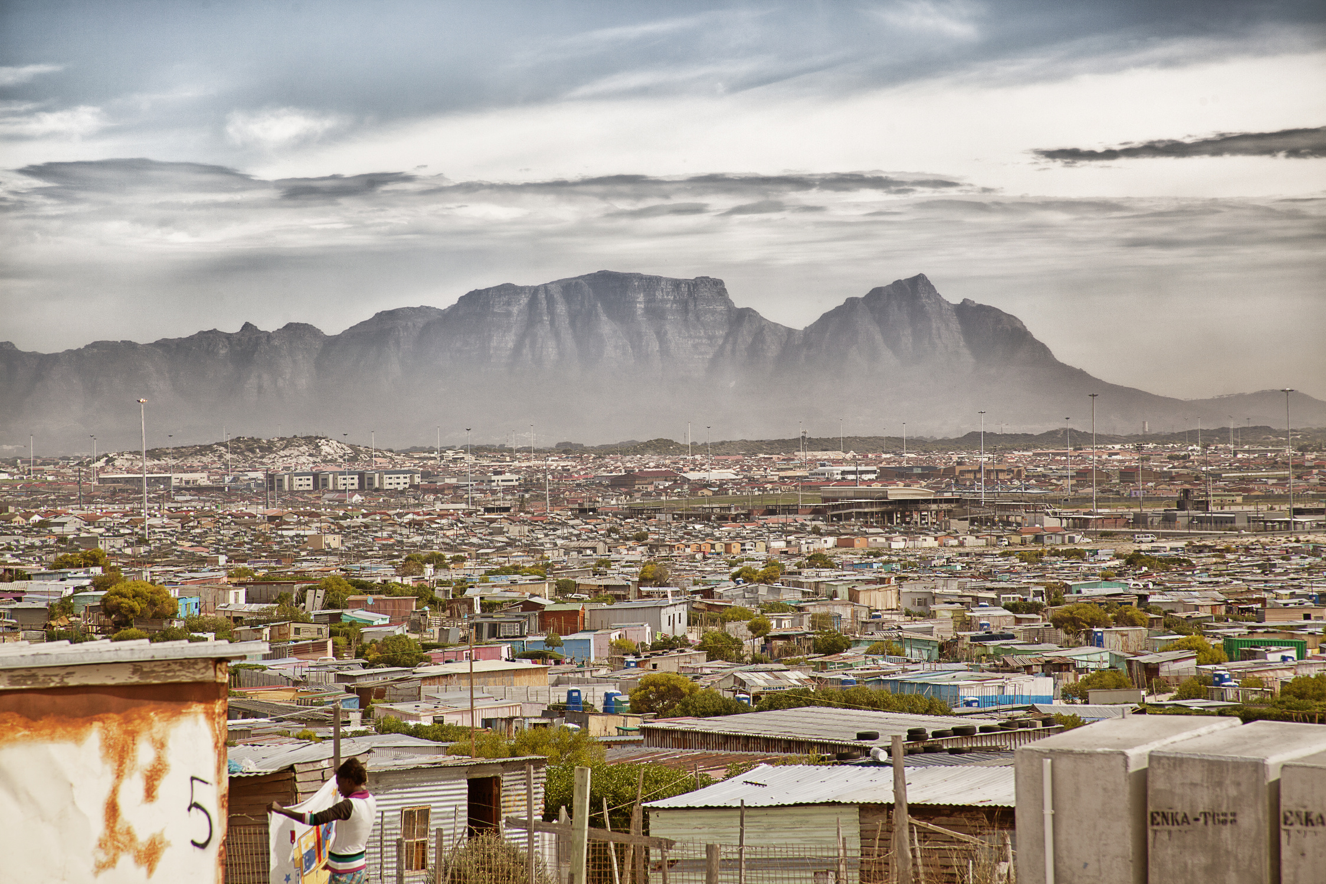

The SA Pavilion Key Messages focused on 7 areas, including the Just Transition
JUST TRANSITION: South Africa is implementing a Just Transition to a climate resilient, socially sustainable, and net zero future and is unlocking investment opportunity
ADAPTATION AND RESILIENCE: Implementation and finance needs to be fast tracked for South Africa to adapt to a warmer world as part of a Just Transition
LOSS AND DAMAGE: the impacts and costs associated with loss and damage need to be unpacked, well understood and integrated into our climate response
FINANCE: Access to Finance is required to unlock the green economy and support a transition that is just and equitable
BIODIVERSITY: protecting, managing and restoring biodiversity and ecosystem services is central to a robust climate response for both planet and people
WATER: Water and climate action must be accelerated, and has a big role to play in the Just Transition
PARTNERSHIPS: Implementing a Just Transition requires strong and credible partnerships between business and government

Slide 7
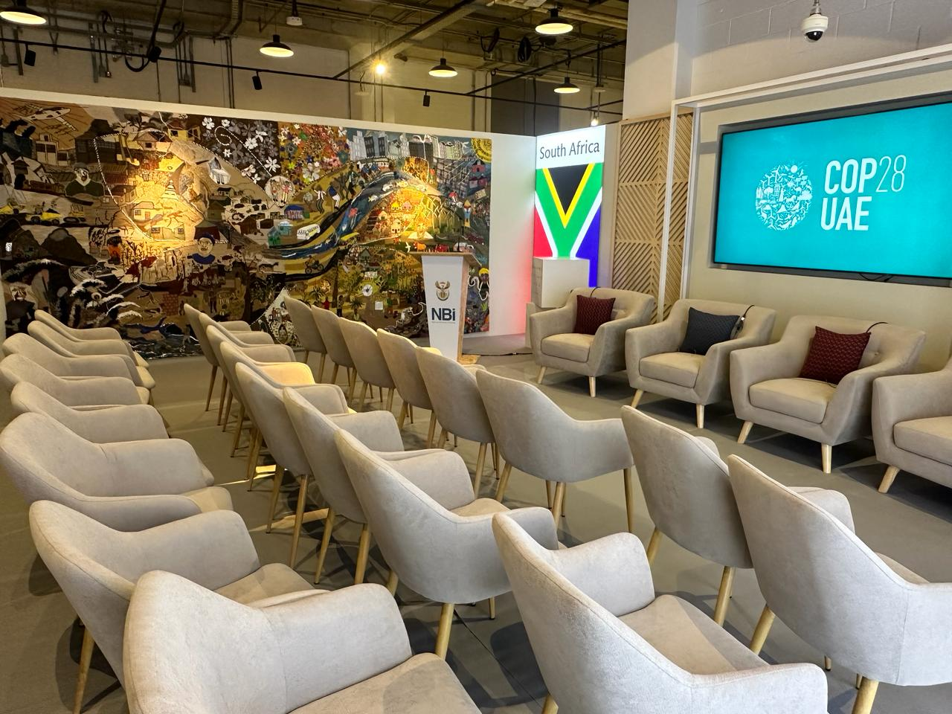
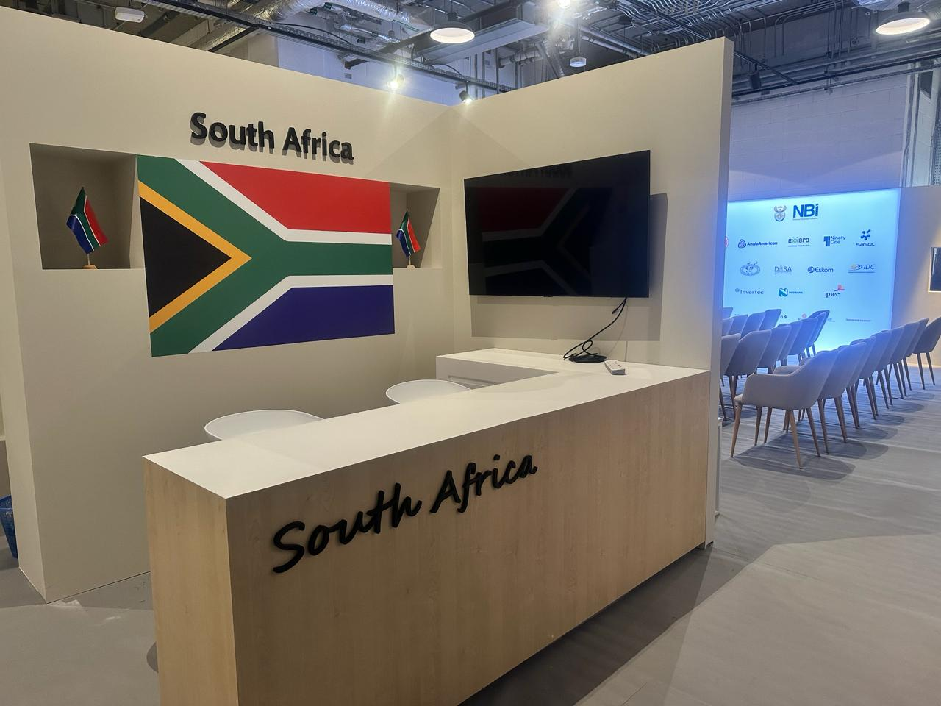
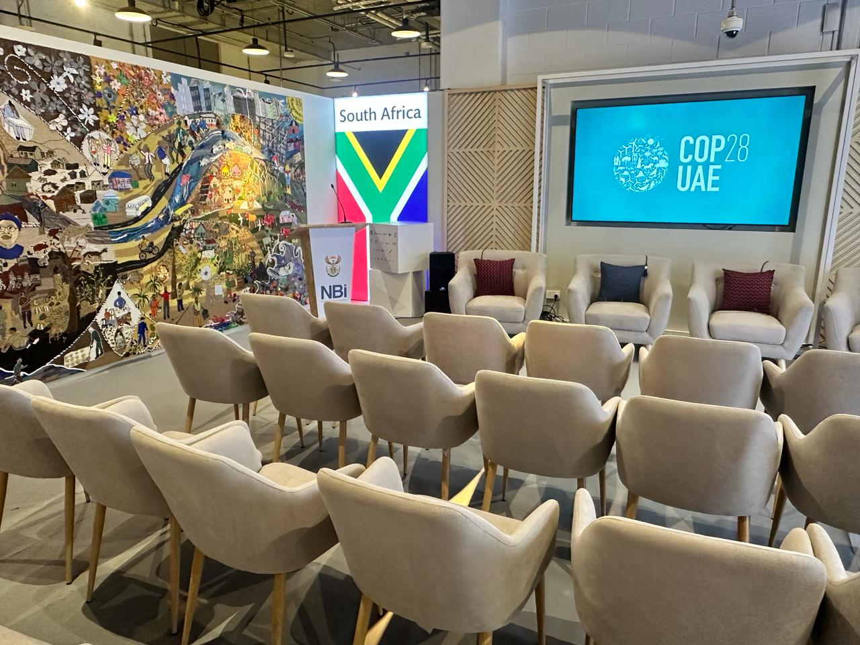
•The COP partnership between government and business been in place for the past 6 years, and business participation at COP has been growing
Of
59 events in just 10 days with a range of stakeholders including our collaborative business community of Pavilion sponsors, a variety of National and Local Government Departments, NGOs, Civil Society, Youth and Academia.
  11 social media length videos produced daily which summarised the events at the Pavilion, as well as a video of the President's visit and the SA Pavilion Launch event.

Slide 8

The South Africa COP28 Pavilion showcased local communities’ response to climate change
Text
Click here for more info: The Keiskamma Art Project
Click here for more info: Climate change advocacy artwork to spread the word | WWF South Africa

Slide 9
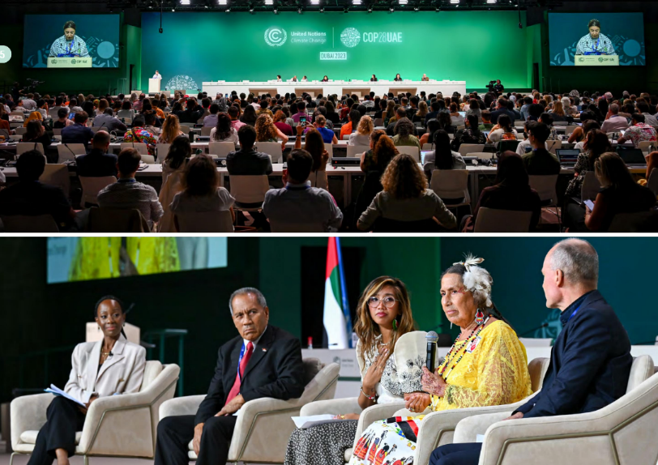
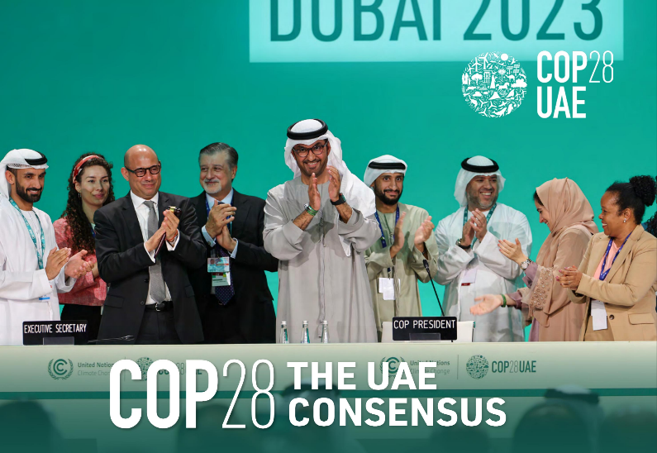
Key COP28 Outcomes:
The Global Stocktake
COP28 was the largest COP on record. COP28 brought together 97,000 delegates, including over 150 heads of state
01
The technical report of the first Global Stocktake (GST) noted that collectively the world is not on track to meet its commitments under the Paris Agreement.
02
For the first time there was collective agreement from nearly 200 countries to move away from fossil fuels, “…in a just, orderly, and equitable manner.” This is an important political signal about the significant transition that lies ahead, with explicit fossil fuel transition language never before included in a COP outcome
03
The GST calls for tripling the global capacity of renewable energy and doubling the annual rate of energy efficiency improvements before 2030 and phasing out inefficient subsidies for fossil fuels
04
Throughout South Africa’s facilitation of the GST, South Africa has emphasised that climate ambition must be balanced across mitigation, adaptation and means of implementation and that equity and common but differentiated responsibilities and respective capabilities should underpin all asks on developing countries
9
BUSINESS ACTION FOR SUSTAINABLE GROWTH

Slide 10

Key COP28 Outcomes:
Global Goal on Adaptation
South African Negotiation team played a key role in the landmark decision to adopt a Global Goal on Adaptation at COP28
01
The Global Goal on Adaptation includes different thematic areas for adaptation action and it has measurable targets that are time bound. It also recognises the importance of securing adequate public finance for adaptation from developed countries
02
At COP26 in 2021, the 2022-2023 Glasgow–Sharm el-Sheikh work programme on the Global Goal on Adaptation (GlaSS work programme) was launched by signatory parties to better conceptualise and understand what the GGA was and how it may be achieved.
03
The decision text of the GGA within the GlaSS work programme was finalized leading to the formation of global, time bound targets for adaptation and the adoption of a framework on the GGA called the UAE Framework on Global Climate Resilience. The targets are defined in themes and sectors (including water and biodiversity)
04
In addition to thematic targets, dimensional targets of the iterative adaptation cycle were also decided on, recognising the need for adaptation action and support by 2030. These targets specifically relate to impact, vulnerability and risk assessment; planning; implementation and monitoring, evaluation and learning.
10
BUSINESS ACTION FOR SUSTAINABLE GROWTH

Slide 11
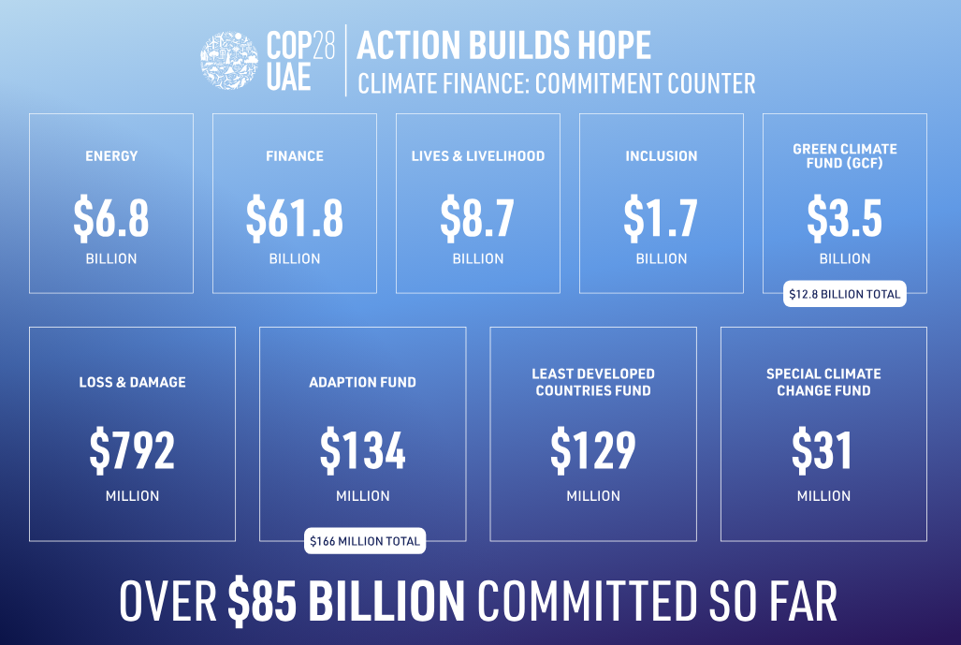
Key COP28 Outcomes: Finance
COP28 saw a significant number of funds pledged or established by a range of sources. In total $85 billion was pledged with the $57 billion marked reached in the first four days of COP28
01
The COP28 host government, the UAE launched Alterra – a $30 billion catalytic fund with an emphasis on unlocking climate finance in the Global South
02
World Bank will increase finance for climate- related projects by $ 9 billion annually. An additional $3.5 billion was pledged to the Green Climate Fund
03
Funds for Loss and Damage was established at COP28 – with pledges amounting to $ 700 million so far – however, this falls short of what is needed by developing countries.
  Contributions to the fund are voluntary - there is no obligation for countries to fund it.
  The World Bank will act as a trustee of the fund for the first four years.
  The fund will be governed and supervised by a Board that will have full responsibility for funding decisions
11
BUSINESS ACTION FOR SUSTAINABLE GROWTH

Slide 12






Thank you
BUSINESS ACTION FOR SUSTAINABLE GROWTH
Notes:
25

