Slide 1


South Africa's Climate Policy Framework in the context of achieving its Nationally Determined Contribution (NDC) commitments
2 March 2023
DEPARTMENT OF FORESTRY, FISHERIES & THE ENVIRONMENT
Chief Directorate: Climate Change Mitigation & Specialist Monitoring Services

Slide 2
PRESENTATION OUTLINE
Background/national context
South Africa’s GHG emission profile
South Africa’s progress and commitment to the Paris agreement
Low Emission Development Strategy 2050
South Africa’s mitigation system
  Sectoral Emissions Targets (SETs)
  Carbon Budget (CBs)
Where are we?

Slide 3
South Africa National context to respond to climate change
South Africa is a developing country and aims to develop its economy in order to deal with its triple challenges (i.e., poverty, unemployment, and inequality).
Climate Change (CC) poses considerable risks and is a critical constraint to inclusive and sustainable economic growth for South Africa. South Africa’s climate is known to have a high degree of variability at all timescales and is highly susceptible to climate risks.
The current economy in South Africa is dominated by large-scale, energy-intensive mining and minerals beneficiation industries as well as a heavy reliance on fossil fuels for electricity generation along with significant levels of liquid-fuel consumption. As such, the energy and mining (Energy) and industrial processes and product use (IPPU) sectors are primary contributors to the South African economy, GDP growth and jobs.
An estimated 93% of South Africa’s electricity produced within the energy sector, currently comes from coal combustion that contributes to greenhouse gas (GHG) emissions. This over-reliance on coal presents significant transition and climate risks.

Slide 4
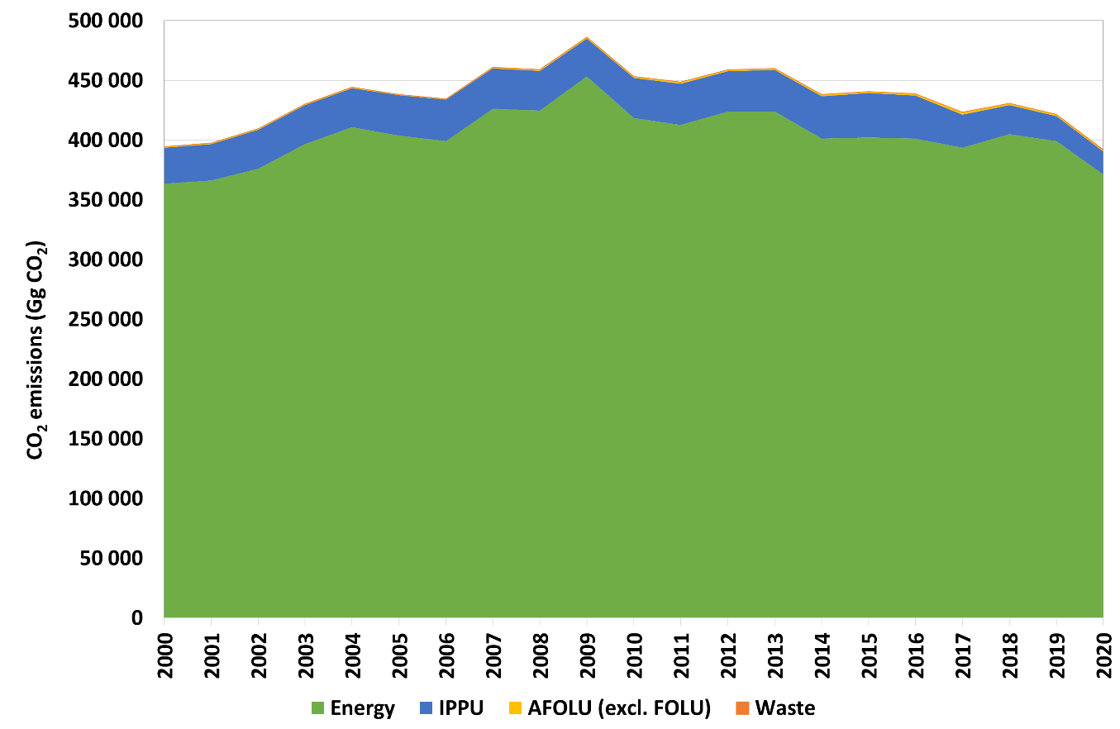
Energy sector emissions in South Africa
GHG Inventory 2000 – 2020
The energy sector is critical to South African economy because it accounts for a total of 15% in the Gross Domestic Product (GDP).
The energy sector is heavily dependent on coal as the primary energy source and the largest emission source.
Although the energy sector has the largest share of GHG emissions it does represent opportunities to mitigate climate change.
GHG emissions levels for 2020
The sector features an increase of 0.8%
The Energy Sector was the largest contributor with a contribution of 81.0% in 2020.
A decrease of 5.9% in overall emissions was observed between 2017 and 2020 due to decreases in the Energy and IPPU sectors.

Slide 5
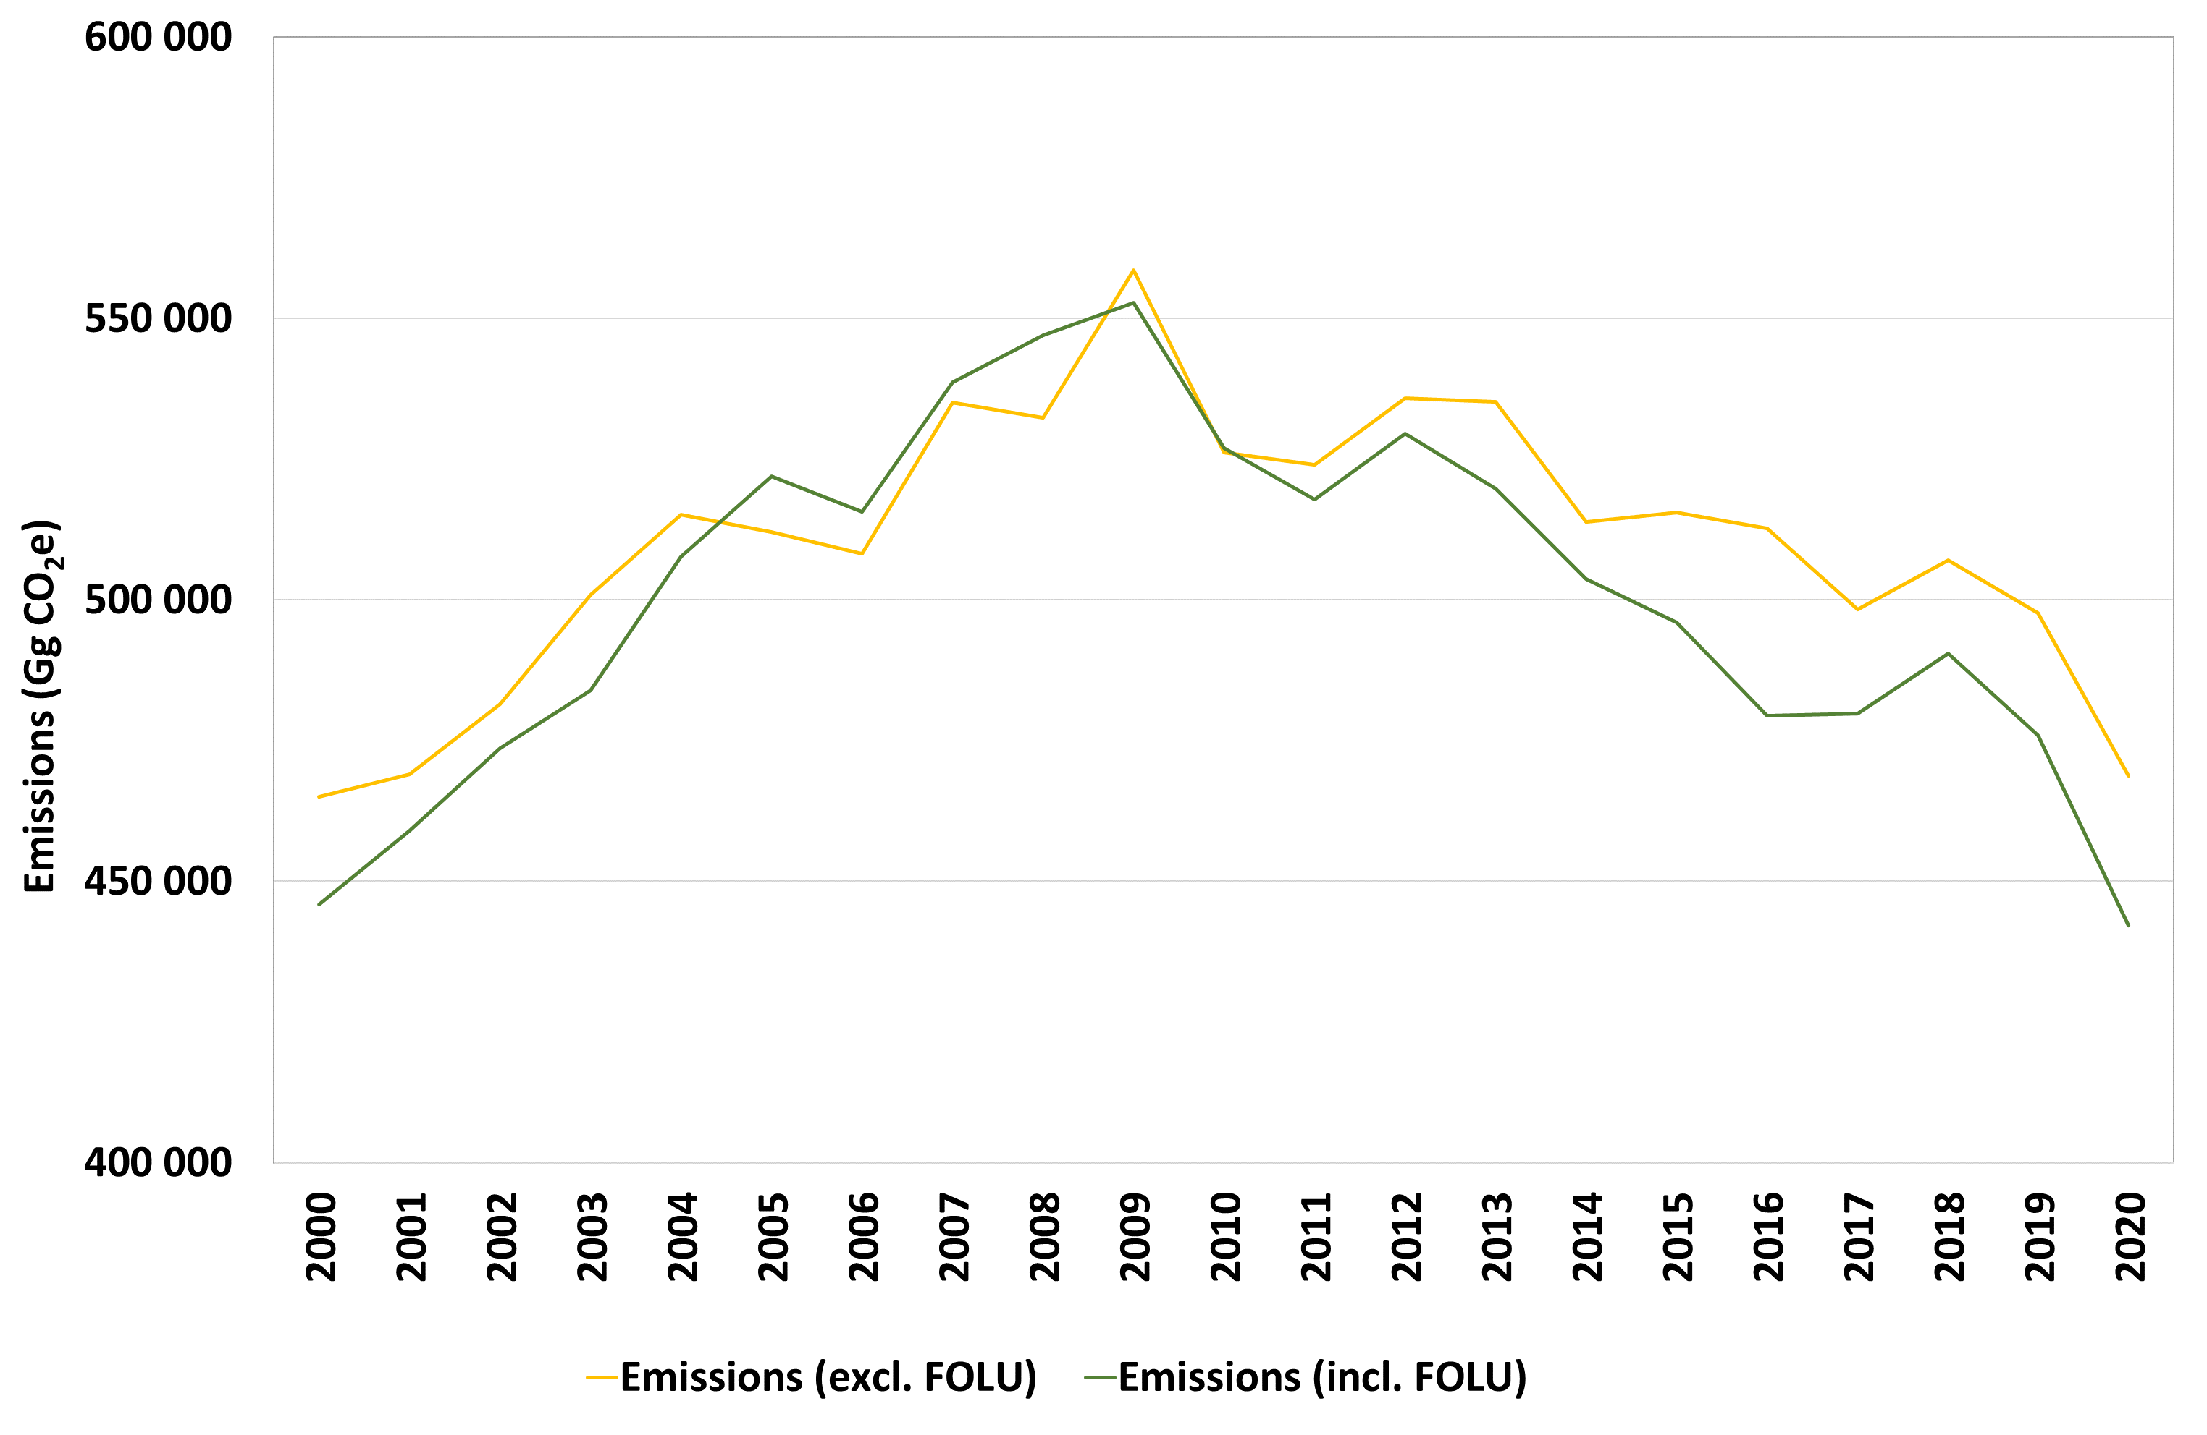
Energy sector emissions in South Africa
GHG Inventory 2000 – 2020
Decreased by 0.8% by 2020
Due to the increase in land sinks since 2011
7.8 % decrease in overall emissions observed between 2017 and 2020.
The decrease was attributed to the decline in IPPU and AFOLU

Slide 6
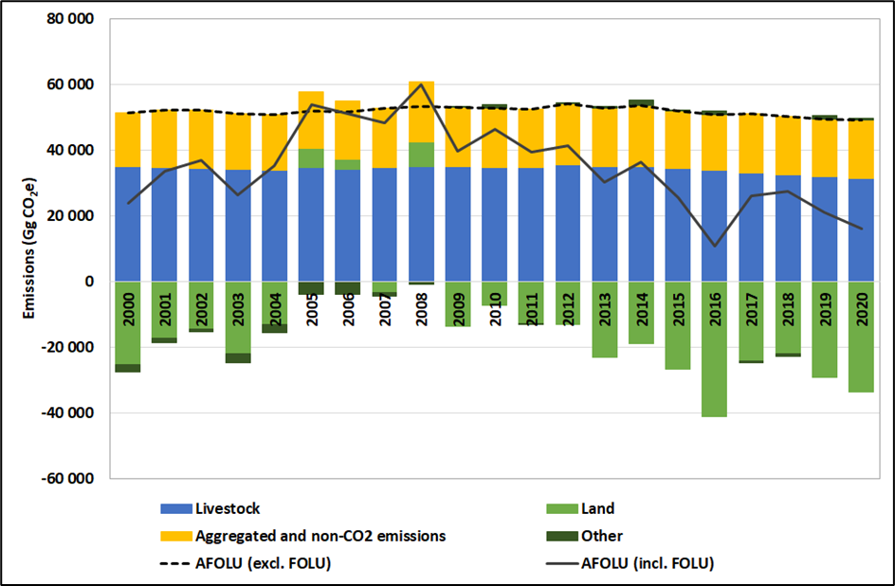
3. Sectoral Trends - AFOLU
GHG Inventory 2020
  Contributed 8.5% to total emissions (excl. FOLU)
  3.2% contribution (incl. FOLU)
2000 – 2020
  Decline by 3.9% (excl. FOLU) and 39.7%
  (incl. FOLU).
  Livestock contributes 77% to AFOLU (excl. FOLU)
  Decrease in Livestock emissions:
  decreasing population
  Land component was an overall sink
  There were fluctuations in the land
  sink with an overall increase
2017 – 2020
  Decline in emission due to decrease in Livestock and Aggregated and non-CO₂ emissions on land.
  AFOLU (incl. FOLU) decreased 41.1% due to the increase in Land sink

Slide 7
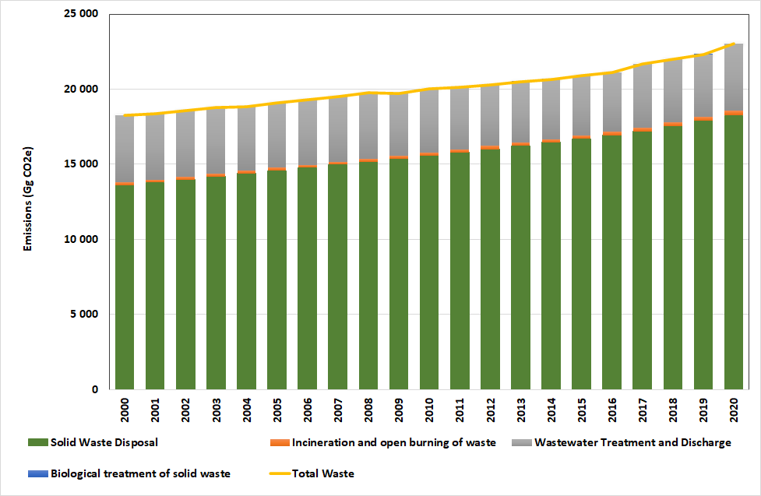
3. Sectoral Trends - Waste
2020
  3.9% contribution to total emissions
  Largest contributor was Solid Waste Disposal (79.2%) followed by Wastewater Treatment & Discharge (19.3%)
2000 – 2020
  Total waste sector emissions increased by 26.3%.
  Solid Waste Disposal Increased by 34.1%
2017 – 2020
  Total waste sector emissions increased by 6.2%
  Due to an increases in Solid Waste Disposal (6.2%) and Open Burning of Waste (33.6%)

Slide 8
SA’S PROGRESS AND COMMITMENT TO THE PARIS AGREEMENT
In order to remain committed to the Paris Agreement we need to:
Update and communicate to the UNFCCC before COP 26 in 2021 the updated Nationally Determined Contribution-done
Implement the domestic Mitigation System- ongoing
Table the Climate Change Bill to Parliament – in progress
Communicate to the UNFCCC by 2020 the mid-century long-term Low greenhouse gas Emission Strategy (LEDS)-done
Implement the National Adaptation Strategy (NAS)-in progress
Set up a Presidential Climate Commission (PCC) to advise Government on broader climate response - done.

Slide 9

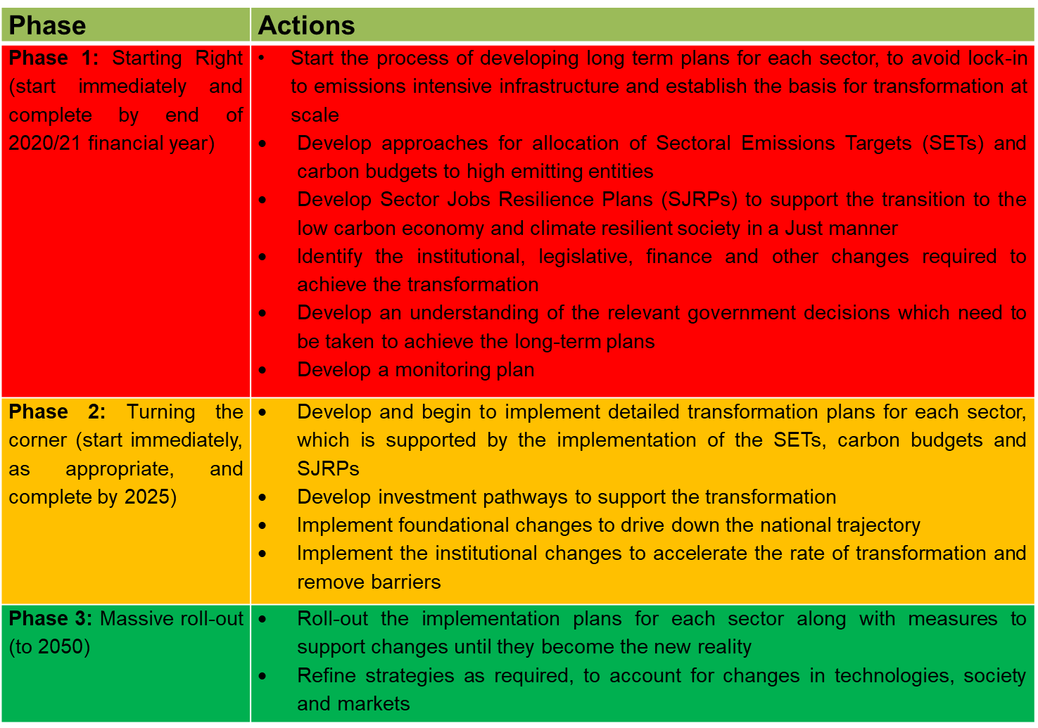
South African Low Emission Development Strategy has a vital role to play in the implementation of the SETs and Carbon Budgets

Slide 10
ELEMENTS OF THE CLIMATE MITIGATION SYSTEM?
Mitigation Goal
National GHG Emissions Trajectory Range, against which outcome of all mitigation actions will be measured
Sectoral Targets
Defining Desired Emission Reduction Outcomes (DEROs), now Sectoral Emissions Targets (SETs), for each significant sector or sub-sector of the economy
Industry implementation
Mitigation plans to demonstrate how mitigation by companies is to be achieved
Sector polies to drive mitigation
Policies and Measures (PAMS), economic measures to drive mitigation (e.g. IRP 2019 – REIPPP)
Monitoring of GHG emissions
Data collection, GHG inventory and M&E system
Industry emissions limits
Adopting a carbon budget approach to provide for flexibility and least cost mitigation in sectors and/or sub-sectors

Slide 11
Sectors considered for SETs
SETs focus | Policy Sector | Lead Department/Entity
Non-Environmental Sector | Energy | Department of Mineral Resources and Energy
 | Transport | Department of Transport Department of Mineral Resources and Energy
 | Human Settlements, including buildings | Department of Public Works Department of Mineral Resources and Energy Department of Water and Sanitation
 | Industry | Department of Trade, Industry and Commerce Department of Mineral Resources and Energy Department of Forestry, Fisheries and Environment
 | Land | Department of Forestry, Fisheries and Environment SANPARKs
 | Agriculture | Department of Agriculture, Land Reform and Rural Development
Environmental Sectors | Environment | Department of Forestry, Fisheries and Environment: Biodiversity, Environmental Programmes, Chemicals and Waste, Forestry, Integrated Environmental Management

Slide 12
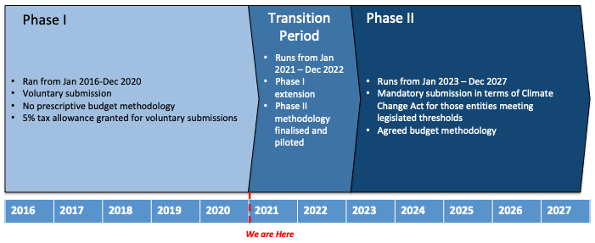
TIMELINE (CARBON BUDGETS)
The end date for Phase I voluntary carbon budget submissions was 31 December 2020
A Transition Period has been agreed and gazetted (22 October 2020), running from Jan 2021-Dec 2025
There are two primary objectives for this 2 year period:
  Phase I extension: Voluntary budgets will continue to be accepted during the Transition Period (5% carbon budget allowance applicable).
  Phase II carbon budget methodology: A budget allocation methodology will be decided through a extensive process of engagement. This will be piloted and the outcomes will inform the mandatory phase.

Slide 13
CLIMATE MITIGATION SYSTEM:
Where are we now?
Progress on Sectoral Emission Targets (emission targets for policy sectors):
  SETs allocation framework approved by cabinet in 2021;
  SETs for the environmental sector (DFFE is the policy custodian) are too be finalized for implementation in the 2023/24 financial year;
  Draft SETs for other sectors (e.g. transport, Energy, Agriculture, Human Settlements, Water and Sanitation, Industry) have been quantified. Engagements with Sectors to start in February 2023 for finalization in March 2024.
Progress on Carbon Budgets (emission limits to industry):
  Carbon Budget allocation framework approved by cabinet in 2021
  Carbon budget allocation for the mandatory period (2023-2027) underway and shall be concluded in June 2024
Industry Implementation (industry mitigation plans):
  Industry mitigation plans support the implementation of Carbon Budgets
  Allocation of mitigation plans to industry for the period 2021-2025 concluded in 2020
  Progress reports on implementation submitted annually from 2021 onwards

Slide 14
CLIMATE MITIGATION SYSTEM:
Where are we now?
Progress on Monitoring of Greenhouse Gas (GHG) emissions:
  Mandatory GHG reporting programme has been in operation since 2017;
  A web-based platform called SAGERS (South African Greenhouse Gas Emissions Reporting System) has been in operation since 2020;
  DFFE uses the SAGERS system to support the South African Revenue Service for the Carbon Tax verification process.
Mitigation Goal (SA’s fair share contribution to the global efforts to reduce GHG emissions):
  South Africa submitted to the United Nations its updated NDC (Nationally Determined mitigation Contribution) in September 2021
  The updated NDC requires South Africa’s total net emissions to be within 398-510 million tonnes of CO2 equivalent by 2025 and 350-420 million tonnes of CO2 equivalent by 2030.
  The latest GHG Inventory covering the period 2000-2020 shows that the net emissions in 2020 were at a figure of 442 million tonnes, which is not far off from the 2030 upper target of 420 million tonnes.

Slide 15

THANK YOU!
Mr. Samuel Mabena
Chief Directorate, Climate Change Mitigation & Specialist Monitoring Services
Department of Environment, Forestry and Fisheries
Tel: 012 399 8650 | Mobile: 078 0791 7081
Website: http://www.environment.gov.za
Address: The Environment House, 473 Steve Biko Road, Arcadia, Pretoria, 0083

