Slide 1
Workshop:
Carbon Budgets and Mitigation Plans Regulations
17 October 2023

Slide 2
CONTENTS
Initial Thoughts on the CB / MP Regulations
Relevant regulations
Methodology and basis for allocation
Monitoring, reporting and verification
Special circumstances
Possible annexures / templates
Mitigation Plan considerations

Slide 3
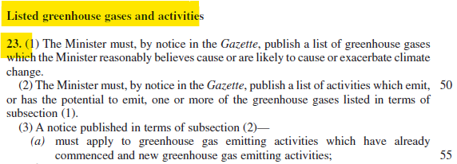
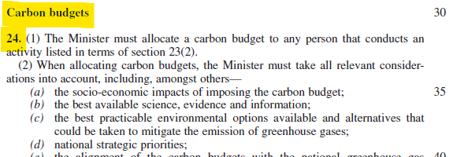
Climate Change Bill
Sections of the Act relevant to Carbon Budgets
Section 23 – Listed Activities and Thresholds
Section 24 – Carbon Budget Allocation

Slide 4
Integrated Regulations
Relevant regulations will be integrated and exist under the Climate Change Act
National Greenhouse Gas Emissions Reporting Regulations to be transferred from the Air Quality Act to the Climate Change Act (CCA)
Carbon Budgets and Mitigation Plans Regulations will exist under the CCA
Pollution Prevention Plan Regulations will be repealed, and the new regulations will take precedent

Slide 5
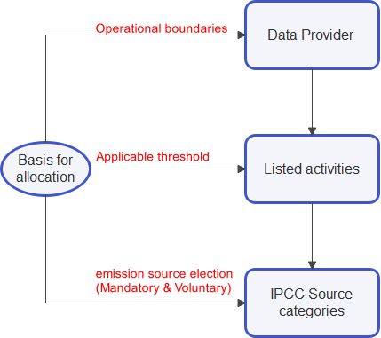
Basis for Allocation
Definition of a Data Provider, Listed Activities and Thresholds
“‘data provider’ means any natural or juristic person conducting any activity listed in Annexure 1* to the NGERs, including —
its holding company or corporation or legal entity, registered in South Africa in accordance with the legislation of the Republic of South Africa;
all its subsidiaries and legally held operations, including joint ventures and partnerships where it has a controlling interest, or is nominated as the responsible entity for the purpose of reporting under the Regulations; and
all facilities generally over which it has operational control, which are not part of another data provider as provided for in the Regulations
*Annexure 1 – list of all activities, as defined in the ‘2006 IPCC Guidelines for National Greenhouse Gas Inventories’ source categories

Slide 6
Basis for Allocation
Definition of a Data Provider, Listed Activities and Thresholds
List of Activities
Electricity production
Crude oil production and/or refining
Natural gas production and/or refining
Polymers production
Petroleum refining
CTL/GTL
Iron and steel production
Ferro alloys production
Aluminium production
Lead production
Zinc production
Chemicals production
Pulp and Paper production
Hydrogen Production
Charcoal and biochar production
Cement production
Lime production
Glass production
Ceramics production
Brick production
Coal mining and handling
Non-coal mining and processing
Domestic aviation
Water-borne navigation
Food and beverage production (FMCG)

Slide 7
Basis for Allocation
Definition of a Data Provider, Listed Activities and Thresholds
“‘thresholds’ as per the Climate Change Bill: [a notice] must determine quantitative greenhouse gas emission thresholds expressed in carbon dioxide equivalent to identify persons to be assigned a carbon budget
The threshold will be informed by data reported to the DFFE and guided by the principle of inclusivity
Threshold may be set in the following way
  Blanket threshold across all activities
  Listed activity specific thresholds
Threshold and list of activities will be reviewed/revised at the beginning of each commitment period

Slide 8
Basis for Allocation
Gases under Consideration
Carbon dioxide (CO2);
Methane (CH4);
Nitrous oxide (N2O);
Hydrofluorocarbons (HFCs);
Perfluorocarbons (PFCs);
Sulphur hexafluoride (SF6).
Nitrogen Trifluoride (NF3)
IPCC source Categories
As per Annexure 1 of the NGERs list of all activities, as defined in the ‘2006 IPCC Guidelines for National Greenhouse Gas Inventories’

Slide 9
(What) GHG Emission sources to include in carbon budgets allocation
IPCC SOURCE DESCRIPTION | COVERAGE | IMPLICATIONS FOR THE CARBON BUDGET: COMMITMENT PERIOD 1 | APPLICABILITY RULE FOR COMMITMENT PERIOD 2 AND COMMITMENT PERIOD 3
Stationary Combustion | Mandatory | Emission source forms part of Carbon Budget accounting | Accounting of this emission source forms part of Carbon Budget accounting
Civil aviation
Domestic navigation
Fugitive Emissions
Industrial Processes and Product Use
Road Transportation | Voluntary | Once elected, emission source forms part of accounting for Carbon Budgets | If included in Commitment Period 1, emission source remains part of accounting for Carbon Budgets in Commitment Period 2 and Commitment Period 3
Agriculture
Forestry and Land Use
Waste
Scope 2 sources | Voluntary | If elected, emission source will not form part of Carbon Budget accounting Emission savings from scope 2/3 related activities are reported as memo items | If elected, emission source will not form part of Carbon Budget accounting. Emission savings from scope 2/3 related activities are reported as memo items
Scope 3 sources

Slide 10
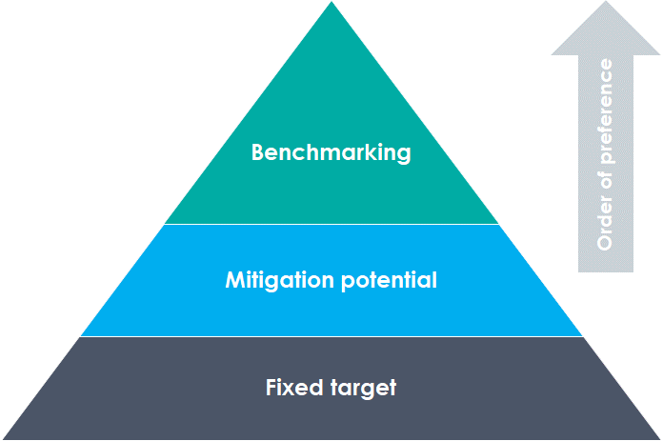
Methodologies for Allocation
Benchmarking
DFFE has placed Product-level Benchmarking at the top of the methodological hierarchy based on an assessment of both what is possible in the South African context and an assessment of global best practice.
Where Product-level Benchmarking is not reasonable feasible, fallback approaches include Mitigation Potential Analysis or a Fixed Target.

Slide 11
Methodologies for Allocation
Intensities and Production Forecasts
Budgets will be allocated using the product intensity calculated via the benchmarking approach, combined with production forecasts obtained from data providers.
This will result in an “indicative assigned amount” allocation.
Intensity x Production Forecast = Indicative Assigned Amount
(tCO2e / product) (product / period) (tCO2e / period)
This “Indicative Assigned Amount will be calibrated throughout the commitment period when actual production data becomes available. The DFFE in this way will focus on the regulating of intensities, rather than production.

Slide 12
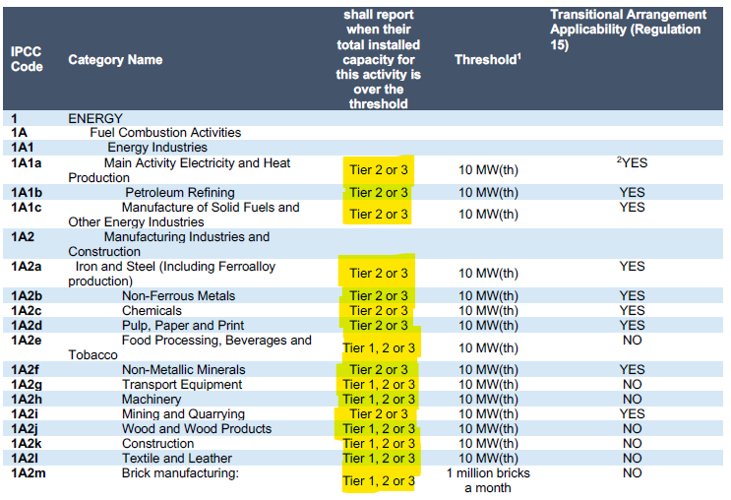
Methodologies for Allocation
Reporting Tier
In terms of reporting Tier, data providers must align with Regulation 15 (Transitional Arrangement Applicability) of the NGERs

Slide 13
Commitment Period
Assessing Compliance
Budget will be allocated as part of the existing system, i.e. allocation phase is likely to be 2023 to 2027 (we might have to consider NDC timelines).
Commitment period might also be aligned with the NDC timelines
Enforcement and assessment of compliance will however be pending the relevant bill and regulations passed into law – tentatively 2025 to 2026

Slide 14
Monitoring, Reporting and Verification
Monitoring
There will be a requirement to have a monitoring plan in place – details on the plan will be captured in an amendment to the existing Verification and Validation Guidelines
Reporting
Reporting will be done via the electronic reporting system, but a manual fallback option will be available with templates provided in a relevant annexure to the Carbon Budget/mitigation plan technical guideline.
Verification
Verification will be required at three points during the commitment period – before, during (at least once) and after.
Current Validation and Verification Guidelines shall be used for carbon budget/ mitigation plan verifications (with some minor amendments)

Slide 15
Special Circumstances
New Entrants and Expansions
Once initial budget allocation process has been conducted for a given commitment period, DFFE will assess the remaining carbon space with reference to our Nationally Determined Contribution
This carbon space will be reserved to accommodate new entrants or significant expansions
Carbon space reservation may be blanket or allocated as sector specific carbon space
Reporting on Loadshedding & other factors affecting performance against allocated carbon budget/mitigation plan.
The effect of loadshedding and other factors that are beyond the control of the data provider on emissions intensity can be motivated for by data providers provided relevant data is available and can be reported, validated and verified.

Slide 16
Possible Templates / Annexures
Template / Annexure | Description
Minimum requirements for determining a Carbon Budget/mitigation plan | Data collection form for data providers to generate budget & mitigation allocation
Annual Progress Report | Annual report by data providers detailing progress against carbon budget and mitigation plan
Annual Assessment Report | Annual report issued by the DFFE assessing data providers performance against carbon budget and mitigation plan
Allocation Decision Report | Report issued by DFFE to data providers confirming carbon budget and mitigation plan allocation
End Of Commitment Period Assessment Report | Report issued by the DFFE assessing data providers performance for entire commitment period
Verification Report | Third party assessment verifying data providers’ performance against allocated carbon budget and mitigation plan

Slide 17
Mitigation Plan Considerations
As per Section 24 (4)(b) of the Climate Change Bill: A greenhouse gas mitigation plan must—
describe the mitigation measures that the person, to whom a carbon budget is allocated, proposes to implement in order to remain within the person’s allocated carbon budget; and
comply with the content requirements of such plans as may be prescribed by the Minister in terms of section 27, including requirements pertaining to processes, procedures and reporting.
As per Section 24 (6): A person to whom a carbon budget has been allocated must—
implement the approved greenhouse gas mitigation plan;
monitor annual implementation of the greenhouse gas mitigation plan in accordance with the prescribed methodology;

Slide 18
Mitigation Plan Considerations
Mitigation Plan may contain
Mitigation measures (projects) with description
Anticipated implementation period
Assumptions used to estimate anticipated GHG emission reduction
Gases to be abated
Anticipated emission reduction per year and over the 5-year period

Slide 19
Regulatory instruments to enforce CB/mitigation plan processes
Regulatory instrument
CB/MP Regs + Annexures
CB/MP tech guide
Verification guide
Minister's Notice
Carbon tax
Web-based platform
Reporting guide
NGERs
Processes
Listted activities +threshold
x
x (cater for amendments as per Minister's notice)
x
x (with flexibility)
Methodology for CB/MP determiantion
x (including graduation as per the CB methodoly hierachy + new entrance
x
x (chages to sectoral application of the methodology hierachy)
x (reporting based on method used
Scope (Who, GHGs, boundaries,IPCC categories, Scope 2 &3)
x (should form part of theregistration infomation)
x (with illustrations + examples
x
x (changes in scope)
x (based on sources selected by a company)
x
x
x
Mitigation Plans
x (scope + principles guiding the consideration of measures and minimu information requirements)
(detailed information and data requirements per group of measures)
x
x (listed activities)
x (MP module)
x
Monitoring Plan
x
x (should form part of the verification scope)
x (Should be submitted as part of the registration information)
x
CB/MP allocations - publication
x
x
Indepedent Verification
x
x
x (record keeping and documentation of decisions)
Reporting + Validation + Assessment
x (who,how, when, where)
x (validation)
x (assessment report)
x

Slide 20


THANK YOU!
Department of Forestry, Fisheries and the Environment
Private Bag X447, PRETORIA, 0001
South Africa
Cell: +27(83) 991 9913
E-mail: jwiti@dffe.gov.za

