Slide 1
GAUTENG DEPARTMENT OF
AGRICULTURE AND RURAL DEVELOPMENT (AND ENVIRONMENT)
Public Hearing on the Climate Change Bill
15 March 2024

Slide 2
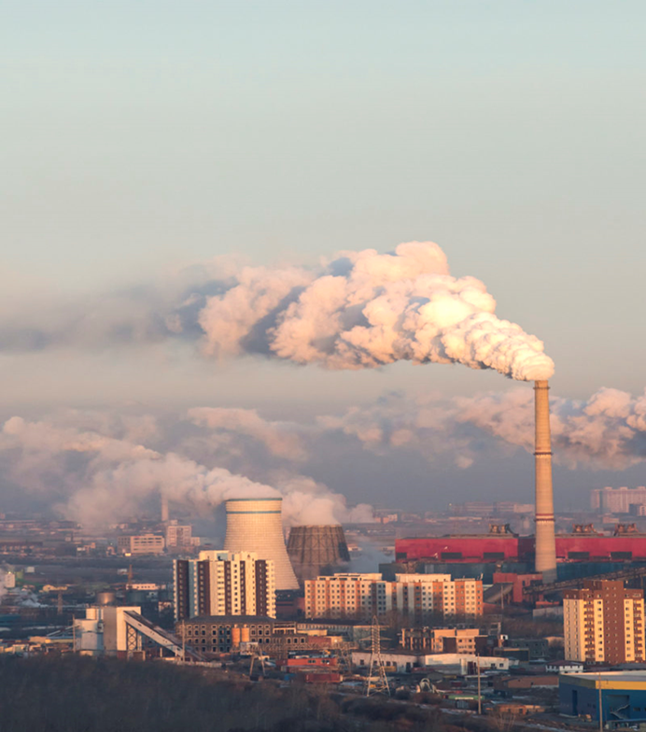
BACKGROUND
IPCC (International Panel on Climate Change) sixth assessment in 2022 - Global GHG emissions have continued to rise, but GHG emissions must peak in the next three years to preserve our chances of meeting the Paris Agreement's 1.5 degrees C goal.
There's no room for building new fossil fuel infrastructure, with CO2 emissions from existing and planned fossil fuel infrastructure alone exceeding global 1.5 degrees C budgets.
Carbon removal will need to play an important role as all pathways that limit warming to 1.5 degrees C (with no or limited overshoot) depend on carbon removal.
For the corporate sector, this means transitioning towards business models that are compatible with a net-zero economy within the next three to five decades
Requires monitoring and tracking of initiatives and responses.

Slide 3

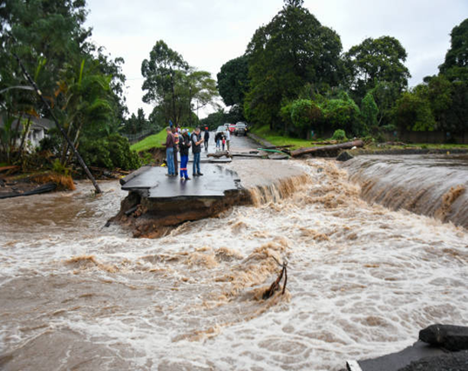
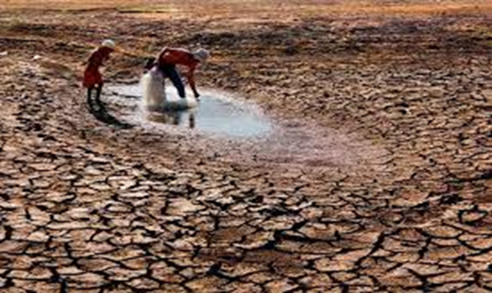
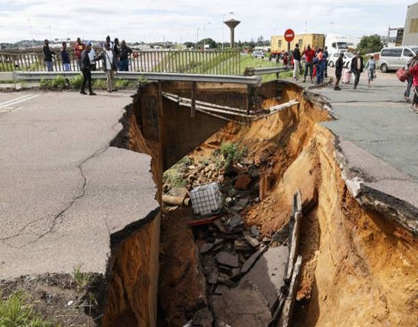
National climate objectives
CLIMATE RISKS FOR GAUTENG
Climate projections (confirmed by Long Term Adaptation Scenarios, SA’s Third National Communication, SA’s Weather Service Climate Change Atlas) indicate that the overall outcome for Gauteng is likely to be a hotter climate overall, with the higher temperatures and longer dry spells dominating the weather patterns.
Intense rainfall events have also been projected, and will lead to increasing runoff rather than infiltration. These also increase the risk for flash floods and erosion, placing pressure on stormwater infrastructure and affecting agricultural practices.
Increased temperature will lead to heat stress and increased evaporation will lead to significant water losses
Deepened drought conditions will impact water security and increase fire risks
At the same time, due to its industrial nature, Gauteng’s heavy dependence on carbon intensive energy is immensely contributing to national GHG emission profile.

Slide 4
PROVINCIAL DEPARTMENT SUPPORTS THE BILL
The GDARD/E is in support of the Bill and stands ready to:
(further) implement the Bill; and
support the Gauteng municipalities, in implementation, where required.
From the next few slides, it will be evident that great strides have already been made towards implementation of the values and principles as contained in the Bill and the aligned provincial strategy.

Slide 5


BACKGROUND
Gauteng City Region Climate Change response is guided by the Gauteng City Region Over-arching Climate Change Response Strategy and Action Plan: - approved for implementation by EXCO on 26
August 2020.
Aligned to Climate Change Bill.
The Strategy supports SA’s commitment to meet Paris Agreement pledges and National Determined Contribution (NDC) targets for reduction of the country’s Greenhouse Gas (GHG) emissions.

Slide 6
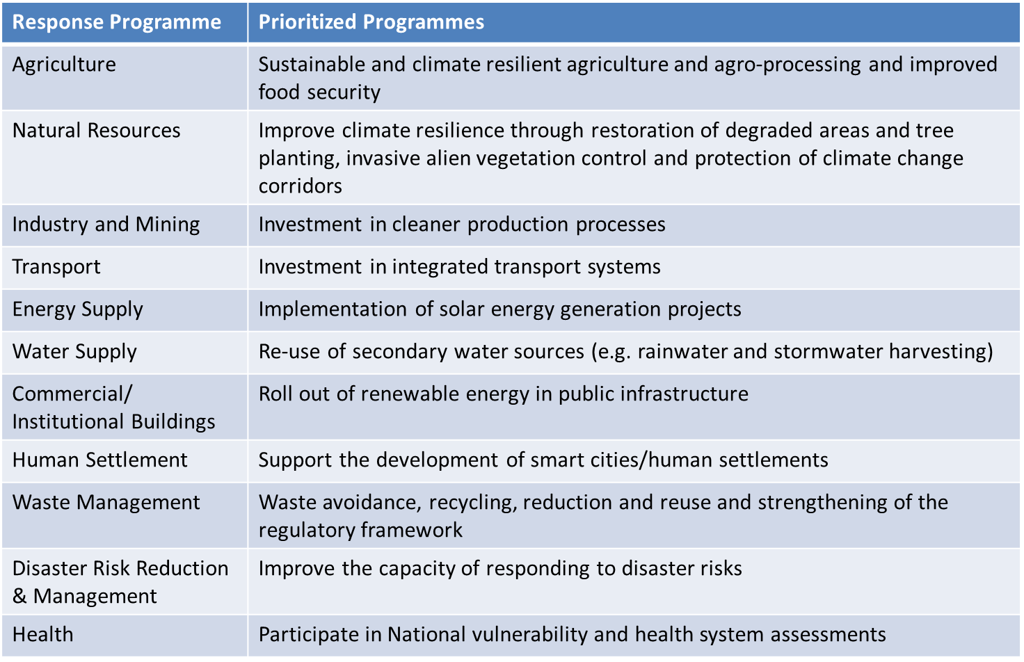
CLIMATE CHANGE REGISTER AND IMPLEMENTATION PLAN

Slide 7
STRATEGIC IMPLEMENTATION OF STRATEGY
The Draft Climate Change Bill - “A Provincial Committee on Climate Change is established for each province in the Republic, in order to coordinate climate change response actions in the relevant province...”.
The Premier’s Expert Advisory Committee on Climate Change (PEACCC) launched by Gauteng Premier on 1 June 2022 – to strategically monitor and report on progress of provincial climate response programmes. It consists of various experts in the fields of energy, water, infrastructure, finance etc.
THE OBJECTIVES OF THE COMMITTEE ARE AS FOLLOWS
  The Expert Advisory Committee will guide and accelerate implementation of the Gauteng City Region Overarching Climate Change Response Strategy.
  The Expert Advisory Committee will also provide expert advice on elements of a just transition pathway for the Gauteng City Region.

Slide 8

STRATEGIC IMPLEMENTATION OF STRATEGY
Climate Change Forums
  Aimed at provincial and municipal officials
  Share climate change knowledge – increase reach
Climate Change Indaba
  Enlarged event for 2023 - hybrid
  International Participation

Slide 9
STRATEGIC IMPLEMENTATION OF STRATEGY
Strategic Alliances
  Under 2 Coalition - technical advice and inputs
  GISP (Gauteng Industrial Symbiosis Programme) – resource efficiency
  Green Building Council of South Arica (GBCSA)
  UJ – projects and programmes to enhance sustainability
  Regions 4 – climate change adaption programs
Private sector participation - bilaterals and engagements
  SASOL
  National Business Initiative (NBI)
  Gautrain Management Authority
  Development Bank of Southern Africa
  Balwin Properties
  Green Building Council of South Arica (GBCSA)
  South African Petroleum Industry Association (SAPIA).

Slide 10
GAUTENG CLIMATE CHANGE STRATEGIC PROJECTS
Project | Department/s
Solar PV installation at public facilities | GDID
Replacement of coal fired boilers with dual fired boilers in hospitals which use light fuel oil and gas | GDID/GHealth
Gauteng 2050 Net-Zero Guidelines and Green Public Procurement Guidelines (GPPG) | GDARD/E
Climate Change School Awareness Programme | GDARD/E
Kaalspruit Climate Resilient Catchment Management Plan | GDARD/E
Gauteng Greenhouse Gas (GHG) Inventory | GDARD/E
Gauteng Industrial Symbiosis Programme | GDARD/E
Planting of 1 000 000 trees | GDARD/E
Training of SMMEs in solar PV installation | GDARD/E
Farmers’ Support Programme in renewable energy (i.e. biogas and solar) | GDARD/E
Pre-feasibility Study for the Regional Integrated Waste Facility | GDARD/E

Slide 11
PURPOSE AND OBJECTIVES OF THE BILL
The purpose of the Bill is to enable the development of an effective national climate change response, and a long term just transition to a low-carbon and climate-resilient economy and society for South Africa in the context of sustainable development.
The objects of the Bill are, amongst others, to –
provide for a coordinated and integrated response by the economy and society to climate change and its impacts in accordance with the principles of co-operative governance;
provide for the effective management of inevitable climate change impacts by enhancing adaptive capacity, strengthening resilience and reducing vulnerability to climate change, with a view to building social, economic, and environmental resilience and an adequate national adaptation response in the context of the global climate change response;
make a fair contribution to the global effort to stabilise greenhouse gas (GHG) concentrations in the atmosphere at a level that avoids dangerous anthropogenic interference with the climate system; and
ensure a just transition towards a low carbon economy and society considering national circumstances.

Slide 12
PRINCIPLES OF THE BILL
Principles to be integrated into decisions which may have a significant effect on the Republic’s ability to mitigate or which exacerbate its vulnerability to climate change;
The national environmental management principles set out in section 2 of the National Environmental Management Act, where applicable in this Act;
Climate system should be protected for the benefit of present and future generations of humankind;
Acknowledges international equity and each country’s common, but differentiated responsibilities and respective capabilities, in light of different national circumstances;
A contribution to a just transition towards low carbon, climate resilient and ecologically sustainable economies and societies which contribute to the creation of decent work for all, social inclusion, and the eradication of poverty; and
The need for integrated management, in the context of climate change, which requires climate change considerations.

Slide 13
POLICY ALIGNMENT AND INSTITUTIONAL ARRANGEMENTS
Every Premier’s intergovernmental forum, established in terms of section 16 of the Intergovernmental Relations Framework Act, also serves as a Provincial Forum on Climate Change.
A Provincial Forum on Climate Change may establish an intergovernmental technical support structure in terms of section 30 of the Intergovernmental Relations Framework Act, if there is a need for formal technical support to the Provincial Forum on Climate Change.
Every district intergovernmental forum, established in terms of section 24 of the Intergovernmental Relations Framework Act, also serves as a Municipal Forum on Climate Change.
A Municipal Forum on Climate Change may establish an intergovernmental technical support structure in terms of section 30 of the Intergovernmental Relations Framework Act if there is a need for formal technical support to the Municipal Forum on Climate Change.
The Presidential Climate Commission which existed immediately before the commencement of this Act, continues to exist.
The Presidential Climate Commission will, upon being listed as a public entity in Schedule 3 to the Public Finance Management Act, be a national public entity for purposes of the Public Finance Management Act and will be subject to the provisions of the said Act.

Slide 14
CLIMATE CHANGE RESPONSE: PROVINCES AND MUNICIPALITIES
At least within one year of the publication (2020) of the National Adaptation Strategy and Plan contemplated in section 18, undertake a climate change needs and response assessment for the province, metropolitan or district municipality, as the case may be;
At least within two years of undertaking the climate change needs and response assessment contemplated in paragraph (a), develop, implement and publish in the Gazette a climate change response implementation plan as a component of, and in conjunction with, provincial, metropolitan or district municipal planning instruments, policies and programmes;
A metropolitan or district municipal climate change response implementation plan, contemplated in subsection (1)(d), must form a component of the relevant municipality’s integrated development plan adopted in terms of section 25 of the Local Government: Municipal Systems Act, 2000 (Act No. 32 of 2000).
The Minister must prescribe a mechanism to support and finance the Republic’s climate change response, planning and implementation by national, provincial and local government in consultation with the Minister of Finance.

Slide 15
CONCLUSION
Notable exception aside, the GDARD/E welcomes the Bill and has as a matter of fact started implementing aspects of the Bill.
The GDARD/E also stands prepared to assist Gauteng municipalities in planning and implementation, in the spirit of the IGRFA and Chapter 3 of the Constitution (Cooperative Government).

Slide 16

THANK YOU

