Slide 1

Donor Funding presentation

Slide 2
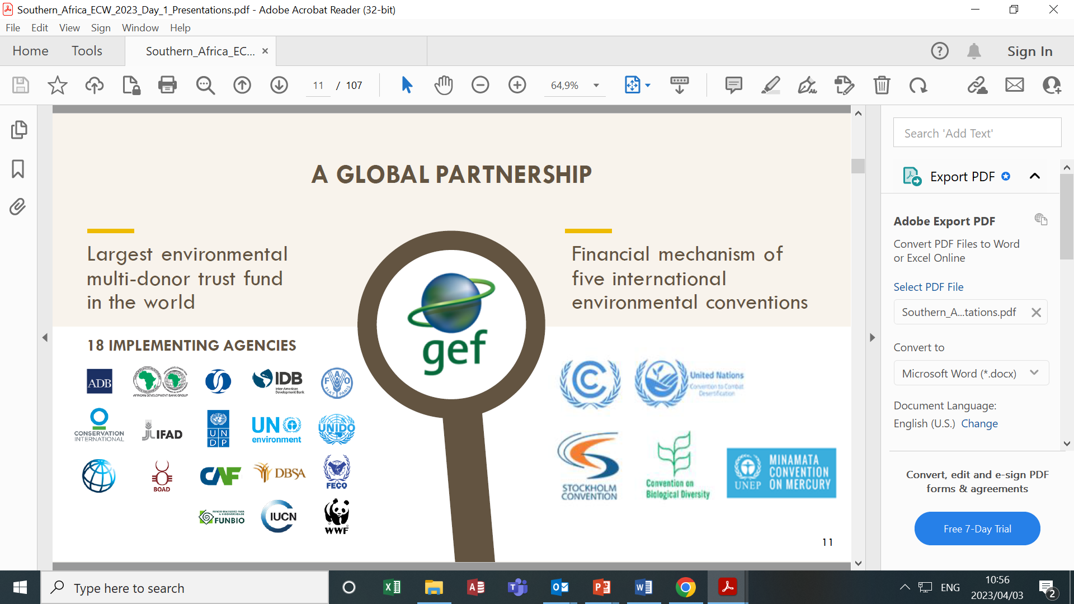
THE GEF

Slide 3




THE GEF IMPLEMENTING AGENCIES
GEF IMPLEMENTING AGENCIES WORKING IN SA

Slide 4
Types of Projects
FULL SIZED PROJECTS: GEF Project Financing of more than US$2M.
MEDIUM SIZE PROJECTS: GEF Project Financing of less than or equivalent to US$2M.
EA: means a project for the preparation of a plan, strategy or report to fulfill commitments under a Convention.
Program: means a longer-term and strategic arrangement of individual yet interlinked projects that aim at achieving large-scale impacts on the global environment.

Slide 5
SEPARATION OF PROJECT IMPLEMENTATION
& EXECUTION
Implementation | Execution
Implementation entails the oversight of project execution to ensure that the project is being carried out in accordance with agreed standards & requirements. Implementation is done by 18 GEF Implementing Agencies | Execution refers to the management & administration of the day-to-day activities of projects in accordance with specific project requirements in an agreement with the GEF Agency. e.g. Government Departments, Government entities, CSOs etc.
Fiduciary Standards & Agency Fee Policy mandates separation of implementation & execution functions to:
Avoid conflict of interest
Promote country ownership
Build capacity of national executing entities

Slide 6
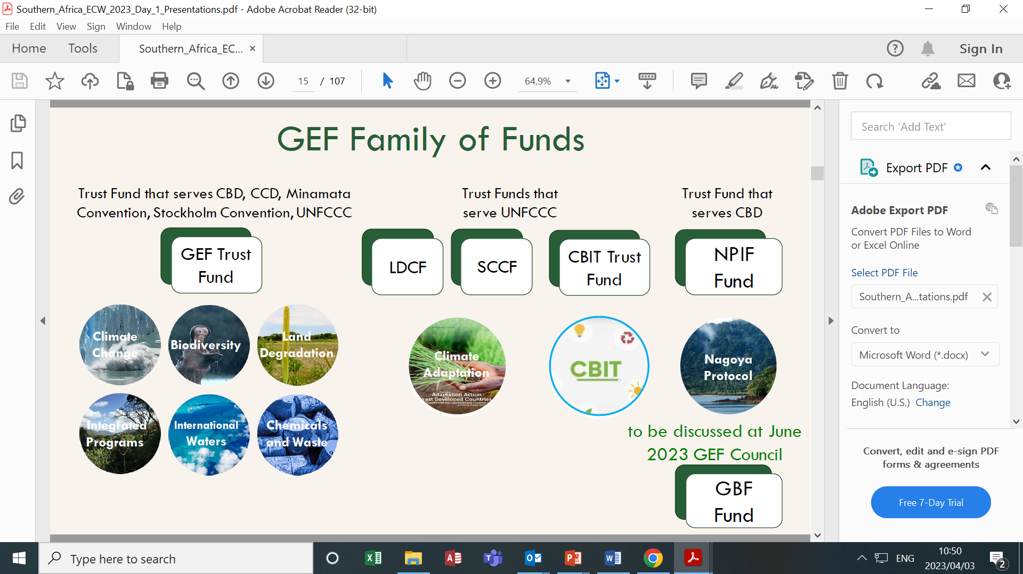
GEF Family of funds

Slide 7
GEF funding allocation
The GEF uses the System for Transparent Allocation of Resources (STAR) to allocate the resources for biodiversity, climate change, and land degradation focal areas
Allocation for International waters, chemicals and waste comes from the GEF core

Slide 8
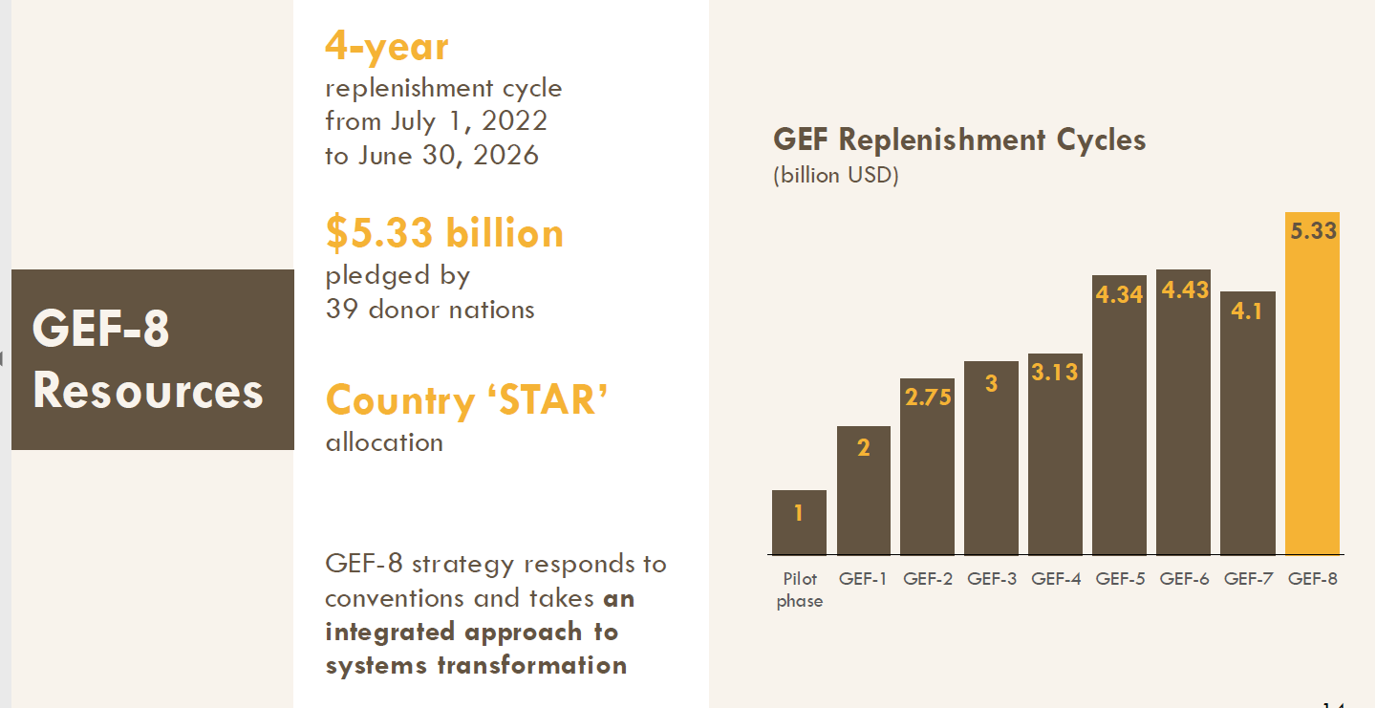
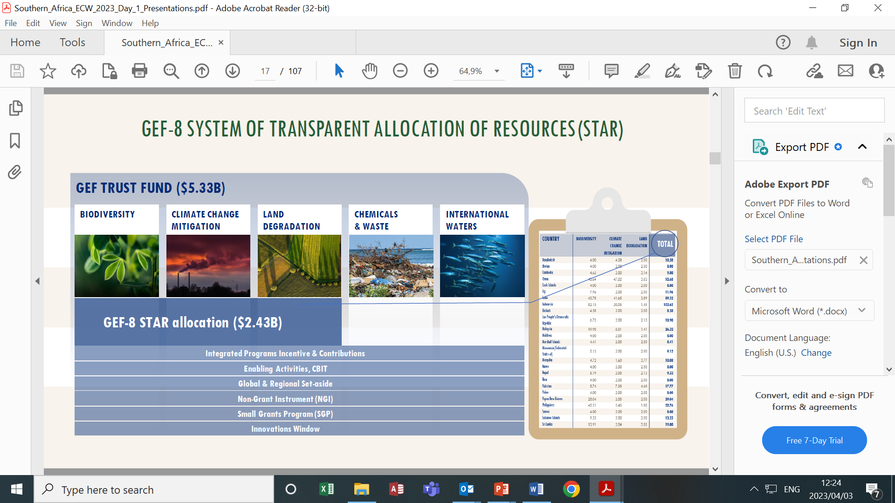
GEF 8 RESOURCES

Slide 9
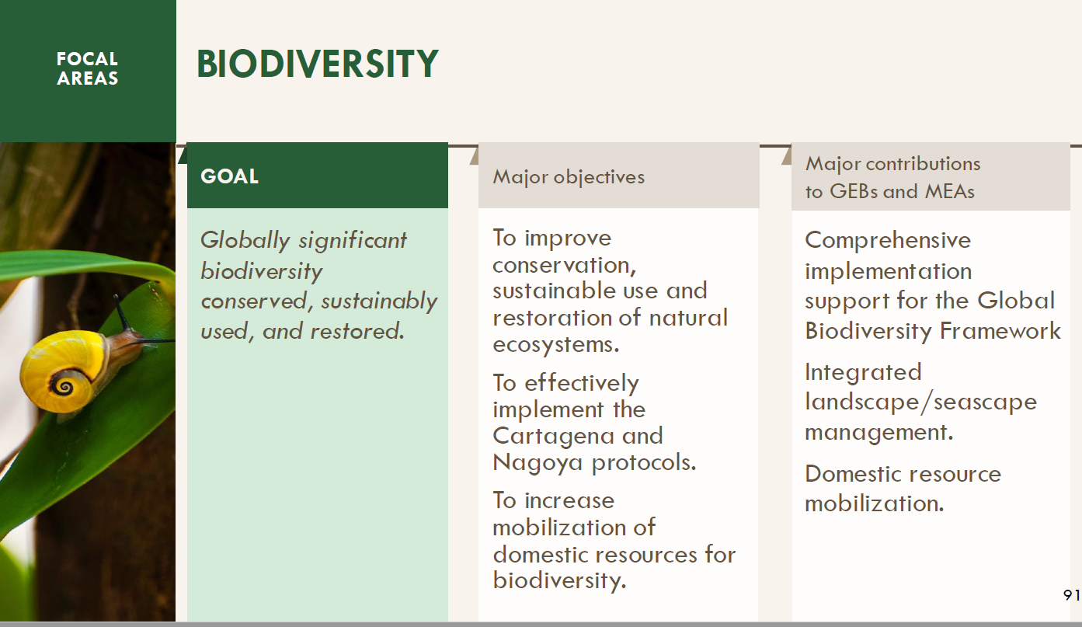
GEF-8 PRIORITIES FOR FOCAL AREAS

Slide 10
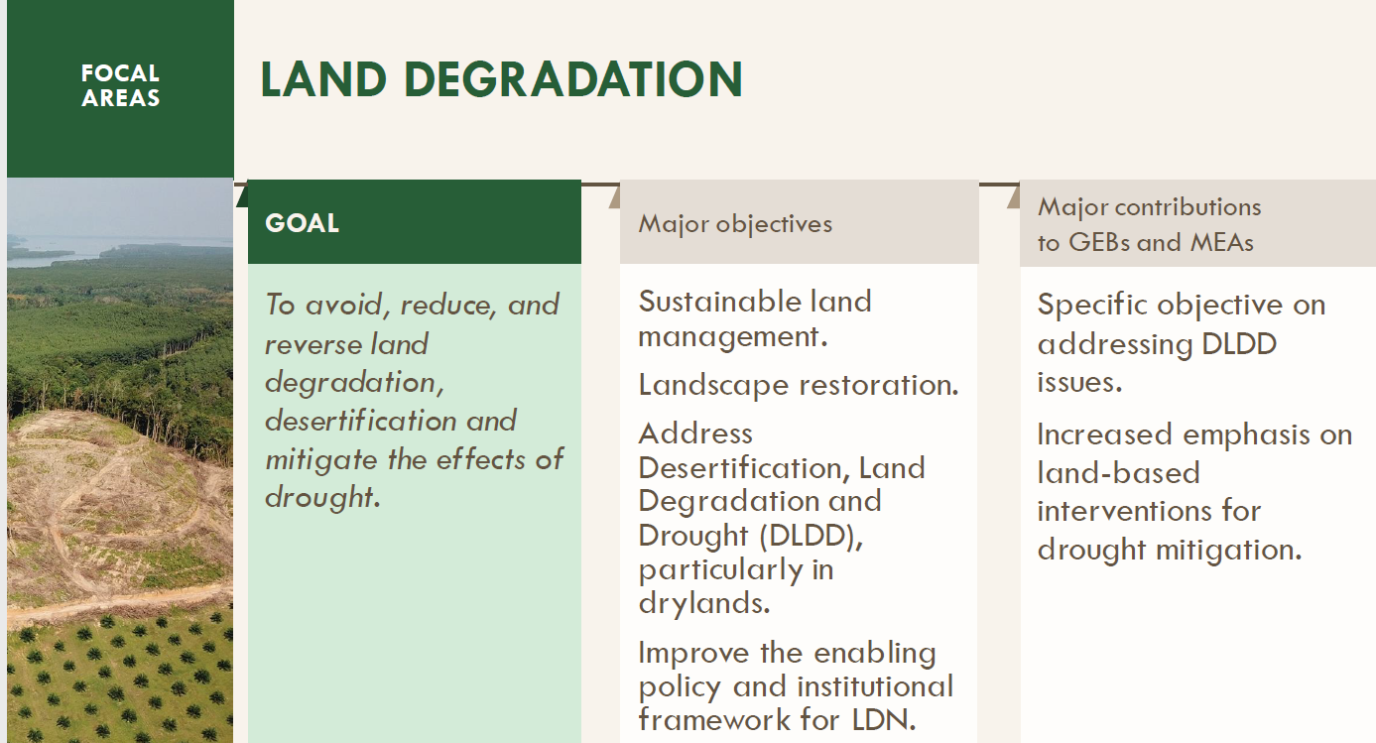
GEF-8 PRIORITIES FOR FOCAL AREAS

Slide 11
GEF STAR ALLOCATIONS FOR SA
FOCAL AREA | GEF 4 US$ million | GEF 5 US$ million | GEF 6 US$ million | GEF 7 US$ million | GEF 8 US$ million
Biodiversity | 22.5 | 21.68 | 22,79 | 23.83 | 35.69
Climate Change | 23.9 | 25.71 | 17,98 | 10.15 | 7.36
Land Degradation | None | 5.25 | 5,18 | 4.12 | 6.05
TOTAL | US$ 46.4 million | US$ 52.65 million | US$ 45,86 million | US$ 38,11 million | US$ 49.10 million

Slide 12
INTEGRATED PROGRAMS
Integrated programs are defined by sharing several of the following characteristics:
Integration of focal areas and approaches
Deliver multiple global environmental benefits
Promote a global platform for coordination and technical support to country projects
Provides incentives for country participation
Promote a global platform for coordination and technical support to country projects

Slide 13
INTEGRATED PROGRAMS
Food Systems
Ecosystem Restoration
Sustainable Cities
Amazon, Congo, and Critical Forest Biomes
Circular Solutions to Plastic Pollution
Blue and Green Islands
Clean and Healthy Ocean
Greening Transportation Infrastructure Development
Net-Zero Nature-Positive Accelerator
Wildlife Conservation for Development
Elimination of Harmful Chemicals from Supply Chains

Slide 14
GEF8 PROGRAMMING
Biodiversity STAR Allocation: US$35 m
Committed funds under Integrated Programs:
Food Systems BY FAO – US$3m
Ecosystem Restoration by UNEP –US$6m
Sustainable Cities by DBSA – US$2m
Circular Solutions to Plastic Pollution by UNIDO – US$3m
SGP by UNDP – US$1m
Land Degradation (UNEP & FAO IPs ) – US$2m
Remaining funds for biodiversity focal area is US$19m

Slide 15
GEF8 PROGRAMMING
Biodiversity focal area (STAR US$18M):
Goal:
Globally significant biodiversity conserved, sustainably used, and restored.
Major objectives
To improve conservation, sustainable use and restoration of natural ecosystems.
To effectively implement the Cartagena and Nagoya protocols.
To increase mobilization of domestic resources for biodiversity.

Slide 16
GEF8 PROGRAMMING
LAND DEGRADATION FOCAL AREA (US$6M):
Goal:
To avoid, reduce, and reverse land degradation, desertification and mitigate the effects of drought.
Major objectives:
SLM,
Landscape restoration,
Desertification, Land Degradation and Drought (DLDD), particularly in drylands.
Improve the enabling policy and institutional framework for LDN.

Slide 17
GAPS IDENTIFIED IN THE IMPLEMENTATION OF GEF IN SA
Lack of National Steering Committee to oversee the entire GEF portfolio,
Lack of Coordination among Convention Focal Points,
Lack of youth and CSO involvement at the project conceptualization stage,
Very slow disbursement of funds and recruitment of staff/PMU

Slide 18
Proposed GEF 8 projects
DESCRIPTION | Implementing Entity | FUNDING
Reimagining National Parks for People and Nature | SANPARKS | $10 million
Advancing NCA in South Africa with transformative outcomes for people, ecosystems and the economy through biodiversity stewardship | SANBI | $5million
Business and Biodiversity | DFFE/SANBI | $4 million
Total |  | $19 million

Slide 19
Full sized Projects under DFFE
 | DESCRIPTION | FUNDING
GEF 6 | Strengthening institutions, information management and Monitoring to reduce the rate of illegal wildlife trade in South Africa | $4.8 million
GEF 7 | Access and Benefit Sharing value chains Biodiversity economy and illegal wildlife trade Invasive Alien species project Wildlife conservation Bond Reducing Human Wildlife Conflict through an Evidence-based and Integrated Approach in Southern Africa | $7 million $10 million $3.4 Million $13 million non-grant instrument $3,427,982

Slide 20


THANK YOU!
Mr Simon Malete
Director
Private Bag X447, Pretoria,0001
Environment House, Cnr Steve Biko and Soutpansberg Road, Arcadia,0083
Tel:
Cell:
Email: smalete@dffe.gov.za

