Slide 1
National Energy Crisis Committee (NECOM)
Workstream 5: Demand Management
Chairs - Thabang Audat and Malcolm Van Harte
Nedlac – 22 Nov 22, Rev02
The country requires you to contribute to the Country Demand Management program in order to improve dispatchability and efficiency in managing demand and consumption in order to limit or eliminate the need for loadshedding.

Slide 2
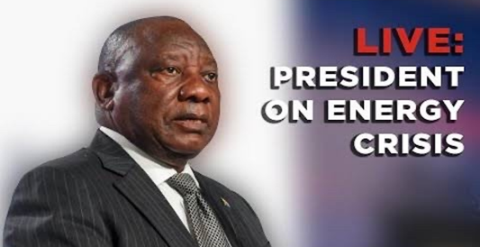
Eskom is contributing to all 8 streams in the energy Natjoints with particular focus on the delivery streams
Focus of this presentation
Structure (Chair)
Role
National Energy Crisis Committee
(President)
Overall political coordination of the response to the energy crisis consisting of ministers of; DMRE, DPE, DFFE, Finance, DTIC
Energy NatJoints
(Presidency DG and Secretary of Defence)
Technical oversight to focus on four key objectives:
Addressing the immediate electricity supply shortfall and ending load shedding
Improving the performance of Eskom’s existing fleet and positioning it for future sustainability
Implementing a coordinated plan by law enforcement agencies to address sabotage, theft and fraud at Eskom
Achieving medium and long-term energy security in the context of our climate commitments and growth
Additional measures to achieve long-term energy security and end load shedding for good:
  Fix Eskom and improving performance of existing fleet
  Accelerate private investment in generation capacity
  Accelerate procurement of new capacity from renewables, gas and battery storage
  Unleash businesses and households to invest in rooftop solar
  Transforming the electricity sector to achieve energy security
8 X workstreams
Plant Performance
Grid strengthening
New Generation Capacity
Demand Management
Safety and Security
Regulatory and Legal
Procurement and Financing
Data Analytics and Research
Communication
Delivery
Energy NATJOINTS has established multi-stakeholder workstreams to deliver outcomes outlined by the President
Short term interventions focused on bringing new generation capacity as quickly as possible, with longer-term actions to achieve energy security
Measures detailed in the Action Plan to assist in reducing the impact of Load Shedding and will serve as the implementation plan for each work stream
Cross cutting

Slide 3
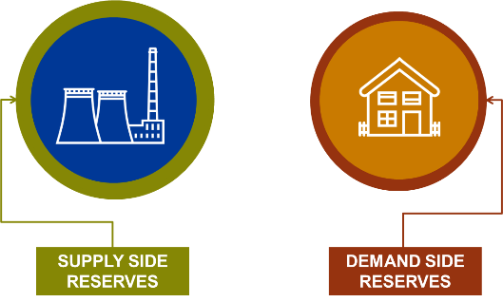
Framing the problem statement: Distribution levers to modify the Eskom and Country DEMAND options
What are the demand options available to alleviate supply constraint?
1
Eskom Problem Statement
Aim: Optimize the Demand Management Side Options
The unavailability of generation capacity to meet customer demand leading to loadshedding
How do we implement Loadshedding with minimal economic impact?
2
Aim: Maintain spirit and principles of the NRS048-9?
How do we communicate to public and stakeholders?
Distribution to explore new ways to support the supply and demand optimisation
3
GOAL
Aim: To provide transparency and support customers to achieve mutual benefit

Slide 4






Demand Management Options
01
02
03
Demand Response
Load Shifting
Residential Load Management
04
05
06
Load Curtailment
Power Alert
Critical Peak Pricing

Slide 5
The demand management interventions are looking at both demand response and demand side management
01
02
03
Phase 1 | Phase 2 | Phase 3
FY 22/23 | FY 23/24 | FY 24/25
250 MW | 500 MW | 700 MW
Residential mass rollout Load shifting Peak clipping Energy Efficiency | Expand on existing programmes plus development of additional DSM programmes (renewables, “gas alternative”, and technology rebates) | Expand on existing programmes plus development of additional DSM programmes (renewables, “gas alternative”, and technology rebates)

Slide 6
Achieved Eskom Demand Management Interventions (3 -6 Months)
 | Demand Management Programmes | Status | Planned MW Savings | Actual MW Savings | Due Date | Key Enablers | Progress To-date
MW Savings | Notified Maximum Demand (NMD) |  | 10 | Subject to M&V PA | 30/11/2022 | None Required | Customer engagements are ongoing. M&V Report due end November 2022.
 | Power Alert |  | 200 | Subject to M&V PA | 30/11/2022 | None Required | Other communication mediums are being considered to enhance the performance. The messaging is also being looked at to improve customer participation. M&V performance report due end Nov 2022. Preparation in progress.
 | Load Shifting - Industrial |  | 20 | Subject to M&V PA | 31/03/2023 | PPPFA Exemption | 7 Projects ( Combined 20MW) to be contracted by first week in Oct 2022. Implementation ranges from 1 to 5 months WS4 to submit the PPPFA Exemption request to NT.
 | Energy Efficiency - Industrial |  | 15,6 | Subject to M&V PA | 31/03/2023 | PPPFA Exemption | 10 Projects ( Combined 15,6 MW) to be contracted by first week in Oct 2022. Implementation ranges from 1 to 5 months WS4 to submit the PPPFA Exemption request to NT.
 | Critical Peak Pricing (CPP) |  | 12 | Subject to M&V PA | 30/11/2022 | NERSA approval to continue programme beyond pilot (End Dec 2022) | The performance monitoring commenced in September 2022.
 | Total |  | 257 | Subject to M&V PA

Slide 7
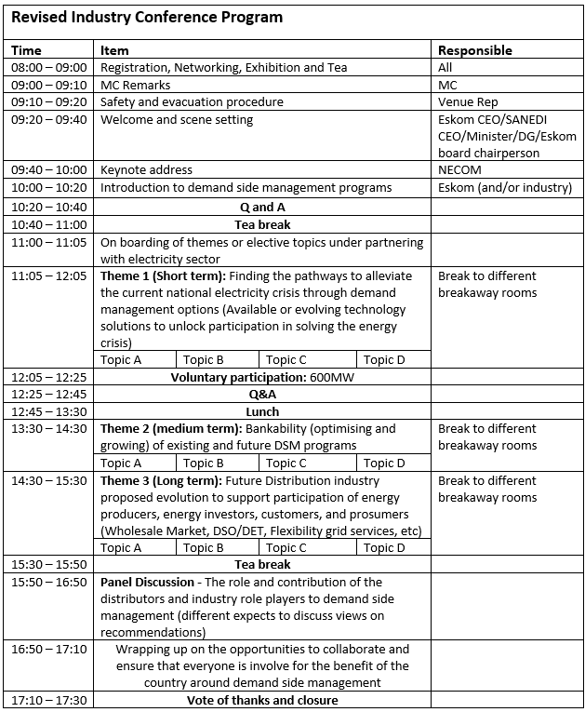
Industry Indaba – Feb 2023
Indaba themes:
“Arresting the energy crisis through demand management options or solutions”.
Purpose:
To gather researchers, industry partners and industries experts to promote and publicise collaborative proposals or solutions on demand management to limit the impact of loadshedding in South Africa.
  The indaba will feature speakers from partners and players in the fields of demand research.
  Also there will a participation from distinguished speakers from around the country in various disciplines of demand management.
  Intended outcome:
Commitment from the industry and role players and policy makers on the demand side as well as receiving proposed solutions, including partnership to resolve the country's demand challenges.
Slogan: “Together we can find solutions to save 600MW of power in six months period.”

Slide 8
Progress: Workstream 5
Key implementation challenges
Delayed and at risk
Med risk/minor delays
Status
On track
Initiative
Latest progress
Accelerating levers
Demand side management
  Eskom Legal & Reg drafting the letter to be submit to NERSA for rates and cost recovery
  Technology & Measurements: First introductory workshop was held 11/10/2022 for aggregator model.
  Develop implementation roadmap with timelines for aggregator/aggregation activities
  DM Indaba: Date: 29th November
  Energy Performance Contracting for Public Lighting DSM initiative was proposed by DMRE.
  Transfer the learnings from the study on Residential load to maximize the impact of DSM programmes completed by CSIR & SANEDI.
  City Power, Buffalo City, SANEDI, Ekurhuleni presented DM initiatives and contributions​ with impact and savings to be confirmed next month
  Eskom EE: Engagement and onboarding of ERE and Clusters completed. Data collection in progress
  Work stream 4 is preparing a letter for submission to NT for the exemption on PPPFA by the 18/11/2022.
  Establishment of the Project Evaluation Committee
  Industry Indaba/Conference delays
  No agreement on standard capability requirements between Eskom and SALGA for smart metering
  Budget allocation for DM programme - approval of DSM management plan, NERSA approval, Ministerial determination, PPPFA exemption
  Outstanding opportunities for large facilities
  Legal work stream to request exemption with upcoming engagements with DTIC.
  Work stream 5 should also start engage with Eskom SD&L and DTIC to resolve
  IDM to solicit support from Regulatory, Policy & Economic committee to engage with NERSA for cost recovery application.
  Unlocking budget for research initiatives
  Book Indaba venue once budget approved​ (National / Provincial)
  Develop a short, medium and long-term view – Strategic vs Operational for the Aggregation model
Notes:
WS 8 publish key messaging.
Strategy approval by WS 5.
Strategy and Conference approval by ENERGY NATJOINT
Alignment with WS 8.
Venue confirmation by Government
Approval of motivation.
DSM Approval of contracting rules
Establish Sub-workstream to focus on amendments.
CSRI programme and WS 7 presentation
Need to categorise these and prioritize those that can be implemented quicker at a relatively low cost

Slide 9

Thank you.
Questions
The country requires you to contribute to the Country Demand Management program in order to improve dispatchability and efficiency in managing demand and consumption in order to limit or eliminate the need for loadshedding.

