Slide 1

Plastics Pollution Treaty
BUSA Environment Subcommittee
13 Sept 2023

Slide 3
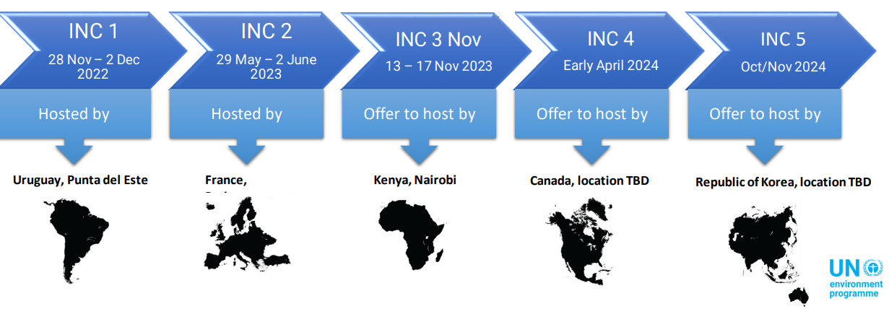
Developments on the Plastics Pollution Treaty
Background
In March 2022, the 5th United Nations Environment Assembly adopted a Resolution to develop an international legally binding instrument on plastic pollution (“the Treaty”) by the end of 2024.
Most global treaties take between five (5) to ten (10) years of negotiations - very ambitious timeline
Ad hoc open-ended working group constituted, to prepare for the work of the Intergovernmental Negotiating Committee (INC). INC established to develop the content of the Treaty.
Zero Draft
UNEA 6

Slide 4
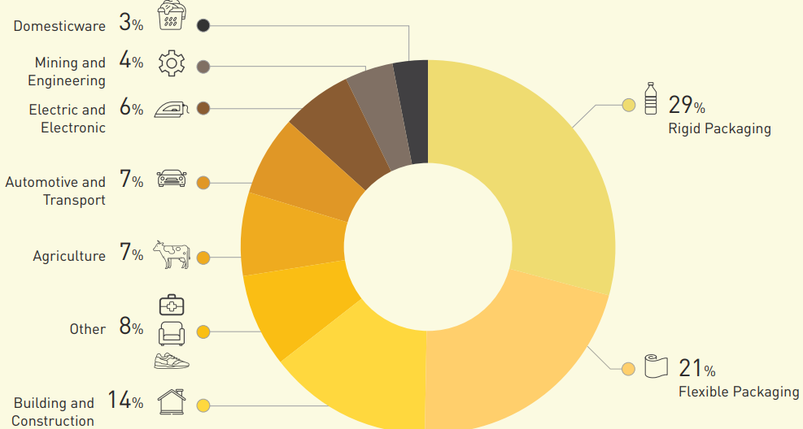
The plastics treaty is expected to address the full lifecycle of plastics, including production, design, and disposal (snapshot of Zero Draft)
UPSTREAM
MIDSTREAM
DOWNSTREAM
Primary Plastic polymers
SA market sectors
Chemicals & Polymers of concern
Non-Plastic Substitutes
Just Transition
Extended Producer Responsibility
Problematic & avoidable products, Microplastics*
Design, Composition & performance
Transparency, tracking, reporting
Emissions & Releases (Air, Soil, water)
Waste management & Legacy plastic pollution
Source: Plastics SA 2021/2022
Trade of polymers, chemicals, plastics products & waste
Means of Implementation (Enablers): Financing, Capacity building, Technology transfer, National Action Plans, Governance

Slide 5
Challenges & Proposed way forward
Wide implications for SA economy and industry
Industry participation is limited (small working group established between Plastics SA & CAIA with upstream representation)
Advocacy with government has been limited to one-way sharing of information
  Government positions has not been made available (currently high-level)
  DFFE’s alignment with Africa Group of Negotiators (AGN) mainly non-producing countries (inability for industry to openly liaise with the AGN)
Apparent divergent positions with Civil society groups
Lack of common body of knowledge informing positions (1-sided)
  Seemingly non-neutral positioning of UNEP
Conflation of the Treaty with Paris Agreement and other MEAs.
Rapid pace of negotiations with limited time for stakeholder engagement, position development
BUSA participation in the Plastics SA Industry Stakeholder Session on 14th September
BUSA & members to evaluate the Treaty and its implications for business –
  develop industry positions, or
  set up a working group
Wider advocacy with DFFE and relevant stakeholders

