Slide 1

ESTABLISHMENT OF THE NATIONAL WATER RESOURCE INFRASTRUCTURE AGENCY AND CATCHMENT MANAGEMENT AGENCIES
DECEMBER 2022

Slide 2
CONTENT
DWS strategic Priorities
Key milestones, progress and remaining processes for the establishment of the NWRIA
NWRIA Consultation programme
Roadmap for the establishment of the NWRIA
Principles on realignment of CMAs from 9 to 6
CMAs implementation progress to date

Slide 3
DWS STRATEGIC PRIORITIES
Plan and implement a range of major projects to augment national bulk water resource infrastructure, e.g. Lesotho Highlands Phase 2, uMkhomazi
Guide and lead the development of other water resources, including groundwater and desalination
Establish the National Water Resource Infrastructure Agency (NWRIA) to own and manage national water resource infrastructure, and to raise finance for its further development
Strengthen the role of DWS in regulating, supporting and intervening in municipalities where municipal water and sanitation services are deteriorating, linked to the reinstated blue, green and no drop regulatory monitoring tools
Strengthen regulatory interventions to address pollution of the environment and communities from waste-water
Increase participation of private sector finance and skills in the water sector
Continue to improve water-use license turnaround times and promote transformation in water-use
Guide and lead increased water-use efficiency and demand and conservation management, including addressing non-revenue water at municipal level
Fight corruption in the water sector at all levels of government
Improve billing and revenue collection across the water value chain
Establish remaining catchment management agencies
Transform Irrigation Boards into Water User Associations
Reconfigure and reorient the Water Boards

Slide 4
PROGRESS ON THE ESTABLISHMENT OF NATIONAL WATER RESOURCE INFRASTRUCTURE AGENCY

Slide 5
KEY MILESTONES, PROGRESS AND REMAINING PROCESSES FOR THE ESTABLISHMENT OF THE NWRIA
The legislation (the Bill) and detailed business plan for the NWRIA are currently been run in two separate but parallel processes, which are coordinated so that they are aligned
The draft business plan has been developed and submitted to National Treasury. Minister of Finance approval of the business plan is required in terms of the PFMA, before the NWRIA is established.
  Cabinet granted approval on 3 August 2022 for the Bill to be published for 90 days for public consultation. Government Gazette published on 16 September 2022. The Bill will be introduced to Parliament for endorsement .
  The consultation with affected stakeholders is taking place between October and December 2022
  Based on the comments received, the Bill will be revised by January 2023
  Bill will be introduced to Parliament for endorsement
  National Treasury to schedule the NWRIA under the PFMA
  Transitional arrangement will start after the Bill and business case have been passed and approved.
.

Slide 6
NWRIA BILL CONSULTATION PROGRAMME
NAME OF SECTOR/ENTITY | DATE OF CONSULTATION | STATUS
South African Local Government Association | 25 October 2022 (virtual) | Completed
Chief Executives of Water Boards | 28 October 2022 (virtual) | Completed
National Consultation workshop | 04 November 2022 (Hybrid) | Completed
Banks (lenders) to the TCTA | 22 November 2022 (virtual) | Completed
BUSA | 7 December 2022 (virtual)
NEDLAC (Development Chamber) | 12 December 2022 (virtual) | Other chambers at NEDLAC to be consulted (DG extended consultation until 23 Jan 2023)
Investors to the TCTA | To be confirmed
Organized labour | To be confirmed

Slide 7
ROADMAP FOR THE ESTABLISHMENT OF THE NWRIA
Draft NWRIA Bill submitted to Cluster in April 2022 and Cabinet on 3 August 2022, for public consultation process on draft
Obtained certification of draft Bill from State Law Advisor in August 2022
Draft Bill published for comments on 16 September 2022
Final Bill submitted to Cabinet for approval for submission to Parliament in early 2023
Bill submitted to Parliament in early 2023
Submit Business case to NT end Jan 2023
Consultations with organised labour and commencement of change management Nov 2022- March 2023
Lenders and investors to TCTA consulted March Nov 2022-Jan 2023
NWRIA Act passed – dependent on Parliament, early 2023
Board and CEO appointed Oct 2023

Slide 8
PROGRESS ON THE ESTABLISHMENT OF CATCHMENT MANAGEMENT AGENCIES

Slide 9
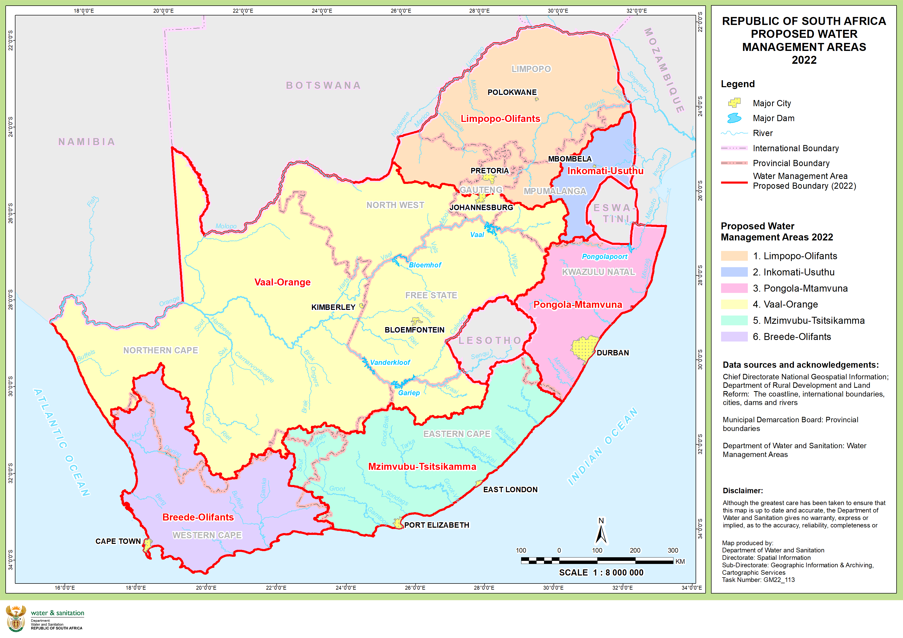
WATER MANAGEMENT AREAS

Slide 10

MAIN PRINCIPLES IN REALIGNING THE WMA AND RESPECTIVELY THE CMAS FROM 9 TO 6 ARE:
Operational Integration
  Connected and integrated water systems
  Easy coordination and monitoring of agreements
  Improved capacity-pooled technical skills
Integrated water resource planning
  The river basins fall within the same water system
  Improved resource planning
  Transboundary systems managed by same conventions
Economies of scale
  Enhance revenue and hence sustainability
  Cost – effectiveness
  Consolidate management structures

Slide 11
CMA IMPLEMENTATION PROGRESS TO DATE
To date there are two CMAs that are operational, the Breede-Gouritz and the Inkomati-Usuthu.
NAME | STATUS OF CMA ESTABLISHMENT | NEXT STEPS
Breede-Olifants | Business case is completed The Minister has signed the Gazette notice for the establishment of the Breede –Olifants CMA The Breede–Gouritz CMAs boundaries have been extended to include Berg-Olifants water management area Minister has approved the mandate to discuss with Labour | Gazette notice for the establishment of Breede-Olifants was published on 25 November 2022. The Board appointment process to be initiated and should be finalised by April 2023 Minister to meet with organised labour
Vaal-Orange | CMA was gazetted for public consultation in May 2022 Business case is finalised Consultation with stakeholders is underway | Minister has signed the Gazette notice for the establishment of Vaal-Orange was published in 25 November 2022. Minister to meet with organised labour Selection Panel to start with the appointment process.

Slide 12
CMA IMPLEMENTATION PROGRESS TO DATE (2)
NAME | STATUS OF CMA ESTABLISHMENT | NEXT STEPS
Pongola-Umzimkulu | CMA was gazetted for establishment in 2014 | The Board appointment process has been initiated and the selection panel will commence its work at the 13 Dec 2022.
Limpopo-Olifants | Business case development is completed Consultation with provincial offices is ongoing | Will be gazetted for public consultation January 2023
Mzimvubu-Tsitsikamma | CMA was gazetted for public consultation in 2016 Business case is under development/review Consultation with the internal and external stakeholders | Final gazette to be issued for establishment by March 2023
Inkomati-Usuthu | No configuration will be done

Slide 13
Thank You

