Slide 1


Transitional Arrangements Workshop
IPPU Sector
Presented by
Hendrik Louw
Directorate: GHG Inventory and Systems
Chief Directorate: Climate Change Mitigation and Specialist Monitoring Services

Slide 2
Activities affected by the
Transitional Arrangements
Currently all IPPU categories will be affected
  2A - Mineral Industry
  2B - Chemical Industry
    Note Hydrogen that was added as a separate category under 2B8g
  2C - Metal Industry
Side note: when you register for ANY category, you need to report the rest as well, i.e. if for ceramics, then the energy as well and vice versa.

Slide 3
Activities affected by the Transitional Arrangements
IPCC Code | Description
2A1 | Cement Production
2A2 | Lime Production
2A3 | Glass Production
2A4c | Non-Metallurgical Magnesia Production
2B1 | Ammonia Production
2B2 | Nitric Acid Production
2B3 | Adipic Acid Production
2B4 | Caprolactam, Glyoxal and Glyoxilic Acid Production
2B5 | Carbide Production
2B6 | Titanium Dioxide Production
2B7 | Soda Ash Production
2B8 | Petrochemical and Carbon Black Production
2B8a | Methanol
2B8b | Ethylene
2B8c | Ethylene Dichloride and Vinyl Chloride monomer
2B8d | Ethylene Oxide
2B8e | Acrylonitrile
2B8f | Carbon Black
2B8g | Hydrogen Production

Slide 4
Activities affected by the Transitional Arrangements
IPCC Code | Description
2C1 | Iron and Steel Production
2C2 | Ferroalloys Production
2C3 | Aluminium Production
2C4 | Magnesium Production
2C5 | Lead Production
2C6 | Zinc Production

Slide 5
Expectations
Data providers should use Tier 2 emissions factors, where available (currently we do not have any in South Africa).
If a Tier 2 emission factor is not available, a Tier 3 method must be used.
All Tier 3 estimates must be accompanied by the necessary supporting documents.
  Direct emission measurements
  Carbon balance
  Process flow sheet (with reporting boundaries)
  Calculations

Slide 6
Expectations
Newly published Methodological Guidelines – 2022
  NB. Section 7, Methodology
    Table 7.1 Standard measurement methods for exhaust gases
  Note updates in some of the categories, i.e. Hydrogen Production, etc.
Note on analyses:
  Must be representative of the process (and all process conditions)
  Only valid for one calendar year
  In line with Air Emission License
  See Table 7.1

Slide 7
Tier 3 Mass Balance
What goes in, must come out….
  C_{in} = C_{out}
Assume 100% conversion unless proven otherwise (measurement)
Attach analyses, calculations, etc.

Slide 8
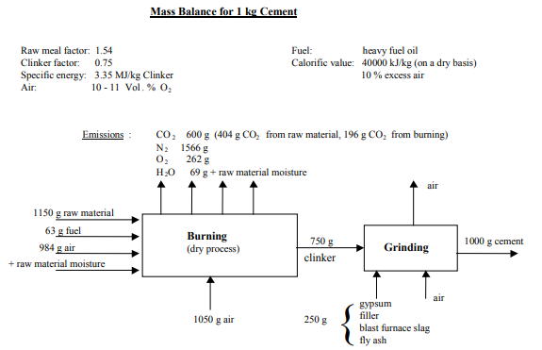
Tier 3 Mass Balance
Source: Based on figure from Austrian BAT proposal 1996, Cembureau for Mass balance for production of 1 Kg cement

Slide 9
Tier 3 Mass Balance
Source: Based on figure from Austrian BAT proposal 1996, Cembureau for Mass balance for production of 1 Kg cement

Slide 10
Tier 3 Mass Balance
Source: Based on figure from Austrian BAT proposal 1996, Cembureau for Mass balance for production of 1 Kg cement

Slide 11
Tier 3 Mass Balance
Source: Based on figure from Austrian BAT proposal 1996, Cembureau for Mass balance for production of 1 Kg cement

Slide 12
Tier 3 Mass Balance
Source: Based on figure from Austrian BAT proposal 1996, Cembureau for Mass balance for production of 1 Kg cement

Slide 13
Tier 3 Mass Balance
Source: Based on figure from Austrian BAT proposal 1996, Cembureau for Mass balance for production of 1 Kg cement

Slide 14
Tier 3 Mass Balance
Source: Based on figure from Austrian BAT proposal 1996, Cembureau for Mass balance for production of 1 Kg cement

Slide 15
Tier 3 Mass Balance
Source: Based on figure from Austrian BAT proposal 1996, Cembureau for Mass balance for production of 1 Kg cement

Slide 16


THANK YOU!
Directorate: GHG Inventory & Systems
Chief Directorate: Mitigation & Specialist Monitoring Services
Branch: Climate Change & Air Quality
Department of Forestry, Fisheries and the Environment
Tel: 012 399 9775 | Mobile: 082 963 5287
Website: http://www.dffe.gov.za
Address: The Environment House, 473 Steve Biko Road, Arcadia, Pretoria, 0083

