Slide 1


Transitional Arrangements Workshop
Overview Presentation
Presented by
Sindisiwe Mashele
Directorate: GHG Inventory and Systems
Chief Directorate: Climate Change Mitigation and Specialist Monitoring Services

Slide 2
Workshop Expectations
All Data Providers share a common understanding on the requirements for reporting in the next reporting cycle.
Overview of the Transitional Arrangement What does It mean?
Energy Sector Activities Implications – Rumbidzai Mhunduru
Industrial Processes and Product use Implications – Hendrik Louw

Slide 3
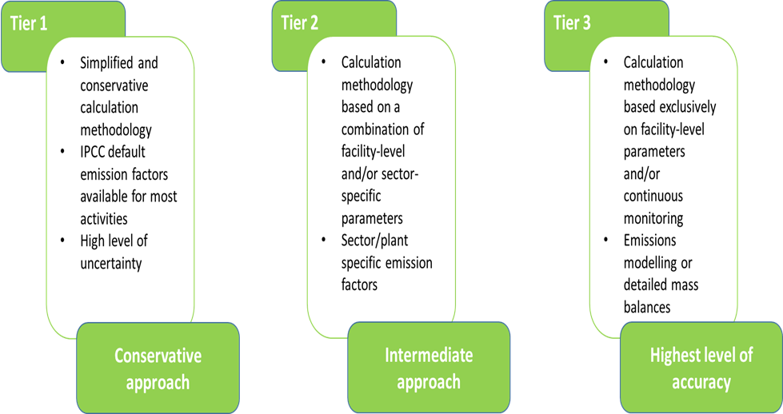
Transitional Arrangements Provision
General methodology which is relevant for all reporting subsectors
Transitional Arrangements
Data providers can apply either any of the tiers when estimating emissions during the first 5 years period after commencement of the regulations.
Regulation date of commencement – 3rd April 2017
End date for transitional period – 3rd April 2022
The next reporting cycle data providers are expected to report using tier 2/tier 3.

Slide 4
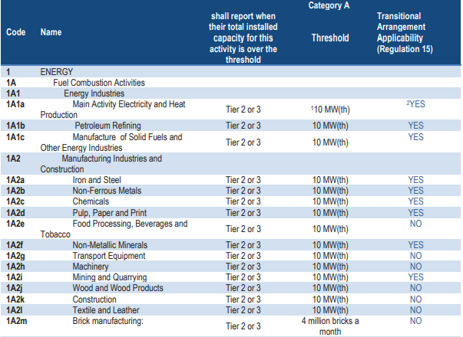
Transitional Arrangements Applicability

Slide 5
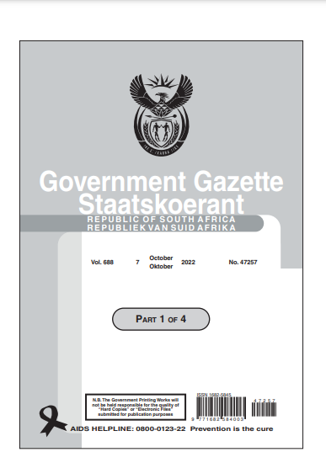
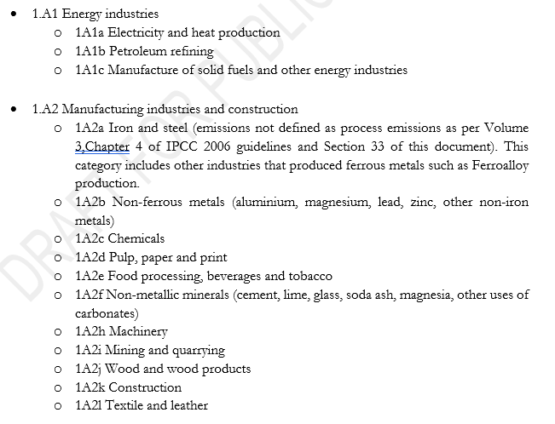
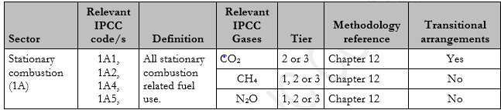
Transitional Arrangements Applicability
Stationary Combustion

Slide 6


THANK YOU!
Directorate: GHG Inventory & Systems
Chief Directorate: Mitigation & Specialist Monitoring Services
Branch: Climate Change & Air Quality
Department of Forestry, Fisheries and the Environment
Tel: 012 399 9195 | Mobile: 082 443 6558
Website: http://www.dffe.gov.za
Address: The Environment House, 473 Steve Biko Road, Arcadia, Pretoria, 0083

