Slide 1

Nairobi • 21 August 2024
Dialogue Session on CBAM and other protectionist measures
Peter Lunenborg
lunenborg@southcentre.int

Slide 2

EU Carbon Adjustment Border Mechanism (CBAM) & green innovation and development in Africa?
First, CBAM increases the costs of exports and directly affects the bottom-line of African producers. A good thing may be that it forces producers to produce greener. However, it could imply less money for R&D or expansion, in other words possibly crowding out investment to increase production
Logic of CBAM is understandable in the presence of domestic Emissions Trading Systems. However, CBAMs should not be more discriminatory than ETS is for domestic producers and be it should be aligned and consistent with international trade rules (WTO and FTAs)
Some issues include
Working capital tied in CBAM certificates required to be held into an account
There is no secondary financial market for CBAM certificates vis a ETS allowances
Implementation of the Verification provisions under CBAM creates knowledgebase in CBAM countries but not in African countries
Impossibility to use carbon credits from green investments to offset CBAM obligations
No additional access to technical knowledge/technology/finance for reducing CO2 emission intensity
Taxes collected from African exports would be used for domestic purposes

Slide 3
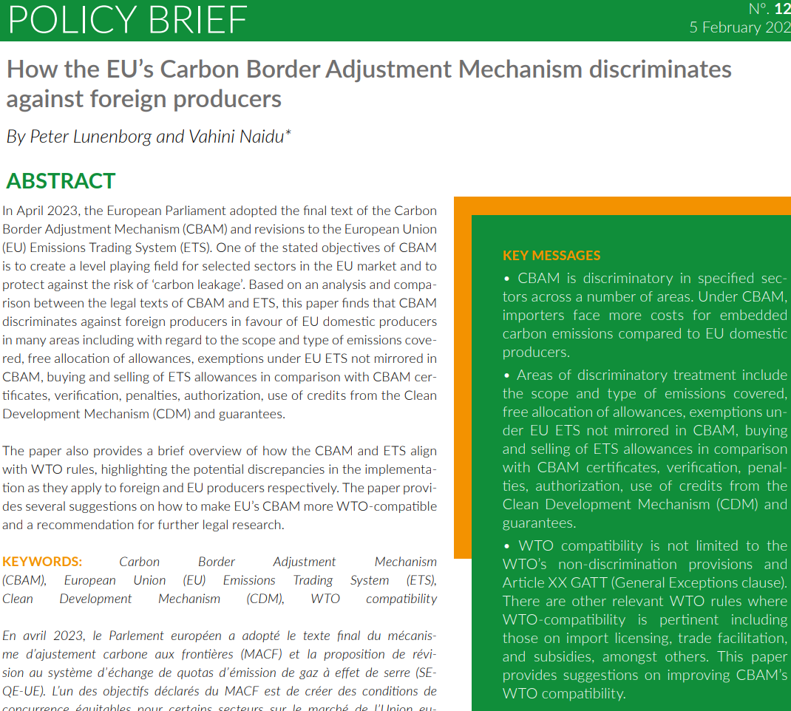
https://www.southcentre.int/policy-brief-124-5-february-2024/

Slide 4
EU Carbon Adjustment Border Mechanism (CBAM) – WTO inconsistencies
Non discrimination
Compliance with other relevant WTO disciplines (e.g. Trade Facilitation Agreement and guarantees, Import Licensing Agreement)

Slide 5
Mitigating risks
Delay implementation of CBAM
  Challenge WTO inconsistencies
  CBAM Implementing Regulations might fall under TBT Agreement and thus comment procedures apply (see. e.g, DS600). Recommendation for 60 days during which the adoption process is frozen and written comments can be sent on the proposed measure
  https://ec.europa.eu/growth/tools-databases/tbt/en/about-tbt/the-notification-procedure-in-brief/

Slide 6
Mitigating risks
CBAM ‘softening’
  Sharing of data to 3rd countries that EU receives under CBAM
    Provision of data in 1st phase – what kind of data should companies provide? Overestimate or underreporting of CO2
  Technical assistance, in particular for MSMEs
  Resource recycling (not only LDCs but perhaps based on reduction potential)
  Recognition of equivalent efforts/carbon credits
  Open up verification of CO2 emissions to African based experts, which would create a cadre of professionals with knowledge and reduce costs for verification of emissions
  Involvement in CBAM Implementing Regulations

Slide 7
Mitigating risks
EU Concessions to South Africa in SADC EPA
  CBAM seems inconsistent with EU’s tariff commitments in SADC EPA → rebalancing
  Art 23.1. A customs duty shall include any duty or charge of any kind, including any form of surtax or surcharge, but shall not include any: (a) internal taxes or other internal charges imposed in accordance with Article 40; or (b) duties imposed in accordance with Chapter II of PART II; or (c) fees or other charges imposed in accordance with Article 27. imposed on or in connection with the importation of goods

Slide 8
Mitigating risks
Supporting action in WTO
  WTO Dispute Settlement
  WTO Committees – Import Licensing Committee (CBAM should have been notified), TF Committee (guarantees), TBT Committee
  Development of guidelines for CBAMs – possibly in WTO Technical Barriers to Trade (TBT) Committee
    See also https://www.netzerotrade.org/
  Development of guidelines for the development and implementation of Trade Related Environmental Measures – possibly in WTO Committee on Trade and Environment (CTE)
    Colombia, African Group made proposals

Slide 9
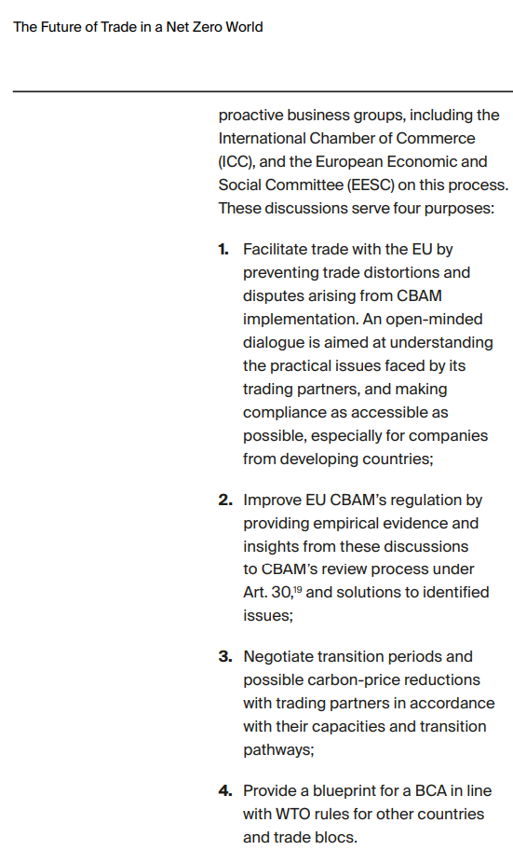
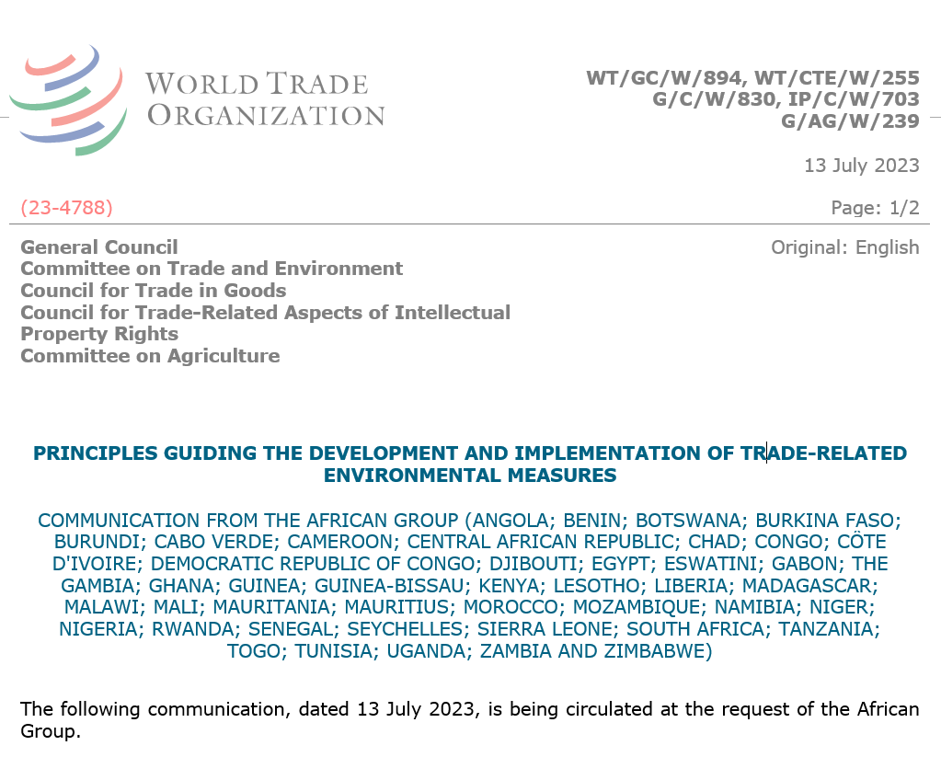

Slide 10




Thank you!
FIND OUT MORE:
www.southcentre.int
@South_Centre
South Centre, Geneva
SouthCentre GVA

