Slide 1
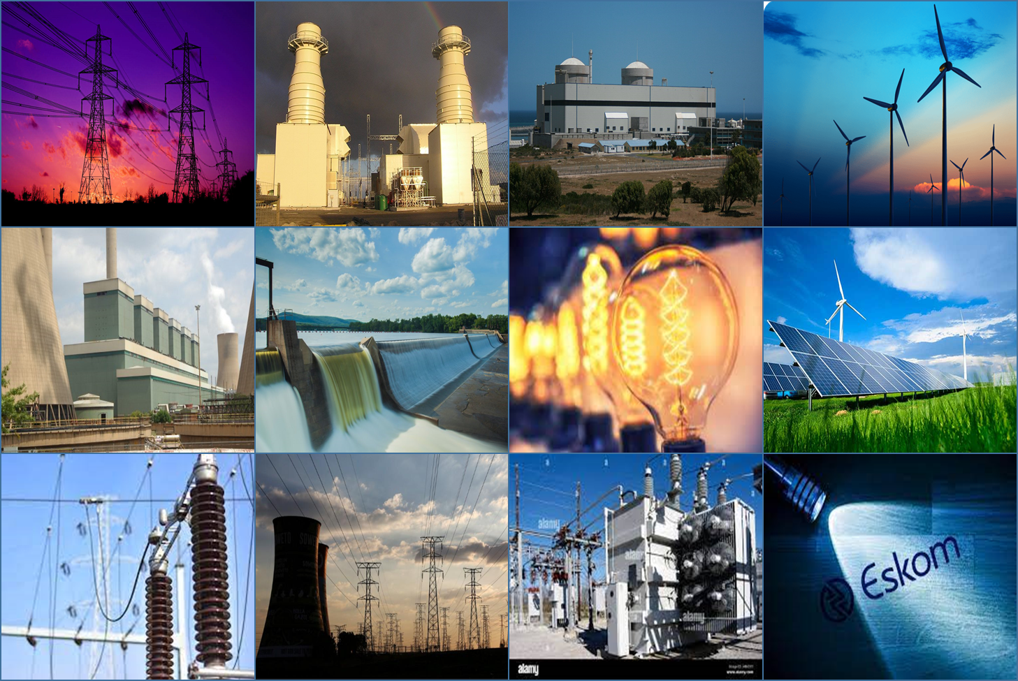

MINISTRY FOR ELECTRICITY AND ENERGY
ADDRESS TO NEDLAC
DR KGOSIENTSHO RAMOKGOPA (MP)
Minister of Electricity and Energy
13 September 2024

Slide 2

INTEGRATED ENERGY PLANNING

Slide 3
INTEGRATED ENERGY PLAN
KEY OBJECTIVES OF THE IEP
Energy security
Affordable energy supply;
Diversification of energy sources;
Emission reduction;
Energy efficiency improvement;
Localisation and job creation;
Conservation of water resources;
Technology transfer
INTEGRATED ENERGY PLAN MAKEUP
KEY
PARAMETERS
Technology Costs (Capital, O&M)
Plant performance
Plant operational life
Other technology parameters
Technology Costs (Capital, O&M)
Plant performance
Plant operational life
Production slates
Other technology parameters
Infrastructure & Technology Costs (Capital, O&M)
Molecules source
Molecules costs.
Anchor demand & volume
Electricity Plan
Liquid Fuel Plan
Gas Master Plan
Electricity generation build plan
Transmission build plan
System Adequacy
Electricity Price Path
Liquid Fuel Supply Options
Liquid fuel supply infrastructure
Location and logistics
Gas development scenarios
Gas price scenarios
Gas supply and infrastructure
Demand location
SCOPE
All primary energy carriers
All primary energy carriers
Indigenous and imported gas
IRP2024
LFMP
GMP 2024

Slide 4
TRANSMISSION EXPANSION AND MODERNISAITON

Slide 5

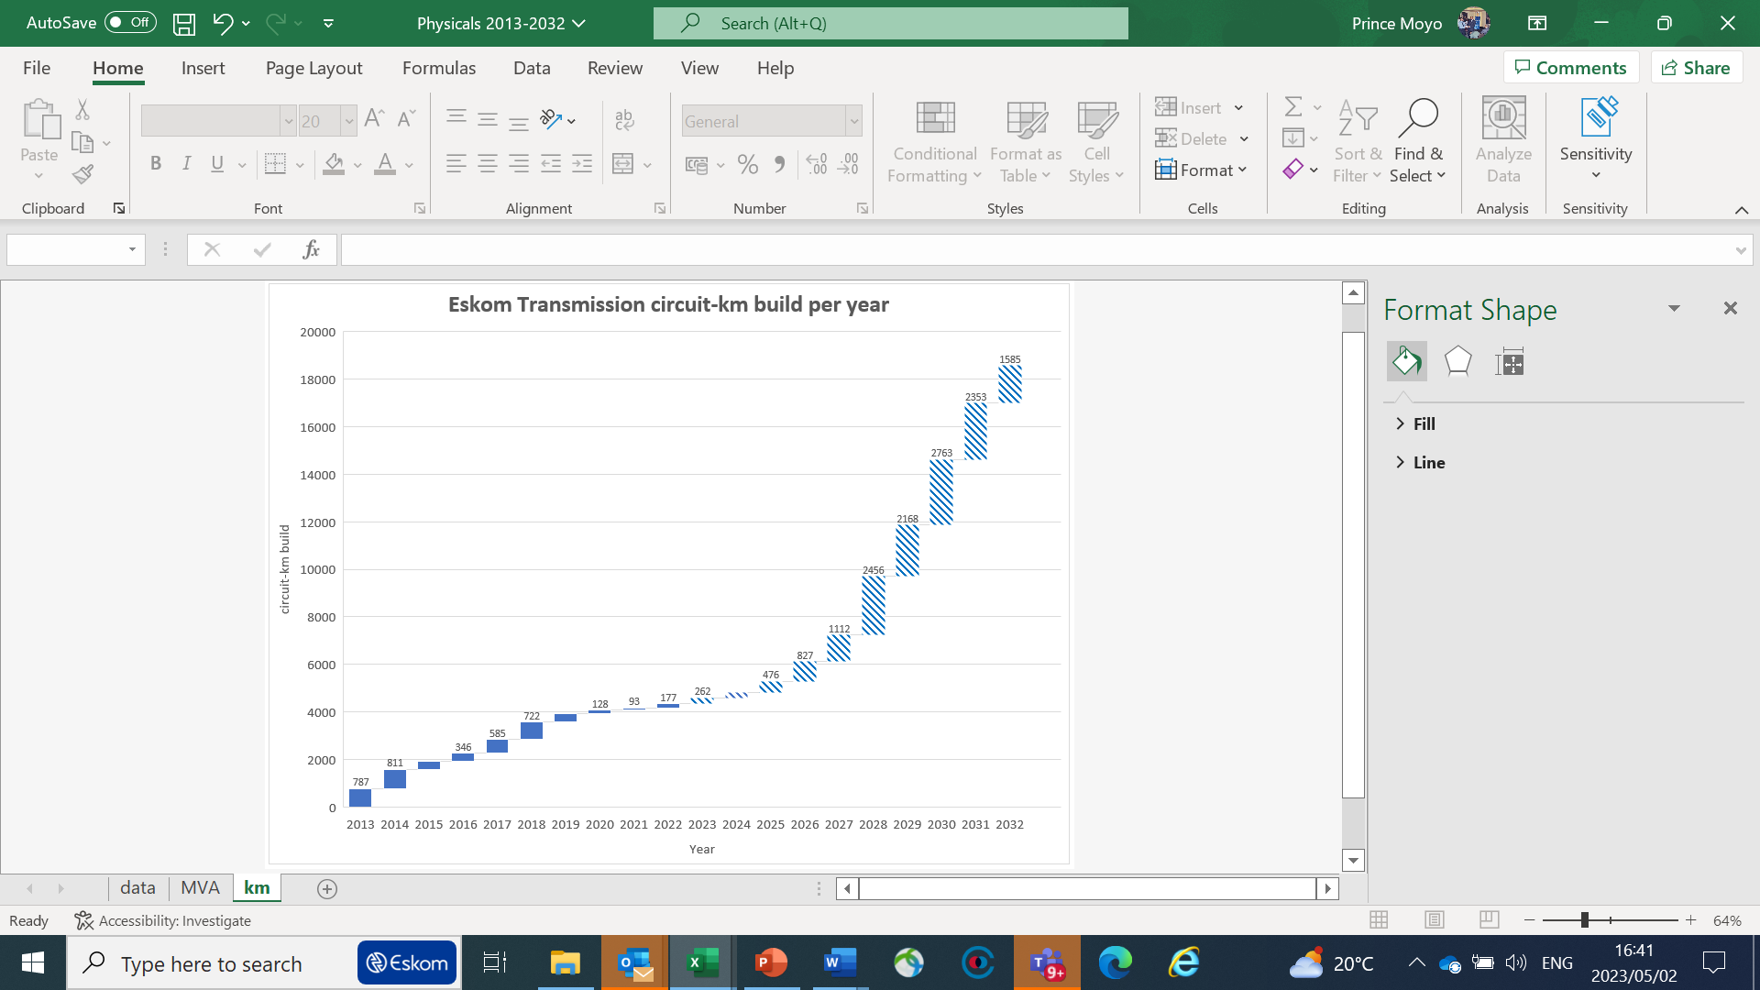
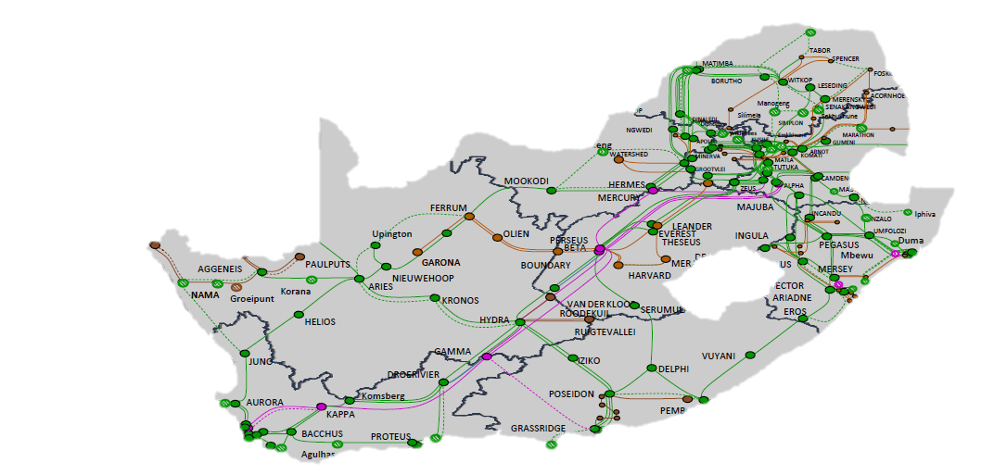
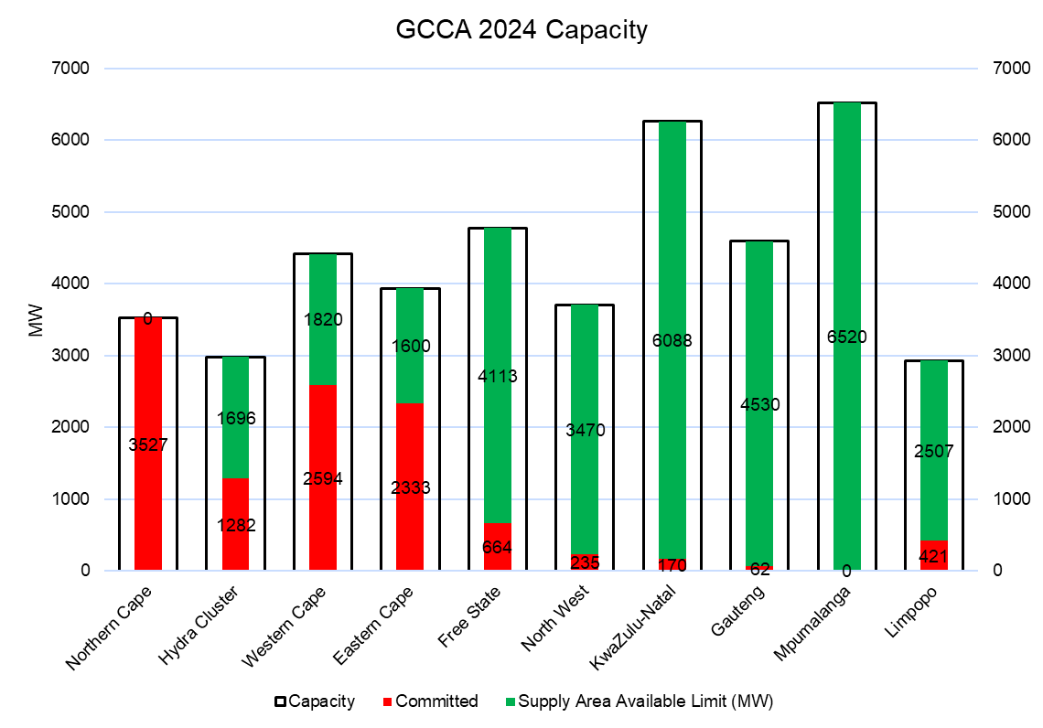
TRANSMISSION PRIORITY CORRIDORS
AVAILABLE GRID CAPACITY ACCORDING TO GCCA* 2024
A survey of project developers conducted by Eskom and the South African Wind Energy Association (SAWEA), and the South African Photovoltaic Industry Association (SAPVIA) shows that 66 GW of wind and solar projects are in development across the country.
14,218km
4,347km
325% increase in transmission infrastructure required over the next 10-years
14 218 circuit km is 43% of current
33 000 circuit km
This demonstrates a robust pipeline of private sector investment in new-generation capacity. Strengthening the transmission network will be key to enabling this investment.
5
ILLUMINATING FINANCING & FUNDING PATHWAYS FOR TRANSMISSION INFRASTRUCTURE DEVELOPMENT

Slide 6
ENABLING SOUTH AFRICA’S ENERGY SECURITY THROUGH PUBLIC/PRIVATE SECTOR PARTICIPATION – DECEMBER 2023 CABINET APPROVED SOLUTION
The most suitable model for South Africa must ensure that the national grid continues with oversight from government with robust regulation by NERSA
Defining the Regulatory & Governance Framework
Cabinet approved transmission finance pathway
December 2023
Appointment of the National Transmission Company of South Africa (NTCSA) Board
The NTCSA Board was appointed in January 2024
The Ministry has deposited its work on transmission finance pathways into the governance processes of the Board
Tariffs
NERSA approved new tariff methodologies in December 2023 but these are likely to be amended once ERA has passed.
Transmission users will be paying transmission charges separately from the energy charges on a MW and/or MWh basis
Some form of nodal or zonal pricing may be required given grid constraints with most renewable energy development occurring in the Cape.
Cost-benefit analyses will be required to determine the level of price signals versus the development of new lines
Licencing
NERSA would be approving the overall transmission tariff methodology including the passthrough costs of ITPs.
Secondary regulations to be developed following ERA will determine NERSA’s role in relation to the TDP (Transmission Development Plan), the selection of lines to be tendered in the short-term and medium-term
Regulatory Framework
Processes to promulgate the Electricity Regulation Amendment Act, following the President’s assenting of the Act into law, are underway.
The Regulatory Framework for scaling capacity and scaling finance into transmission is currently being defined through the drafting of new Transmission Regulations
6
ILLUMINATING FINANCING & FUNDING PATHWAYS FOR TRANSMISSION INFRASTRUCTURE DEVELOPMENT

Slide 7
DISTRIBUTION REFORM AND ENERGY PRICING POLICY

Slide 8
PROBLEM STATEMENT – QUANTITATIVE
The Distribution industry faces numerous systemic challenges
Major Challenges
Other Priority Areas
Municipal Debt
R78Bn in arrear debt (May 2024)
(Munics to Eskom)
R347.6Bn - Owed to Munics (March ’24)
Gvt, Business and H’holds
Losses
Non-technical: High theft
Technical losses
Declining Sales
Grid defection
Economic impact
Customer Experience
Customer Delight Indices exceeding target
Grid Health
SAIDI and SAIFI
better than tolerance limits
Human Capital
People Health Index exceeding target
Unrelenting debt growth
Current levers:
IRFA
NT Debt relief
NMD management
* Based on a 20% upswing from NT intervention and 10% growth on the remaining debt
3195*
Bigger metros are defaulting
Collateral damage to the South African economy
Significant impact to paying customers
Industry
self-destruction!

Slide 9
REVIEWING THE EPP
Ensuring affordability and increasing access to electricity
The highest increase in electricity tariffs is at municipal level and not at the Eskom level
Reducing energy poverty without damaging municipal revenue streams
The Ministry will lead the review of the EPP, which will be finalised for extensive consultation in early 2025
Improving security of supply of electricity towards ensuring a more competitive market and in the long-run reduced real generation costs
Socio-economic considerations ensure energy justice and a better life for all
NERSA process is transparent and ensures that electricity is supplied at the cheapest possible cost to the consumer.
In addition, in part due to socioeconomic considerations, a lower WACC is applied by NERSA thereby directly influencing tariffs
Electricity tariffs need to ensure that the country’s economy remains competitive and that these tariffs do not contribute to structural inflation or make people worse-off.
Regulated pricing is necessary in a small market with multiple different energy carriers supplying electricity.

Slide 10
NUCLEAR INITIATIVES

Slide 11
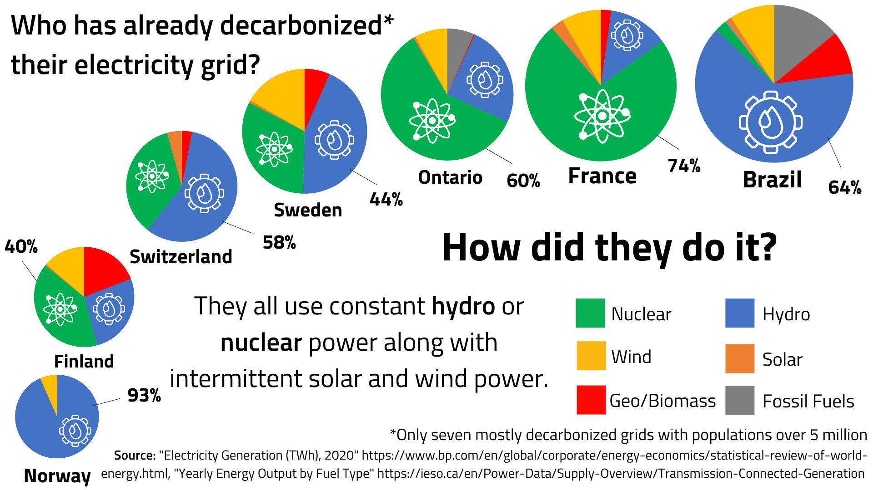
GLOBAL NUCLEAR FOOTPRINT
Nuclear has made a significant contribution to global decarbonisation
Nuclear solves the energy trilemma
Baseload – as a source for development. ALL industrialised countries have grown on the back of baseload power supply
Environmental compliance – nuclear is clean; it does not have greenhouse emissions
Affordability – cheapest form of baseload

Slide 12
GLOBAL NUCLEARFOOTPRINT BY REGION
Nuclear Power Plants in operation
Source: PRIS database. Last update on 2024-09-10

Slide 13
GLOBAL NUCLEARFOOT PRINT BY REGION
Nuclear Power Plants in Construction

Slide 14
NUCLEAR ENERGY: CLEAN BASELOAD
Energy is the backbone and catalyst for growth in any economy
The carbon border adjustment mechanism will increasingly require clean base load to maintain access to global markets
Clean baseload power opens up opportunities for collaboration with ESG-sensitive partners while ensuring security of supply. Socio-economic considerations ensure energy justice and a better life for the people
South Africa has significant Uranium natural resources (Estimated 6% of the world total).
South Africa produced 6000 tons of Uranium per annum between 1982-1985.
Uranium extraction and beneficiation presents significant opportunity for beneficiation and industrialization

Slide 15
GLOBAL ACCEPTANCE OF NUCLEAR ENERGY
Nuclear continues to gain acceptance as a clear source of baseload.
COP 28, held in Dubai, December 2023 and the Subsequent Nuclear Energy Summit in Brussels, March 2024 High-level representatives from various countries emphasized the importance of using nuclear power to achieve energy security, climate goals and drive sustainable development. Increased financing, workforce development and more proactive support to nuclear newcomer countries were identified as key to long-term success.
The EU included in its energy policies the green taxonomy on nuclear which is aimed at supporting a range of low-carbon technologies while addressing the associated environmental and safety concerns.
The global trend reflects an increased acceptance of nuclear as a clean Baseload Power source and its role in achieving sustainable energy systems and addressing climate change
The EU included in its energy policies the green taxonomy on nuclear which is aimed at supporting a range of low-carbon technologies while addressing the associated environmental and safety concerns.

Slide 16
NECOM: UPDATE AND REVISED STRUCTURE

Slide 17
NECOM OVERALL PROGRESS SUMMARY:
As at September 2024
Not yet commenced
Completed
On track
Some delays, no intervention
Off track, intervention needed
Critical challenges
21 actions completed
21 actions completed
11 actions on track
12 actions on track
8 actions progressing with no intervention needed
7 actions progressing with delays
8 actions off-track and requiring intervention
9 actions off-track and requiring intervention
2 actions facing critical challenges (may not materialize)
1 actions facing critical challenges (may not materialize)
0 actions not started
0 actions not started

Slide 18
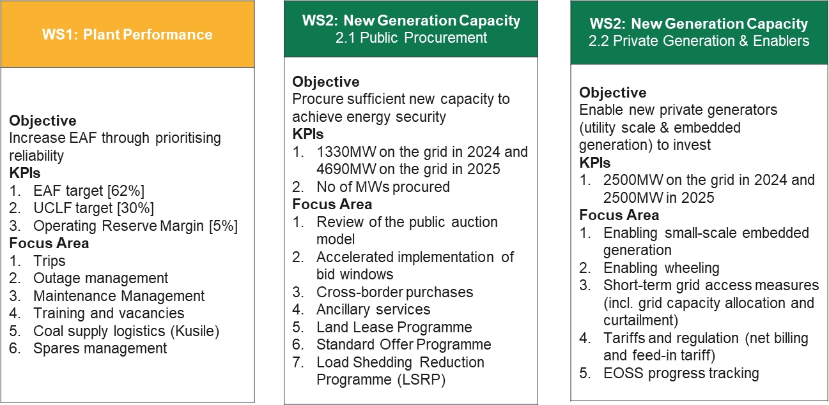
REVISED NECOM STRUCTURE
Objectives, KPI’s and Focus areas

Slide 19
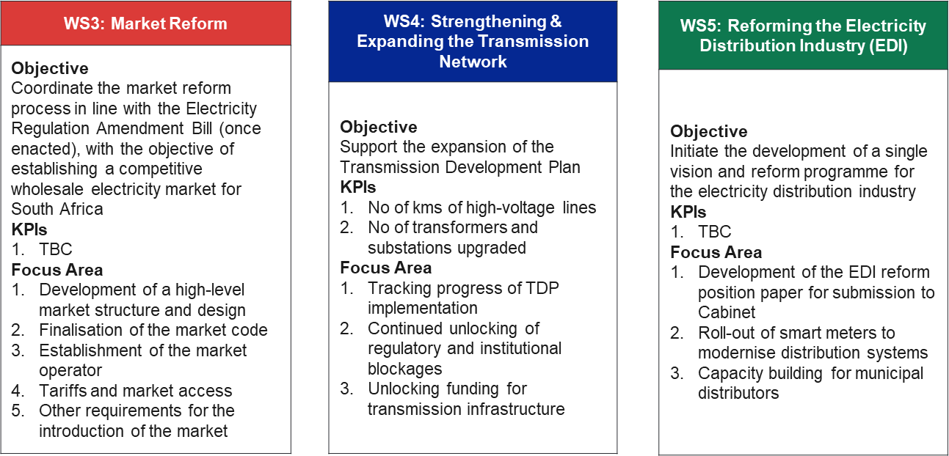
REVISED NECOM STRUCTURE
Objectives, KPI’s and Focus areas

Slide 20
THANK YOU

