Slide 1
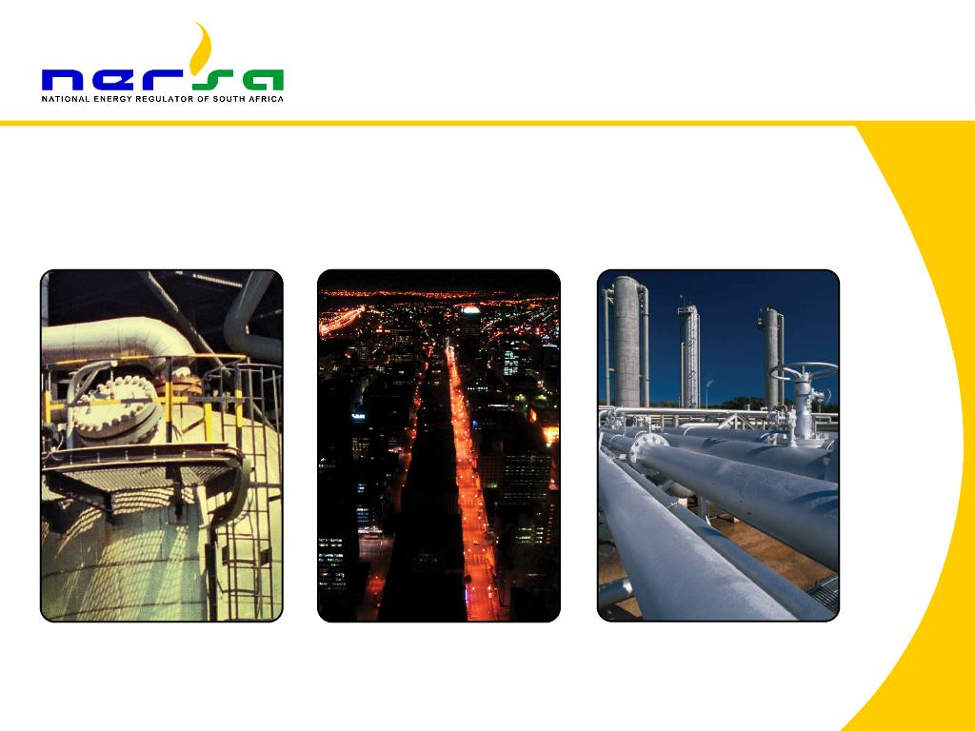
NERSA PRESENTATION OF ITS ANNUAL REPORT FOR 2023/24 AT THE PORTFOLIO COMMITTEE ON ELECTRICITY AND ENERGY (PCEE)
PRESENTATION BY NERSA CHAIRPERSON, MR THEMBANI BUKULA,
16 OCTOBER 2024

Slide 2
Presentation Outline
Executive Summary of detailed presentation
  Introduction
  Overview of performance in 2023/24
    2.1 Key achievements
      2.1.1 Regulatory activities
      2.1.2 Organisational activities
      2.1.3 Financial performance
    2.2 Planned targets not met
    2.3 Auditor General of South Africa (AGSA) report
  Main challenges for the 2023/24 financial year
  Conclusion
  Detailed presentation on organisational performance (from slide 34 - 90)
2

Slide 3
Executive summary of detailed presentation
3

Slide 4
Introduction
4

Slide 5
Introduction
  To gain a perspective on NERSA’s performance in respect of its planned target – it should be borne in mind that NERSA’s targets relate to –
    the regulation of three energy industries, namely electricity, piped gas and petroleum pipelines; including
    cross-cutting regulatory and organisational functions.
  NERSA’s functions are grouped into the following programmes:
    Programme 1: Regulatory Service Delivery
    Programme 2: Regulatory Advocacy and Engagement
    Programme 3: Innovation
    Programme 4: Operational Efficiency and Quality Management
    Programme 5: People and organisational culture
  The above programmes are linked to Government’s Medium-Term Strategic Framework (MTSF) priorities and policies.
5

Slide 6
Overview of performance in 2023/24
6

Slide 7
2.1 Key achievements
7

Slide 8
Key achievements – Summary
  NERSA achieved 63/65 (97%) of its annual performance targets for 2023/24. This signifies an overall increase of 8% in the performance when compared to the overall performance of 89% in 2022/23.
  The above achievement can be broken down as follows:
      Regulation of the electricity industry: 92% achievement, which signifies an increase of 17% in the performance when compared to 2022/23, where 75% of the planned targets were met.
      Regulation of the piped-gas industry: 100% achievement, which signifies the same level of performance when compared to 2022/23, where 100% of the planned targets were met.
      Regulation of the petroleum pipelines industry: 100% achievement, which signifies the same level of performance when compared to 2022/23, where 100% of the planned targets were met.
      Support Functions: 100% achievement, which signifies an 18% increase compared to 2022/23, where 14/17 (82%) of the planned targets were met.
      People and organisational culture environment: 88% achievement, which signifies an increase of 10% in performance when compared to 2022/23, where 78% of the planned targets were met.
  NERSA remains committed to continued improvement in its performance.
8

Slide 9
2.1.1 Key achievements:
Regulatory activities
9

Slide 10
Key achievements – Regulatory activities (1)
  A. Electricity Regulation
  Approved the following:
      Issuance of 3 licences to the National Transmission Company of South Africa (NTCSA). namely transmission, import export and trading licences.
      48 Licence applications amended within 120 working days.
      6 Licence applications for electricity generation facilities, mostly from the preferred bidders of the Renewable Energy Independent Power Producer Procurement (REIPPP) Programme bid window 6 were approved in terms of the Electricity Regulation Act of 2006 (ERA).
  Achieved the following:
      62/57 (109%) of distribution compliance audits executed (conducted five more compliance audits than planned).
      34/35 (97%) of the planned enforcement licence conditions for distribution, transmission and generation were executed in the local municipalities.
  3. Approved the following:
      4 Reports on distribution, transmission, and generation audits.
      4 Reports on the distribution, transmission and generation of the non-compliance findings.
      4 Quarterly reports on engagements with customers and stakeholders
10

Slide 11
Key achievements – Regulatory activities (2)
  B. Piped-Gas Regulation
  Approved the following:
      12/12 (100%) applications for maximum prices of gas.
      3 applications on transmission tariffs.
      5 applications for licences to construct and operate gas facilities and trade in gas.
      3 applications for amendment of licence applications.
      11/11 (100%) monitoring reports per licensee on the implementation of Maximum Prices.
  Approved or noted the following:
      4 quarterly calculations of the ROMPCO tariff for gas volumes below 120 million Gigajoule were noted.
      12 monthly reports on volumes of gas transported from Mozambique to SA were noted.
      3 monitoring reports on compliance with licence conditions were noted.
      3 monitoring reports on the implementation of transmission tariffs were noted.
      3 reports on the developments in new gas sources in South Africa and neighbouring countries were noted.
11

Slide 12
Key achievements – Regulatory activities (3)
  C. Petroleum Pipelines Regulation
  The Energy Regulator approved the following applications:
      35 storage, loading and pipeline facilities tariff applications and 4 were not approved
      4 complete licence applications
        1 to construct marine loading facility and associated petroleum pipelines
        3 to operate a storage facility
      13 applications for licence amendments / revocations
        7 amendments (either extension of construction timelines or additional capacity)
        6 revocations (mainly due to change of ownership)
  The following reports were noted by the PPS and Energy Regulator:
      2 reports on trends regarding utilisation of storage facilities and third-party access
      2 reports on the inland security of supply
      2 reports on the construction of new facilities
      2 reports on licensees’ compliance with statutory reporting requirements
      1 Report on investigations done into suspected unlicensed activities
      1 Complaints lodged against NERSA licensees
12

Slide 13
2.1.2 Key achievements: Organisational activities
13

Slide 14
Key achievements – Organisational activities (1)
  A. Human Resource Management (1)
  Achieved a vacancy rate of 5.9% compared to a 5.5% vacancy rate in the same period for 2022/23.
  Staff strength = 236 employees
      16 (5.9%) vacancies by the end of the review period.
  Finalised the Operating Model Review project
      Aimed to optimize business processes, resource allocation, and the organisational structure in order to enhance efficiency, effectiveness and alignment with strategic goals.
      The next phase of the project will be the implementation of the recommendations of the Operating Model Review.
  Conducted an organisational culture assessment.
      Provided management with valuable insights into the current state of the organisational culture, enabling them to make informed decisions and take actions that foster a positive and productive work environment.
14

Slide 15
Key achievements – Organisational activities (2)
  A. Human Resource Management (2)
  NERSA talent management initiatives continued the implementation of the technical regulatory training programme:
      Aimed at deploying a learning and development strategy geared at building and cultivating a high-performance and highly engaged workforce.
      Aimed to ensure the capacitation and upskilling of roles in the Regulatory Divisions, which is expected to result in excellence, professionalism and innovation within NERSA.
  B. International Coordination and Partnerships
      Continued to be an active member of the Regional Electricity Regulators Association (RERA) and the African Forum for Utility Regulators (AFUR).
      NERSA presented a paper on market reforms at the AFUR Conference of 2023.
15

Slide 16
2.1.3 Key achievements:
Financial performance
16

Slide 17
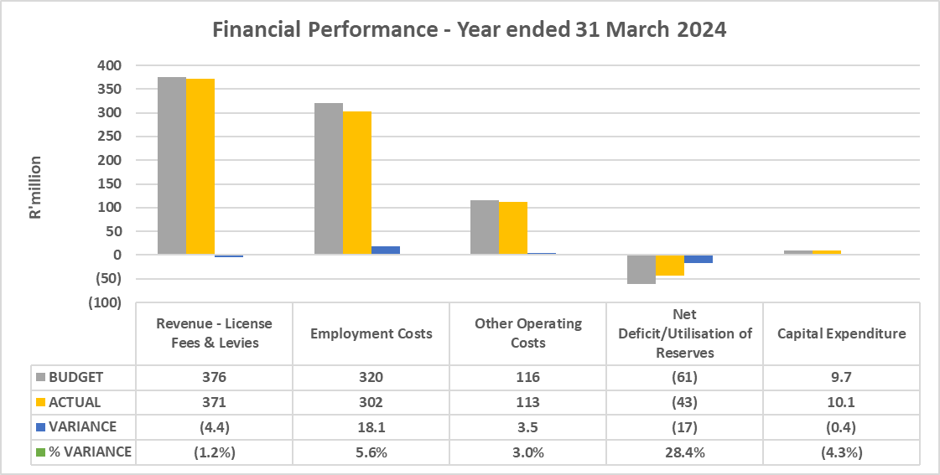
Key achievements – Financial performance (1)
  Revenue was under-recovered by R4,4 million due to lower-than-expected volumes in electricity and petroleum pipelines.
  Employment costs were below budget due to vacancies.
  Operating expenditure was below budget due to fewer travel engagements than expected.
  Net deficit/ utilisation of reserves were lower than expected due to expenditure coming in below budget.
17

Slide 18
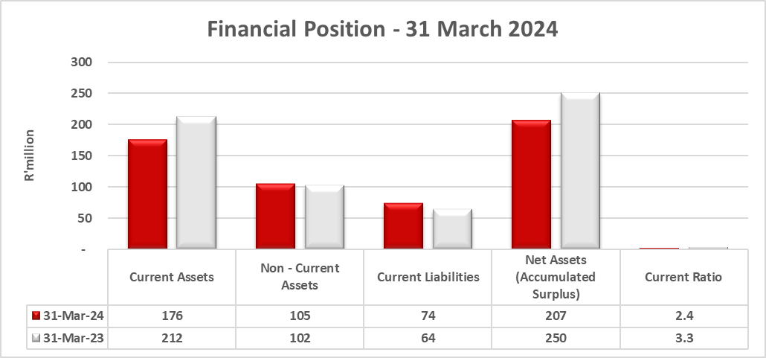
Key achievements – Financial performance (2)
  The financial position as at 31 March 2024, was a positive net asset value of R207 million.
  This was mainly due to cash reserves of R122 million included in current assets invested in the SA Reserve Bank’s Corporation for Public Deposits account.
  The current ratio was at 2.4 where there are sufficient assets to cover current liabilities.
18

Slide 19
Key achievements – Financial performance (3)
  Revenue collection challenges
Actual volumes reported were lower than expected which affected revenue collection in 2023/24.
Electricity generation volumes were 4.3% below budget due to load shedding implemented in 2023 calendar year.
Piped gas volumes were above budget by 11.3% due to increase in demand on gas imports
Petroleum pipeline volumes were significantly lower than expected by 7% due to maintenance shut down on one of the refinery plants which affected export volumes
  .
19

Slide 20
Key achievements – Financial performance (4)
  Revenue collection challenges
Decline in volumes remains a challenge in the budget in forecast years.
Electricity generation volumes are projected to decline further in 2026/27
Piped gas volumes are projected to decline significantly from 2026/27 due to possible depletion of gas reserves
Petroleum pipeline volumes are remaining stagnant due to less product imports through pipelines and possibly closure of refineries
20

Slide 21
2.2 Planned targets not met
21

Slide 22
Planned targets not met
Targets not met | Reason for not meeting targets | Proposed solution
Of the 80% - targeted tools and systems for a changing electricity industry reviewed and developed planned only 70% was achieved | The outcome of the industry Stakeholder consultations was that there is still a need for further consultations to deal with legal implications of the proposed amendments and other technical issues that have emerged in the process. Therefore, the GCAC is not in a position to recommend the amendments to NERSA for approval | The project plan to be revised to cater for more stakeholder consultation meetings and consistently communicate with the Grid Code secretariat for timely arrangements of these meetings
2% of people with disabilities employed was planned and only 1% was achieved | There were two terminations (due to retirement and resignation) of employees with disabilities during the third quarter: One due to retirement and one due to medical | The recruitment process will place specific focus on the recruitment of people with disabilities in 2024/25
22

Slide 23
2.3 Auditor General of South Africa (AGSA) report
23

Slide 24
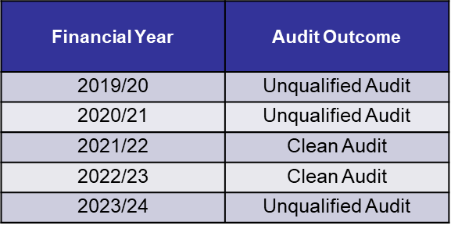
2023/24 Auditor General of South Africa Report (1)
  Annual Financial Statements
  Audit Outcome – Annual Financial Statements
      Unqualified opinion – with no findings (Clean Audit)
  Irregular Fruitless and Wasteful Expenditure
      None reported for 2023/24
  NERSA has had unqualified audits for the last 5 years
24

Slide 25
2023/24 Auditor General of South Africa Report (2)
  Audit Outcome – Performance information
      Unqualified opinion – with material findings. The 12 material findings made by the AG were all under Sub-Programme 1: Electricity Industry Regulator (EIR). These can be categorised into the following areas:
    Missing targets or key performance indicators (KPIs) related to one of the core functions, that is “enforcement performance and compliance and taking appropriate steps in case of non-performance”. The Electricity Division is developing relevant indicators to address the findings. These will be effected in the 2024/25 APP and future plans.
    Reliability and consistency owing to insufficient evidence provided to support achievement. The licensing, customer education and dispute resolution portal is being developed through NERSA’s ICT as part of the automation of NERSA systems.
    Consistency and measurability of 3 key performance indicators. The finding has been addressed by reviewing and updating the affected KPIs and their TIDs in the 2024/25 APP.
    Output indicators not accurately reported and adjusted in the annual performance report. This APR was updated before the audit process concluded.
25

Slide 26
Main challenges for the 2023/24 financial year
26

Slide 27
Main challenges for the 2023/24 (1)
Electricity Industry Regulation
Main challenges | Mitigation actions
Delay in the development of regulatory tools (standard processes, rules, frameworks, pricing methodologies, etc.) | Improve planning and upskilling of some resources in line with the changes in the industry.
Unimplementability of some of the provisions of the Electricity Regulation Act of 2006 | Promulgation of the Electricity Regulation Amendment Act of 2024
Inability of electricity distributors from submitting their cost of supply (CoS) together with their tariff applications for the 2023/24 financial year | NERSA is intensifying training and workshops to assist municipalities develop their cost of supply (CoS) studies this includes assistance by Sustainability Energy Africa a private service provider.
27

Slide 28
Main challenges for the 2023/24 (2)
Piped-Gas Industry Regulation
Main challenges | Mitigation actions
1. Lack of adequate gas supply Current gas supplies are not sufficient to meet demand from industry Hampers growth and competition in the gas market Furthermore, there is possible decline of natural gas supply from Mozambique effective from 2025 | Explore supply opportunities from neighboring countries such as Mozambique/Namibia/Tanzania Importation of LNG to plug supply deficit Gas Masterplan to enable local gas sources as a long-term supply solution
2. Limited mandate under the current Gas Act e.g. distribution tariffs not regulated, no provisions for third party access to gas distribution facilities | Expedite finalization of the Gas Amendment Bill to give NERSA sufficient regulatory powers
28

Slide 29
Main challenges for the 2023/24 (3)
Piped-Gas Industry Regulation
Main challenges | Mitigation actions
3. Inadequate competition in the gas market Market is dominated by one vertically integrated supplier (Sasol Gas) Sasol Gas owns and operates more than 90% of gas infrastructure | NERSA conducted a study to identify measures to facilitate competition, investment and achieve security of supply in the piped-gas industry. A plan was also developed to implement the measures identified to promote competition and investments in the industry Enforce third party access to facilitate entry of new players in the market
29

Slide 30
Main challenges for the 2023/24 (4)
Petroleum Pipelines Industry Regulation
Main challenges | Mitigation actions
Outdated legislation (Petroleum Pipelines Act) for an example enforcement of compliance for below bulk licensees. | Continuous engagements with the Policy Maker on the amending of the legislation.
Overlapping mandates in terms of petroleum infrastructure regulation continue to pose challenges in terms of licensing and alignment of activities. | Through the implementation and operationalisation of the Memorandum of Understanding between NERSA, Transnet National Ports Authority (TPNA), Port Regulator of South Africa (PRSA) authorities have commenced the collaboration, cooperation, and sharing of information to better enable a seamless regulatory.
30

Slide 31
Main challenges for the 2023/24 (5)
Organisational
Main challenges | Mitigation actions
Inability to recruit people living with disabilities. | Partnering with disability organisations/ associations as well as head hunting
Decline in volumes remains a challenge in the budget in forecast years. | Implementation of the developed Financial Sustainability Strategy and Plan
31

Slide 32
Conclusion
32

Slide 33
Conclusion
NERSA is thankful for the opportunity given to present its annual report from 2023/24 financial year.
The results of NERSA’s work continues to have a profound impact on the lives of ordinary people as well as on the economy of the country.
The regulation of the three energy industries continues to pose some challenges in that the Energy Regulator is required to balance the conflicting interests of licensees, investors, consumers/end-users and the policy maker.
There is an urgent need for finalization of the Gas Amendment Bill and the review of the Petroleum Pipelines Act.
To deal with regulatory challenges, NERSA has undertaken various initiatives to refine regulatory practices and methodologies in its quest to become a recognized world-class leader in energy regulation and will continue to do so.
33

Slide 34

Thank you
  Website: www.nersa.org.za
  Tel: 012 401 4600
Fax: 012 401 4700
  Email: info@nersa.org.za
  @NERSAZA
  @NERSA_ZA
34

Slide 35
Detailed presentation on organisational performance
35

Slide 36
Presentation Outline
  Introduction
  Mandate
  Strategic Imperatives
  Corporate Governance
  Performance in the 2023/24 financial year
  Human Resource Management
  International Activities
  Financial performance
  Auditor General of South Africa (AGSA) report
  Main challenges for the 2023/24 financial year and corrective steps being taken
  Conclusion
36

Slide 37
Introduction

Slide 38
Introduction (1)
The National Energy Regulator of South Africa (NERSA), a Schedule 3A Public Finance Management Act, 1999 (Act No. 1 of 1999) Public Entity was established on 1 October 2005 in terms of the National Energy Regulator Act, 2004 (Act No. 40 of 2004) to regulate:
  Electricity industry (Electricity Regulation Act, 2006 (Act No. 4 of 2006));
  Piped-Gas industry (Gas Act, 2001 (Act No. 48 of 2001)); and
  Petroleum Pipelines industry (Petroleum Pipelines Act, 2003 (Act No. 60 of 2003)).
38

Slide 39
Introduction (2)
Governance Structure
In terms of section 5 of the Energy Regulator Act, No. 40 of 2004, the Minister appoints nine (9) Regulator Members:
  Of the nine (9) Regulator Members:
    Four (4) are Full-Time Regulator Members (FTRMs) and hold office for a period of five (5) years
    Five (5) are Part-Time Regulator Members (PTRMs) and hold office for a period of four (4) years
    Chairperson & Deputy Chairperson are Part-Time Members
  Full-Time Regulator Members are:
    Chief Executive Officer
    3 Members each primarily responsible for Electricity, Piped-Gas and Petroleum Pipelines industry regulation
39

Slide 40
Introduction (3)
Regulatory Independence
  In terms of the National Energy Regulator Act the Regulator must act independently when making regulatory decisions.
  In order to ensure regulatory independence, the Energy Regulator has developed regulatory mechanisms (i.e. procedures, rules, guidelines, systems, etc.) that makes its decision-making processes to be open, transparent, credible, consistent, predictable, as well as making it accountable for its decisions.
Revenue and Funding
  NERSA is currently funded through imposing prescribed levies, licence fees and registration fees on the regulated industries following a prescribed transparent procedure.
40

Slide 41
Introduction (4)
NERSA’s overarching role is to:
Ensure the development and sustainability of the electricity, piped-gas and petroleum pipelines industries;
      while facilitating the affordability of and accessibility to the three regulated industries to balance the economic interests of all stakeholders
      to ensure the sustainable socio-economic development of South Africa and a better life for all.
41

Slide 42
Vision
‘To be a recognized world-class leader in energy regulation’
Mission
‘To regulate the energy industry in accordance with government laws and policies, standards and international best practices in support of sustainable and orderly development’
42

Slide 43
Mandate
43

Slide 44
Mandate (1)
NERSA’s mandate is anchored in:
  4 Primary Acts:
    National Energy Regulator Act, 2004 (Act No. 40 of 2004)
    Electricity Regulation Act, 2006 (Act No. 4 of 2006)
    Gas Act, 2001 (Act No. 48 of 2001)
    Petroleum Pipelines Act, 2003 (Act No. 60 of 2003)
  3 Levies Acts:
    Gas Regulator Levies Act, 2002 (Act No. 75 of 2002)
    Petroleum Pipelines Levies Act, 2004 (Act No. 28 of 2004)
    Section 5B of the Electricity Act, 1987 (Act No. 41 of 1987)
  3 Facilitating Acts:
    Public Finance Management Act, 1999 (Act No. 1 of 1999) (PFMA)
    Promotion of Access to Information Act, 2000 (Act No. 2 of 2000) (PAIA)
    Promotion of Administrative Justice Act, 2000 (Act No. 3 of 2000) (PAJA)
    Protection of Personal Information Act, 2013 (Act No. 4 of 2013) (POPIA)
44

Slide 45
Mandate (2)
NERSA’s mandate is summarised as follows:
  Issuing of licences and setting pertinent conditions
  Setting and/or approving tariffs and prices
  Monitoring and enforcing compliance with licence conditions
  Dispute resolution including mediation, arbitration and the handling of complaints
  Gathering, storing and disseminating industry information
  Setting of rules, guidelines and codes for the regulation of the three industries
  Determination of conditions of supply and applicable standards
  Registration of import and production activities
  In executing its mandate NERSA endeavours to balance the conflicting interest of both licensed entities and end users.
45

Slide 46
Strategic Imperatives
46

Slide 47
Impact Statements
Electricity Industry Regulation | A stable and accessible Electricity Industry that supports an improved quality of life and economic activity
Piped-Gas Industry Regulation | Efficient, safe, effective, sustainable, accessible, competitive and transformed piped-gas industry
Petroleum Pipelines Industry Regulation | Efficient, safe, effective, sustainable, competitive and transformed petroleum pipelines industry
Support services | NERSA established and perceived as an efficient, effective and credible regulator
47

Slide 48
Corporate Governance
48

Slide 49
Corporate Governance (1)
  NERSA is committed to good corporate governance. It adopted the Corporate Governance Handbook containing corporate governance rules and prescripts.
  The provisions of the National Energy Regulator Act, 2004 (Act No. 40 of 2004), the PFMA, and the principles contained in the King IV Report on Corporate Governance are included in the Corporate Governance Handbook to which NERSA adheres.
  NERSA ensures declaration of interest.
  In adhering to best practices and sound governance principles, the Energy Regulator subjects itself to an annual assessment on the effectiveness of the Energy Regulator and its committees.
49

Slide 50
Corporate Governance (2)
Oversight
  The Parliamentary Portfolio Committee (PPC) on Electricity and Energy has oversight of NERSA
Executive Authority
  The Executive Authority of the National Energy Regulator is the Minister of Electricity and Energy.
  The Energy Regulator submitted a number of statutory documents to the Executive Authority (DMRE), namely:
  The Annual Performance Plan (2023/24 – 2025/26) submitted by 31 January 2023 to the Minister of Mineral Resources and Energy and approval and tabling in Parliament.
  4 quarterly performance reports submitted within prescribed timeframes
  The Annual Report (2023/24) was submitted to the Minister of Mineral Resources and Energy, the Minister of Finance, and the Auditor-General by August 2024.
Accounting Authority
  The Energy Regulator, as the Accounting Authority, retains full and effective control over NERSA.
50

Slide 51
Energy Regulator Subcommittees and Committees
  Regulatory Subcommittees – open to the public except where confidential matters are to be considered:
  Electricity Subcommittee (ELS)
  Piped-gas Subcommittee (PGS)
  Petroleum Pipelines Subcommittee (PPS)
  Crosscutting Subcommittees – open to the public except where confidential, organisational, or governance matters are to be considered:
  Regulator Executive Committee (REC)
  Governance Committees – not open to the public:
  Human Resource and Remuneration Committee (HRRC)
  Finance Committee (FIC)
  Audit and Risk Committee (ARC)
  Information Technology Governance Committee (ITGC)
51

Slide 52
Risk Management
  The Energy Regulator approved the Risk Appetite and Tolerance Thresholds for the organisation.
  Progress made with mitigating the top 9 risks was reported in the quarterly performance reports.
  NERSA has embarked on the implementation of the Combined Assurance Framework and Model.
Internal Audit
  The Internal Audit Unit completed all audits planned for the period under review.
  An external five-year quality assessment of the Internal Audit Activity was conducted in 2024 and a ‘generally conform’ rating – the highest rating available – was obtained.
52

Slide 53
Compliance monitoring
  NERSA reports on compliance with the PFMA and Treasury Regulations in its quarterly reports submitted to the Executive Authority (Minister).
  All policies and procedures approved by the Energy Regulator are maintained in the Corporate Governance Handbook and are complied with.
Fraud and Corruption
  A fraud policy and a fraud prevention plan are in place.
  A fraud hotline is in place, which is operated by an external service provider and guarantees the anonymity of any person calling in to report suspected fraud, corruption or misuse of public resources.
  No cases of fraud were reported during the financial year.
53

Slide 54
5. Performance in the 2023/24 financial year
54

Slide 55
Performance in the 2023/24 financial year
  NERSA achieved 63/65 planned targets amounting to 97% overall achievement for 2023/24. This signifies a 8% increase when compared with 89% in the 2022/23.
Financial Year | Annual Actual Achievement | Audit Outcome
2019/20 | 79% | Unqualified Audit
2020/21 | 88% | Unqualified Audit
2021/22 | 90% | Clean Audit
2022/23 | 89% | Clean Audit
2023/24 | 97% | Unqualified Audit
55

Slide 56
Programmes for 2024/25
Annual Performance Plan (APP)
NERSA’s Performance is in line with the approved Annual Performance Plan (2023/24 – 2025/26) and the report is organised as follows:
Programme 1: Regulatory Service Delivery
Programme 2: Advocacy And Engagement
  Programme 3: Innovation
  Programme 4: Operational Efficiency and Quality Management
  Programme 5: People and Organisational Culture
  The above programmes are linked to Government’s Medium Term Strategic Framework (MTSF) priorities and policies.
56

Slide 57
Overall performance against planned outputs and targets (1)
 | Planned Annual Targets |  | Annual Targets Met |  | Reasons for Annual Targets Not Met
 |  |  |  |  | External Dependencies |  | Internal factors
 | 2022/23 | 2023/24 | 2022/23 | 2023/24 | 2022/23 | 2023/24 | 2022/23 | 2023/24
Programme 1: Regulatory Service Delivery
Electricity Industry Regulation | 7 | 9 | 5/7 (71%) | 8/9 (89%) | 0 (0%) | 1/9 (11%) | 2/7 (29%)1 | 0 (0%)
Piped-Gas Industry Regulation | 16 | 17 | 16/16 (100%) | 17/17 (100%) | 0 (0%) | 0 (0%) | 0 (0%) | 0 (0%)
Petroleum Pipelines Industry Regulation | 12 | 14 | 12/12 (100%) | 14/14 (100%) | 0 (0%) | 0 (0%) | 0 (0%) | 0 (0%)
Programme 2: Advocacy And Engagement
Electricity Industry Regulation | 5 | 4 | 4/5 (80%) | 4/4 (10%) | 0 (0%) | 0 (0%) | 1/5 (20%) | 0 (0%)
Piped-Gas Industry Regulation | 2 | 2 | 2/2 (100%) | 2/2 (100%) | 0 (0%) | 0 (0%) | 0 (0%) | 0 (0%)
Petroleum Pipelines Industry Regulation | 2 | 2 | 2/2 (100%) | 2/2 (100%) | 0 (0%) | 0 (0%) | 0 (0%) | 0 (0%)
Support Functions | 3 | 2 | 3/3 (100%) | 2/2 (100%) | 0 (0%) | 0 (0%) | 0 (0%) | 0 (0%)
57

Slide 58
Overall performance against planned outputs and targets (2)
 | Planned Annual Targets |  | Annual Targets Met |  | Reasons for Annual Targets Not Met
 |  |  |  |  | External Dependencies |  | Internal factors
 | 2022/23 | 2023/24 | 2022/23 | 2023/24 | 2022/23 | 2023/24 | 2022/23 | 2023/24
Programme 3: Innovation
Support Functions | 2 | 1 | 2/2 (100%) | 1/1 (100%) | 0 (0%) | 0 (0%) | 0 (0%) | 0 (0%)
Programme 4: Operational Efficiency and Quality Management
Support Functions | 12 | 6 | 9/12 (75%) | 6/6 (100%) | 0 (0%) | 0 (0%) | 3/12 (25%) | 0 (0%)
Programme 5: People and Organisational Culture
People and Organisational Culture | 9 | 8 | 7/9 (78%) | 7/8 (88%) | 0 (0%) | 1/8 (13%) | 2/9 (22%) | 0 (0%)
Total | 70 | 65 | 62/70 (89%) | 63/65 (97%) | 0/70 (0%) | 2/65 (3%) | 8/70 (11%) | 0 (0%)
58

Slide 59
Regulatory Programmes (1)
Programme 1: Regulatory Service Delivery
Sub-Programme: Electricity Industry Regulation
Key activities achieved in 2023/24
During the 2023/24 reporting period the Energy Regulator facilitated a stable and accessible Electricity Industry that supports an improved quality of life and economic activity through the following key outputs: Energy Regulator (ER) approved electricity prices for Eskom and the Regulator Executive Committee (REC) approved the Municipal electricity prices (The Electricity Price Determination Rules) in December 2023. 48/48 (100%) licence applications amended and approved by the Energy Regulator within 120 working days. 415/415 (100%) applications for electricity generation facilities were issued and approved by the Full-Time Regulator Member (FTRM) within 45 working days, in terms of Scheduled 2 of the Electricity Regulation Act of 2006 (ERA). 62/57 (109%) distribution compliance audits executed and reports produced. Target overachieved by 9%. 292/296 (99%) of complaints and disputes received including initiated investigations were closed within 120 working days upon receipt. 4 reports on the analysis of distribution, transmission, and generation compliance audits approved by Electricity subcommittee (ELS). 34/35 (97%) distribution, transmission and generation enforcement plans were conducted in the local municipalities. Four reports on distribution, transmission and generation on the non-compliance finding approved by ELS.
Strategic Outcomes | Envisaged Impact
Efficiency in facilitating entry, setting prices and resolving disputes A stable and diverse energy sector system and pricing regime that supports access through regulatory services that are delivered on time and to quality standards | A stable and accessible Electricity Industry that supports an improved quality of life and economic activity
MTSF Priority 2: Economic transformation and job creation
59

Slide 60
Regulatory Programmes (2)
Programme 1: Regulatory Service Delivery
Sub-Programme: Piped-Gas Industry Regulation
Key activities achieved in 2023/24
During the 2023/24 reporting period the Energy Regulator facilitated an efficient, safe, effective, sustainable, accessible, competitive and transformed piped-gas industry through the following outputs: 100% (11/11) applications for complete maximum price of gas were approved within 120 working days after date of publication of the preliminary assessment of the maximum price applications by the Energy Regulator (ER). 100% (7/7) of applications on transmission tariffs were considered and approved by the ER. 4 quarterly calculation of the ROMPCO tariff for gas volumes below 120 million Gigajoule were noted by the ER. 100% of licence applications within 60 days from date of close of public comment period or period of applicant’s response to objections received; Three (3) applications on transmission tariffs were approved by the ER. 12 monthly volumes of gas transported from Mozambique to SA were noted by the Piped-Gas Subcommittee (PGS).
Strategic Outcomes | Envisaged Impact
Efficiency in facilitating entry, setting prices and resolving disputes A stable and diverse energy sector system and pricing regime that supports access through regulatory services that are delivered on time and to quality standards | Efficient, safe, effective, sustainable, accessible, competitive and transformed piped-gas industry
MTSF Priority 2: Economic transformation and job creation
60

Slide 61
Regulatory Programmes (3)
Programme 1: Regulatory Service Delivery
Sub-Programme: Piped-Gas Industry Regulation
Key activities achieved in 2023/24
During the 2023/24 reporting period, the Energy Regulator facilitated an efficient, safe, effective, sustainable, accessible, competitive and transformed piped-gas industry through the following outputs: Three (3) reports on the developments in new gas sources in South Africa and neibouring countries were noted by Piped Gas Subcommittee (PGS). One (1) audit report on the compliance of ROMCO pipeline was considered and noted by the PGS. Three (3) reports on developments in new gas sources in South Africa and neighbouring countries were noted by ER. Two (2) stakeholder engagement workshop reports were noted by PGS. Two reports on regulatory advocacy aimed at improving the regulatory framework were approved by ER 100% (5/5) licence applications considered and noted by the REC within 60 days from date of close of public comment or period of applicants’ responses to the objections received. Four (4) quarterly calculations of ROMPCO tariff for gas volumes below 120 million Gigajoule were noted by PGS. Three (3) monitoring reports on compliance with licence conditions were noted by PGS.
Strategic Outcomes | Envisaged Impact
Efficiency in facilitating entry, setting prices and resolving disputes A stable and diverse energy sector system and pricing regime that supports access through regulatory services that are delivered on time and to quality standards | Efficient, safe, effective, sustainable, accessible, competitive and transformed piped-gas industry
MTSF Priority 2: Economic transformation and job creation
61

Slide 62
Regulatory Programmes (4)
Programme 1: Regulatory Service Delivery
Sub-Programme: Petroleum Pipeline Industry
Key activities achieved in 2023/24
The Energy Regulator approved the following applications: 35 of complete storage, loading and pipeline facility tariff applications approved and 4 were not approved. 100% (4/4) of complete licence applications - one (1) were to construct marine loading facility and associated petroleum pipelines; and three (3) to operate a storage facility. 100% (13/13) applications for licence amendments / revocations. The following reports were noted by the PPS and the ER: One (1) report on investigations done into suspected unlicensed activities. Two (2) reports on trends regarding utilisation of storage facilities and third-party access. Two (2) reports on inland security of supply. Two (2) reports on the construction of new facilities. Two (2) reports on licensees’ compliance with statutory reporting requirements. One (1) report on investigations done into suspected unlicensed activities. Two (2) complaints lodged against NERSA licensees. 100% (1/1) of complaints investigated and report noted by the PPS.
Strategic Outcomes | Envisaged Impact
Efficiency in facilitating entry, setting prices and resolving disputes A stable and diverse energy sector system and pricing regime that supports access through regulatory services that are delivered on time and to quality standards | Efficient, safe, effective, sustainable, competitive and transformed petroleum pipelines industry
MTSF Priority 2: Economic transformation and job creation
62

Slide 63
Organisational Programmes (1)
Programme 2: Advocacy And Engagement
  Programme 3: Innovation
  Programme 5: People and Organisational Culture
Key activities achieved in 2023/24
During the 2023/24 reporting period the Energy Regulator facilitated the following outputs to ensure NERSA is established and perceived as an efficient, effective and credible regulator. Two (2) reports on partnership creation to position NERSA as a recognised regulator nationally, regionally and internationally, considered and were noted by the REC. One (1) report on the implementation of stakeholder engagement plan approved by the REC. Four (4) reports on the implementation of the approved ICT Strategy approved by the Information Technology Governance Committee (ITGC). Four (4) reports on the implementation of the Youth Accord was noted by the HRRC. One report on the impact of global, regional and local energy trends on NERSA’s business approved by the REC; and one (1) report on the organisational culture assessment was noted by the HRRC. Unqualified audit opinion achieved. One (1) report on the implementation of gender mainstreaming initiatives noted by the REC. Skills development (bursary programme, regulatory courses) implemented.
Strategic Outcomes | Envisaged Impact
Integrated and value-added services to customers Innovation drives our response to the transition of the industry | ERSA established and perceived as an efficient, effective and credible regulator.
MTSF Priority 1: Capable, Ethical and Developmental State MTSF Priority 7: A better Africa and world
63

Slide 64
Organisational Programmes (2)
Programme 4: Operational Efficiency and Quality Management
Key activities achieved in 2023/24
Review of Regulatory Reporting Manuals for Financial and Non-financial Information Unqualified Audit Opinion Financial Sustainability Strategy and Plan Implementation of gender mainstreaming initiatives Broad-based Black Economic Empowerment (B-BBEE) rating improved annually Benchmarking of NERSA’s operational processes against international standards Environmental scanning conducted
Strategic Outcomes | Envisaged Impact
Integrated and value-added services to customers Innovation drives our response to the transition of the industry | NERSA established and perceived as an efficient, effective and credible regulator
MTSF Priority 1: Capable, Ethical and Developmental State MTSF Priority 7: A better Africa and world
64

Slide 65
6. Human Resource Management
65

Slide 66
Staff development (1)
  Training interventions included the upskilling of managers through management and leadership development interventions. The foundation for the NERSA leadership and development programme was laid by the finalisation of the Heads of Department’s (HODs) leadership and competency assessments.
  NERSA continued to support the beneficiaries of its Bursary Programme, which boasts a beneficiary base of 75% women. With the aim of funding deserving students who intend to pursue postgraduate studies in areas of value to NERSA.
  Four students at a postgraduate level were awarded bursaries during 2023/24, with two students studying towards their PhD degrees and two studying towards their Master’s degrees.
  The NERSA Youth Employment Strategy aims to facilitate the integration of young people into the mainstream economic activities of the energy sector through the creation of decent work opportunities and unlocking learning development opportunities to ensure sustainable livelihoods and reduce income inequalities.
66

Slide 67
Staff development (2)
  In the period under review, 12 learners were appointed to embark on NERSA’s Learnership Programme to attain a National Certificate: Energy Regulation NQF Level 5 – SAQA ID 63209.
  Out of the 24 appointed learners and interns, 12 of the learners and interns are female which accounts for 50% of the cohort. This is true to the NERSA ethos and Employment Equity Strategy of ensuring the increased representation of women within the Energy Sector.
  NERSA’s Job-Shadowing Programme exposes female learners from grades 9 to 11 to different energy industry careers. During the reporting period, the programme had an intake of 10 learners from previously disadvantaged communities. NERSA presents this programme in partnership with Uweso Consulting and the Department of Women, Youth and Persons with Disabilities.
67

Slide 68
Staff analysis
  Achieved a vacancy rate of 5.9% compared to a 5.5% vacancy rate in the same period for 2022/23.
  Staff strength = 236 employees
      16 (5.9%) vacancies by the end of the review period.
 | 2022/23 | 2023/24
Total staff complement | 252 | 252
Total staff strength | 238 | 236
Vacancies | 14 | 16
68

Slide 69
7. International Activities
69

Slide 70
Regional Energy Regulatory Association of Southern Africa (RERA)
  NERSA is a Member of the Executive Committee of RERA and chairs the following:
  Portfolio Committee on Energy Sector Policy, Legislation and Trade (PC–EPLT)
  Gas, Petroleum and Biofuels Subcommittee (GPBRS).
RERA Objectives:
  Capacity Building and Information Sharing;
  Facilitation of Electricity Supply Industry Policy, Legislation and Regulations; and
  Regional Regulatory Cooperation.
RERA Membership
Angola - Institute for Electricity Sector Regulation Botswana - Botswana Energy Regulatory Authority Eswatini - Eswatini Energy Regulatory Authority Lesotho - Lesotho Electricity and Water Authority Malawi - Malawi Energy Regulatory Authority (MERA) Mauritius - Utility Regulatory Authority | Mozambique - National Electricity Advisory Council Namibia - Electricity Control Board South Africa - National Energy Regulator of South Africa Tanzania - Energy & Water Utilities Regulatory Authority Zambia - Energy Regulation Board (ERB) Zimbabwe - Zimbabwe Energy Regulatory Authority
70

Slide 71
African Forum For Utility Regulators (AFUR)
  NERSA is a member of AFUR EXCO and Energy Sectoral Committee.
  AFUR focuses on issues related to the regulation of the Energy, Telecommunications, Transport, Water and Sanitation Sectors.
AFUR Objectives:
  Information sharing;
  Capacity building; and
  Harmonisation of regulatory policies and legislation.
AFUR Objectives:
  Information sharing;
  Capacity building; and
  Harmonisation of regulatory policies and legislation.
AFUR Membership
Algeria Benin Burkino Faso Cameroon Cote d’Ivoire Gambia Ghana | Kenya Lesotho Malawi Mali Mauritania Mozambique Namibia | Niger Nigeria Rwanda Senegal South Africa Tanzania Togo | Uganda Zambia Zimbabwe Angola – observer DRC - observer Ethiopia - observer North Sudan - observer
71

Slide 72
Co-operation with other global institutions / organisations
RERA and AFUR continue to enjoy excellent working relationships and support from the:
  African Union (AU);
  SADC Secretariat;
  Southern African Power Pool (SAPP);
  International Confederation of Energy Regulators (ICER);
  Council of European Energy Regulators (CEER);
  Energy Regulators Regional Association (ERRA);
  ECOWAS Regional Electricity Regulatory Authority (ERERA);
  Roundtable of Regional Energy Regulators Associations of Emerging Market;
  German funding agency (GIZ);
  Danish Energy Agency (DEA); and
  National Regulatory Utility Commissioners (NARUC); and
  Minister Counsellor for Economic and Commercial Affairs of the People’s Republic of China.
72

Slide 73
Financial Performance
73

Slide 74
Funding Methodology (1)
  In terms of the National Energy Regulator Act, 2004 (Act No. 40 of 2004) NERSA derives its revenue by, among others, imposing prescribed levies on the regulated industries following a prescribed transparent procedure.
  The following Acts govern the imposition of such levies and fees:
    Section 5B of the Electricity Act, 1987 (Act No. 41 of 1987) – this provides for funding that is levied on licensed electricity generators. The said levy is based on the estimated generation capacity.
    Gas Regulator Levies Act, 2002 (Act No. 75 of 2002) – makes provision for the levy to be payable by users of pipelines (holders of the title to gas at the inlet flange).
    Petroleum Pipelines Levies Act, 2004 (Act No. 28 of 2004) – makes provision for the levy to be payable by users of the pipelines (holders of the title to petroleum at the inlet flange).
74

Slide 75
Funding Methodology (2)
  Costs for industry-specific regulatory functions are ring-fenced.
  Costs that cannot be directly attributed to an industry-specific regulatory function, but are incurred as common costs in order to support the three industry-specific regulatory functions, are allocated between the three industry-specific regulatory functions using the following ratio proportionate to the approved staff complement attributable to the industry-specific function:
    58% for the electricity industry regulation;
    21% for the petroleum pipeline industry regulation; and
    21% for the piped-gas industry regulation.
75

Slide 76
Financial Management (1)
76

Slide 77
Financial Management (2)
  Financial position
The financial position as at 31 March 2024, was a positive net asset value of R207 million. This is mainly due to cash reserves of R122 million included in current assets invested in the CPD account. The current ratio is at 2.4 where there are sufficient assets to cover current liabilities.
77

Slide 78
Auditor General of South Africa (AGSA) report
78

Slide 79
Audit outcomes
The overall audit outcome of the public entity is unqualified with findings. This is a regression from the previous year’s audit outcome.
Outcome area | Movement | 2023-24 | 2022-23 | 2021-22
Financial statements
Annual performance report
Regulatory Service Delivery
Advocacy and engagement
Compliance with legislation
Annual financial statements, performance and annual reports
Procurement and contract management
Expenditure management
Revenue management
Asset management
Consequence management
Strategic planning and performance management
 | Unqualified / No material findings |  | Qualified |  | Adverse |  | Disclaimed |  | Material findings |  | Not audited
 | Improvement |  | Regression |  | Unchanged
79

Slide 80
Auditor General of South Africa (AGSA) Report
  Annual Financial Statements
  Audit Outcome – Annual Financial Statements
      Unqualified opinion – with no findings (Clean Audit)
  Irregular Fruitless and Wasteful Expenditure
      None reported for 2023/24
  NERSA has had unqualified audits for the last 5 years
80

Slide 81
Summary of 2023/24 Audit Findings and
Action Plans (1)
Audit Findings | Audit Action Plan | Status Update – as at 30 September 2024
Output Indicator not accurately reported and adjusted in the annual performance report | The planning documents to be reviewed to ensure there is consistency between the Annual Performance Plan (APP) and the Annual Performance Report (APR). | The reviewed planning documents have been incorporated in the 2024/25 APP and will also be used in the finalization of the 2025 – 2030 Strategic Plan and the 2025/26 APP.
Missing targets NERSA did not develop indicators relating to one of their core functions which is to “enforce performance, and take appropriate steps in the case of non-performance. | Management should ensure that all the indicators relating to the core functions are included in the APP, planned for and targets are also set and that the performance is reported on those specific indicators | The Electricity Division is under a process of developing relevant KPIs to address the finding. findings
81

Slide 82
Summary of 2023/24 Audit Findings and
Action Plans (2)
Audit Findings | Audit Action Plan | Status Update – as at 30 September 2024
Reliability and Consistency AGSA could not determine if reported achievements were correct as adequate supporting evidence was not provided. | Management to ensure that NERSA has a centralised database that will serve as a primary source that is easily and efficiently accessible. | The licensing, customer education and dispute resolution portal is being developed through NERSA’s ICT as part of the automation to streamline receipt of information by stakeholders.
Consistency and Measurability The reported achievement is not consistent with the planned indicator and target: | Review Inconsistencies between the planned document (indicator) and the reporting document (actual achievement) in terms of the method of calculation for the indicator | The finding has been addressed by reviewing and updated KPIs and TIDs in the 2024/25 APP review.
82

Slide 83
Main challenges for the 2023/24 financial year and corrective steps being taken
83

Slide 84
Main challenges for the 2023/24 (1)
Electricity Industry Regulation
Main challenges | Mitigation actions
Delay in the development of regulatory tools (standard processes, rules, frameworks, pricing methodologies, etc.) | Improve planning and upskilling of some resources in line with the changes in the industry.
Unimplementability of some of the provisions of the Electricity Regulation Act of 2006 | Promulgation of the Electricity Regulation Amendment Act of 2024
Inability of electricity distributors from submitting their cost of supply (CoS) together with their tariff applications for the 2023/24 financial year | NERSA is intensifying training and workshops on assisting municipalities to develop their cost of supply (CoS) studies to assist municipalities including assistance by Sustainability Energy Africa a private service provider.
84

Slide 85
Main challenges for the 2023/24 (2)
Piped-Gas Industry Regulation
Main challenges | Mitigation actions
1. Lack of adequate gas supply Current gas supplies are not sufficient to meet demand from industry Hampers growth and competition in the gas market Furthermore, there is possible decline of natural gas supply from Mozambique effective from 2025 | Explore supply opportunities from neighboring countries such as Mozambique/Namibia/Tanzania Importation of LNG to plug supply deficit Gas Masterplan to enable local gas sources as a long-term supply solution
2. Limited mandate under the current Gas Act e.g. distribution tariffs not regulated, no provisions for third party access to gas distribution facilities | Expedite finalization of the Gas Amendment Bill to give NERSA sufficient regulatory powers
85

Slide 86
Main challenges for the 2023/24 (3)
Piped-Gas Industry Regulation
Main challenges | Mitigation actions
3. Inadequate competition in the gas market Market is dominated by one vertically integrated supplier (Sasol Gas) Sasol Gas owns and operates more than 90% of gas infrastructure | NERSA conducted a study to identify measures to facilitate competition, investment and achieve security of supply in the piped-gas industry. A plan was also developed to implement the measures identified to promote competition and investments in the industry Enforce third party access to facilitate entry of new players in the market
86

Slide 87
Main challenges for the 2023/24 (4)
Petroleum Pipelines Industry Regulation
Main challenges | Mitigation actions
Outdated legislation (Petroleum Pipelines Act) for an example enforcement of compliance for below bulk licensees. | Continuous engagements with the Policy Maker on the amending of the legislation.
Overlapping mandates in terms of petroleum infrastructure regulation continue to pose challenges in terms of licensing and alignment of activities. | Through the implementation and operationalisation of the Memorandum of Understanding between NERSA, Transnet National Ports Authority (TPNA), Port Regulator of South Africa (PRSA) authorities have commenced the collaboration, cooperation, and sharing of information to better enable a seamless regulatory.
87

Slide 88
Main challenges for the 2023/24 (5)
Organisational
Main challenges | Mitigation actions
Inability to recruit people living with disabilities. | Partnering with disability organisations/ associations as well as head hunting
Decline in volumes remains a challenge in the budget in forecast years. | Implementation of the developed Financial Sustainability Strategy and Plan
88

Slide 89
Conclusion
89

Slide 90
Conclusion
NERSA is thankful for the opportunity given to present its annual report from 2023/24 financial year.
The results of NERSA’s work continues to have a profound impact on the lives of ordinary people as well as on the economy of the country.
The regulation of the three energy industries continues to pose some challenges in that the Energy Regulator is required to balance the conflicting interests of licensees, investors, consumers/end-users and the policy maker.
There is an urgent need for finalization of the Gas Amendment Bill and the review of the Petroleum Pipelines Act.
To deal with regulatory challenges, NERSA has undertaken various initiatives to refine regulatory practices and methodologies in its quest to become a recognized world-class leader in energy regulation and will continue to do so.
90

Slide 91
Thank you
  Website: www.nersa.org.za
  Tel: 012 401 4600
Fax: 012 401 4700
  Email: info@nersa.org.za
  @NERSAZA
  @NERSA_ZA
91

