Slide 1


Parliamentary Committee Presentation
31 January 2025
Our suite of reports and summarised performance commentary are available at www.eskom.co.za/investors/integrated-results/

Slide 2
Agenda
Overview of 2024 Performance and updated 2025 half year performance:
Introduction - Mteto Nyati, Chairman
Overview of 2024 performance - Dan Marokane, Group Chief Executive
2024 financial overview - Calib Cassim, Chief Financial Officer
2025 half-year performance - Dan Marokane
Action plans:
Financial recovery plan
Technology recovery plan
Audit recovery plan
Question and Answer session
Close and Next Steps

Slide 3
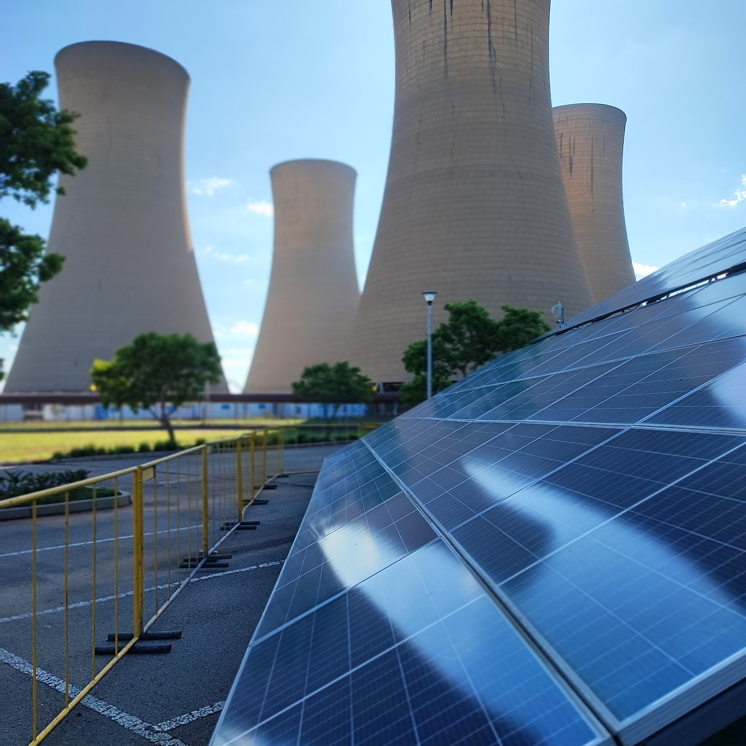
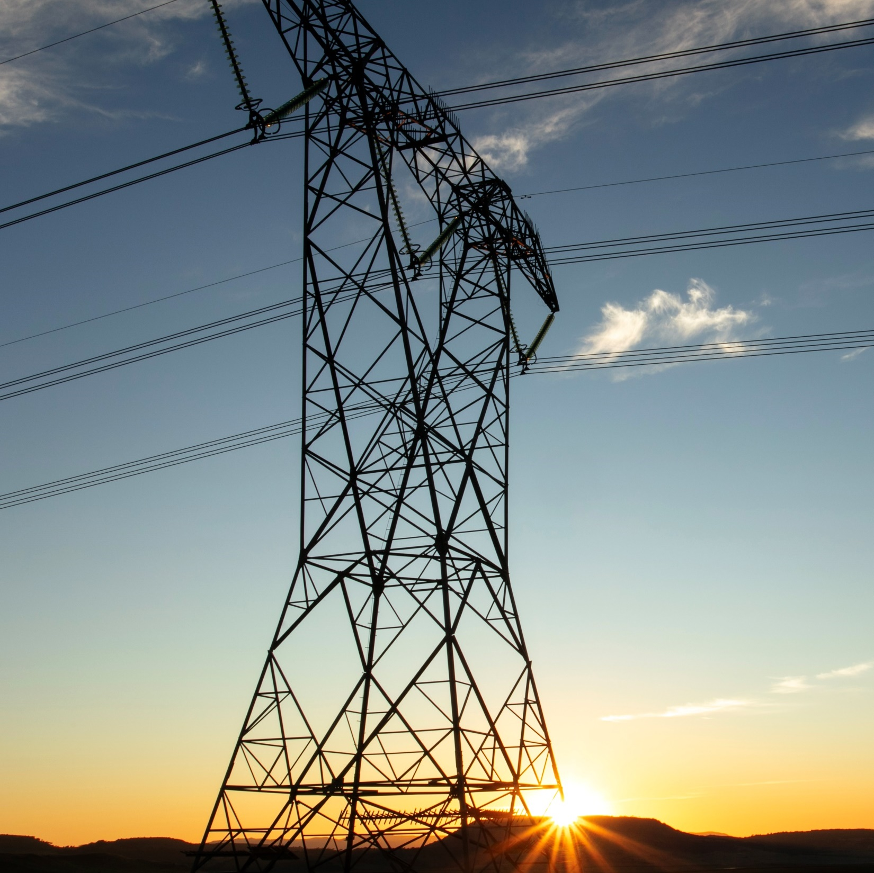
INTRODUCTION
Mteto Nyati, Chairman

Slide 4
Several key challenges delayed the publication of the FY2024 results
Bulk generation of illegal prepaid electricity tokens on Eskom’s online vending system for prepaid meters
  Collusion is suspected between Eskom staff and illicit operators who breached controls within the prepaid ecosystem to facilitate the creation and sale of fraudulent prepaid electricity tokens
  A forensic investigation is underway to determine the root causes and make recommendations
  Inability to reliably estimate the potential obligation from the exposure that illicit tokens can be used in the future due to the high level of uncertainty around the number of illicit prepaid electricity tokens that remain in circulation and compatible with Eskom meters
Challenges involving NTCSA
  Determination of take-on balances at 31 March 2024 following the disposal of the Transmission business to NTCSA
  Subsequent derecognition of a deferred tax asset of R36.6 billion following the transaction
  Valuation of an upstream guarantee from NTCSA for third-party debt secured by NTCSA’s assets
Responding to reportable irregularities raised by the external auditors
Operational challenges and the lack of adherence to internal controls urgently need to be addressed, to ensure that Eskom can return to a normal audit cycle, which allows for sufficient time to address audit findings
INTRODUCTION

Slide 5


A sustainable Eskom is essential to powering growth for South Africa and the SADC region
A dysfunctional energy utility leads to economic decline
Affordable, secure and sustainable electricity fuels growth
FY2024 saw exceptionally poor performance
329 days of loadshedding
OCGT spend of R33.9 billion
Loss before tax of R25.5 billion
Municipal arrear debt escalated to R74.4 billion
Breakdown in internal controls and matters leading to repeat audit findings
Performance in FY2025 is much improved
No loadshedding, with > 250 days of steady electricity supply
Savings on OCGT spend of R11.9 billion during the first six months
After-tax profit of > R10 billion forecast for the year
  Enforcing discipline and adherence to internal controls
Eskom must be financially and operationally sustainable to deliver on its mandate to enable growth
INTRODUCTION

Slide 6


Eskom is facing several systemic issues, which require focus, focus and more focus to resolve
Operational
Financial
Sustainability
Systemic issues
Unreliable generation plant resulting in poor performance
Grid constraints to connect additional capacity
Dysfunctional organisational culture
Weak balance sheet due to high debt burden
Tariff not reflective of prudent and efficient costs
Revenue pressure due to non-payment by customers and declining sales volumes
Outdated vertically integrated business model
Need to transition to clean energy
Prevalent crime, fraud and corruption
Lack of adherence to internal controls and ineffective combined assurance
Interventions
Execute Generation Recovery Plan
Curtailment and grid capacity allocation rules; execute Transmission Development Plan
Appoint strong and inspirational leaders at all levels
Drive a high-performance values-driven culture
National Treasury debt relief programme,
as well as municipal debt interventions
Migrate towards unbundled cost-reflective tariff structure
Improve revenue collection and cost-efficiency initiatives
Reduce unplanned losses and excessive OCGT usage → end loadshedding
Drive legal separation of Eskom – settle NTCSA, unbundle Distribution and Generation
Pursue clean energy project pipeline and JET, including partnerships
Enhance governance and controls to eradicate crime, fraud and corruption
INTRODUCTION

Slide 7

OVERVIEW OF 2024 PERFORMANCE
Dan Marokane, Group Chief Executive

Slide 8

FY2024 was exceptionally challenging, operationally and financially.
However, we have laid a solid foundation for FY2025
Plant availability declined to 54.56% (2023: 56.03%), with 15 500MW unavailability and 13.2TWh lost to loadshedding
329 days loadshedding
(2023: 280 days),
despite diesel usage of
R33.9 billion
Emissions performance
worsened to
0.79kg/MWhSO
(2023: 0.70kg/MWhSO)
Transmission
network reliability
improved significantly
Distribution
network
performance improved
Distribution energy losses escalated, with 13.9TWh lost due to electricity theft
2 employee and
3 contractor fatalities
(2023: 2 employees and 3 contractors)
Lost-time injury rate deteriorated to 0.29
(2023: 0.26)
Net loss before tax improved
to R25.5 billion
(2023: R34.6 billion)
Tariff increase of
18.65%,
tempered by a 3% decline in sales volumes
Arrear municipal debt escalated to
R74.4 billion
(2023: R58.5 billion)
R76 billion
in Government debt relief, subsequently converted to equity
OVERVIEW OF 2024 PERFORMANCE

Slide 9

Qualified audit opinion received, with several matters requiring intense management focus
Qualified external audit opinion based on
PFMA records were not complete or accurately maintained in line with legislative requirements relating to:
Irregular expenditure
Fruitless and wasteful expenditure
Losses due to criminal conduct
Prior year audit qualification issues have not been adequately addressed and continued into 2024
  Emphasis of matters, including
  Material uncertainty relating to Eskom’s ability to continue as a going concern
  Impact of open internal and external investigations
  Restatement of comparative figures
  Events after the reporting date
Detailed information is available in the Report of the Audit and Risk Committee and the independent auditor’s report
AFS note | Notable matter
3.2 | Going concern assessment
12 | Disposal of Transmission Division to NTCSA
14 | Derecognition of deferred tax asset
44.2 | Contingent liability relating to non-technical energy losses
47 | Events after the reporting date
48 | Restatement of comparative figures
51 | PFMA information¹
52 | Reportable irregularities
Refer to the integrated report for detailed disclosure required by the Public Finance Management Act, 1999 (PFMA)
OVERVIEW OF 2024 PERFORMANCE
Notes:
Irregular expenditure – cumulative R98.7 billion, FY2024 incurred R4.7 billion (of which R0.4 billion relates to new matters). Condonation of R1.2 billion plus recovery of R500 million iro SAP
Fruitless and wasteful expenditure – cumulative R6.1 billion, FY2024 incurred R1 million. R4.6 billion is still being assessed (not included in the balance), of which R3.5 billion relates to prior periods
Losses due to criminal conduct – FY2024 R6.7 billion, of which R6.4 billion is electricity theft/non-technical losses

Slide 10
A clear time-based action plan is being rolled out to enforce controls
  Reportable irregularities
  Breaches of environmental legislation relating to emissions and water (reported from 2021 onwards)
  Management’s inability to confirm that all matters relating to PRECCA¹ were reported (2022 onwards)
  Non-compliance with recordkeeping requirements of PFMA and Companies Act, 2008 (2022 onwards)
  Investigations and consequence management relating to PFMA
  non-compliance not done timeously (2022 onwards)
  Failure to submit complete and accurate financial statements to National Treasury and external auditors by 31 May
  (2022 onwards)
  Incorrect draft information provided to the Standing Committee on Public Accounts (reported in 2023)
  Certain prescribed officers breached their fiduciary duty relating to short-term IPP programmes (reported in 2024)
  Consequence management and interventions being actioned
  Executive team strengthened with appropriate skills for internal controls, risk management and PFMA oversight
  Consolidation of Eskom’s forensics, security and investigative functions under the Group Investigations and Security function reporting directly to the Group Chief Executive
  Established a dedicated project management office to address findings from data analytics as well as internal and external investigations
  Address the backlog in investigations and disciplinary action
  Strengthen the culture of accountability and consequence management
  Enforce discipline and adherence to internal controls
  Resourcing drive to adequately capacitate the finance, internal audit and forensics functions
  Comply with Eskom’s environmental duty of care
  Execute Generation Recovery Plan and strengthen focus on environmental compliance
Prevention and Combatting of Corrupt Activities Act, 2004
OVERVIEW OF 2024 PERFORMANCE

Slide 11









We are stopping the leakage by eradicating crime, fraud and corruption
Key initiatives
Outcomes
Dedicated State Capture Task Team
  Instituting criminal charges
  Consequence management against employees and suppliers
  Pursuing director delinquency proceedings
  Civil recovery of financial losses suffered by Eskom
304 arrests
17 convictions
Security risks and threats to infrastructure and people
Partnerships with stakeholders and law enforcement agencies
526 of 729 vetting cases in progress or complete
Security Vetting Programme
Focusing on non-executive directors, executives and employees in critical areas
145 cases
Optimisation of processes and technology
Reviewing policies, processes, systems, controls and structures
Embarking on technology optimisation, security contract management and driving integrated security strategies
referred to the supplier disciplinary process for assessment
Supplier consequence management
Supplier disciplinary process in place to review contracts of suppliers implicated in malfeasance
28 cases
closed with no further action
79 suppliers
received sanctions or suspended sanctions
OVERVIEW OF 2024 PERFORMANCE
Notes:
107 supplier disciplinary cases concluded, 38 in progress
41 suppliers sanctioned with removal from the Eskom Supplier Database (ESD) and recommended for referral to National Treasury for restriction
36 suppliers received a suspended sanction
2 suppliers sanctioned with removal from the ESD without referral to National Treasury
28 suppliers cases closed with no further action (no malfeasance found, or deregistered and no longer in existence)

Slide 12
2024 FINANCIAL OVERVIEW
Calib Cassim, Chief Financial Officer

Slide 13
Eskom’s loss after tax was affected by a once-off accounting adjustment to deferred tax related to the NTCSA separation
Standard tariff increase 18.65% ↑ (2023: 9.61%) | Sales volumes 3% ↓ to 183.3TWh (2023: 188.4TWh) | Revenue 14% ↑ to R295.8 billion (2023: R259.5 billion)
Primary energy costs 11% ↑ to R173.7 billion (2023: R156.8 billion) | EBITDA 26% ↑ to R43.4 billion (2023: R34.6 billion) | EBITDA margin 14.67% (2023: 13.32%)
Loss before tax 26% ↓ to R25.5 billion (2023: R34.6 billion) | Deferred tax asset of R36.6 billion derecognised following NTCSA separation | Loss after tax 2x ↑ to R55 billion (2023: R26.1 billion)
Strong improvement in EBITDA, reducing the loss before tax
2024 FINANCIAL OVERVIEW
Notes:
Excluding the impact of the deferred tax adjustment, we improved financial performance improved year-on-year

Slide 14

EBITDA improved mainly due to the tariff increase, while systemic and operational challenges continued to impact profitability
Leading factors negatively affecting profitability
  GROUP INCOME STATEMENT FOR THE YEAR ENDED 31 MARCH 2024
1
R33.9 billion spent on OCGTs (2023: R29.6 billion)
Estimated 13.2TWh demand not met due to loadshedding → ±R22 billion* revenue impact
Estimated 13.9TWh of electricity theft →
±R23 billion* revenue impact
Net R8.9 billion revenue not recognised due to collectability criteria not met (2023: R8.2 billion)
R million | 2024 | 2023 | %
Revenue | 295 814 | 259 543 | 14▲
Other income | 1 295 | 2 742 | 53▼
Primary energy | (173 729) | (156 819) | 11▲
Net employee benefit expenses | (35 096) | (32 321) | 9▲
Net impairment loss and write-downs | (3 433) | (2 182) | 57▲
Other operating expenses | (41 441) | (36 398) | 14▲
EBITDA | 43 410 | 34 565 | 26▲
Depreciation and amortisation expenses | (33 239) | (31 941) | 4▲
Operating profit (EBIT) | 10 171 | 2 624 | 288▲
Net fair value and foreign exchange gain/(loss) | 2 644 | (285) | 1 028▲
Net finance cost | (38 389) | (37 015) | 4▲
Share of profit of equity-accounted investees | 105 | 93 | 13▲
Loss before tax | (25 469) | (34 583) | 26▼
Income tax | (29 546) | 8 501 | 448▼
Loss for the year | (55 015) | (26 082) | 111▲
2
3
4
Regulated return on assets of 1.7% lower than nominal cost of capital of ± 11%
* Based on the average electricity price of 165.43c/kWh
▲ Income/gain increased ▼ Income/gain declined ▼ Expense/loss declined ▲ Expense/loss increased
2024 FINANCIAL OVERVIEW

Slide 15
Revenue grew by 14% driven by a 18.65% tariff increase, tempered by a
3% decline in sales volumes impacted by loadshedding and self-generation
Electricity breakdown by destination¹
Electricity sales by customer category
Sales and revenue trend
1%
R billion
14%
TWh
3%
<1%
300
-3%
220
250
200
41%
200
180
208.2TWh
183.3TWh
150
160
100
140
50
120
0
2020
2021
2022
2023
2024
100
Local
Energy losses
Distributors
Mining
Commercial
Rail
Sales, TWh
Revenue, R billion
International
Internal use and unaccounted
Industrial
Residential
Agricultural
International
Net of pumping and excluding wheeling
Sales volumes mainly impacted by loadshedding and load curtailment of 13.2TWh (around 7% of sales volumes)
Increase in embedded self-generation capabilities across many sectors (rooftop solar capacity estimated at 6.1GW)
Biggest decline in distributor (4.3% ↓), international (9.4% ↓) and residential (6.7% ↓) customer segments
International customers subjected to load curtailment given South Africa’s supply constraints
2024 FINANCIAL OVERVIEW

Slide 16
Primary energy costs increased by 11% to R174 billion due to higher OCGT usage, despite a 2% overall decrease in production
Electricity breakdown by supplier¹
Electricity supplied by technology¹
Generation cost by source
2%
Unit cost, R/MWh | 2024 | 2023 | %
Coal | 541 | 503 | 8▲
Nuclear | 113 | 106 | 7▲
Eskom-owned OCGTs | 6 579 | 7 077 | 7▼
IPPs | 2 367 | 2 326 | 2▲
IPP OCGTs | 6 348 | 7 278 | 13▼
Renewable IPPs | 2 029 | 1 986 | 2▲
Other IPP programmes | 1 018 | –
Imports | 883 | 748 | 18▲
<1%
208.2TWh
208.2TWh
Eskom
IPPs
Imports
Coal
Hydro (net)
Solar
Other
Wind
Nuclear
Diesel
Net of pumping and excluding wheeling
Supply constraints due to:
Poor Eskom generation performance (±1.7TWh shortfall against budget)
Delays in IPP programmes (±8.8TWh shortfall)
Lower-than-budget imports (±1.6TWh shortfall)
Higher usage of OCGTs to mitigate loadshedding, leading to a higher overall cost of production
Marked improvement in primary energy costs expected in 2025 due to lower OCGT usage
2024 FINANCIAL OVERVIEW

Slide 17
Balance sheet stabilised by Government’s debt relief, which enabled cash from operations to be invested in capital expenditure and working capital
  GROUP STATEMENT OF FINANCIAL POSITION AT 31 MARCH 2024
Current ratio 0.98 (2023: 0.89) | Cash interest cover 1.18 (2023: 1.29)
Debt/equity ratio 1.99* (2023: 1.88) | Gross debt/EBITDA 11.58 (2023: 13.92)
R million | 2024 | 2023 | %
Property, plant and equipment and intangible assets | 684 388 | 671 709 | 2▲
Working capital – current inventory and receivables | 65 692 | 51 819 | 27▲
Liquid assets – cash and cash equivalents and investments | 40 063 | 23 145 | 73▲
Derivatives held for risk management | 27 016 | 26 992
Other assets | 49 163 | 52 079 | 6▼
Total assets | 866 322 | 825 744 | 5▲
Equity | 222 858 | 233 944 | 5▼
Debt securities and borrowings | 412 200 | 423 929 | 3▼
Loan from shareholder | 32 000 | –
Working capital – current payables | 67 199 | 58 064 | 16▲
Derivatives held for risk management | 593 | 2 029 | 71▼
Non-current decommissioning liabilities | 52 294 | 50 025 | 5▲
Contract liabilities and deferred income | 38 371 | 28 097 | 37▲
Other liabilities | 40 807 | 29 656 | 38▲
Total equity and liabilities | 866 322 | 825 744 | 5▲
* Includes subordinated shareholder loan not yet converted to equity at year end
  Movement in debt securities and borrowings
R billion
423.9
412.2
▲ Asset/equity increased ▼ Asset/equity decreased ▼ Liability decreased ▲ Liability increased
Opening balance
Pre-funding secured Mar 2023
DFI drawdowns
Debt repaid
Fair value adj
Interest accrual & other
Closing balance
2024 FINANCIAL OVERVIEW
Notes:
Other assets comprises future fuel supplies, embedded derivatives and non-current inventory and receivables
Equity – R76 billion in Government support was received (2023: R21.9 billion), of which R44 billion was approved for conversion to equity by year end. The remaining R32 billion shareholder loan was approved for conversion in the 2025 financial year
Other liabilities mainly comprises employee benefit obligations and lease liabilities
Debt/equity ratio excluding the shareholder loan would’ve been 1.85
If the Rand had remained stable, debt/equity would’ve been around 1.78
Investor target rates: gross debt/EBITDA of 4, cash interest cover of 3.5, debt service cover of 1.5 (ours was 0.46), EBITDA margin of 35% (ours was 14.67%)
Debt securities and borrowings didn’t reduce by the full R76 billion in debt support due to interest of around R35 billion

Slide 18

Received R76 billion debt relief towards servicing debt obligations, which has improved liquidity and unlocked Eskom’s positive performance spiral
Improved liquidity
Improved planning
Improved investment in assets
Improved operational performance
Improved financial performance
Benefits of the debt relief
Assisted in addressing debt servicing outflows of R89.8 billion (principal and interest)
Allowed focus on executing strategy by freeing up cash from operations and alleviating funding challenges
Supported cash flow certainty, unlocking improved execution of the Generation Recovery Plan
The full R76 billion has been converted to equity since year end based on Eskom’s compliance with the debt relief conditions
Credit rating upgrades received, which will support future capital expenditure needs
Municipal debt challenges are undoing the positive benefits of Government’s debt relief
Eskom’s positive spiral
Government debt relief
Government debt relief, together with cost-reflective tariffs and an ongoing focus on cost efficiencies, are anchoring enablers for Eskom’s financial and operational recovery
2024 FINANCIAL OVERVIEW

Slide 19
The municipal debt relief programme is not delivering the desired results. Unless a new solution is found, the separation of Distribution is in jeopardy
  Arrear municipal and metro debt
Top 10 defaulting municipalities and metros at Nov 2024
R billion
+28%
%
R billion | Mar 2023 | Mar 2024 | % | Nov 2024 | %
Emalahleni Local Municipality* | 7.4 | 8.5 | 15▲ | 9.9 | 17▲
Maluti-A-Phofung Local Municipality* | 7.2 | 8.0 | 10▲ | 8.6 | 7▲
Emfuleni Local Municipality* | 5.9 | 7.1 | 19▲ | 8.1 | 15▲
City of Tshwane Metro | 1.1 | 3.1 | 194▲ | 6.7 | 114▲
Matjhabeng Local Municipality* | 5.3 | 5.8 | 10▲ | 6.3 | 9▲
City of Johannesburg Metro | – | 1.1 |  | 5.3 | 393▲
Govan Mbeki Local Municipality* | 3.7 | 4.5 | 20▲ | 5.2 | 17▲
Lekwa Local Municipality* | 1.9 | 2.2 | 18▲ | 2.6 | 17▲
City of Matlosana Local Municipality* | 1.4 | 1.8 | 22▲ | 2.3 | 33▲
Ngwathe Local Municipality* | 1.7 | 2.0 | 17▲ | 2.3 | 15▲
Total | 35.6 | 44.1 | 23▲ | 57.3 | 30▲
+27%
95.4
Mar 2020
Mar 2021
Mar 2022
Mar 2023
Mar 2024
Nov 2024
YTD
Arrear municipal debt, R billion
Municipal payment levels (including metros), %
  Municipal debt relief programme
71 municipalities participating |  | Accounting for 95% of March 2023 arrear debt targeted for write-off
By March 2024, only 23 municipalities honouring current accounts (12% of the arrear debt) |  | By November 2024, only 10 municipalities honouring current accounts (2% of the arrear debt)
HOWEVER
* Participating in the municipal debt relief programme
Arrear debt continues to escalate due to poor adherence to the municipal debt relief conditions, with more recent challenges with metros
2024 FINANCIAL OVERVIEW
Notes:
Municipal debt relief programme facilitates the ability for Eskom to write off municipal debt under strict conditions and with the guidance of the National Treasury.
Expected to improve payment levels and the settlement of current accounts by municipalities over time
The overdue amounts have not been recognised as revenue and have been fully provided for, therefore the write-offs will not affect Eskom’s profitability
No write-offs processed during 2024 as the municipalities must comply with the conditions for 12 months for Eskom to process the first third of the debt write-off
One municipality met the compliance cycle for 12 consecutive months in September 2024, resulting in a write-off of R0.3 billion
City of Tshwane five-year payment arrangement plan
Since the introduction of the munic deb relief programme (1 Apr 2023) to Nov 2024, arrear debt has grown by almost R40 billion
Other customers: Transnet = R586 million outstanding at 31 March 2024 (R724 million at Sept 2024), in an arbitration process; EDM = R845 million at year end (R790 million at Sept 2024), not complying with their repayment plan

Slide 20
Liquidity improved on the back of the debt relief from Government, addressing most of Eskom’s R89.8 billion debt servicing obligations
  CASH FLOWS FOR THE YEAR ENDED 31 MARCH 2024
R billion
Primary energy
Cash and cash equivalents
↑ to R23.6 billion
(2023: R7.5 billion)
Employee benefits
13.6
Working capital
Repairs, maintenance and other
(255.4)
44.9
4.5
23.6
10.9
18.4
54.6
76.0
35.3
Revenue
Operating outflows
Cash from operations
Capital expenditure and other investing
Balance before debt servicing
Debt repaid
Interest repaid
Government debt relief
Balance before funding
Debt raised
Other funding activities
Net cash
movement
Sufficient liquidity is essential to ensure a consistent runway of capex execution and planned maintenance, to support sustainable operational performance
2024 FINANCIAL OVERVIEW
Notes:
1. Debt raised comprises pre-funding of R16 billion from March 2023 (private placement approved by MoF), as well as drawdowns from existing DFIs of R7.5 billion -> compliant with Debt Relief Act conditions
2. Other funding activities is predominantly cash flows from derivatives held for risk management
3. Interest repaid of R35.3 billion is bigger than employee benefits costs of R35.1 billon

Slide 21
We increased our investment into existing generation infrastructure to address poor plant performance and lay a solid foundation for the future
Repairs and maintenance expenditure
  Repairs and maintenance breakdown
R billion
30%
R billion | 2024 | 2023 | %
Generating plant | 22.8 | 16.6 | 38▲
Transmission network | 1.1 | 1.2 | 3▼
Distribution network | 4.8 | 4.4 | 8▲
Total repairs and maintenance | 28.7 | 22.1 | 30▲
2020
2021
2022
2023
2024
Eskom funded capex
  Capex breakdown
R billion
R billion | 2024 | 2023 | %
Generating plant (including future fuel) | 29.3 | 27.4 | 7▲
Transmission network | 4.3 | 3.5 | 20▲
Distribution network | 2.9 | 2.6 | 11▲
Other | 0.6 | 0.4 | 35▲
Total group funded capex | 37.0 | 33.9 | 9▲
9%
2020
2021
2022
2023
2024
2024 FINANCIAL OVERVIEW

Slide 22



Sufficient liquidity will enable the necessary investments to sustain and expand infrastructure over the next decade
Indicative view, including aspirational and unfunded projects
Current energy mix
Energy mix by FY2035
Generation capex requirements (FY2025 to FY2035)
R billion
1%
Coal
4%
5%
Nuclear
834
Average expansionary capex of ±R45 billion p.a.
Average sustaining capex of ±R31 billion p.a.
OCGT/Gas
Pumped storage
Renewables
Total
+ 17GW
4%
NTCSA capex requirements (FY2025 to FY2035)
R billion
449
Average expansionary capex of ±R34 billion p.a.
Average sustaining capex of ±R7 billion p.a.
+ 15 446km lines ↑ 46%
+ 151 550MVA capacity ↑ 97%
73
Total
Distribution capex requirements¹ (FY2025 to FY2035)
R billion
162
Average expansionary capex of ±R12 billion p.a.
Average sustaining capex of ±R3 billion p.a.
+ 13 807km lines ↑ 4%
+ 7 270MVA capacity ↑ 5%
Total
+ 7 million smart meters, microgrids, grid modernisation, rooftop solar and fleet (electric vehicles and charging stations)
Expansionary capex
Sustaining capex
1. Excluding Government-funded electrification connections
2024 FINANCIAL OVERVIEW
21
Notes:
Sustaining capital is made up primarily of the following:
Mandatory environmental and compliance projects to drive compliance through addressing emission, water
Projects to enable continued operations and recovery i.e. outages and maintenance
Network (NTCSA and Distribution) refurbishment projects
Expansion/Growth projects are made up of the following:
Projects to enable new clean generation capacity i.e. New Wind, Solar, BESS and Gas
Projects to enable the TDP i.e. network strengthening, new transmission lines, transformers and land acquisitions
Projects to modernise the Distribution network i.e. Smart meters, Microgrids and Distribution System Operator (DSO)

Slide 23
Borrowings must be limited beyond the three-year debt relief period, to move Eskom to a more sustainable debt level of R250 billion over time
Debt securities and borrowings (including new borrowings from FY2028)*
New projects will require extensive funding, through a combination of
on-balance sheet funding and partnerships with external parties
New borrowings must be limited to
±R15 billion per year to ensure that debt service costs are capped at
±R50 billion per year
R billion
2024
2025
2026
2027
2028
2029
2030
2031
2032
2033
2034
2035
Base debt
New borrowings
* Indicative view based on financial modelling
We must generate sufficient operating cash flows to fund most of our capital expenditure requirements, without further leveraging the balance sheet. This is highly dependent on achieving an adequate tariff path, resolving the municipal arrear debt challenge and achieving cost efficiencies
2024 FINANCIAL OVERVIEW
Notes:
Preliminary treasury modelling estimates maximum borrowings of ~R15bn p.a. to maintain a debt level of ~R250bn and debt service costs of ~R50bn p.a.
Initial indications from National Treasury are that Eskom could be limited to borrowing on a project-by-project basis and on the premise that the project is within a PSP construct
FY25-35: ~R443bn in CAPEX to sustain the existing business will be fully funded from cash from operations (includes environmental compliance and extended operations)
FY25-35: Of the total growth CAPEX requirement of R1tn, Eskom estimates a funding pot of ~R410bn from cash from operations (R20bn p.a.) and borrowings (R15bn p.a). This can be used to self-fund a limited portion of growth projects or can be utilised through leveraging off the private sector
Cash from operations available for growth is subject to the growth rates in revenue (tariff and sales), costs and municipal debt

Slide 24
All four pillars of the financial strategy must be addressed to support the positive spiral that will lead to sustainable performance
Our financial strategy
Although Government debt relief is essential in the short term, it is unsustainable for the country in the long term. Systemic challenges must be addressed to achieve standalone financial sustainability
✗
✔
REVENUE
SECURITY AND ENHANCEMENT
Cost-reflective tariffs
Unbundled tariffs
New products and services
BALANCE SHEET OPTIMISATION
R250 billion debt relief
Dispose non-core assets
Diversify funding mix
Operations
Strengthen balance sheet
Improve income statement
✗
Fix systemic issues …
Obtain cost-
reflective tariff path, with measures to address affordability for vulnerable sectors
Resolve municipal debt challenge
… to enable Eskom’s positive spiral and remove Eskom’s burden on the fiscus
✔
COST EFFICIENCIES
Review cost trajectories and drive efficiencies
Enhance financial controls
Root out crime, fraud and corruption
MUNICIPAL DEBT
REDUCTION
Improve payment levels
Pursue legal rights
Address poor adherence to municipal debt relief conditions
✔
Improved liquidity
Improved planning
Improved investment in assets
Improved operational performance
Improved financial performance
✔
The path to investment-grade credit ratings is dependent on all four pillars being executed within appropriate timeframes
2024 FINANCIAL OVERVIEW
23

Slide 25
2025 HALF-YEAR PERFORMANCE
Dan Marokane

Slide 26
The first six months of FY2025 showed remarkable improvement, with substantial efficiencies achieved
Plant availability improved significantly to 62.97%
(Sep 2023: 55.27%), with significantly higher planned maintenance
No loadshedding
(Sep 2023: 183 days),
with diesel usage reducing by R11.9 billion YOY
Emissions performance
improved to
0.55kg/MWhSO
(Sep 2023: 0.92kg/MWhSO)
Transmission
network reliability
performance declined
Distribution energy losses escalated to 10.42%
(Sep 2023: 9.64% ), with 8.7TWh lost due to theft
1 employee and
2 contractor fatalities
(Sep 2023: 1 employee)
Lost-time injury rate worsened to 0.30
(Sep 2023: 0.28)
Distribution
network
performance improved
Net profit after tax
significantly ↑
(profit after tax of > R10 billion* forecast for FY2025)
Tariff increase of 12.74%
(Sep 2023: 18.65%) coupled with 4% YOY increase in sales volumes
Arrear municipal debt escalated to
R90.1 billion
(Mar 2024: R74.4 billion)
R64 billion
Government debt relief committed for FY2025
(Mar 2024: R76 billion)
* Unaudited
2025 HALF-YEAR PERFORMANCE

Slide 27







Customers have reported a positive outlook on the back of the suspension of loadshedding for more than 9 months
Sentiment towards the real estate sector has improved dramatically. With more than 230 days with no loadshedding … contributing to improved business confidence with is evident in our operational performance. The prospect of imminent interest rate cuts … together with no loadshedding since
March 2024, will positively influence retailers’ operations and performance
~ Growthpoint
The suspension of loadshedding in South Africa resulted in significant savings on diesel and other generator-related costs. These savings of R243 million were fully reinvested into lower prices for customers, particularly on essential food and grocery items
~ Pick n Pay
While there were macroeconomic positives of no loadshedding, increased political stability …
~ Mr Price
Generator diesel costs declined from R124 million in FY2023 to
R47 million, mostly due to reduced loadshedding during the year. Key indicators such as a significant reduction in energy loadshedding … provide a more favourable outlook for consumers and signal improvements in both the economic and operating environment
~ Netcare
In South Africa, the outlook is positively buoyed by the formation of the Government of National Unity, suspension of loadshedding …
~ TFG
In South Africa, … consumer sentiment is improving, supported by … the prolonged suspension of loadshedding
~ Woolworths
… the suspension of loadshedding will enhance customers’ ability to earn an income [supporting] an optimistic consumer outlook
~ Pepkor
Consumer confidence has been buoyed by … the suspension of loadshedding
~ Lewis Stores
This has had a positive impact on Sovereign credit ratings and the country’s growth prospects
2025 HALF-YEAR PERFORMANCE

Slide 28
The suspension of loadshedding is due to a reduction in unplanned losses, driven by disciplined execution of planned maintenance
Eskom Generation actual performance on unplanned losses
GW
Reduction in unplanned losses over the period
Actual monthly unplanned unavailability
-5.6
16.2
18.0
16.0
16.5
15.9
15.8
16.2
14.5
13.7
14.6
14.7
14.9
14.2
12.7
11.9
11.5
10.8
11.8
11.5
10.6
Apr-23
May-23
Jun-23
Jul-23
Aug-23
Sep-23
Oct-23
Nov-23
Dec-23
Jan-24
Feb-24
Mar-24
Apr-24
May-24
Jun-24
Jul-24
Aug-24
Sep-24
Oct-24
Nov-24
2023 Winter outlook period
2023/24 Summer outlook period
2024 Winter outlook period
2024/25 Summer outlook period
Downward trend observed in unplanned losses from base-load capacity, specifically driven by eight priority stations (Tutuka, Majuba, Kusile, Kendal, Matla, Duvha, Arnot and Kriel)
Unplanned unavailability over the summer period has reduced by about 4GW since the prior year
Unplanned losses are better than anticipated in the Summer outlook, with no loadshedding required since 26 March 2024
To ensure overall supply adequacy, Eskom’s base-load capacity needs to perform
2025 HALF-YEAR PERFORMANCE

Slide 29
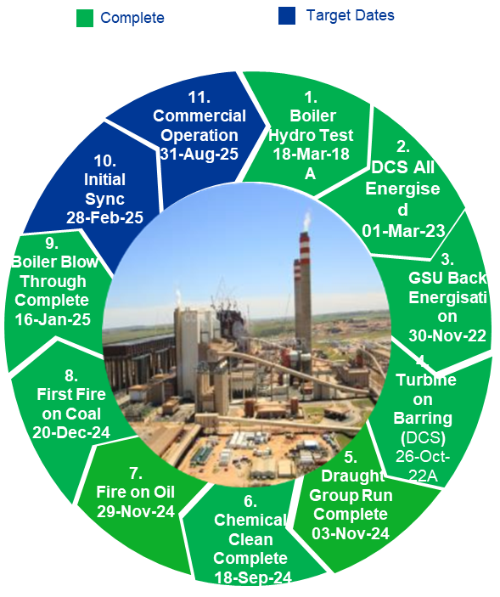
We aim to add 2 500MW to the grid by March 2025 to support security of supply with continued suspension of loadshedding
  Return to service of units on long-term outage
Koeberg 1
930MW
Kusile 1, 2, 3, 5
~2 880MW
Tutuka 1, 2, 4, 5
~1 500MW
Koeberg 2
~930 MW
Kusile Unit 5 synchronised to the grid on
31 December 2023. Commercial operation achieved on 30 June 2024 → Completed
Tutuka return to service
Unit 4 planned outage for LP turbine rotor and HPH replacement → Completed
Unit 5 on major outage → Completed
Despite some delays, three units are expected to return to service by
March 2025
Koeberg Unit 2 → Completed
Kusile Unit 6 synchronisation experienced some delays due to material availability and delays in acid clean
Medupi Unit 4 return to service delayed by unexpected design issues on the second-hand stator
Kusile 6 1st sync
~800 MW
Medupi U4
~794 MW
Nov 2023
Dec 2023
May 2024
Dec 2024
Feb 2025
Mar 2025
Following the construction of temporary stacks, Units 3, 1 and 2 were returned to the grid and are providing power up to
2 160MW
Unit 5 achieved commercial operation on 30 June 2024
Unit 1 completed on
12 January 2024
Unit 2 returned on
27 December 2023
Unit 4 returned on
22 April 2024
Unit 5 returned on
7 July 2024
STRATEGY AND OUTLOOK

Slide 30
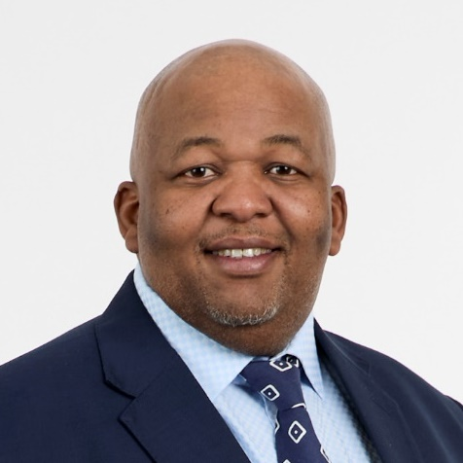
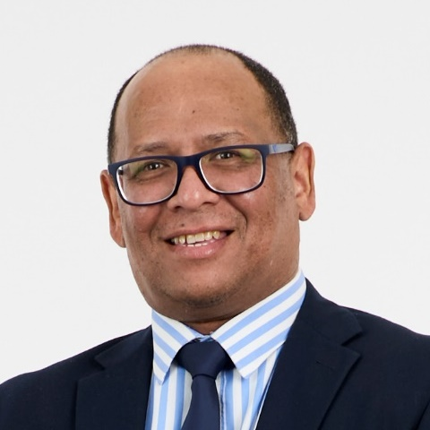
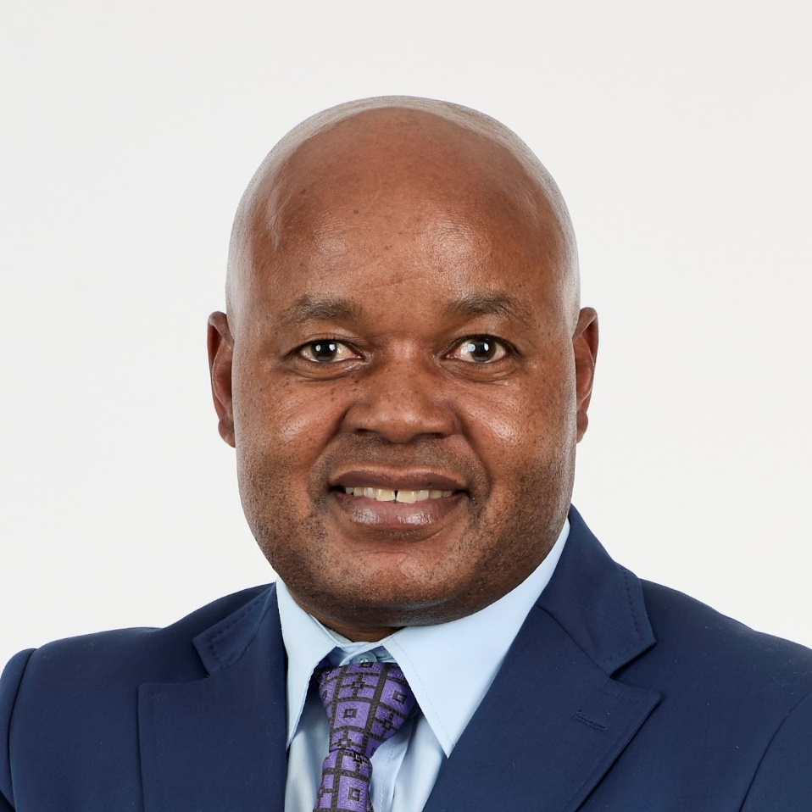
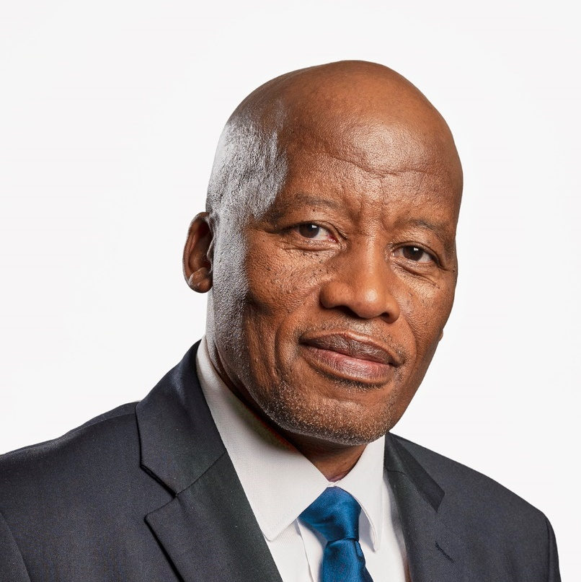
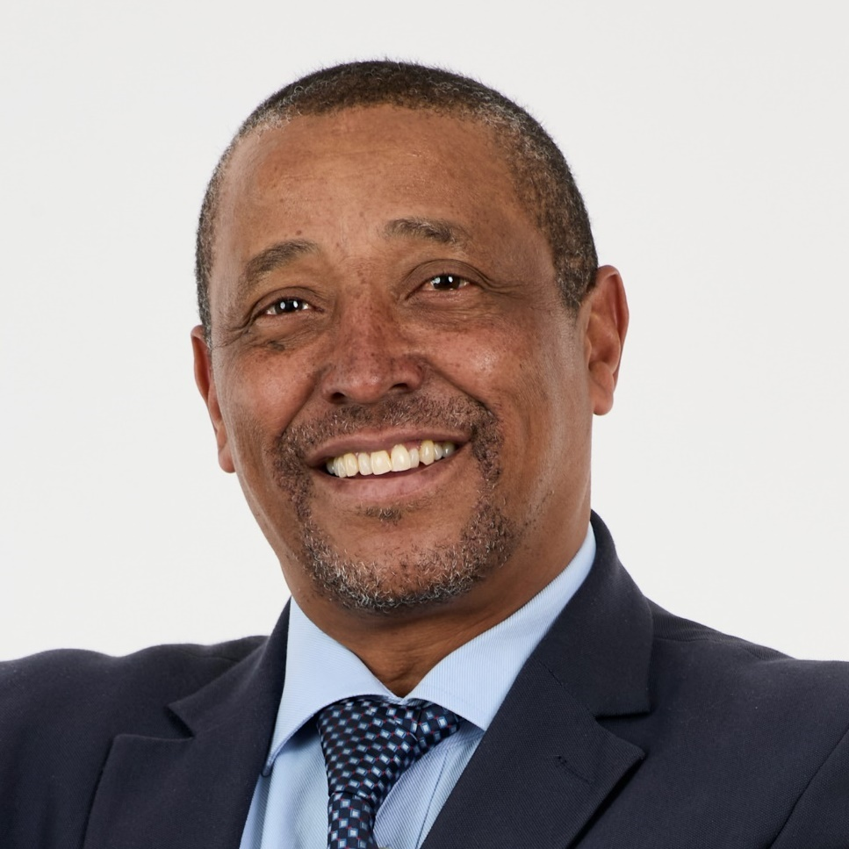
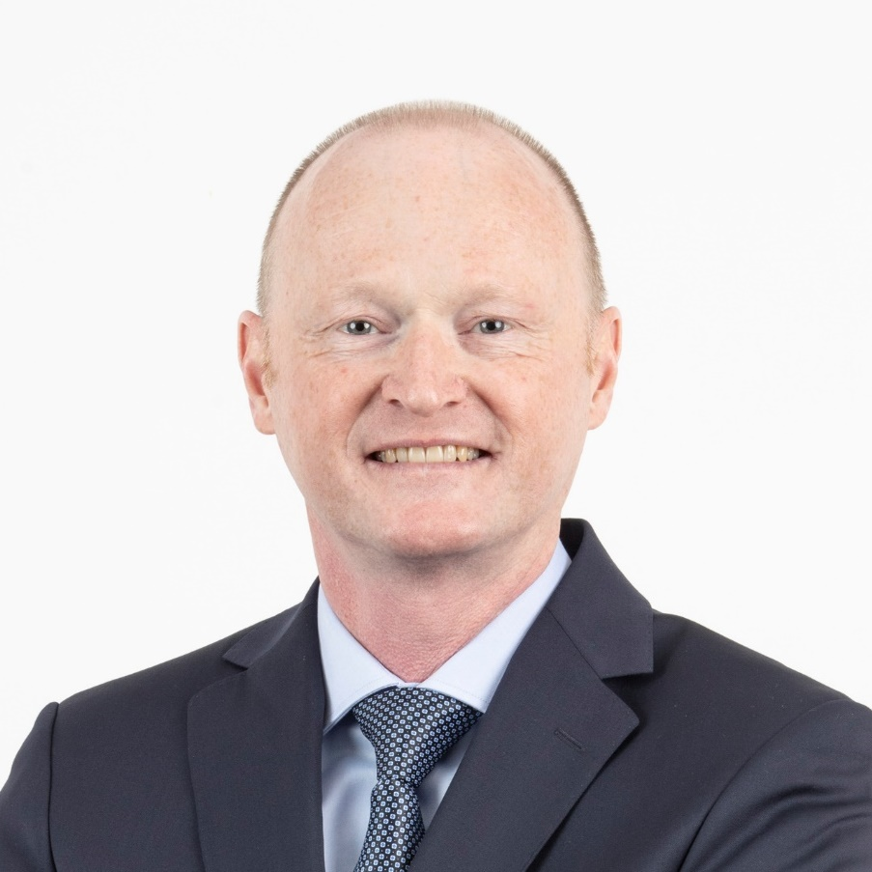
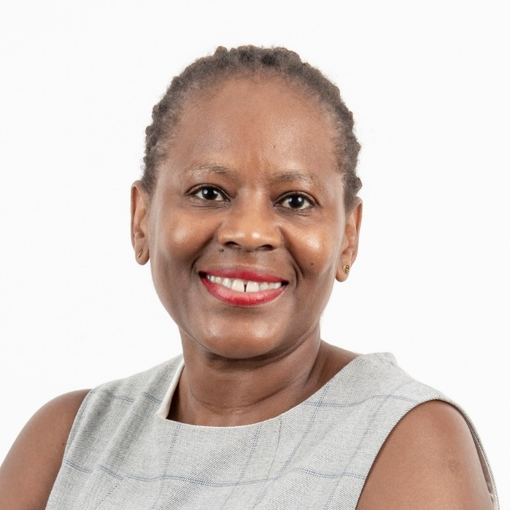
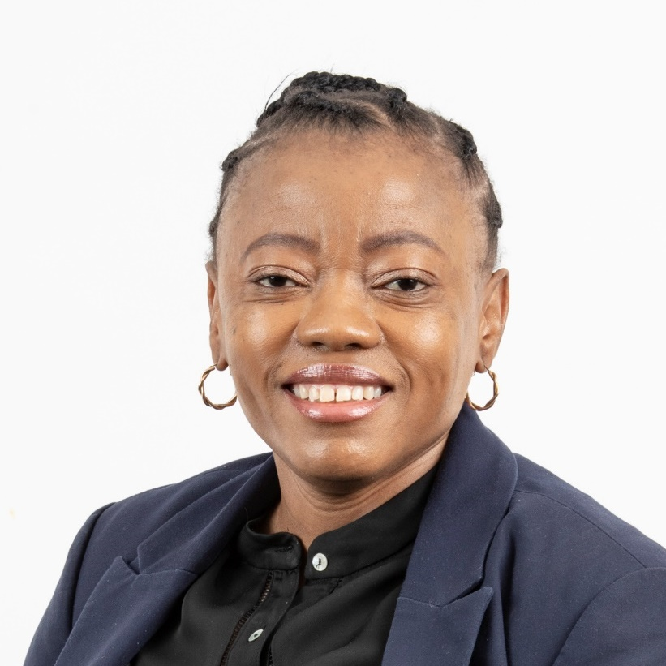
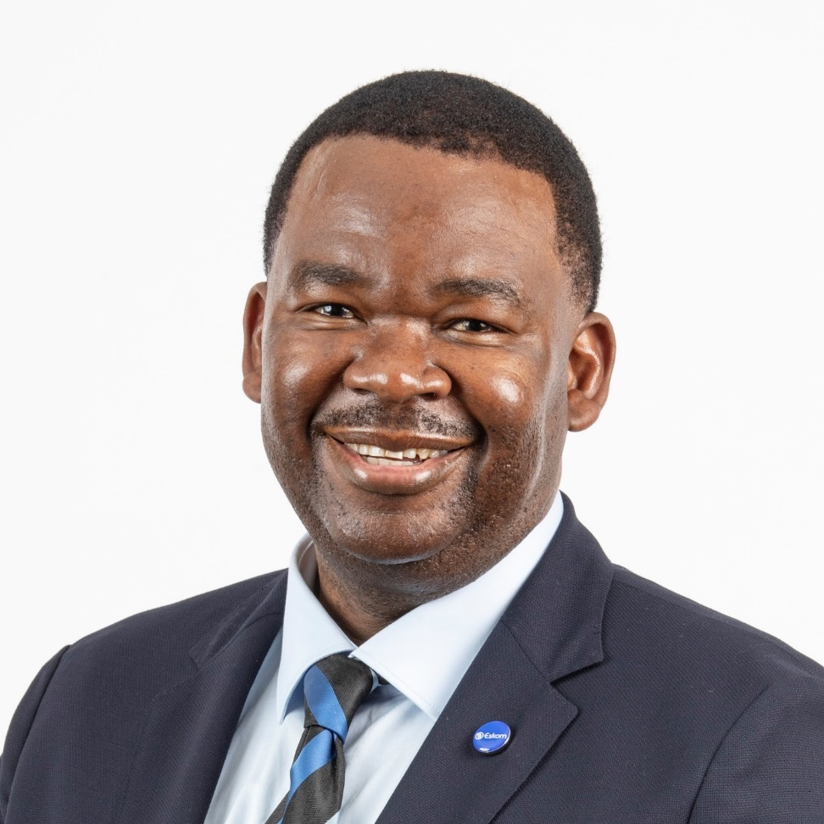
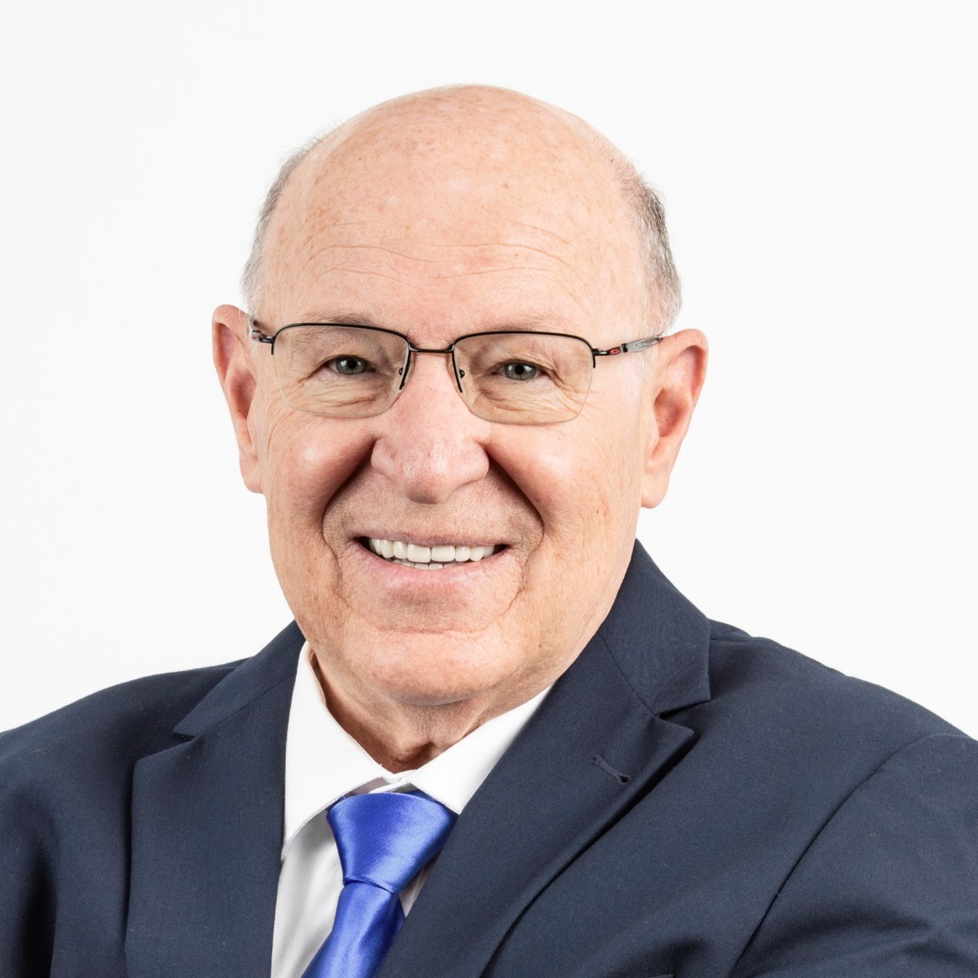
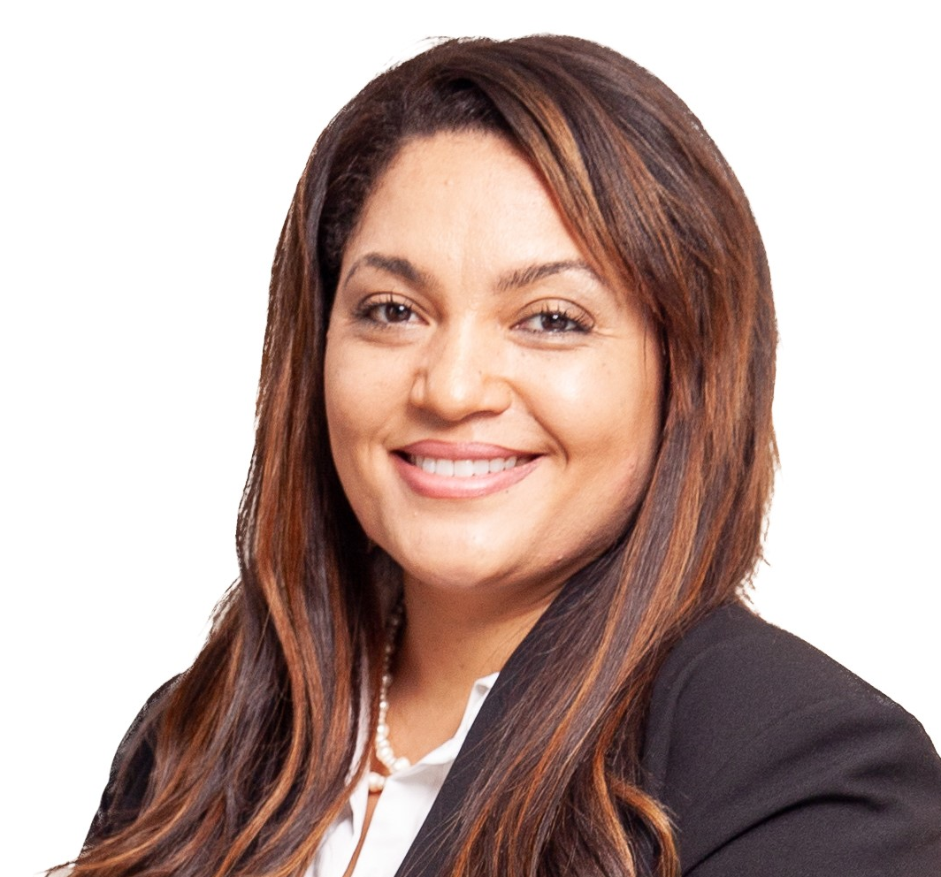

We have completed a new executive structure to embed operational recovery and future-proof Eskom for long-term growth and sustainability
Supported by the following permanent invitees:
Tembela Kulu Group Investigations and Security
Mlawuli Manjingolo Company Secretary
Jerome Mthembu Legal and Compliance
Ureka Rangasamy Chief Audit Executive
Dan Marokane
Group Chief Executive
Calib Cassim
Group CFO
Bheki Nxumalo
Generation
Segomoco Scheppers
NTCSA interim CEO
Permanent invitee
Monde Bala
Distribution and acting Human Resources
Roman Crookes
Group Capital
Nontokozo Hadebe
Strategy and Sustainability
Portia Mngomezulu
Corporate Services
Alfred Seema
Strategic Delivery
Len de Villiers
Chief Technology and Information Officer
Dr Candice Hartley
Chief People Officer
Rivoningo Mnisi
Eskom Renewables
STRATEGY AND OUTLOOK

Slide 31
Action Plans:
Overview

Slide 32
Action Plans:
Financial recovery plan

Slide 33

Action plan: Financial recovery
The key levers to financial recovery and profitability require simultaneous focus
  (1) cost reflective and unbundled tariffs, revenue growth and security
  (2) cost efficiencies and controls
  (3) reduce municipal non-payment and
  (4) balance sheet optimisation
Non-Payment is trending negatively and requires consolidated focus from multiple stakeholders
Positive Outcomes to date include
  Healthy Liquidity Position and Positive Profit Forecast for Year End
  Revenue up by 15.9% YoY and sales up by 3.6%
  Diesel costs year-on-year: Saving~R17.1bn in
  Primary energy cost:16% lower than budget and 6.9% lower YoY
Audit Recovery Programme: Eskom's repeated challenges in securing unqualified audit opinions highlight the critical need to enhance internal controls and governance
  The Eskom board has therefore requested that a recovery programme be initiated, to improve Eskom’s audit outcomes
  Eskom’s success in these areas is crucial for restoring stakeholder confidence, maintaining operational stability, and achieving its strategic objectives
FOCUS: A SUSTAINABLE RECOVERY PROGRAMME TO ENABLE AN UNQUALIFIED AUDIT OPINION
UNQUALIFIED AUDIT OPINION
RECOVER
STABILSE & IMPROVE
MAINTAIN & ENHANCE
PHASE 1: FY25
PHASE 2: FY26
PHASE 3: FY27
IMPROVE READINESS & EXECUTION OF
THE EXTERNAL AUDIT
A
ENHANCE INTERNAL CONTROLS
B
ENHANCE CAPACITY AND SUPPORT
C
ENHANCE SYSTEM INTEGRATION & AUTOMATION
D
IMPROVE CULTURE (ACCOUNTABILITY AND DISCIPLINE)
E
PROGRAMME DELIVERY, INTEGRATION & OVERSIGHT TO ENABLE TRANSPARENCY

Slide 34
Action Plans:
Technology recovery plan

Slide 35
Action plans: Technology recovery plan
Eskom’ Disaster Recovery and Business Continuity
Overview
Critical Business Applications DRP and BCP
Ensures robust resilience and continuity of IT operations.
  Minimal disruption to mission-critical systems during outages or disasters.
  Integrates Data Center (DC) recovery, critical business application recovery, network redundancy, and alternative routing strategies.
Eskom has Disaster Recovery (DR) plans and procedures for all critical applications and systems.
Annual Disaster Recovery Plan (DRP) tests ensure continuity for all critical applications and systems.
New applications and systems undergo a Business Impact Assessment (BIA) to classify them and determine the required level of support..
Data Center Disaster Recovery (DR)
Backup and Replication: Advanced backup solutions with scheduled, automated backups.
No real-time replication; backups delayed by 12–24 hours. Zero RPO systems use application-layer clustering and log shipping.
Failover and Switchover: Warm standby configuration with some capacity available. DR server online at Teraco Data Center; manual intervention required for IT operations redirection.
Continuous Monitoring and Testing
Annual DR Test: The Disaster Recovery tests are done annually to ensure continuity on all Eskom critical applications and systems
24x7 network monitoring by a dedicated Monitoring and Response Centre with automated alerts and corrective actions.
Network Recovery Plan
Conclusion
Alternative Routing Design: Two primary Data Centers (MWP and Teraco Isando) interconnected via Dark Fibre with Cisco ONS, ensuring redundancy and resilience.
High Availability: Direct peering with cloud service providers at Teraco, automatic traffic redirection during failures.
Internet Breakout: Primary 5Gbps link at MWP, failover to 1Gbps backup link at Teraco.
Active-Active Configuration: High availability and redundancy for DC LAN equipment at MWP and Isando
MPLS Network: 9 POPs, diverse Telcos for redundancy and high availability.
Eskom is dedicated to maintaining operational resilience and reliability, ensuring that critical systems and services continue to function during adverse events.
34

Slide 36
Action Plans:
Audit recovery plan

Slide 37
Action plans: Audit recovery plan
P & SCM - Audit Readiness Stream (Compliance Reviews)
Audit Co-ordination Stream (Execution and support)
Audit Recovery Stream (Future Focus)
Divisional CMOs to conduct Periodic Compliance Contract Reviews, and Central CMO (CCMO) to oversee divisional compliance.
Governance Enhancement stream
An audit recovery plan in response to the PFMA external audit findings has been developed.
Appointment of External Capacity to assist with audit readiness reviews.
Empowering teams with skills, motivation and clear roles for optimal performance.
Divisions to conduct population completion checks and provide signed off checklist.
Establish war room to assist with implementation of Hybrid model which would allow boots on the ground whilst coordinating efforts centrally.
Divisions to Self report review findings, procurement and legal collaborate to ensure completeness of the irregular expenditure register.
Central Monitoring and Reporting dashboards to allow for the tracking of records.
The status of the Public Sector Compliance audit findings is monitored monthly by a dedicated resource within the Loss Control Function.
Deployment of PFMA champions to line divisions as part of the audit recovery initiatives. The team will assist business with identification, evaluation, registration and reporting of PFMA matters.
Processes – PFMA procedures and training available and awareness roadshows to be done across the business.
Human Resources - recruitment of permanent resources is underway to meet the audit requirement and the Loss Control Function mandate.
Systems development is underway for an interim SharePoint reporting tool to replace the PFMA report currently done in Excel.
Enhance Contract Management Policy across the divisions.
Establish Central CMO, which in turn will review divisional CMO activities and performance against agreed KPIs and reporting dashboards.
Capacity development – conduct gap analysis on Contract Managers, tailor-make specific trainings to close gaps, conduct workshops, and disseminate lessons learned across divisions:
Divisional CMOs to place more emphasis on establishing contract environment (contract strategies) so that proper contracts are put in place.
Collaborate with external policy and procedure stakeholders for ease of implementation of the procurement bill.
Conduct regulation scans monthly.
36

Slide 38
Question & Answer session

Slide 39
Close and next steps

Slide 40
Disclaimer
This presentation does not constitute or form part of and should not be construed as, an offer to sell, or the solicitation or invitation of any offer to buy or subscribe for or underwrite or otherwise acquire, securities of Eskom Holdings SOC Ltd (Eskom), any holding company or any of its subsidiaries in any jurisdiction or any other person, nor an inducement to enter into any investment activity. No part of this presentation, nor the fact of its distribution, should form the basis of, or be relied on in connection with, any contract or commitment or investment decision whatsoever. This presentation does not constitute a recommendation regarding any securities of Eskom or any other person.
Certain statements in this presentation regarding Eskom’s business operations may constitute “forward looking statements”. All statements other than statements of historical fact included in this presentation, including, without limitation, those regarding the financial position, business strategy, management plans and objectives for future operations of Eskom are forward looking statements.
Forward-looking statements are not intended to be a guarantee of future results, but instead constitute Eskom’s current expectations based on reasonable assumptions. Forecasted financial information is based on certain material assumptions. These assumptions include, but are not limited to continued normal levels of operating performance and electricity demand in the Distribution and Transmission Divisions and operational performance in the Generation Division consistent with historical levels, and incremental capacity additions through Group Capital at investment levels and rates of return consistent with prior experience, as well as achievements of planned productivity improvements throughout the business activities.
Actual results could differ materially from those projected in any forward-looking statements due to risks, uncertainties and other factors. Eskom neither intends to nor assumes any obligation to update or revise any forward-looking statements, whether as a result of new information, future events or otherwise.
In preparation of this document certain publicly available data is used. While the sources used are generally regarded as reliable the content has not been verified. Eskom does not accept any responsibility for using any such information.

Slide 41
13 December 2024
Our suite of reports and summarised performance commentary are available at www.eskom.co.za/investors/integrated-results/
Our suite of reports and summarised performance commentaries are available at www.eskom.co.za/investors/integrated-results/

