Slide 1
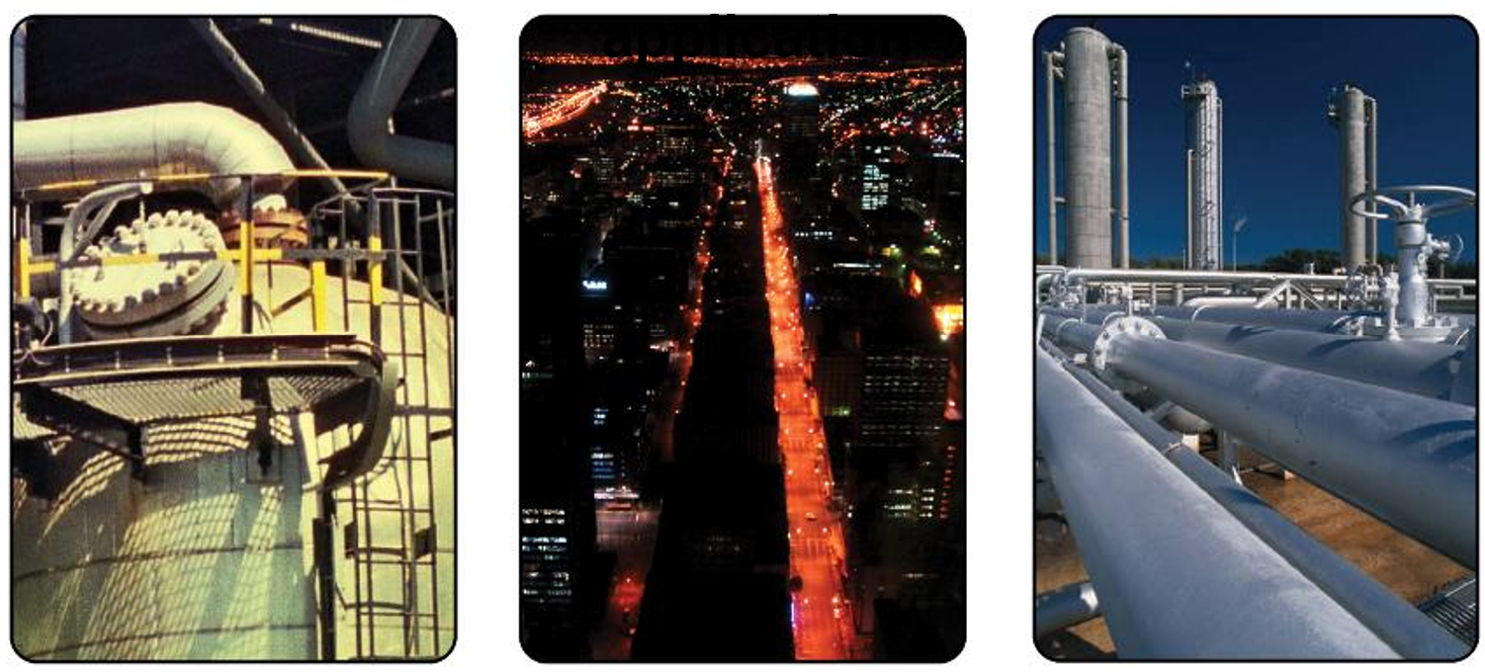
Briefing to the Portfolio Committee on Electricity and Energy (PCEE) on Eskom’s Sixth Multi-Year Price Determination (MYPD6) Revenue Application.
Mr. Thembani Bukula
Chairperson
05 March 2025

Slide 2
Eskom MYPD6 revenue application for (FY 2026 – FY 2028)
 | 2025/26 | 2026/27 | 2027/28
Eskom generation | R 292bn | R 324bn | R 322bn
NTCSA | R 101bn | R 15bn | R 155bn
Eskom distribution | R 53bn | R 57bn | R 59bn
Total revenue application | R 446 bn | R 495 bn | R 537 bn
Average tariff | 266,77 | 298,27 | 325,40
% increase | 36,14 | 11,81 | 9,10

Slide 3
Large Cost Items for the 3 year MYPD6 period
The large cost items are Primary Energy, Opex, Depreciation, ROA and IPPs

Slide 4
NERSA SUMMARY DECISION - ALLOWABLE REVENUES
 | 2025/26 |  |  | 2026/27 |  |  | 2027/28
 | Eskom Application | Regulator Adjustment | Regulator Decision | Eskom Application | Regulator Adjustment | Regulator Decision | Eskom Application | Regulator Adjustment | Regulator Decision
Eskom generation | R 292bn | -R42bn | R 250bn | R 324bn | -R65bn | R 259bn | R 322bn | -R65bn | R 258bn
NTCSA | R 101bn | -R 5bn | R 96bn | R 115bn | -R 5bn | R 110bn | R 155bn | -R19bn | R 136bn
Eskom distribution | R 53bn | -R14bn | R 39bn | R 57bn | -R15bn | R 41bn | R 59bn | -R16bn | R 43bn
Total revenue application | R 446bn | -R61bn | R 385bn | R 495bn | -86bn | R 410bn | R 537bn | -100bn | R 437bn
 | Average tariff
MYPD5 | MYPD6 Y1 |  |  | MYPD6 Y2 |  |  | MYPD6 Y3
195,95 (c/kWh) | 266,77 |  | 220,92 | 298,27 |  | 232,75 | 325,40 |  | 247,16
 | 36,14% |  | 12,74% | 11,81% |  | 5,36% | 9,10% |  | 6,19%
The Regulator decisions reduced the MYPD6 tariff increases from a cumulative 57,1% to 24,3%

Slide 5
Reason for Decision – PRIMARY ENERGY
NERSA has set the performance standards for Eskom:
An efficient licensee is expected to operate @ 75% EAF with a UCLF of 13% and PCLF of 10.5%
The primary energy costs have been adjusted:
  To align with the set performance standards
  To address the anticipated energy short fall from the s34 IPPs
  Use of diesel OCGTs has been capped at 4%
  To meet a higher demand as projected by the Energy Regulator
Reason for Decision – OPEX
NERSA has endeavored to cap operating expenditure at rates aligned with inflation:
Overall opex was adjust downwards by an average of 17%
Employee benefit costs were capped at 7% (inc. wage agreements)
Eskom generation was allowed reasonable maintenance costs to achieve targeted performance standards

Slide 6
Reason for Decision – DEPRECIATION
Eskom Generation accounts for the largest portion of the overall depreciation, and was adjusted downwards by an average of 45%
The generation regulatory asset base was cut by an average 22%, whilst NTCSA and distribution were adjusted marginally downwards
The generation RAB was approved on condition that Eskom submits the asset revaluation with the next RCA application, and
NTCSA was allowed the full deprecation to enable it to implement the transmission development plan and address grid congestion
Reason for Decision – RETURNS
The Eskom WACC was calculated at 10,65% which is applied to debt held at “group” level, including NTCSA ‘apportioned’ debt
Returns allowed as applied for (4%, 5% and 6%) annually
Eskom must meet National Treasury’s conditions for the R254bn equity injection (Eskom Debt Relief Act, 2023 (Act No. 7 of 2023)

Slide 7
Reason for Decision – SECTION 34 IPPs
According to the updated timelines from the DEE/IPP Office projected IPP energy from BW7 IPPs will come online earliest October 2027
Not all energy costs from BW7 will be incurred in FY2028 as about 50% of the projected energy from BW7 will not be available
BW8 IPP projects unlikely to reach commercial operation in MYPD6
NTCSA is allowed 50% of the IPP costs applied for BW7 (FY2028), and costs for BW8 (FY2028) are disallowed in the MYPD6 period.
 | 2025/26 |  |  | 2026/27 |  |  | 2027/28
 | Eskom Application | Regulator Adjustment | Regulator Decision | Eskom Application | Regulator Adjustment | Regulator Decision | Eskom Application | Regulator Adjustment | Regulator Decision
IPP costs | R 67bn | -R0,123bn | R 67bn | R 78bn | -R0,144bn | R 77bn | R 110bn | -R14bn | R 96bn

Slide 8
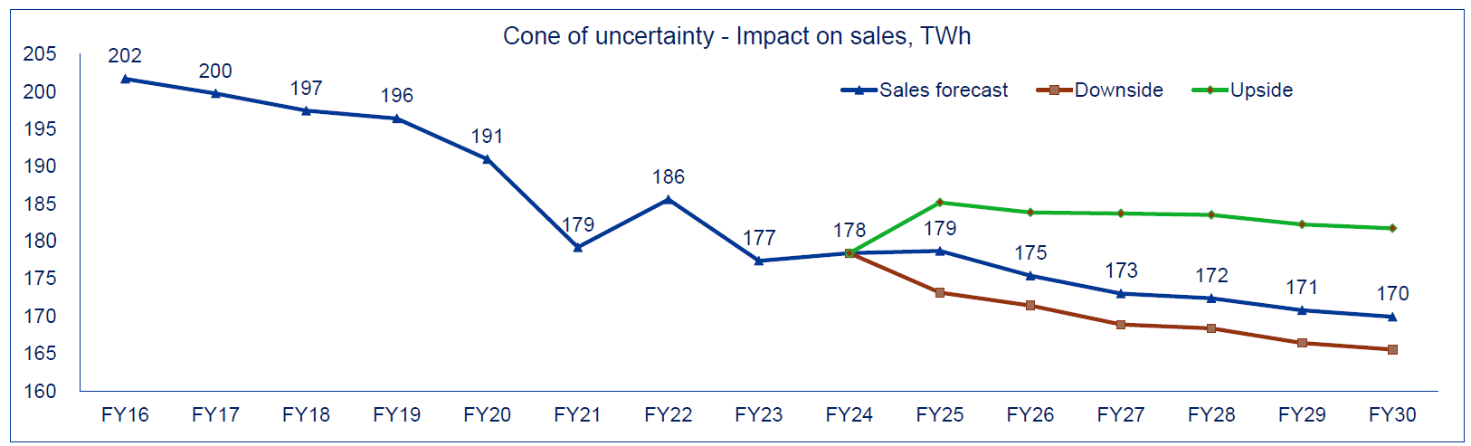
Reason for Decision – SALES FORECAST
Eskom’s application selected the ‘middle’ scenario for sales volumes.
There was a 4% year-on-year sales volume growth reported in December 2024 (not mentioned in the revenue application)
Based on the reduced average tariff, the higher sales volumes scenario was selected by NERSA
Improved sales volumes are predicted as an outcome of improved performance and moderate average tariff increases

Slide 9
Reason for Decision - ECONOMIC IMPACT ANALYSIS
The NERSA-approved average electricity tariff increase of 12.74%, while still expected to negatively impact South Africa's economic fundamentals and productivity, significantly mitigates the adverse effects compared to Eskom's requested 36.15% hike. ​
Primary Sector: Eskom's 36.15% hike would have reduced productivity by 3.34%. ​ NERSA’s 12.74% increase limits this decline to 1.24 percentage points. ​
Secondary Sector: Eskom's 36.15% hike would have caused a 3.98% productivity loss. ​ NERSA’s 12.74% increase reduces this impact to 0.58 percentage points. ​
Tertiary Sector: Eskom's 36.15% hike would have led to a 0.65% productivity loss. NERSA's phased increases of (12.74% in FY2025/26, 5.36% in FY2026/27, and 6.19% in FY2027/28) limit this decline to 0.24 percentage points. ​
Overall, NERSA's decision significantly reduces the negative impact on productivity across all economic sectors as well as ensure affordability of electricity by poor households and all users of electricity.

Slide 10
Other factors considered in making the decision
Affordability
  Industrial customers – Reduced operational costs, attracting new investment and job creation
  Households – more affordable electricity for households (more than 10 million households rely on social welfare grants)
  Phased-in fixed charges over three-years to improve affordability (RTP)
Competitiveness – commercial and industrial
  NPAs targeted towards energy-intensive industries i.e., smelters, to achieve:
    Predictable electricity price - No seasonal or time of use charges
    Reduce risk of production facility closures - Saved jobs
    Sustained productivity and exports – sustained demand for electricity
  Alternative Energy: Increased registration efficiency – commercial consumers able to self generate
  Wheeling framework – NERSA approved national wheeling framework to enable wheeling of energy from alternative energy suppliers located remotely
  Predictability – consumer confidence
  Move towards a more predictable price path
  Drive towards inflation-related increases

Slide 11


Thank you
  Website: www.nersa.org.za
  Tel: 012 401 4600
Fax: 012 401 4700
  Email: info@nersa.org.za
  @NERSAZA
  @NERSA_ZA

